Slide 1
Status Report on Collaboration between FRAV and SG1
Submitted by SG1
VMAD-22-08
December 2nd-3rd, 2021
SG1

Slide 2
Background
FRAV and VMAD have been working in parallel on their respective activities/discussions. In such a situation, SG1 leader understands that there were some demands on VMAD side, that some VMAD activities/discussions could not proceed until FRAV had reached conclusions on them.
In the summer of this year, the FRAV Co-Chairs requested the VMAD Co-Chairs to clarify what exactly SGs wanted to be decided by FRAV.
The SG1 leader understands that this was the beginning of this collaboration between FRAV and SG1.
It has not been easy for SG1 to make “what SG1 needs from FRAV” clear. Subsequently, after multiple discussions in SG1 (p.3), the division of roles between FRAV and SG1 (p.4) was generally agreed.

Slide 3
(Reference)Progress to date on this topic mainly in SG1
July 12th | VMAD co-Chairs requested SG leaders to provide their questions/requests to FRAV as specifically as possible.
July 16th | SG1 leader answered to VMAD co-Chairs by mail and shared the answer to SG1 members; - Item3: Which scenarios are required to validate the functional safety requirements established by FRAV? - Item 8: How to deal with various parameters (e.g. perception, vehicle disturbance) during certification? - Item10: What is pass/fail criteria for scenario-based testing?
July 21st | In a small meeting with VMAD co-Chairs, SG1 leader explained above and was asked to provide more details.
August 3rd | In SG1 #17, SG1 leader suggested to extract something from “safety topics” that are being discussed in FRAV, but the suggestion was not agreed.
September 1st | In extended FRAV/VMAD co-Chairs meeting, SG1 leader showed the following general view that was to be discussed in the next day’s SG1 session, but FRAV’s request was not resolved: - the more topics for which FRAV can provide Measurable/Verifiable Criteria, the more helpful for SG1 to prepare logical scenario.
September 2nd | In SG1 #18, SG1 leader suggested that Detailed Safety Requirements shown in FRAV-17-07 are not necessarily enough to identify parameters used in scenarios and explained the general view above.
September 10th | In extended FRAV/VMAD co-Chairs meeting, SG1 leader proposed one possible way to resolve this situation (see next two slides). This proposal had not been agreed in SG1, but the leader believed no SG1 member would disagree because it embodies the “general view" that was already agreed in SG1. FRAV/VMAD agreed.
October 4th | In SG1 #19, SG1 agreed to the leader’s proposal above, and to identify 2 scenarios (lane keeping and cut in) to be used as “test cases” in the collaboration between FRAV and SG1.
November 17th-18th | FRAV #21 discussed the scenarios and agreed to give them further consideration in order to provide meaningful feedback to SG1. FRAV generally considered the lane-keeping cases to be two distinct scenarios.

Slide 4
FRAV
SG1
Having the major target aligned
Each group has been ‘digging through the tunnel’
Establish General safety requirements
Cover Functional Scenarios for Motorway use-case under NATM MD Annex2
DONE in main point
DONE in main point
From this point forward,
we need to clarify the order and the role/responsibility of the following works
Functional Scenario
NEXT STEP is HERE！
For each Functional Scenario
describe expected roles of the ADS
(or translate Detailed Safety Requirement for each Functional Scenario)
Identify parameters in each Functional Scenario based on the expected roles of ADS
Define the data range of parameters
At the same time, numbers of Concrete scenarios are made
Logical Scenario
Establish Measurable and Verifiable criteria based on the expected roles of ADS (and data range of parameters if needed)
Concrete Scenario
Assessment/Validation using the multi-pillar testing methodologies
To decide which concrete scenario should be used is out of scope of SG1

Slide 5
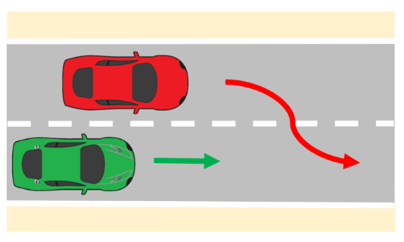
Ex. Cut-in in front of the ego vehicle
FRAV
SG1
Having the major target aligned
Each group has been ‘digging through the tunnel’
(NATM MD Annex2 p.33)
Another vehicle is driving in the same direction as the ego vehicle in an adjacent lane. The other vehicle makes a lane change, such that is becomes the LV from the ego vehicle’s perspective. Depending on the distance and lateral velocity of the LV, the severity of the cut-in manoeuvre changes.
Establish General safety requirements
Cover Functional Scenarios for Motorway use-case under NATM MD Annex2
(Detailed Safety Requirements)
Adapt its behaviour to the surrounding traffic conditions (e.g., by avoiding disruption to the flow of traffic)
One example：
ADS shall avoid collision after the other vehicle’s lane change
DONE in main point
DONE in main point
From this point forward,
we need to clarify the order and the role/responsibility of the following works
Functional Scenario
NEXT STEP is HERE！
For each Functional Scenario
describe expected roles of the ADS
(or translate Detailed Safety Requirement for each Functional Scenario)
Identify parameters in each Functional Scenario based on the expected roles of ADS
Example:
Initial velocity of Ego and LV, Initial distance (3D), Lateral motion of LV, Deceleration of Ego, etc.
Example:
According to a level of safety (C&C (+α) driver, for example), ADS shall avoid a collision, taking into account the combination of every parameter
Define the data range of parameters
At the same time, numbers of Concrete scenarios are made
Logical Scenario
Example:
Initial velocity of Ego and LV: 80-130 km/h,
Distance: 0-60 m,
Lateral velocity of LV: 0-3 m/s2, etc.
Establish Measurable and Verifiable criteria based on the expected roles of ADS
(and data range of parameters if needed)
Concrete Scenario
Assessment/Validation using the multi-pillar testing methodologies
To decide which concrete scenario should be used is out of scope of SG1

Slide 6
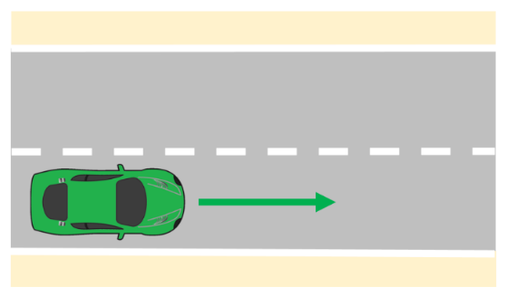
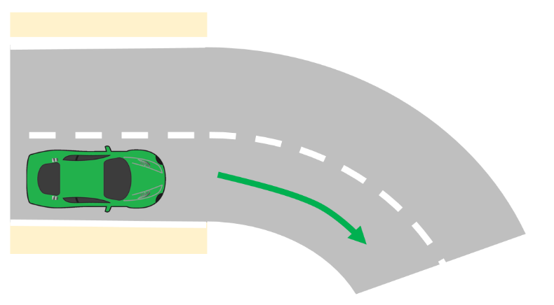

A Few Test Cases
VMAD IWG reported in GRVA11 (27 Sept.-1 Oct.) that:
  FRAV and VMAD agreed to select a few test cases to work on collaboratively to develop a better synchronization between our two groups.
SG1 agreed to pick up the two test cases (On 4th Oct., SG1 #19):
  lane keeping scenario as an ultimate simple case, and
  cut-in scenario as a case that is not too simple, not too complicated
FRAV agreed to give them further consideration and generally considered the lane-keeping cases to be two distinct scenarios (On 18th Nov., FRAV #21)
  lane keeping scenarios that are divided into straight and curve lane, and
  cut-in scenario
lane keeping scenarios
  cut-in scenario
Note: “Test cases” does not necessarily mean concrete scenarios to “test” ADS functions. Picking up a few “test case” means picking up a few functional scenario for now, because the purpose of picking up some cases is not to test ADS but to evaluate NATM.

Slide 7
Future Plan on this Collaboration (short term)
FRAV
  Considers the lane keeping and cut in scenarios as test cases, and
  Identifies which detailed safety provisions are applicable to the scenarios, as a next step based on the flow chart
    This may help to establish a process for FRAV-SG1 collaboration to create 'testable scenarios' covering the safety provisions.
SG1
  Proceeds discussion of templates/abstract scenarios and ODD based framework etc. in parallel.
    These activities would help to organize the information that could bridge scenarios and safety requirements.
    Also, these activities would be necessary for creation of logical scenarios.
  Note: As the next steps will be mainly on FRAV side based on the flow chart, SG1 would like to refrain from suggesting how to proceed the collaboration for now (forming a small group, holding joint meetings, etc.).

