Slide 1
VMAD-SG3 report
VMAD-23-05
23rd VMAD Meeting
11 January, 2022

Slide 2
Status update
No additional comments on AUDIT and ASSESSMENT pillar text
ISMR pillar text submitted to all VMAD experts on Dec 14th (VMAD-SG3-16-01-rev.1 Requirements ISM_clean.doc), no comments received
Two minor updates proposed by JRC (see next slides)
Meeting with ITU FGAI4AD on Dec 9th: possible synergies to be further explored (exchange of documents, next meeting in January)

Slide 3
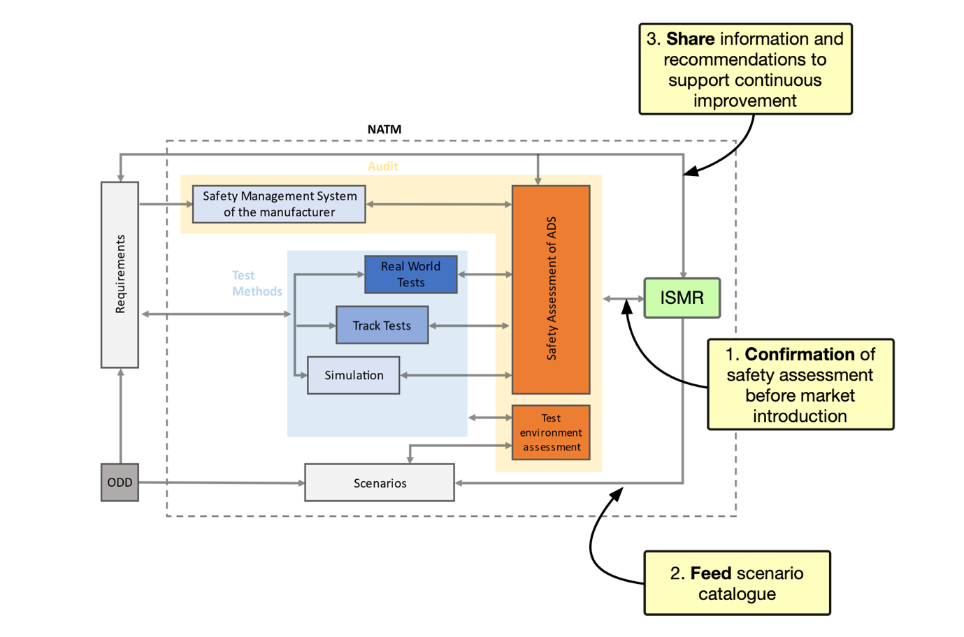
Proposed update to ISMR document (1)

Slide 4
Proposed update to ISMR document (2)
Additional example of effective information sharing under “Expected further discussion on areas outside the scope of WP.29/VMAD/SG3“
  An additional example is related to occurrences (either critical or non-critical) involving the inability of the ADS to properly detect and react to a traffic obstacle, e.g., in the presence of false positives and/or false negatives detections. Conversely, if the ADS was not aware of the obstacle, the system would not be able to record the event correctly. In such a case, the possibility of using information from other road users or infrastructure enables a better reconstruction of the occurrence.

Slide 5
Thank you !

