Slide 1
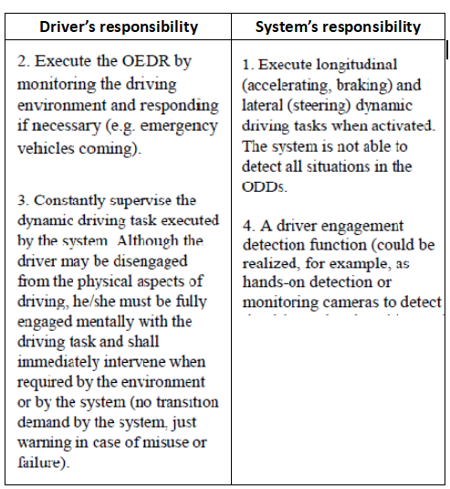
1. Background introduction
Consistence between the requirements in China national standards and that of WP.29 for Level 2 driver assistance systems
China national standard description:
ECE/TRANS/WP.29/1140 description:
The Level 2 driver assistance system continuously performs vehicle lateral and longitudinal motion control of dynamic driving task under its operational design condition, and has the objects / events detection and response capabilities corresponding to its execution of lateral and longitutinal motion control.
(Attention：For level 2 system, the entire dynamic driving task should be conducted by the driver and the system together, the driver should monitor the behaviors of the system and perform proper response and actions when necessary. )
consistent
Notes:
（1）In China national standard of Automatic level classification for automobile driving, the definition of Level 2 Automatic driving including conbined driving assistant are as follows: 接PPT内容
（2）强调工信部关于驾驶员在环的要求，In addition, the ICV access regulation of the Ministry of industry and information technology of People’s Replublic of China has clearly required that the technical measures such as hand-on detection and so on should be conducted to ensure that drivers are always engaged in performing dynamic driving tasks. It shows that the driver engagement test for L2 system has been clearly required in the access management of relevant products in China. At present, hand-on test is the main method.
（3）Generally speaking, the requirements for Leval 2 automatic driving system in China are consistent with that of WP.29

Slide 2
2. CATARC Proposal: Harmonize the global standard system for Level 2 driver assistance systems
Within the framework of Chinese L2 standards, the system is mainly divided into two categories:
Category 1 Cruising assistance: according to the number of lanes where the system is designed to operate, it is classified into ,for example, single-lane driving (ref.ACSF B1), multi-Lane driving (ref.ACSF C/D) and "turning" driving (to be formulated)
Category 2 Parking assistance, for example, assisted parking system.
intersection : driver triggers/driver confirms /systen triggers turn
lane
parallel : driver triggers/driver confirms /systen triggers lane change
single lane
speed
As for the two standards categories above, due to different ODDs, different traffic scenarios and different use cases, the system OEDR and vehicle motion control capabilities are surely differentiated for cursing and parking features. Therefore, in the China national standards, the two categories remain independent to avoid cross reference of technical requirements.
Notes:
As for task execution ability of L2 system, from the perspective of vehicle driving direction, vehicle driving can be mainly divided into two states that is, forward driving and reverse driving. For vehicle reversing, this kind of driving state mainly occurs in the vehicle parking scenarios, and there have already been different products applied in the market, therefore, corresponding standards need to be formulated to restrict and standardize such products. For the forward driving of vehicles, according to the lane conditions of the driving road, it can be divided into single lane driving function and multi-lane driving function namely changing between different lanes. For the multi-lane driving function, the positional relationship between different lanes includes two forms: parallel and intersecting. The function triggering methods include driver active triggering, system recommended lane change driver confirmation and system automatic lane change, Therefore, the multi lane function needs to be further divided according to the different lane scenarios and trigger methods, as shown in the figure above.
As for the two types of standards above, due to different odd involved, different traffic scenarios and different immplement scenarios, the system oedr and vehicle control capabilities are also different. Therefore, in the China domestic standard regulations, the two categories remain independent to avoid cross reference of technical requirements.

Slide 3
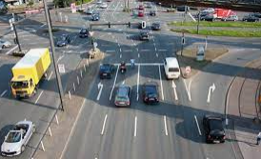
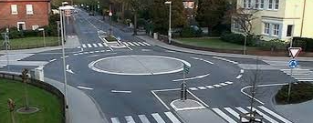
3. Two key issues to be clarified of this regulation
Question 1: The current draft version of DCAS regulations has actually involved scenes relating to roundabout, intersection and turning. Whether will the relevant technical requirements be specified in details, including some certain performance requirements (e.g. specific critical situations for lane change performing) in the future?
ADAS-08-06
Provides steering input
provide longitudinal control assistance
monitor the driver engagement
DCAS will support the driving task
Provide longitudinal control assistance
provides steering input assistance
monitor the driver engagement
Intersection
Roundabout
Question 2: Whether UN R79 will be simplified and adjusted in the future after this regulation completion, e.g. removing functional requirements such as ACSF and RMF?
UN R79
?
ACSF B1
ACSF C/D
ACSF A
Incl.RCP
UN Rxxx DCAS
RMF
new group ?
Notes:
问题1
intersection:
DCAS will support the driving task by
Knowing what lane to change into to make the correct turn
Indicating the lane change and turn to other road users
Providing longitudinal control assistance to
Stop at a red light
Yield to other road users
Turn at an appropriate speed
and providing steering input assistance to guide the driver to
steer the vehicle into the correct lane safely
follow the appropriate trajectory when making the turn
DCAS also monitor the driver engagement by:
Verifying driver has its hands on the steering control
Verifying eyes are turned to the road or driving task
Checking the manual usage of „secondary“ controls, e.g. turn indicator
Confirming driver eyes are oriented to the road before resuming driving operation after a stop
Roundabout:
DCAS support the driving task by
Providing steering input to guide him
In entering, passing through an exiting the roundabout safely
And provide longitudinal control assistance to
Yield to other road users
Drive into the roundabout at an appropriate speed
DCAS also monitor the driver engagement by:
Verifying driver has its hands on the steering control
Confirming driver eyes are oriented to the road before resuming driving operation after a stop
Checking the manual usage of „secondary“ controls, e.g. turn indicator
问题2
In China, the national standard of GB/T17675 corresponds to the simple （basic）steering requirements in R79, and there are also other individual standards correspond to the functions of ACSF in R79, so whether there are sill plans for ADAS TF group to develop new stardards to corresponds to the newly derived functions such as ACSF in R79 in the future?

