Slide 1
Safety assessment of human-machine-interaction for assisted driving functions (SAE Level 2) – Validation study part 2
André Wiggerich, M.Sc.

Slide 2
Review of 1st validation study
Design and Validation of a performance-based test and assessment procedure for safety of Human-Machine-Interaction for Level 2 systems was presented on 5th session of TF ADAS
Two different Level 2 systems (A & B) had been compared in a standardized test scenario (system limit: cut-out)
Results: Drivers of system B showed difficulties in controlling the vehicle at a system limit without prior system initiated warnings

Slide 3
Aim of 2nd validation study
Comparison of Level 2 systems with a sample of conventional drivers to consider baseline criticality and controllability of the test scenario
Repetition of test procedure with a second sample of drivers (same manufacturer and system, but different vehicle and software version)

Slide 4
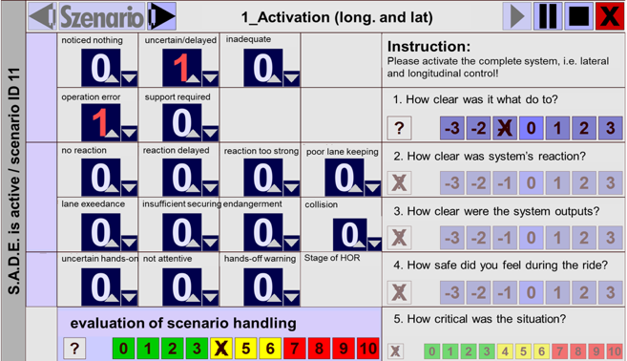
Assessment Categories
System Control Related Problems
General Vehicle Guidance Related Problems
Monitoring Behaviour and Misuse
General Safety Rating of Human-Machine-Interaction

Slide 5
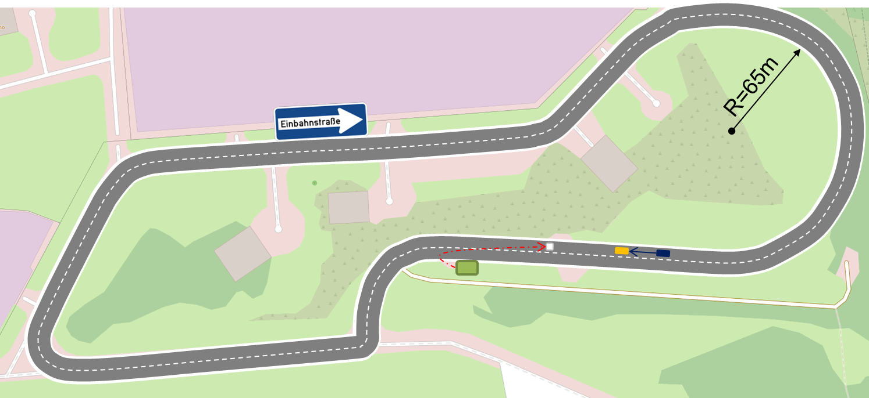
Method
1 Test vehicle
2 groups (conventional driving vs. Level 2)
39 Participants in total
14 Laps à 1.6km
60 kph
1 Test Scenario
© OpenStreetMap

Slide 6
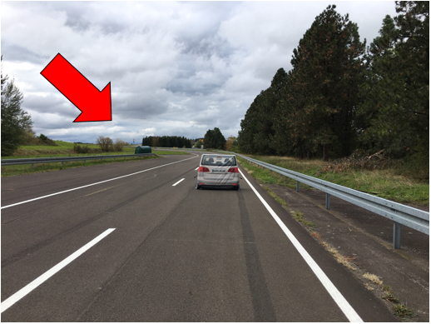
Method

Slide 7
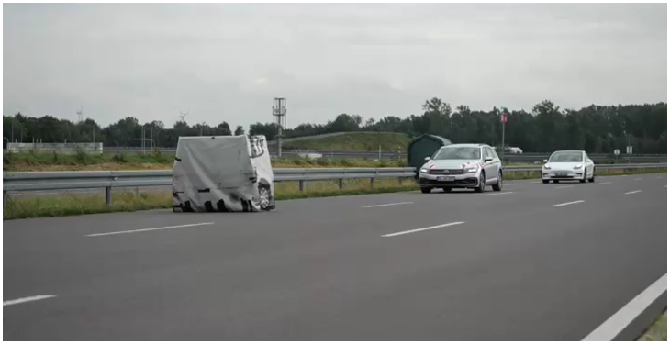
Method

Slide 8
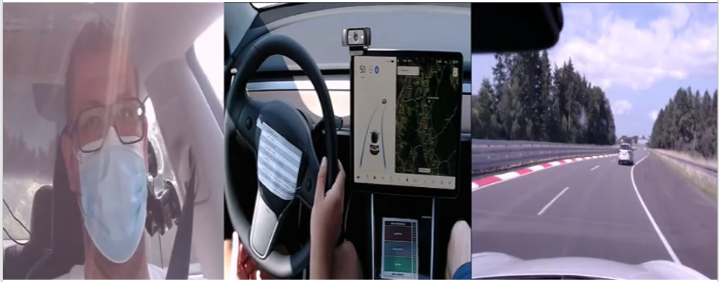
Example: Level 2

Slide 9
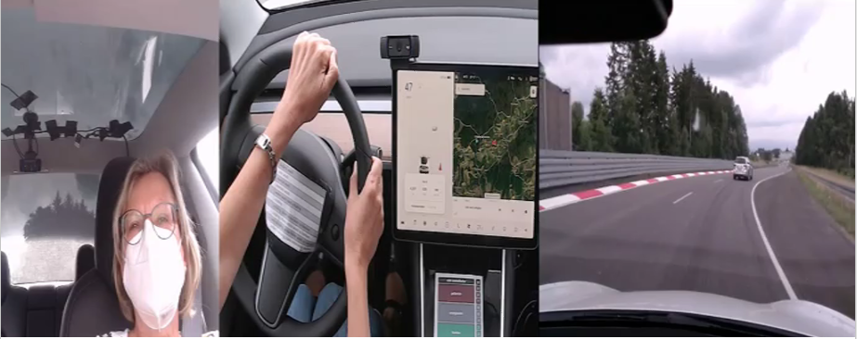
Example: Conventional Driving

Slide 10
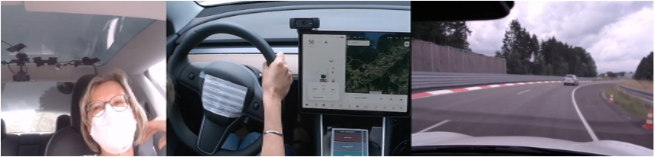
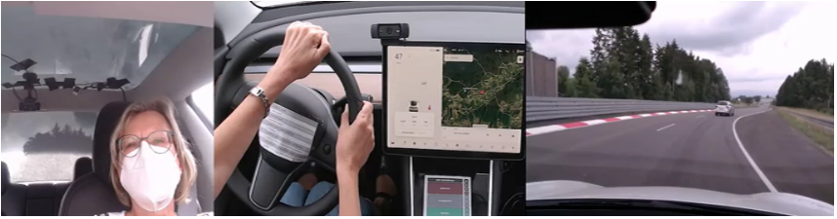
Baseline Driving
Target Situation

Slide 11
Measure for criticality
Based on research results, criticality of near misses are considered starting at TTCs below 1 s
Well in line with legal German court judgements that also consider a threshold around 1 s as human reaction time
Therefore, a TTC well above 1 s need not be considered as critical

Slide 12
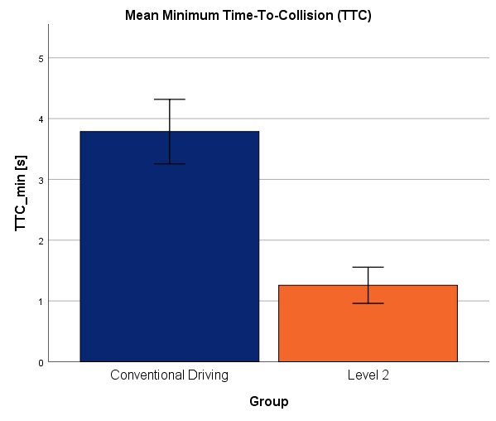


Results
Number of collisions [n]
Conventional Driving
Level 2
Group
→ 15% of Level 2 drivers do not intervene to avoid a collision with the stationary target
→ Group of Level 2 drivers has a significant lower mean TTC_min compared to group of conventional drivers

Slide 13
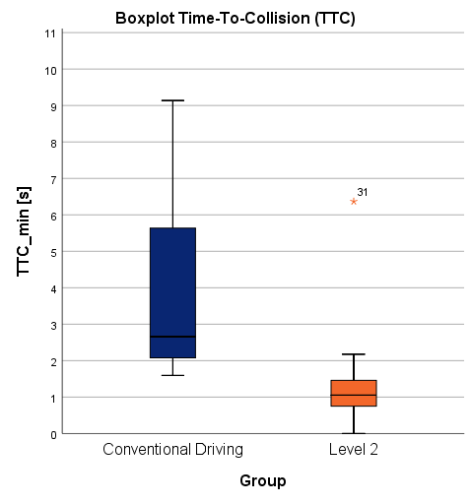
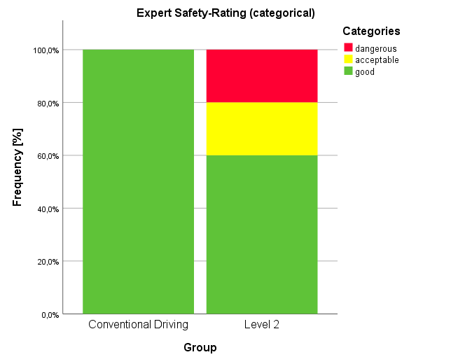
Results
→ 20% of Level 2 drivers show a dangerous interaction behaviour in the test scenario
→ Approx. 50% of Level 2 drivers have a TTC_min <1s; TTC values <1s are related to critical near-miss situations (Hayward, 1972)

Slide 14
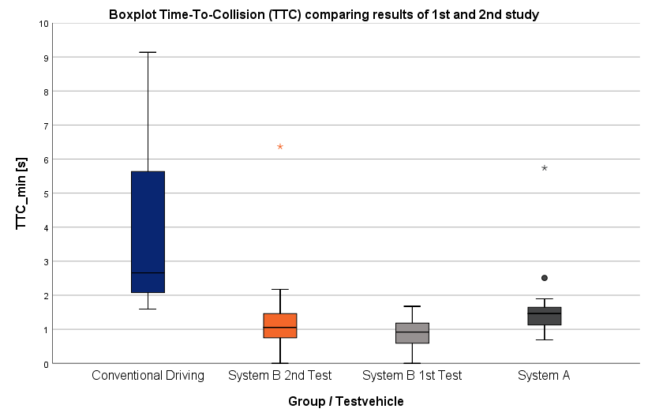
Results
Data of 2nd study
Data of 1st study (presented on 5th session of TF ADAS)
Comparison of results of 1st and 2nd validation study possible with limitations (same test track and procedure, different vehicles and software versions of system B)
Similar results of TTC_min for system B in 1st and 2nd study (median approx. 1s)
Large differences in TTC_min for all Level 2 systems compared to conventional driving

Slide 15
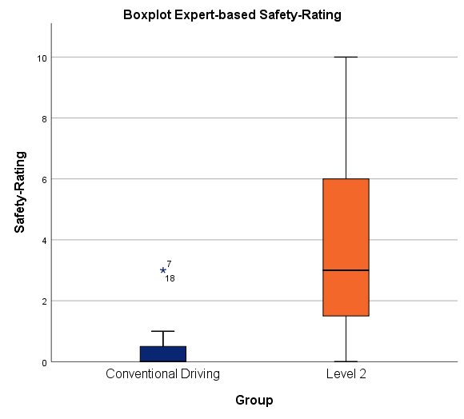
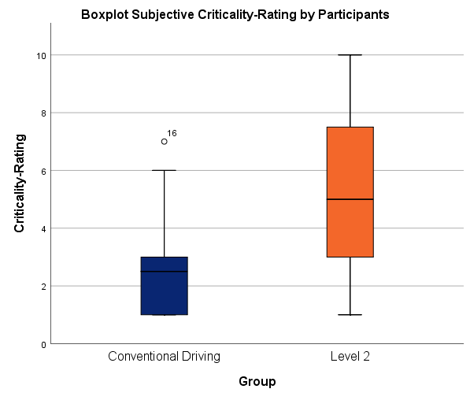


Results
→ Level 2 driver’s reaction is rated significantly worse compared to conventional driver’s reaction
→ Level 2 drivers rate the situation significantly more critical compared to conventional drivers

Slide 16
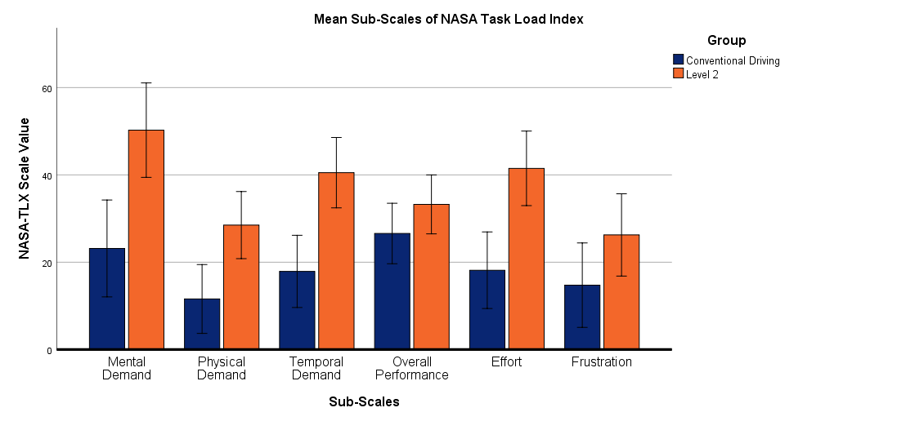
Results
Workload: Mental demand, physical demand, temporal demand and effort are rated significantly higher for Level 2 compared to conventional driving

Slide 17
Summary
Repetition of test procedure with a second sample of drivers shows similar results of TTC_min for Level 2 system B in 1st and 2nd study (median approx. 1s)
  Indicator of stability and reliability of effect as well as assessment method
Conventional drivers as baseline have no difficulties in controlling the test scenarios
Level 2 driving has a significantly higher workload for naive users

Slide 18
Additional initial findings
Comparison of manual drive and assisted* drive:
  EITHER system capabilities improved
  OR driver better engaged in driving task
„Limits“ of driver monitoring apparent: driver may be looking to the front, yet still reacting too late – overreliance in the system or lack of situation awareness!?
* longitudinal and lateral support

Slide 19
Thank you for your kind attention!

