Slide 1
SAE Cooperative Research Project – FMVSS 141
Overview
July 2021

Slide 2
SAE Cooperative Research Project
Overview and Goals
Summary of draft recommendations
Participants
Vehicles Tested
Test Locations
Test Equipment
Tests Conducted
Preliminary test results
Conclusions and Recommendations

Slide 3
Overview and Goals
Evaluate sources and amount of measurement uncertainty in the test procedures of FMVSS 141, SAE J2889-1, and ISO 16254.
Evaluate proposals in ISO/CD 16254 to reduce the measurement bias and variation.
Evaluate the use of psychoacoustic Tonal Loudness as a method to assess detection as an alternative criteria to one-third octave band levels.
Evaluate the concerns raised by NHTSA in the FMVSS 141 final rule of why frequency shift was not chosen as a performance criteria.
Evaluate the use of psychoacoustic Tonal Loudness as a method to assess the frequency content of a signal for use to calculate frequency shift as defined in ISO 16254 or SAE J2889-1.

Slide 4
Summary of draft recommendations
Improvements proposed for all standards and regulations (FMVSS 141, ECE R138, ISO 16254, SAE J2889-1):
Revise measurement microphones to include a five-microphone array as described in ISO/CD 16254 to replace the single microphone of current test standards.
Revise the one-third octave signal processing to use a max hold method as described in ISO/CD 16254 in each individual one-third octave band.
Add Tonal Loudness methods to calculate detection by one-third octave frequency bands as an option to the existing sound pressure level (SPL) based methods.
Revise the background noise requirements to eliminate background noise correction and establish a simplified signal to noise criteria which will limit maximum error from the background noise to no more than 1.0 dB

Slide 5
Summary of draft recommendations (cont.)
Improvements specific to SAE J2889-1, ISO 16254, and ECE R138
Revise background noise criteria required for acceptance of one-third octave band data. Recommend to remove procedure for correcting overall sound pressure levels and replace it with a requirement that there shall be a minimum of 6dB of difference between the maximum sound pressure level of the background ambient noise and the reported vehicle overall sound pressure level.
Add Tonal Loudness methods to calculate frequency shift as an option to the existing methods.

Slide 6
Summary of draft recommendations (cont.)
Improvements specific to United States FMVSS 141:
Revise background noise measurement and acceptance criteria to be aligned with updated ISO 16254 and SAE J2889-1 standards.
After completion of revision for ISO16254 and/or SAE J2889-1 (expected 2022), replace volume change requirement with frequency shift requirement.

Slide 7
Variation items studied
Variation and error due to background noise levels and the specific treatment of background noise levels within FMVSS 141.
Variation due to spatial variation of a local sound field when measuring with a single microphone.
Variation due to different test sites.
Variation due to processing algorithms used.
Variation due to the use of different tires.

Slide 8
Participants
BMW (Germany)
Bruel & Kjaer (Denmark)
Mercedes-Benz (Germany)
General Motors (United States)
Head Acoustics (Germany)
Honda (Japan)
Mitsubishi (Japan)
Nissan (Japan)
Siemens (Belgium)
Transportation Research Center (United States)
Virginia Tech University (United States)

Slide 9
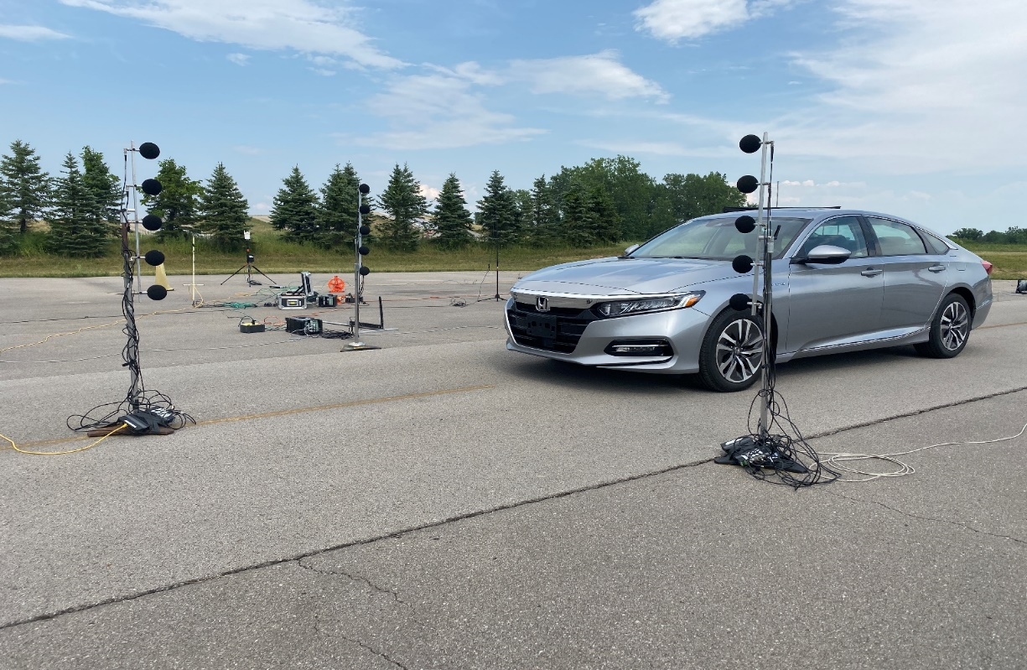
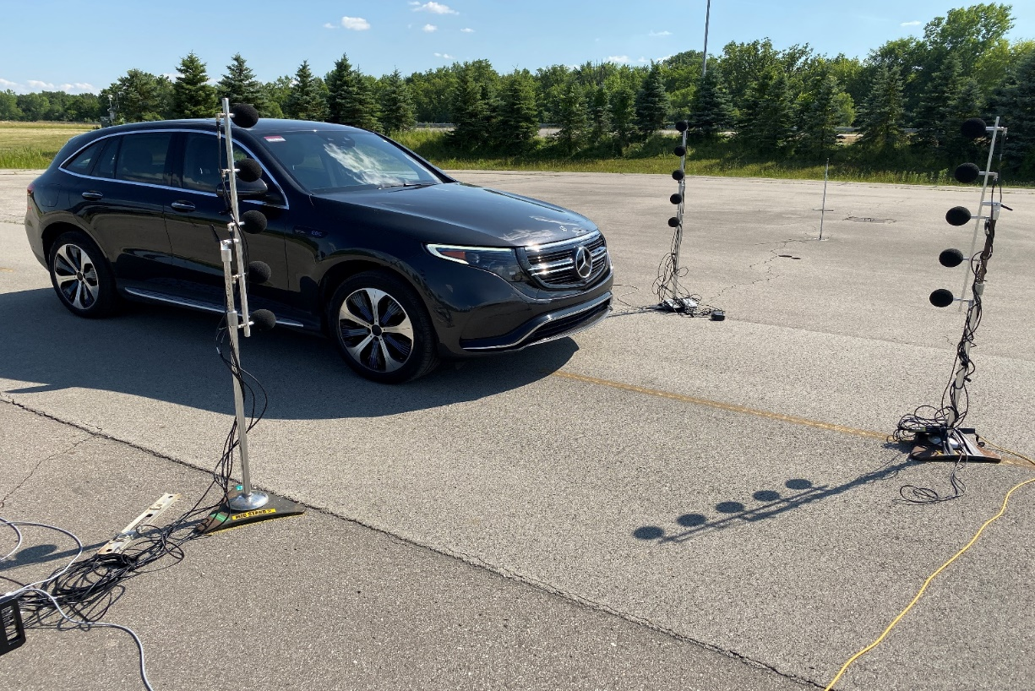
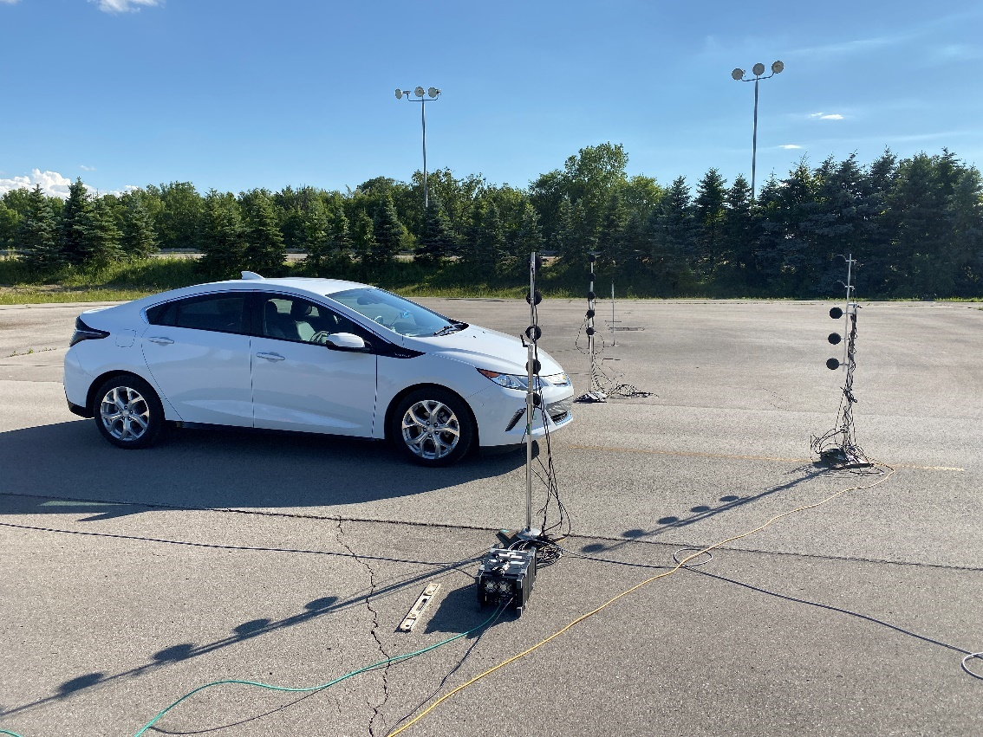
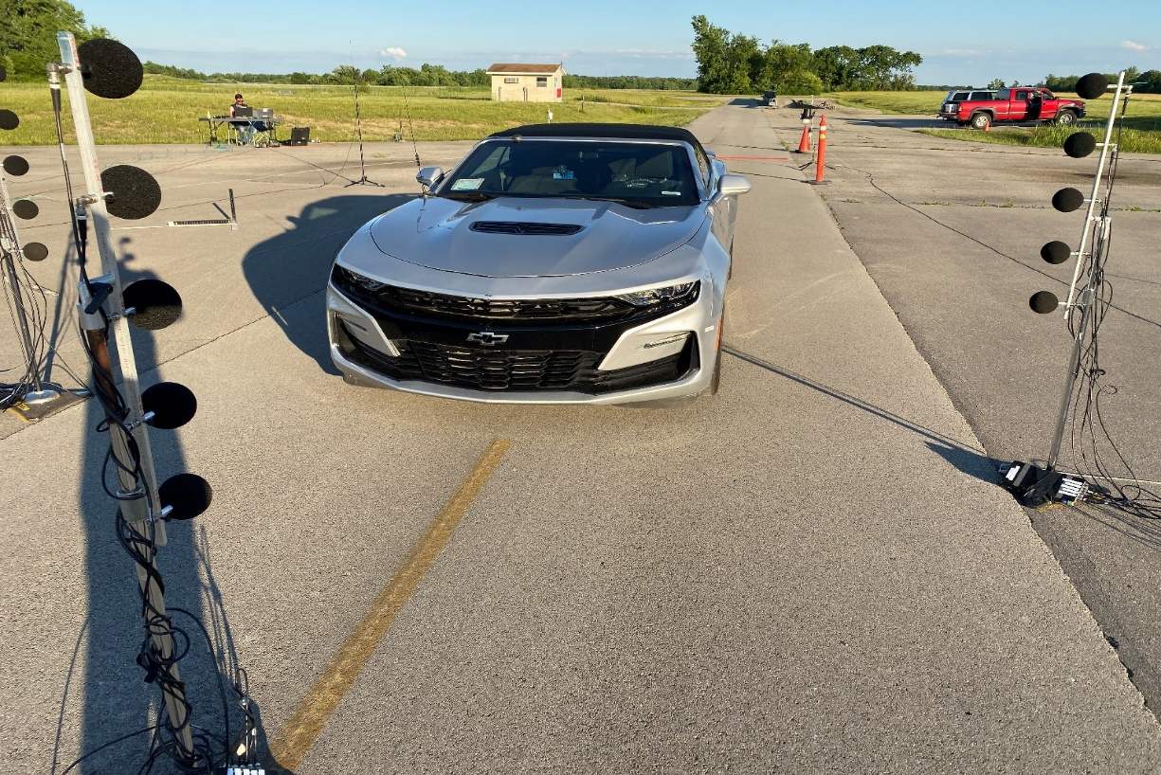
Vehicles Tested
Honda Accord Prototype, Mercedes EQC, Chevrolet Volt, Chevrolet Camaro
The Accord Prototype, EQC, and Volt all have electric operation modes. The Camaro is a V8 internal combustion sports car
with a performance exhaust system

Slide 10
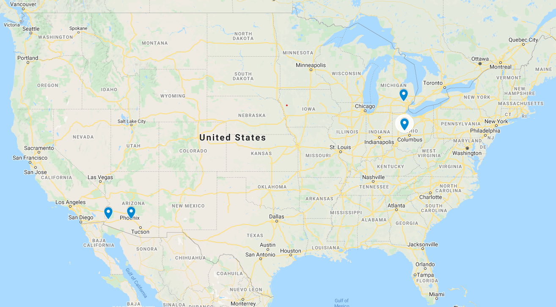
Test Locations
Transportation Research Center, East Liberty, Ohio
GM Milford Proving Grounds Milford, Michigan
GM Yuma Proving Grounds Yuma, Arizona
Nissan Technical Center Arizona Testing Center, Stanfield, Arizona

Slide 11
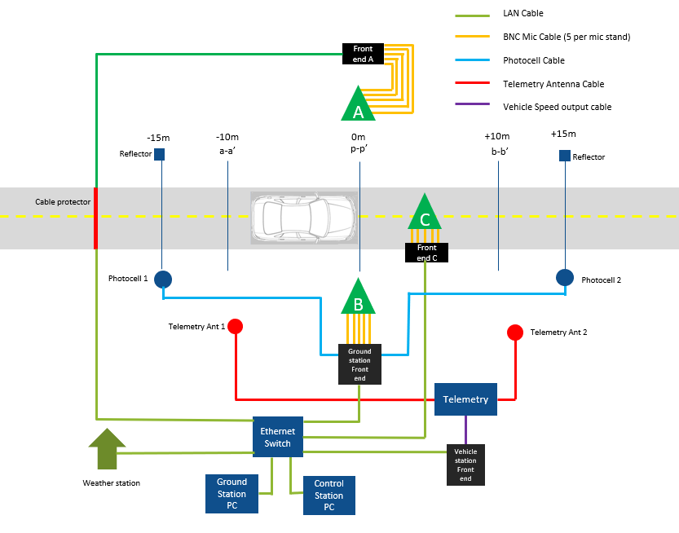
Test Equipment
Common test equipment was provided by Bruel and Kjaer (B&K) to remove the test variation due to different test equipment at each site. Test equipment was configured to conduct FMVSS 141 as well as ISO/CD 16254.

Slide 12
Tests Conducted
As specified in FMVSS 141, the following test conditions were evaluated:
Stationary Forward
Stationary Reverse
Forward 10 km/h (11 km/h)
Forward 20 km/h (21 km/h)
Forward 30 km/h (31 km/h)

Slide 13
Test data
A complete vehicle test consists of a minimum of four (4) acceptable runs at each test condition for a total of 20 runs for a complete vehicle test.
To help with measurement variation assessment, six (6) runs at each test condition were conducted when possible to help insure four acceptable runs for each test condition.
Each vehicle was tested four times at each test facility.
This results in 80 test runs for each vehicle at each test site, 320 test runs for each test site, and 1280 total runs possible.
Based on test acceptance criteria, a total of 1240 test runs were usable for further processing.

Slide 14
Test Results – Compliance overview

Slide 15
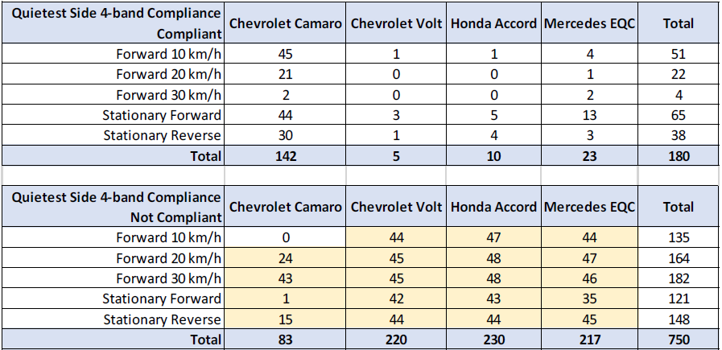
Preliminary test results – FMVSS 141 4-band Compliance

Slide 16
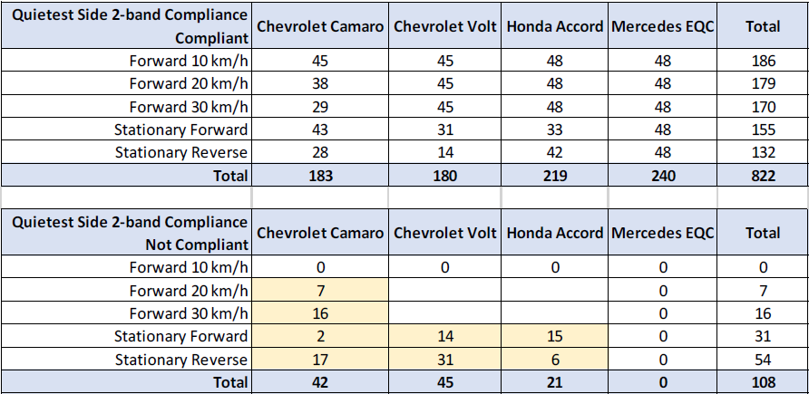
Preliminary test results – FMVSS 141 2-band Compliance

Slide 17
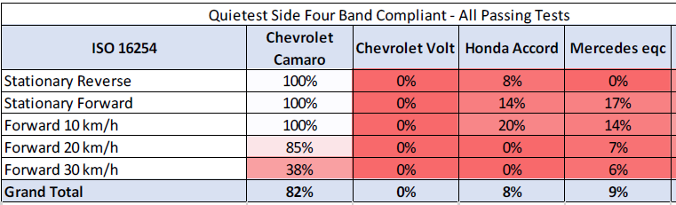
Preliminary test results: 4-band compliance when assessed using ISO/CD 16254

Slide 18
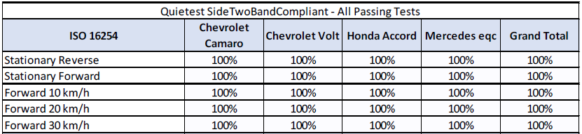
Preliminary test results: 2-band compliance when assessed using ISO/CD 16254

Slide 19
Test Results – sound level data sample

Slide 20
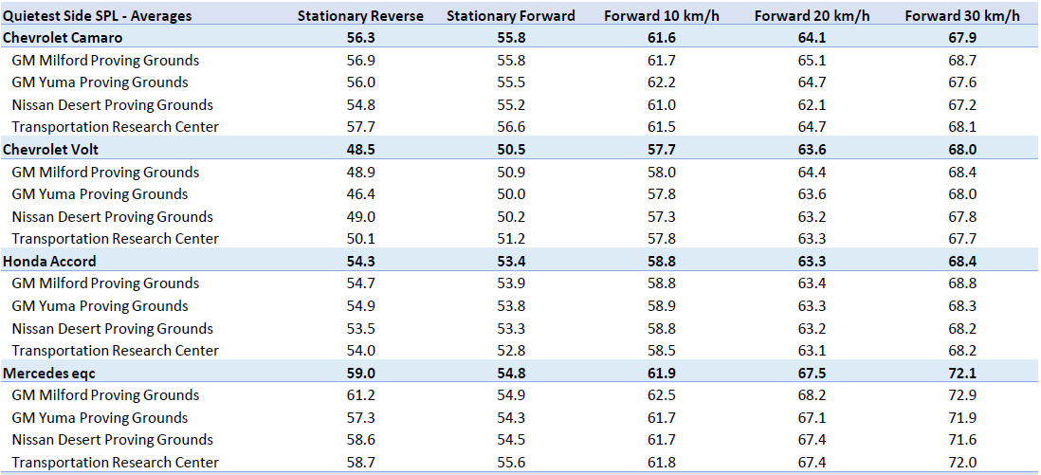
Preliminary test results – Overall SPL

Slide 21
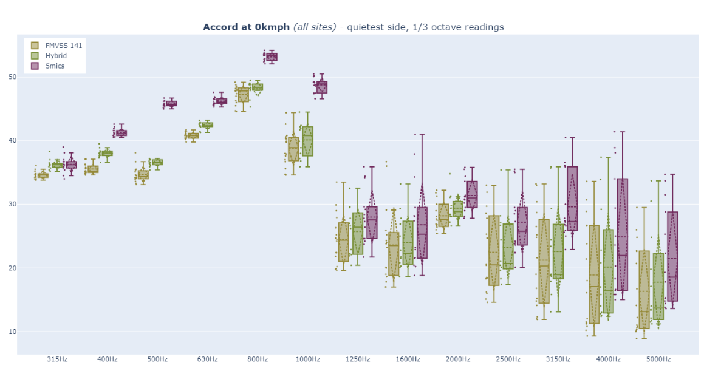
Example of one-third octave data

Slide 22
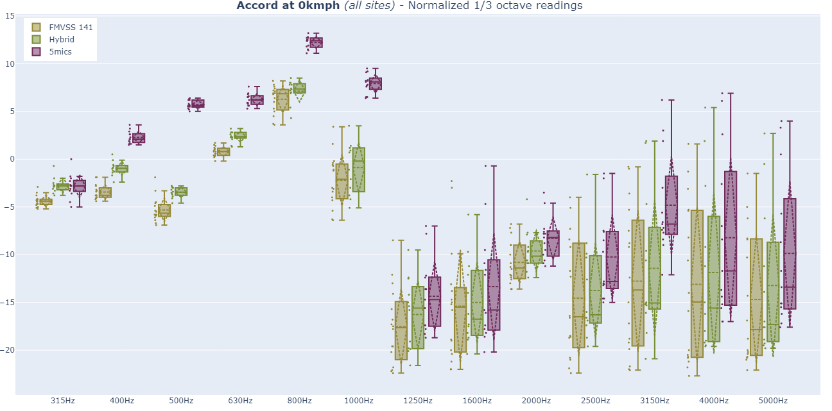
Example of Normalized band level data
Band level where individual band
contributes to normalized band sum
Band level
required for
aggregate
non signal
bands not to
contribute

Slide 23
Background sound

Slide 24
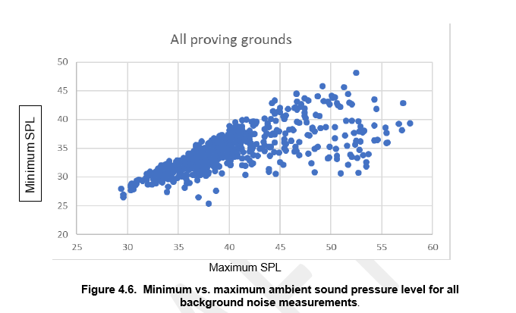
Example of background sound

Slide 25
Background sound
Current correction procedure can be simplified with limited practical influence on measurement variation – and a maximum theoretical error of 1.0 dB.
Propose simplified criteria of 6dB minimum signal to noise between the maximum overall SPL of the background and the overall SPL of the test result.

Slide 26
Tonal Loudness
Psychoacoustic Tonality is an analysis that provides results on how human beings perceive signals containing tonal components. It is based on the Hearing Model of Sottek that is also used for the calculation of other metrics such as loudness and roughness. The technical implementation of these algorithms is described in ECMA-418-2.

Slide 27
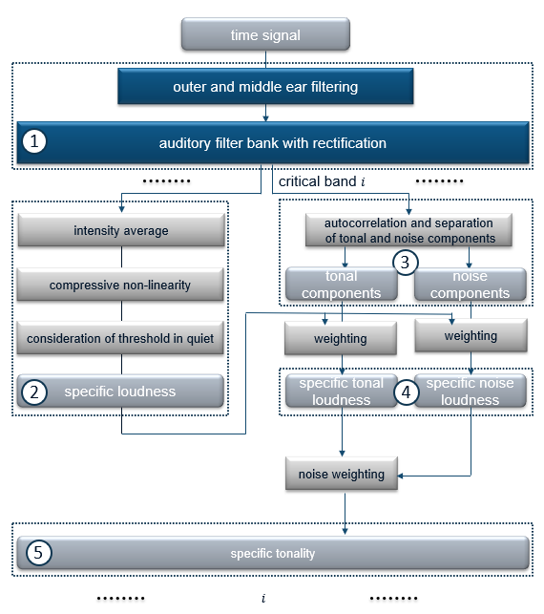
Tonal Loudness calculation overview

Slide 28
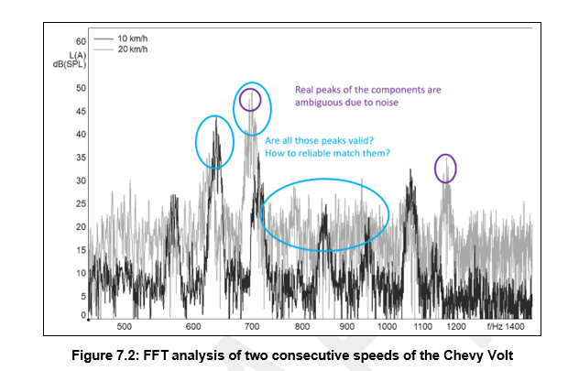
Determining Frequency Shift

Slide 29
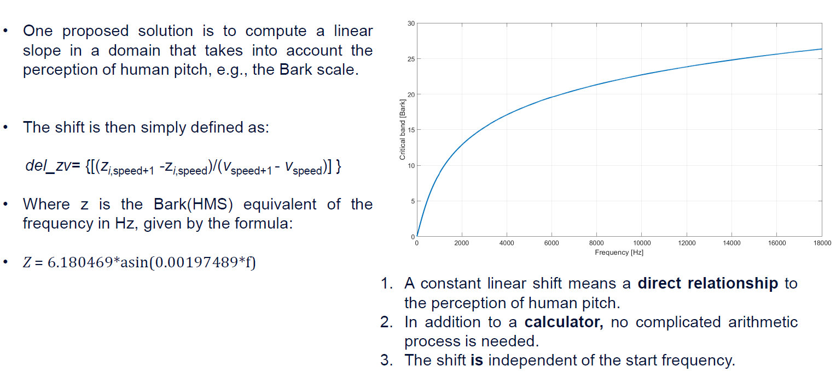
Frequency Shift

Slide 30
Tonal loudness for frequency identification
Procedure required no prior knowledge of signal.
Frequencies are identified only if they meet audibility thresholds
Eliminates possible errors due to existing frequency shift calculations

Slide 31
Other issues studied
Variation due to different implementation of software
  FINDING: Not a significant source of variation compared to other existing sources of variation
Variation due to different tires
  FINDING: Not a significant source of variation compared to other existing sources of variation -> Assuming standard tires (No off-road, winter tires, etc.)

Slide 32
Work still in progress
Indoor test compared to outdoor

Slide 33
Conclusions and recommendations
Update SAE and ISO standards to incorporate multi-microphone array
Update SAE and ISO Standards to update 1/3 octave signal processing methods
Update SAE and ISO standards to simplify treatment of background noise acceptance criteria.
Update ISO and SAE standards to include tonal loudness for frequency identification
Update FMVSS 141 and UN R138 to align test procedures to revised SAE and ISO standards

Slide 34
Thank you
Questions?

