Slide 1
SLR-53-09/Rev.1
Comments on SLR-52-10
Transition of component type-approvals
in lighting installation regulations
53rd SLR – January 2022

Slide 2
Summary of the main issue
The “sunset clause” to mandate the 01 series of R148, R149 and R150 in the transitional provisions of R48 (and R53, R74, R86) as proposed in last SLR should be converted into new requirements in installation regulations, resulting into new series of amendments, to avoid conflicts with 1958 Agreement Mutual Recognition principle.

Slide 3
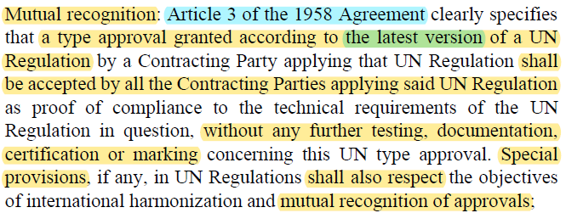
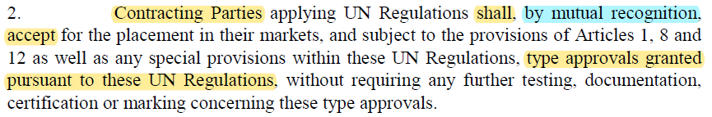
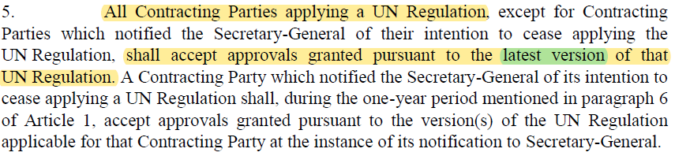
Mutual Recognition Principle
A type approval granted to the latest version of a UN Regulation, shall be accepted by all Contracting Parties:
Extract from UN Guidelines for Transitional Provisions
Extracts from Articles 3 and 12, respectively, of the 1958 Agreement (Rev. 3)

Slide 4
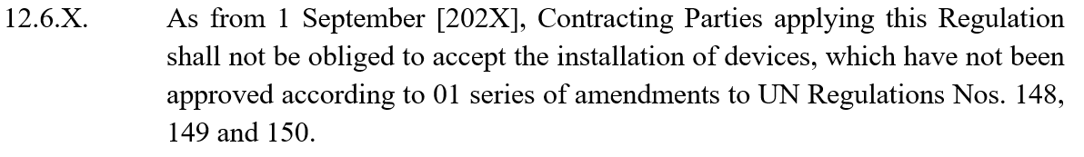
Potential Mutual Recognition Conflict
Proposed clause in the TPs of R48 (SLR-52-10):
From 1 September [202X], Contracting Parties may reject type approvals to the latest series of R48 if they contain any device approved to the 00 series to R148/149/150, which would result in potential Mutual Recognition issues.

Slide 5







Example: Mutual Recognition Conflict
E
XY
CP1
R48.0X
00
01
01
00
latest series
01
01
1. After 1 September [202X], a vehicle equipped with direction indicators approved to R148.00 is submitted for approval to the latest series of R48 in CP1.
!
2. CP1 verifies that the vehicle complies with the latest series of R48 and issues the corresponding certificate which, according to the 1958 Agreement Mutual Recognition, shall be accepted by all Contracting Parties.
CP2
3. The type approval certificate is submitted to CP2 but, subject to the proposed clause, CP2 does not accept the type approval certificate to the latest series of R48 issued by CP1, in contradiction with 1958 Agreement Principles.
Note: Contracting Parties shown in this slide were chosen randomly for illustrative purposes only.

Slide 6
Concern: Indiscriminate approach
The proposed approach would require to re-approve every single device to the 01 series of R148/149/150, regardless of whether it is technically affected by the 01 series or not, resulting in an unreasonable and enormous burden.
Not every function covered by the 01 series to R148/149/150 provides a higher level of vehicle safety.
The need to require the 01 series in installation regulations should be assessed for each function separately, based on safety benefit.

Slide 7
Proposed transition to 01 series
References to specific series for devices should not be specified in the Transitional Provisions of installation regulations. This should be addressed in the requirements of installation regulations (to avoid potential Mutual Recognition conflicts).
These new requirements would increase the level of stringency of the regulations, so it should result in a new series of amendments to installation regulations, according to the UN Guidelines. This new series would have its own Transitional Provisions.
The 01 series should be required only for functions which provide higher vehicle safety.

Slide 8
Proposed transition to 01 series
Generic example based on R48:
  6. Individual specifications
  (…)
  6.X.2. Number
  Two, complying with the requirements of the 01 and subsequent series of amendments to UN Regulation No. 149.
This activity requires careful consideration and SLR Stage 2 / Step 2 is the right forum for developing the requirements for devices in installation regulations. This could be reflected in the updated SLR ToR.

