Slide 1
OICA TF-EMC
Answer to GRE request to add ESD testing in R10
January 2022

Slide 2
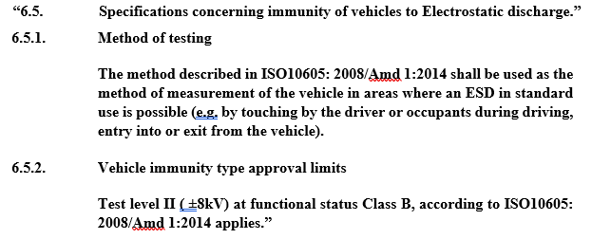
Reminder: NL proposal from TF-EMC-23-05e
Proposal to include a new clause about ESD testing at vehicle level

Slide 3
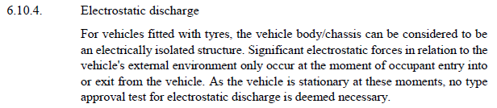
Current situation in R10.6 regarding ESD
In clause « 6.10 Exceptions », sub-clause 6.10.4 excludes application of ESD

Slide 4
ESD tests are however included in R116
R116 uniform technical prescriptions concerning the protection of motor vehicles against unauthorized use
  Part 1. Approval of vehicle of category M1 and N1 with regard to its devices to prevent unauthorized use
  Part 2. Approval of vehicle alarm systems
  Part 3. Approval of a vehicle with regards to its alarm system
  Part 4. Approval of immobilizers and approval of a vehicle with regard to its immobilizer
Annex 9 is specifying EMC test requirements for these systems
  ESD are part of these requirements
Moreover, last year it has been decided to split R116 into 3 new separate regulations, and OICA EMC TF supported the development of up-to-date EMC annexes

Slide 5
ESD tests in Annex 9 of R116 (as in last Amd.)
Two alternative methods are proposed:
  ISO method: according to ISO/TR 10605 released in 1993
  IEC method: according to IEC 61000-4-2 (not dated)
No specific guidelines in R116, e.g. regarding the choice of application points
It should be reminded that these tests are motivated by the fact that ESD events may be used as an intentional way to try to destroy any immobilizer or anti-theft or alarm system in case of car theft
  It means that application points of ESD are generally chosen by considering points accessible to any person from outside or inside, and maybe not restricted to points connected to electronic devices involved in R116 systems
  This practice may differ from one Technical Service to another

Slide 6
New R161 / R162 / R163
On 25th Oct. 2021, three new separate regulations were introduced and will supersede the existing R116:
  R161 on uniform provisions concerning protection of motor vehicles against unauthorized use and the approval of the device against unauthorized use (by mean of a locking system)
  R162 on uniform technical prescriptions concerning approval of immobilizers and approval of a vehicle with regard to its immobilizer
  R163 on uniform provisions concerning the approval of vehicle alarm system and approval of a vehicle with regard to its vehicle alarm system
The EMC annex has been deeply revised and is consistent between the 3 regulations: same test specifications, test severity levels, system operating mode (in terms of « set » or « unset » mode), etc.
  Annex 6 for R161 and R162, annex 7 for R163
  According to ISO 10605 Ed2 2008 + Corr 2010 + Amd 2014
  Applicable at ESA/sub-system level or at vehicle level

Slide 7
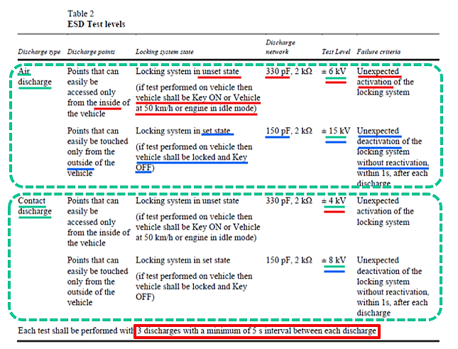
List of ESD requirements in R161
This is exactly the same table in R162 and R163 except from the system name of course.

Slide 8
Conclusion & proposal
There is no reason to remove the ESD exception and its justification from R10
Besides :
  R116 already introduces ESD requirements
  R161/R162/R163 series have introduced full up-to-date and clearer requirements for ESD tests, with relevant operating modes regarding customer use case
  These existing ESD tests enable to check the impact of ESD (destructive potential) in case of car theft, therefore in case ESD application affects the functioning of the car, this should be detected during or after these regulatory tests
As a conclusion, we don’t see any reason for considering introduction of additional ESD tests in R10

Slide 9
THANK YOU

