Slide 1
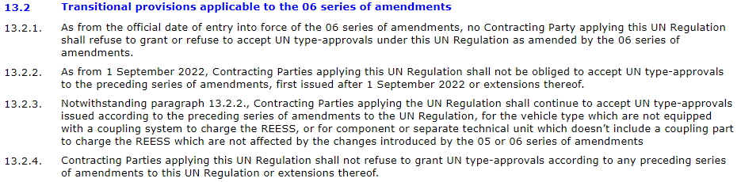
R10.06 Transitional Provisions
13.2.2. New type requirement, corresponding with 58 agreement guidelines “V.2.”
Meaning: as from 09/2022, new types (original approval), must be approved at R10.06 level in EU
V.2. As from 1 September Date (b), Contracting Parties applying this Regulation shall not be obliged to accept type approvals to the preceding series of amendments, first issued after 1 September Date (b).
13.2.3. Existing Type exemption, corresponding with 58 agreement guidelines “V.7.”
→ Meaning: R10.05 approvals for NOVC vehicles are still acceptable after 09/2022
V.7. Notwithstanding paragraph V.4, Contracting Parties applying this Regulation shall continue to accept type approvals issued according to the preceding series of amendments to this Regulation, for the vehicles/vehicle systems which are not affected by the changes introduced by the XX series of amendments.2
(Note: V.7 is for special case 1-2 and comes in addition to V.4 when applicable.)
Reading R10.06 TP points 13.2.2. & 13.2.3. does not lead to any conclusion on registration stop/EOS
Remark: …Even though confusion is created by:
  V.7. is intended to allow exemptions on existing approvals, avoiding EOS for requirements set in V.4.
  However, in R10.06, it is linked to V.2. for new types, instead of V.4. (which is not used)

Slide 2
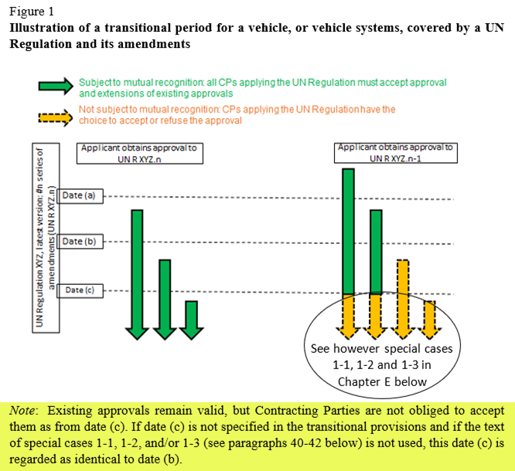
1958 Agreement guidelines
R10.06 TP only indicate a “date (b)”,
no “date (c)” (see previous slide)
Guidelines’ “Note” summary:
When:
date (c) is not specified, and
No special case 1-1, 1-2 and/or 1-3…
→…then date (b) becomes date (c).
Date (c) is linked to registrations (EOS)
R10.06 TP
Special case 1-2 text is (only) used for NOVC (in 13.2.3.). OVC vehicles don’t get an exemption.
As R10.06 does not specify a date (c), date (b) becomes date (c)
If strictly applied by Contracting Parties, there is a risk for refusal of registration for R10.05 approved OVC vehicles

Slide 3
OICA proposal
OICA propose to modify the paragraph 13.2.3 as follow:
13.2.3. Notwithstanding paragraph 13.2.2., Contracting Parties applying the UN Regulation shall continue to accept UN type-approvals issued according to the preceding series of amendments to the UN Regulation, for the vehicle type which are not equipped with a coupling system to charge the REESS, or for component or separate technical unit which doesn’t include a coupling part to charge the REESS which are not affected by the changes introduced by the 05 or 06 series of amendments.
Justification:
R10.05 and R10.06 contain the exact same homologation tests and associated setup for WVTA, including electrified vehicles equipped with a coupling system to charge the REESS (XEV), so re-certifying to R10.06 instead of R10.05 adds no additional requirements from what was already certified.
While R10.06 does contain a new technical requirement in terms of the NARROWBAND limits for WVTA when compared to R10.05, this new requirement applies to all vehicle types (i.e., it is independent of whether or not the vehicles is an XEV or whether it is a non-plug-in vehicle (e.g., internal combustion engine (ICE) vehicles)). Since R10.06 does not require ICE vehicles (vehicles without the coupling system to charge the REESS) to re-certify, this same courtesy/exemption should be granted to those vehicles which do contain this equipment (XEV).

