Slide 1
Worn WGI C1 Round Robin Track FRICTION Properties Proposal
WT-34-02

Slide 2
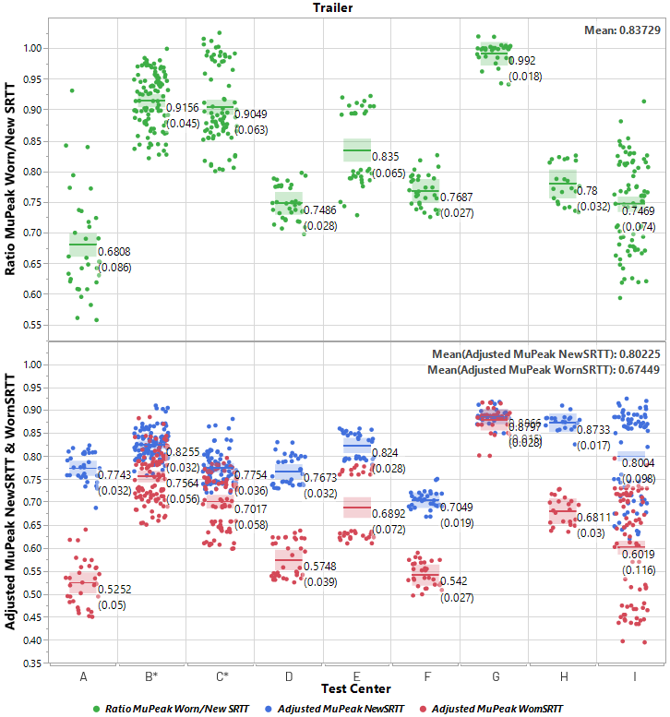
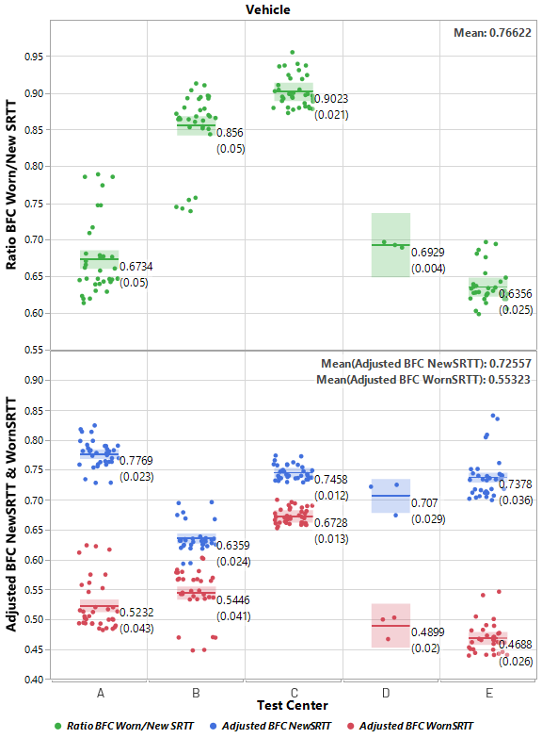
Track friction properties - ETRTO PROPOSAL
* Test Centers B & C data include ANW trailer tests
(New & Worn SRTT tested at different Water Depths)
ISO 23671:2021 / R117 Supp. 13:
  Range µ_{peak_NewSRTT} = [0.65, 0.90]
  Range BFC_{NewSRTT} = [0.57, 0.79]
Technical consideration:
  Scaling approach with the average ratio WornSRTT/NewSRTT from RRT (ratio µ_{peak} = 0.837 & ratio BFC = 0.766)
  Considering watering system (external or self-watering) and interaction with track texture depth
Testing/Operational consideration:
  Adjusting to keep similar range width as WGI in ‘new’ state above
  Adjusting to slightly expand the lower limit for trailer method to keep conditions aligned with current regulatory prescriptions (water depth @ 1.0±0.5 mm from the peak of the pavement)
Proposed ranges for WGI in ‘worn’ state (WWGI) :
  Range µ_{peak_WornSRTT} = [0.45, 0.80]
  Range BFC_{WornSRTT} = [0.40, 0.65]
CONS: - Restrictive for testing as some test centers will have to adapt (mainly their Water Depth)
➔ PROS: - Test procedure simplification (same tire used as ref. & for track validation/characterization) - R117 text to be aligned accordingly
- With such proposed limits, and by adapting mainly Water Depth per test center, the WornSRTT variation between test centers will be reduced, what will also potentially reduce the global test variation of WWGI

Slide 3
Thank you

