Slide 1

[TF-VS] "Cross-matrix" Subgroup
Traffic Scenarios Classification in other Standards
19 January 2022
China Automotive Technology and Research Center Co., Ltd.
1
Notes:
1

Slide 2
Introduction
As for Parameters to Define Road Traffic Scenarios, ISO has been working on a few standards and/or technical reports in TC22/SC33/WG9, TC22/SC36/WG7 and other groups.
Current works mainly focus on automated driving and crash scenarios, from which we can get some inspirations for our noise prediction model.
Chinese experts have been taken deep part into those works and relative national standards are under development.
2

Slide 3
Standards list
ISO/DIS 34501 Road vehicles — Terms and definitions of test scenarios for automated driving systems
ISO/DIS 34502 Road vehicles — Scenario-based safety evaluation framework for Automated Driving Systems
ISO/AWI 34503 Road vehicles — Taxonomy for operational design domain for automated driving systems
ISO/AWI 34504 Road vehicles — Scenario attributes and categorization
ISO/WD TR 8234 Pre-crash classification systems
GB/T #### Intelligent and connected vehicles—Operational design condition for automated driving system
3

Slide 4

ISO/TC 22/SC 33/WG 9*
Group name: "Test scenarios of automated driving systems"
Convenorship: SAC
Convenor: Wang Zhao Mr.
Standards:
ISO/DIS 34501 Road vehicles — Terms and definitions of test scenarios for automated driving systems
ISO/DIS 34502 Road vehicles — Scenario-based safety evaluation framework for Automated Driving Systems
ISO/AWI 34503 Road vehicles — Taxonomy for operational design domain for automated driving systems
ISO/AWI 34504 Road vehicles — Scenario attributes and categorization
*Source: https://www.iso.org/
4

Slide 5
ISO/TC 22/SC 33/WG 9
ISO/DIS 34502 Road vehicles — Scenario-based safety evaluation framework for Automated Driving Systems*
Logically structured scenarios are necessary to facilitate the handling of a large number of variables and to enable testing of these scenarios.
This structuring of scenarios canbe achieved following a number of approaches:
descriptions from the outside of the ADS (e.g. PEGASUS 6-layer)
descriptions from the inside the ADS (e.g. SAKURA 3-categories)
by establishing a relationship between the scenario structures and corresponding patterns reported in accident databases.
ISO/DIS 34502 focus on a description from the inside of the ADS.
Dynamic driving task (DDT) : perception, judgement and control.
*Source: ISO 34502-#:####(X)-DIS draft 210908
5

Slide 6
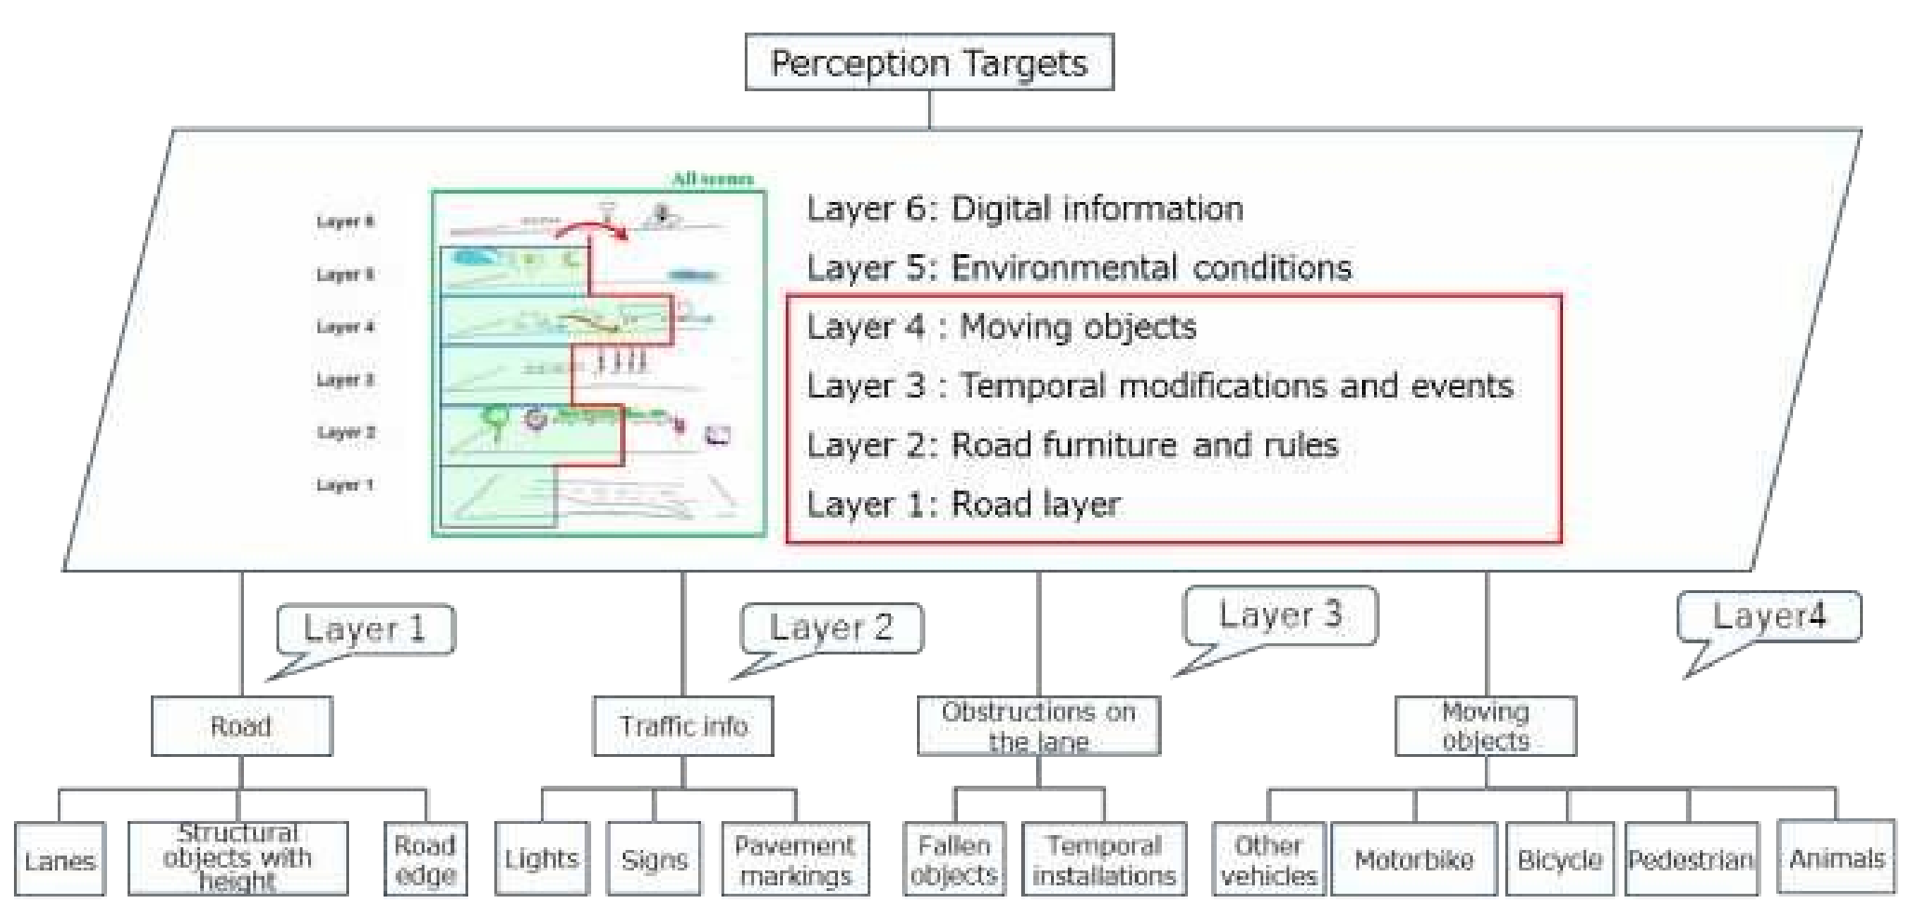
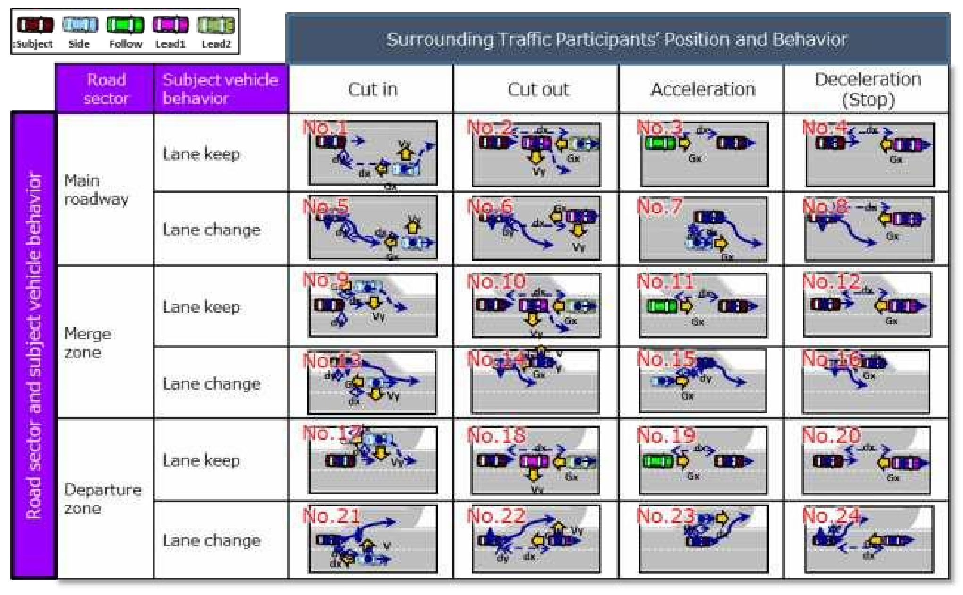
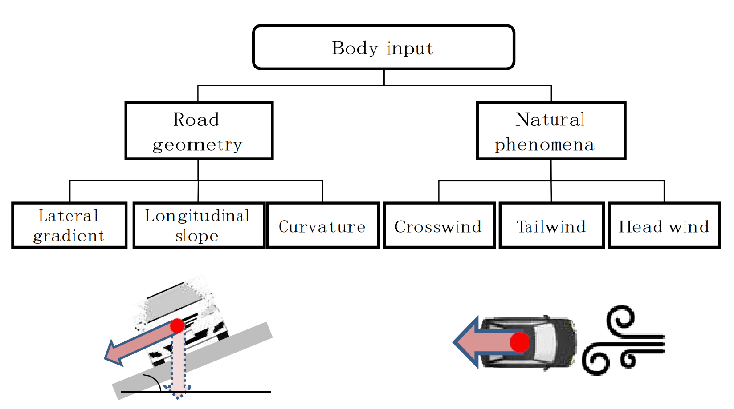
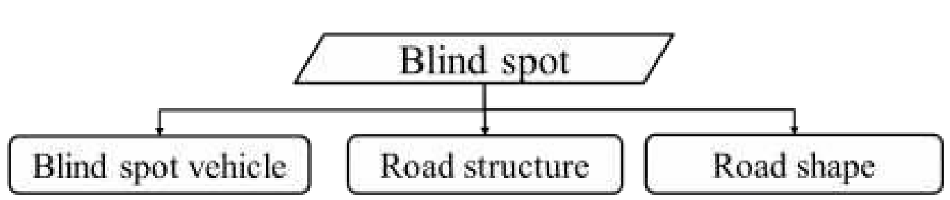
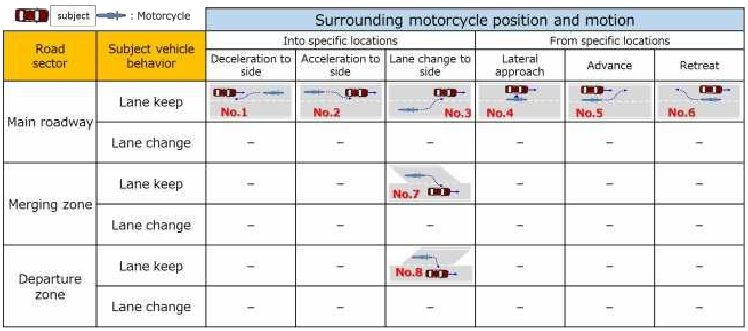
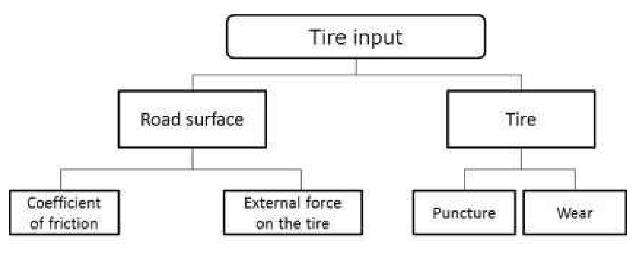
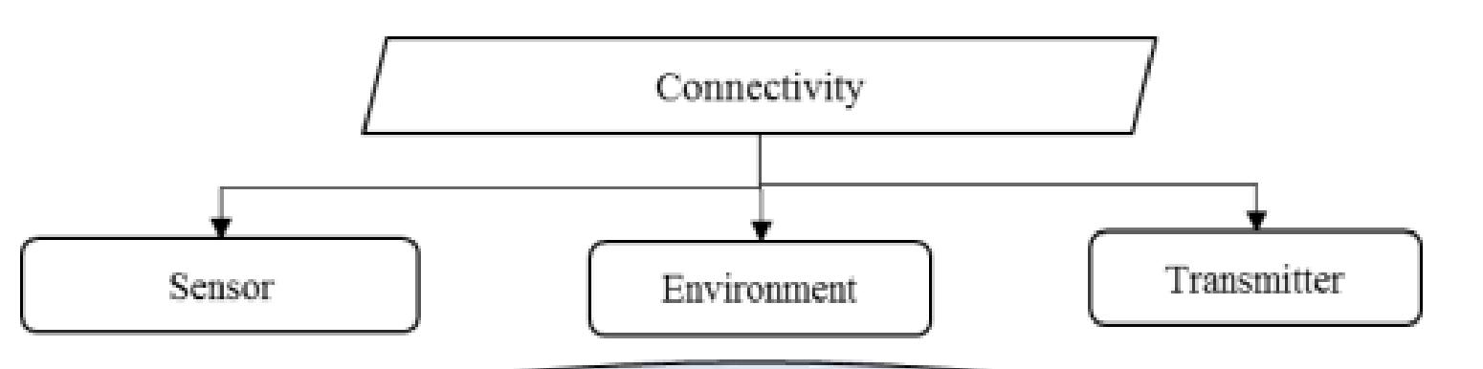
ISO/TC 22/SC 33/WG 9
ISO/DIS 34502 Road vehicles — Scenario-based safety evaluation framework for Automated Driving Systems*
Perception related critical scenarios
Traffic related critical scenarios
Vehicle control related critical scenarios
*Source: ISO 34502-#:####(X)-DIS draft 210908
6

Slide 7
ISO/TC 22/SC 33/WG 9
ISO/DIS 34502 Road vehicles — Scenario-based safety evaluation framework for Automated Driving Systems*
Scenario Description: e.g. by the PEGASUS project
• non-formal, human readable
• behavior-based description of a traffic scenario
• possibly containing a visualization
• formalized, machine readable, and declarative description (i.e. constraints on the happenings)
• closely tied to an ontology (or rather family of ontologies)
• efficient description of relations (e.g. cause-effect).
• parameterized representation of a set of scenarios, where
• influencing factors are described by means of parameter ranges and distributions
• enables parameter variation
• single scenario,describing exactly one specific scenery and chain of events with fixed parameters
• can, for example, be written as OpenDRIVE + OpenSCENARIO
Functional
Abstract
Logical
Concrete
*Source: ISO 34502-#:####(X)-DIS draft 210908
7

Slide 8
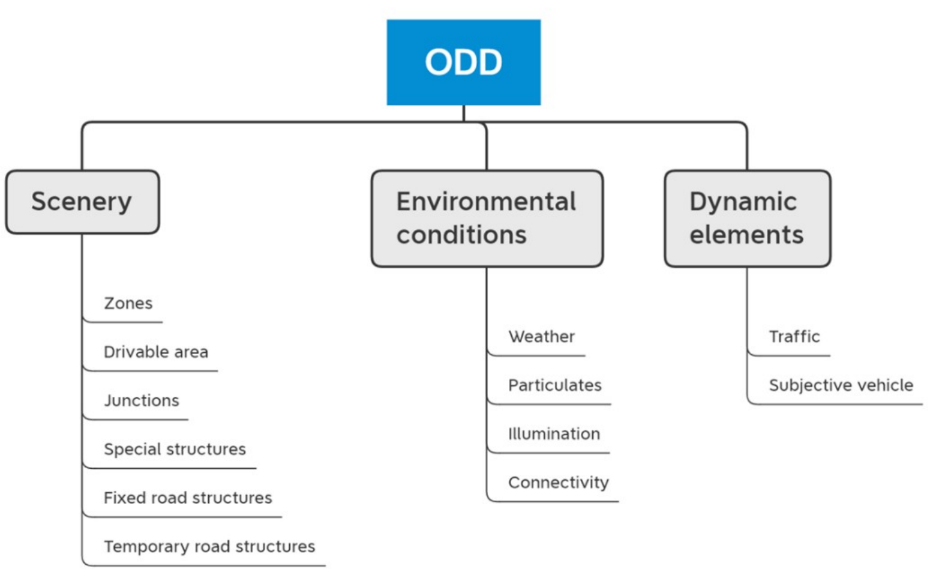
ISO/TC 22/SC 33/WG 9
ISO/AWI 34503 Road vehicles — Taxonomy for operational design domain for automated driving systems*
Top level taxonomy with ODD attributes
*Source: ISO 34503-#:####(X)-WD 34503 – r11.0
8

Slide 9
ISO/TC 22/SC 33/WG 9
ISO/AWI 34503 Road vehicles — Taxonomy for operational design domain for automated driving systems*
Zone:
Geo-fenced areas
Traffic management zones
School zones
Regions or states
Interference zones (e.g. dense foliage or loss of GPS due to tall buildings)
Port Zone
Freight distribution Centre
Drivable area:
Drivable area type
Drivable area geometry
Drivable area lane specification
Drivable area signs
Drivable area edge
Drivable area surface
a) Motorways or highways or interstates;
b) Primary roads (e.g. dual-carriage ways, single carriage ways, )
c) Radial roads;
d) Distributor roads;
e) Minor or local roads;
f) Slip roads or off-ramps
g) Parking space
h) Shared space
*Source: ISO 34503-#:####(X)-WD 34503 – r11.0
9

Slide 10
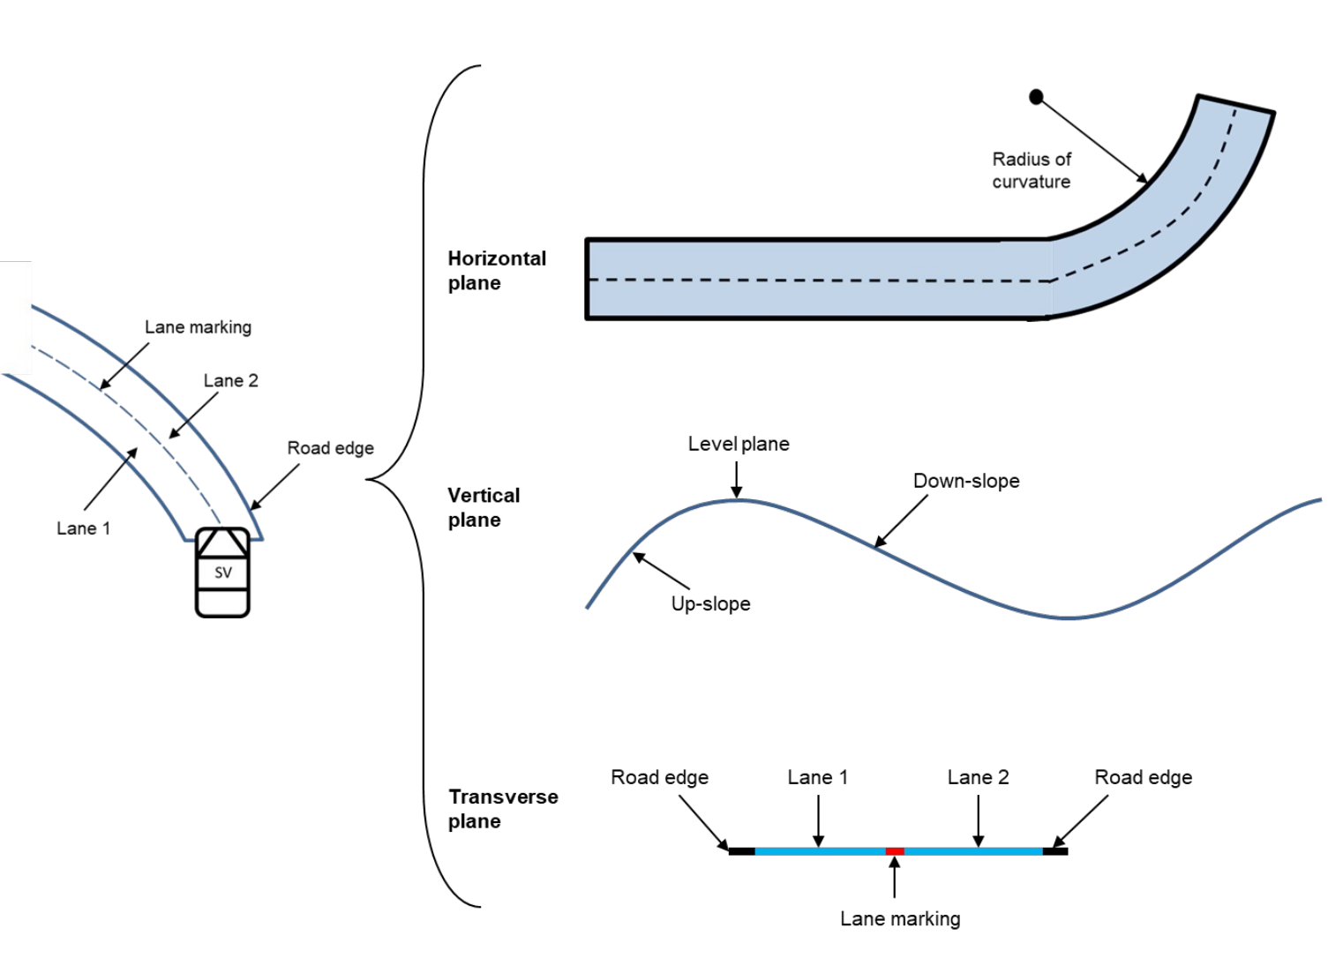
ISO/TC 22/SC 33/WG 9
ISO/AWI 34503 Road vehicles — Taxonomy for operational design domain for automated driving systems*
Drivable area:
Drivable area type
Drivable area geometry
Drivable area lane specification
Drivable area signs
Drivable area edge
Drivable area surface
*Source: ISO 34503-#:####(X)-WD 34503 – r11.0
10

Slide 11
ISO/TC 22/SC 33/WG 9
ISO/AWI 34503 Road vehicles — Taxonomy for operational design domain for automated driving systems*
Drivable area:
Drivable area type
Drivable area geometry
Drivable area lane specification
Drivable area signs
Drivable area edge
Drivable area surface
a) Lane dimensions;
b) Lane marking;
c) Lane type;
d) Number of lanes;
e) Direction of travel.
surface type:
asphalt, cement concrete, pavers, cobblestone, granite setts and gravel
surface features:
cracks, potholes, ruts or swells
induced surface condition:
Icy ,Flooded,Standing water, Mirage, Snow on surface, Wet, Surface contamination
a) Regulatory signs (e.g. traffic lights)
b) Warning signs
c) Information signs
a) Line markers
b) Shoulder (paved or gravel)
c) Shoulder (grass)
d) Shoulder (snowbanks)
e) Solid barriers (e.g. grating, rails, curb, cones)
f) Temporary line markers
g) none
*Source: ISO 34503-#:####(X)-WD 34503 – r11.0
11

Slide 12
ISO/TC 22/SC 33/WG 9
ISO/AWI 34503 Road vehicles — Taxonomy for operational design domain for automated driving systems*
Junctions:
Roundabout:Mini/ Compact/ Normal/ Large/ Double
Intersection:
T-junction/ Y junction/ Cross road/ Staggered/ Grade separated
Basic road structures:
Building/Streetlight/Street furniture (e.g. bollards)/Vegetation
Special structures:
Automatic access control barrier/Bridge/Pedestrian crossing/ Rail crossing/ Tunnel/ Toll plaza
Temporary drivable area structures:
Construction site detour/Refuse collection
Road work/ Signage
*Source: ISO 34503-#:####(X)-WD 34503 – r11.0
12

Slide 13
ISO/TC 22/SC 33/WG 9
ISO/AWI 34503 Road vehicles — Taxonomy for operational design domain for automated driving systems*
Environmental conditions:
Outside Air Temperature
Weather:Wind/Rainfall/Snowfall/Particulates/Illumination
Connectivity:
Communication attribute (V2V/V2I/V2P/V2N)
Positioning attribute (Galileo/GLONASS/GPS/BeiDou)
Dynamic elements:
Agent type: motor vehicle, non-motor vehicle, vulnerable road users (pedestrians two wheelers, bicycles, e-scooters) and animals
Each traffic agent shall be classified using two of the following three attributes: Density of agents; Volume of traffic; Flow rate.
*Source: ISO 34503-#:####(X)-WD 34503 – r11.0
13

Slide 14
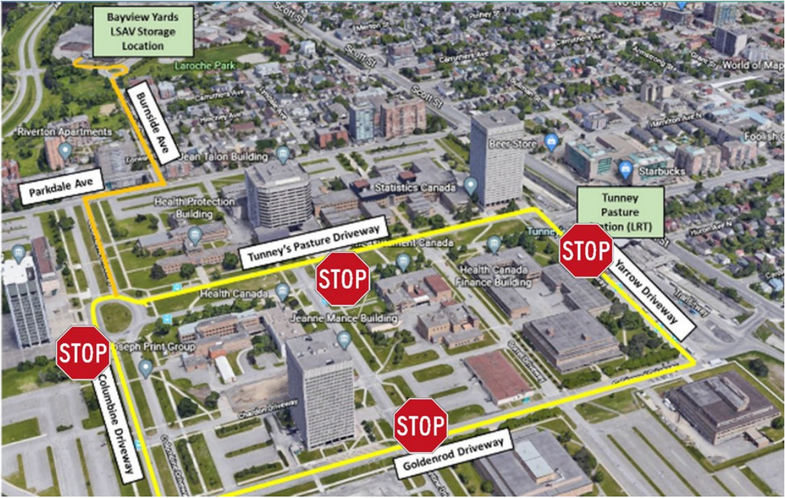
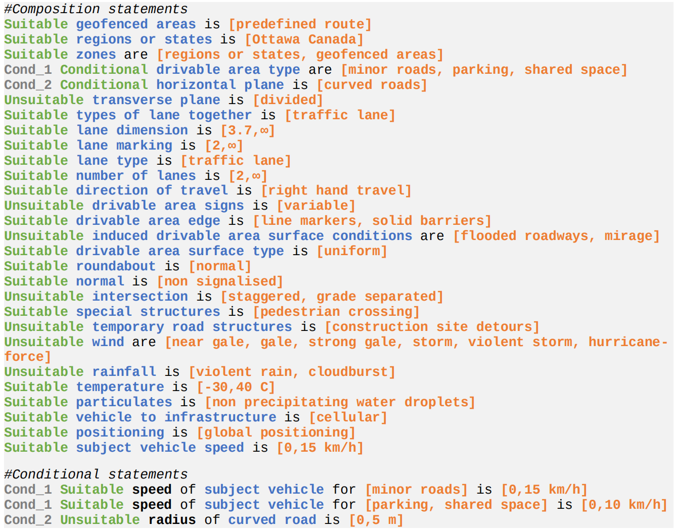
ISO/TC 22/SC 33/WG 9
ISO/AWI 34503 Road vehicles — Taxonomy for operational design domain for automated driving systems*
Examples of ODD definition:
*Source: ISO 34503-#:####(X)-WD 34503 – r11.0
14

Slide 15

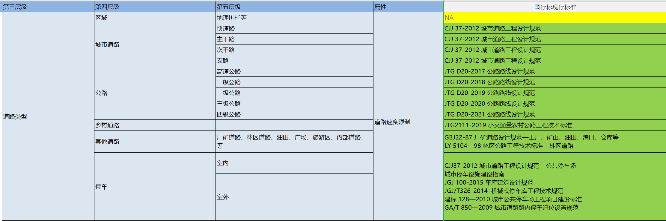
SAC/TC114/SC34
GB/T #### Intelligent and connected vehicles—Operational design condition for automated driving system
ODD
range
occupants status
vehicle status
road
driver
dynamic status
GB 5768.2-2009 Road traffic signs and markings - Part 2: Road traffic signs
GB 14887-2011 Road traffic signal lamps
GB/T 35663-2017 Basic terminology of weather forecast
infrastructure
passenger
ADS conditions
objective
weather
information
15

Slide 16
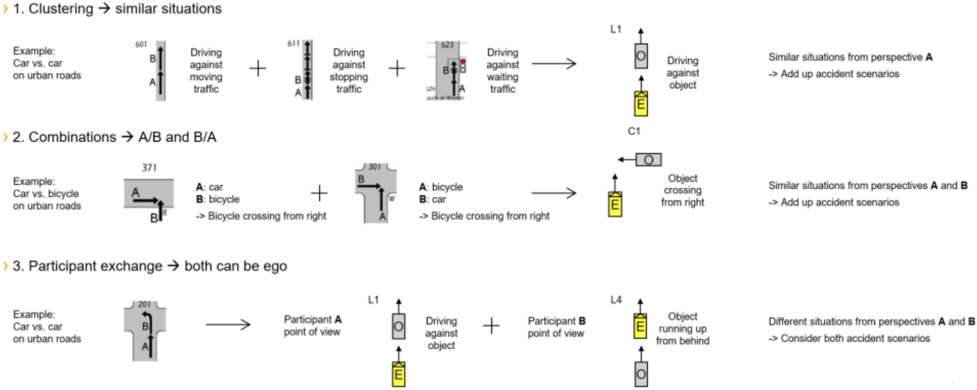
ISO/TC 22/SC 36/WG 7
ISO/WD/TR 8234 Pre-crash classification systems*
Levels of abstraction and data layers according to PEGASUS scheme
Describe which layers of the PEGASUS 6-Layer-Scheme are included in this Classification system. This will help the reader understand the link to the work in ISO/TC 22/SC 33/WG 9.
Continental Pre-Crash Scenarios (PCS): only includes information on the movable objects according to level 4 in the Pegasus scheme.
*Source: Outline ISO_WD_TR 8234 Pre-crash classification systems_2021-10-26
16

Slide 17

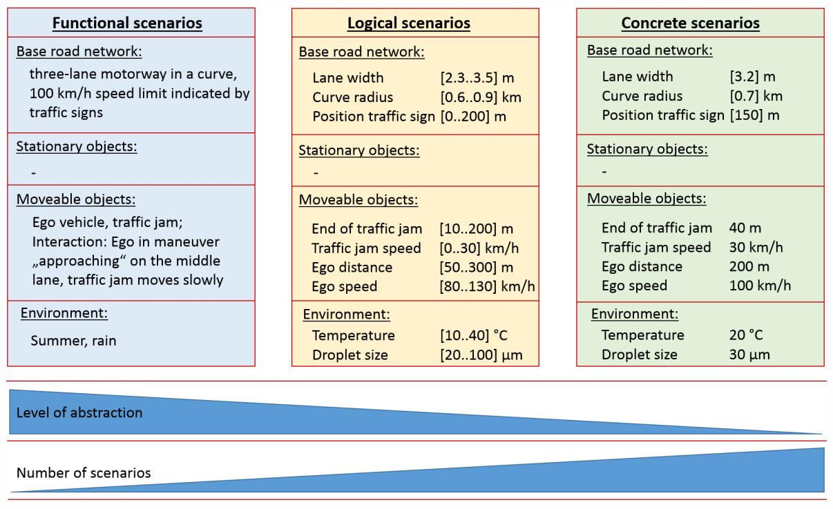
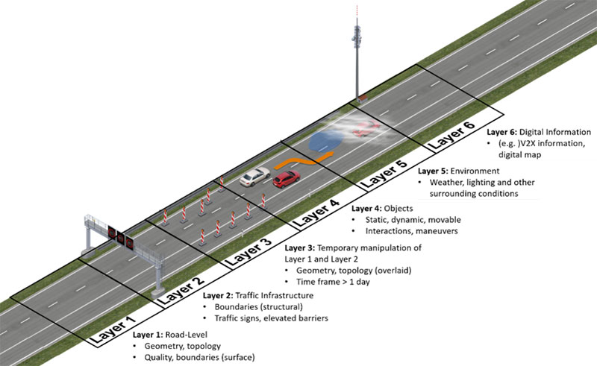
Pegasus
PEGASUS delivers the standards for automated driving, promoted by the Federal Ministry for Economic Affairs and Energy (BMWi): project for the establishment of generally accepted quality criteria, tools and methods as well as scenarios and situations for the release of highly-automated driving functions.
*Source: https://www.pegasusprojekt.de/de/about-PEGASUS
17

Slide 18
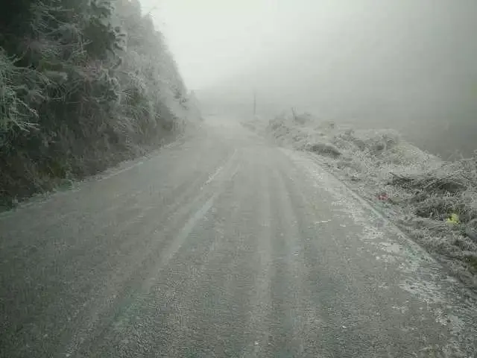
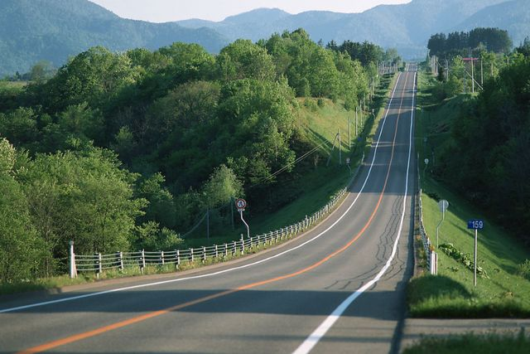
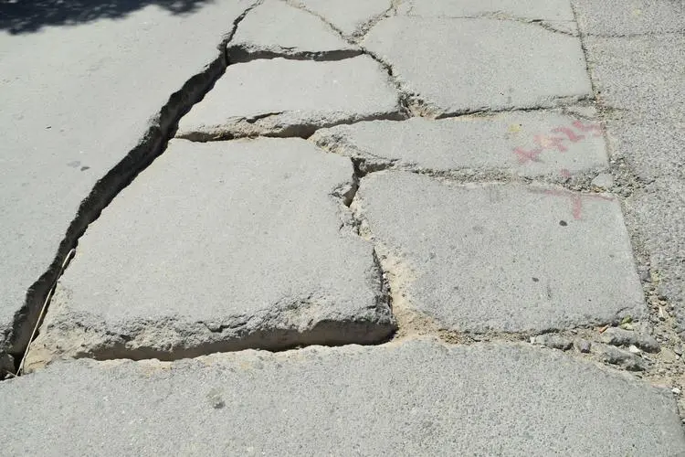
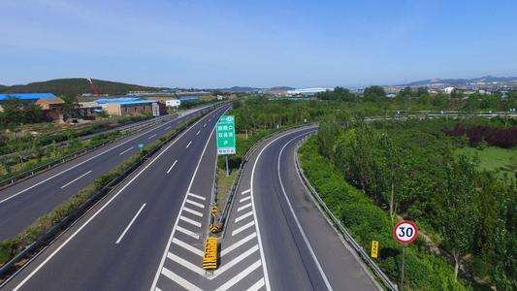
Ideas
Road
Do we need to include geometry/quality/conditions/junction?
  Up-slope always means larger power train noise;
  Cracks, potholes, ruts or swells bring more vibrations and tyre noise;
  Icy surface reduces tyre noises;
  Highway ramp mandates lower speed in a short time.
18

Slide 19
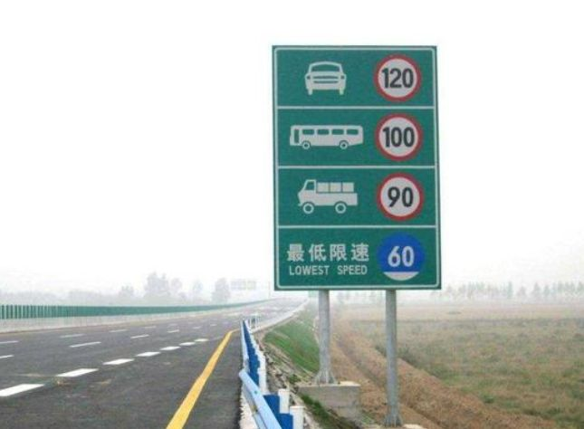
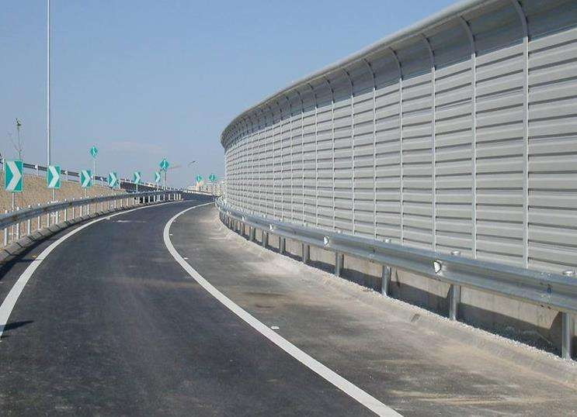
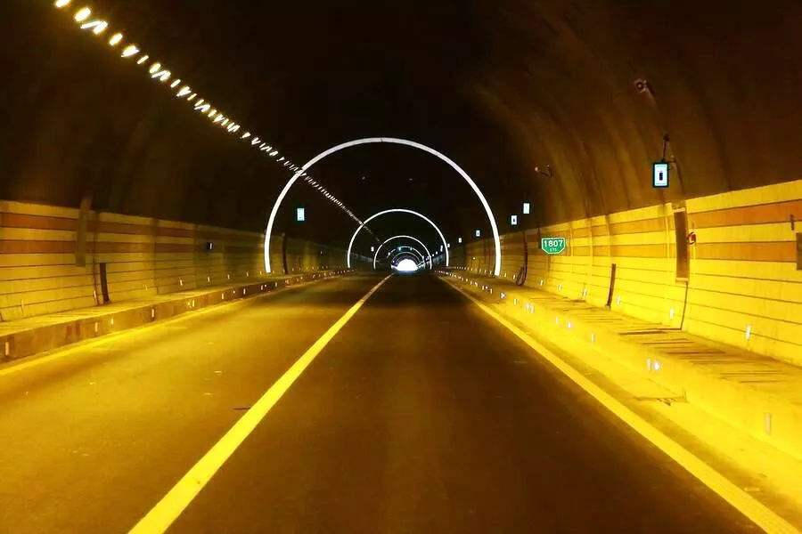
Ideas
Traffic Infrastructure
Do we need to include infrastructures like traffic signs and special facilities?
  Speed limit sign reminds drivers to control the speed;
  Soundproof wall and trees can block the propagation of sound.
Objects
Similar to the TFVS-05-06, including different road users and Volume.
19

Slide 20
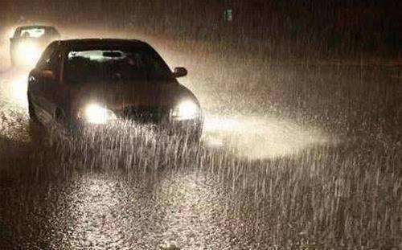
Ideas
Environment
Do we need to include weather and lighting?
  Wind brings more wind noise;
  Low visibility(rain, fog) brings more beeping;
  In the dark road, more driver prefer lights to horns.
Connectivity?
  V2X,navigation signal?
Occupants status?
  driver,passenger?
Vehicle status?
  Speed, acceleration, tyre pressure?
20

Slide 21

Thanks for your attention!
China Automotive Technology and Research Center Co., Ltd.

