Slide 1
Worn WGI C1 Round Robin
Track FRICTION Properties Proposal

Slide 2


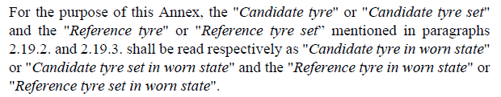
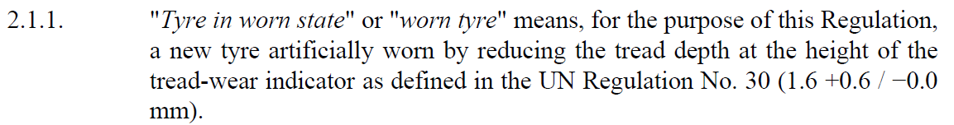
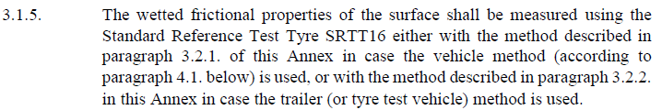
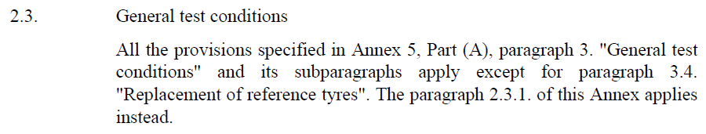
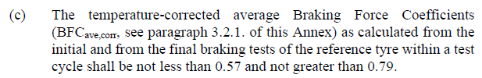
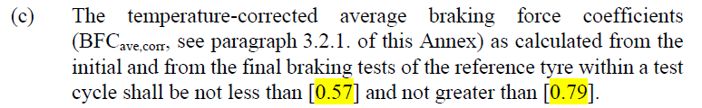
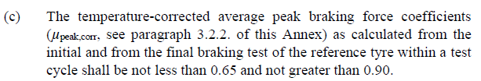
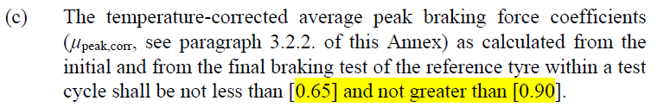
Track friction prop. & Results Validation - R117
 | R117.02 Annex 5 (Part A) WGI in ‘new’ state | R117.03 Annex 9 (current DRAFT) WGI in ‘worn’ state
Definitions
Wetted frictional properties
Methods to measure the wetted frictional properties of the surface | 3.2.1 3.2.2 | Reference to Annex 5 Part A
Validation of results | 4.1.6.2. 4.2.8.2. | 2.4.1.1.2. 2.4.2.1.2.

Slide 3
ETRTO Proposal
 | R117.02 Annex 5 (Part A) WGI in ‘new’ state | R117.03 Annex 9 WGI in ‘worn’ state
Reference tyre | SRTT16 (new state) | SRTT16 (worn state) R117.03 Suppl. 1: SRTT16 (molded)
Wetted frictional properties (track validation) | NewSRTT16 𝐵𝐹𝐶_{ave,corr} = [0.57, 0.79] NewSRTT16 𝜇_{peak,corr} = [0.65, 0.90] | WornSRTT16 𝐵𝐹𝐶_{ave,corr} = [0.40, 0.65] WornSRTT16 𝜇_{peak,corr} = [0.45, 0.80]
Validation of results | NewSRTT16 𝐵𝐹𝐶_{ave,corr} = [0.57, 0.79] NewSRTT16 𝜇_{peak,corr} = [0.65, 0.90] | WornSRTT16 𝐵𝐹𝐶_{ave,corr} = [0.40, 0.65] WornSRTT16 𝜇_{peak,corr} = [0.45, 0.80]
Sections to be updated in R117 | - | 2.3 2.4.1.1.2. c) 2.4.2.1.2. c)
ETRTO rationale for the proposed WornSRTT16 ranges:
Mainly based on scaling factor of the Worn/New SRTT16 drop found in the RRT (average of all test centers)
Adjust the range to include tests conditions that are in line with current regulatory prescriptions (e.g water depth @ 1.0±0.5 mm from the peak of the pavement in case of external watering system) - Ref. WT-34-05
It is important to use the ref. tyre selected for WGI in ‘worn’ state (Worn SRTT) for both track & results validation, in order to:
  Simplify the test procedure & the text of the regulation: 1 single ref. tyre per Annex
  Account for water depth conditions at range limits (~0.5mm / ~1.5mm) that we are currently unable to detect because of:
    No standardized water depth measurement method
    Interactions between water depth & MTD that we need to better understand
could lead to over- or under-estimated MuPeak/BFC measurement for certain tyres
➔ higher test variation

Slide 4
Examples of WWGI vs WornSRTT PeakMu per Tyre ID
Proposed WornSRTT range
The proposed range for step 1 would avoid the possibility to test in extreme conditions (i.e. <0.45 or>0.80) that could increase the variability of the WWGI results.
Colored dots represent different Test Centers from the RRT

Slide 5
Examples of WWGI vs WornSRTT BFC per Tyre ID
Proposed WornSRTT range
The proposed range for step 1 would avoid the possibility to test in extreme conditions that could increase the variability of the WWGI results.
Colored dots represent different Test Centers from the RRT

Slide 6
THANK YOU

Slide 7
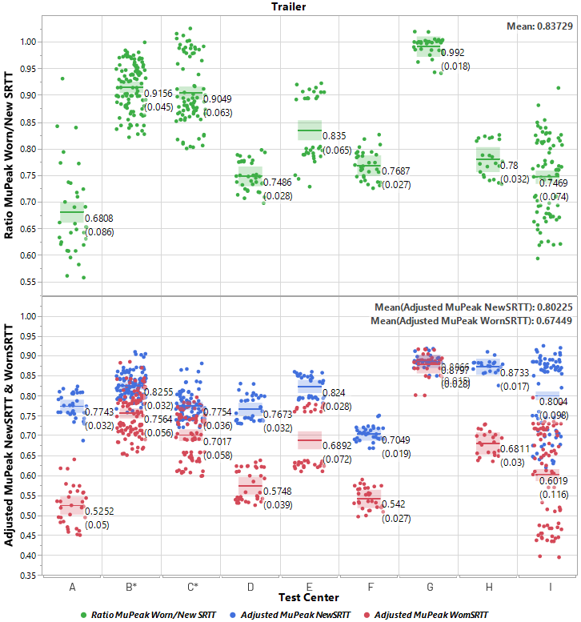
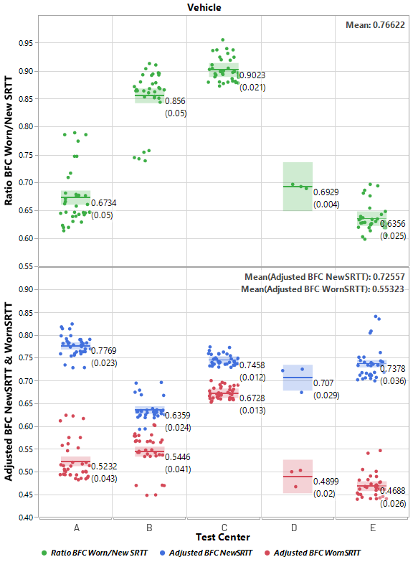
Track friction properties - ETRTO PROPOSAL
* Test Centers B & C data include ANW trailer tests
(New & Worn SRTT tested at different Water Depths)
ISO 23671:2021 / R117 Supp. 13:
  Range µ_{peak_NewSRTT} = [0.65, 0.90]
  Range BFC_{NewSRTT} = [0.57, 0.79]
Technical consideration:
  Scaling approach with the average ratio WornSRTT/NewSRTT from RRT (ratio µ_{peak} = 0.837 & ratio BFC = 0.766)
  Considering watering system (external or self-watering) and interaction with track texture depth
Testing/Operational consideration:
  Adjusting to keep similar range width as WGI in ‘new’ state above
  Adjusting to slightly expand the lower limit for trailer method to keep conditions aligned with current regulatory prescriptions (water depth @ 1.0±0.5 mm from the peak of the pavement)
Proposed ranges for WGI in ‘worn’ state (WWGI) :
  Range µ_{peak_WornSRTT} = [0.45, 0.80]
  Range BFC_{WornSRTT} = [0.40, 0.65]
CONS: - Restrictive for testing as some test centers will have to adapt (mainly their Water Depth)
➔ PROS: - Test procedure simplification (same tyre used as ref. & for track validation/characterization) - R117 text to be aligned accordingly
- With such proposed limits, and by adapting mainly Water Depth per test center, the WornSRTT variation between test centers will be reduced, what will also potentially reduce the global test variation of WWGI

