Slide 1

24th Session
Status Review and Session Orientation
Document FRAV-24-03
Web Conference
8 February 2022

Slide 2
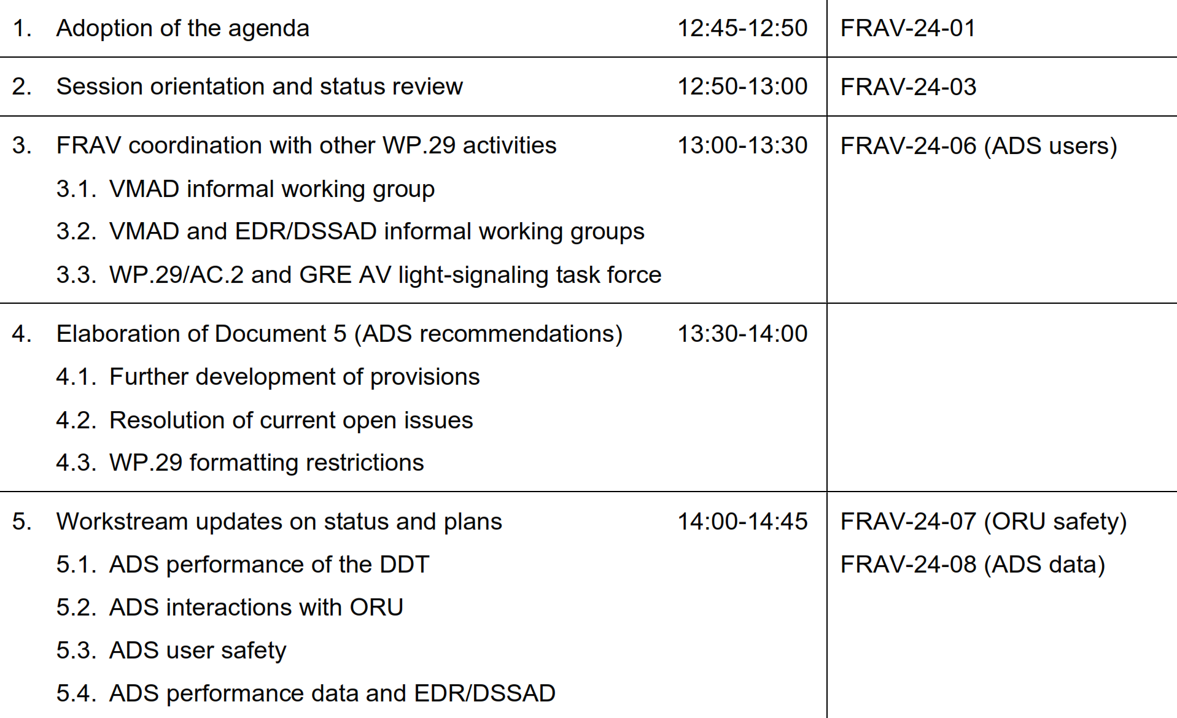
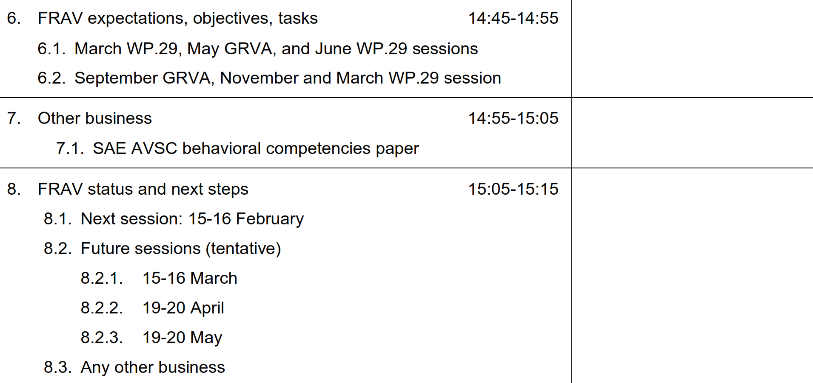
Agenda item 1
Adoption of the agenda
Assess the current state of FRAV work, review short-term tasks and obligations, consider goals for the next 12 months, and prepare for two-day session next week.

Slide 3
Agenda item 2
FRAV status
FRAV reported its status to GRVA (document GRVA-12-22)
  Document 5 submitted as GRVA-12-23
  Recalled FRAV framework for ADS safety (definitions, descriptions, specifications applicable across ADS configurations)
  Working on provisions for safety specifications and ADS descriptions
  Highlighted open issues with current working text
  Noted elaboration of detailed provisions
  Integration of VMAD work to develop performance criteria
Leadership discussions with other groups/activities
  VMAD scenarios and assessment methods
  ADS provisions under EDR/DSSAD
  AC.2 discussions on GRE AV signaling

Slide 4
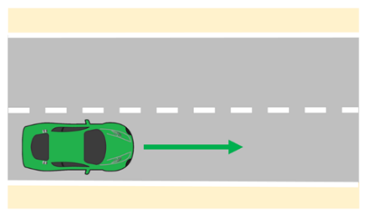
Agenda item 3
VMAD interaction
Two steps
  FRAV to check if the 24 safety requirements and their detailed provisions are applicable to lane keeping [scenario].
  VMAD to identify which methodology including whether scenarios are necessary for each detailed provision for lane keeping.
FRAV response due mid-February
  Relevant safety specifications (opportunity to elaborate if useful)
  Information on scenario conditions (impacting ADS performance)
Input for VMAD by the end of the next FRAV session (15-16 February)

Slide 5
Agenda item 3
VMAD and EDR/DSSAD interaction
General recommendations (September 2021)
  ADS configurations and uses
    Technical specifications
    ODD parameters
    User roles
  Data use
    Safety authority crash analysis
    Manufacturer in-service reporting
  Technical specifications
    Data locked on board for retrieval
    Data uploaded from vehicles
Data requirements should be clearly applicable (categorized)
FRAV-VMAD-EDR/DSSAD leadership meetings
ADS safety requirements provide basis for recording ADS/user actions.
FRAV requested to provide specific illustrations.
  Proposal from workstream for FRAV consideration
DSSAD subgroup meets on 10 February.
Leadership meeting on 16 February.
EDR subgroup meets on 22 February.

Slide 6
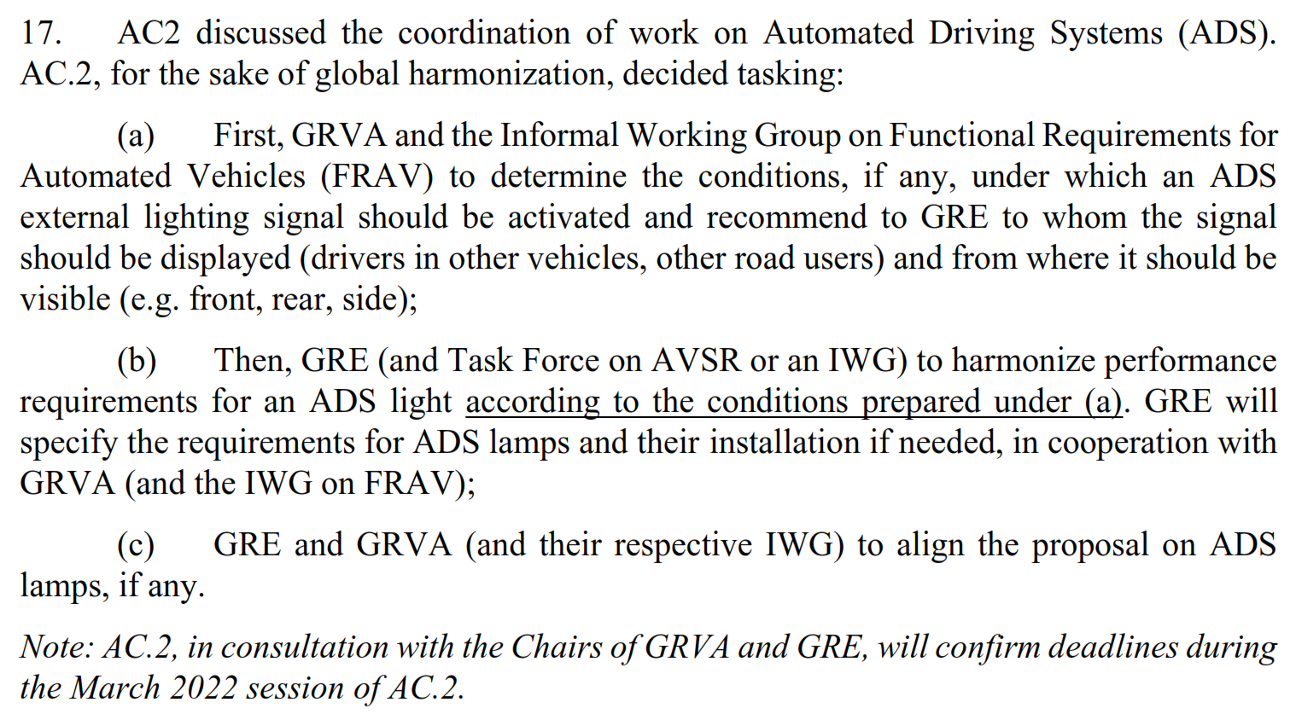
Agenda item 3
AC.2, GRVA, and GRE interaction
AC.2 to discuss deliverables and deadlines next March.
FRAV needs general view for 7-11 March WP.29 session.
  Relevant issues and time needed to fulfill item (a).
Considerations
  Benefits and/or risks of external signaling
  If signaling needed for safety:
    What might be signaled?
    Directed to whom?
    Visible from where? (Front, rear, side)
    Under what conditions?
    ORU workstream to elaborate?
November 2021 WP.29/AC.2 session
Input for AC.2 by the end of the next FRAV session (15-16 February)

Slide 7
Agenda item 4
Elaboration of Document 5
FRAV-24-05: Document 5 as submitted to GRVA
Detailed provisions outlined in Table 1 (Elaboration of recommendations)
  Workstream consensus on elements for main body
  FRAV decisions on measurable/verifiable criteria
List of open issues to be resolved
  Items to be resolved during FRAV sessions
  Items to be resolved via workstream discussions
Administrative issues raised by GRVA secretariat
  Editorial formatting (indent, margins, etc.)
  Figures must be editable
  Tables cannot have bullet points

Slide 8
Agenda item 4
Document 5 open issues
Document open to change with items for further consideration.
Inclusion of ODD in ADS definition (2.1.)
ADS determination that driver qualified (2.5.)
Differentiation of “dynamic control” and DDT (2.6., 2.7.)
Clarification of ORU (2.7.2.1.2.)
Consideration on animals (2.7.2.1.2.)
Clarify perception “in vehicle path” versus in vehicle environment (2.7.2.1.2.)
ADS conspicuity functions and relevance of “gesturing” (2.7.2.3.4.)
Fallback user: “Fallback-ready user” under SAE/ISO
MRC: Consideration of SAE/ISO definition
ODD: Inclusion of illustrative examples under definition
Clarification of operational and tactical function definition per literature (2.12., 2.17.)
Transition of control: Attention to verification of driver control by completion (2.18., 4.2.5.)
Further consideration of ADS user definition (2.19.)
ODD elements to be expanded and to be measurable/verifiable (3.3.)
Consider roles of traffic laws in defining readiness obligations of fallback users (3.4.3.1.)
Clarify manufacturer obligations in describing user roles and responsibilities (3.4.3.1.)
Clarify targets of user HMI information (3.4.3.5.)
Clarify addressable misuse and error foreseen by 4.2.3.
Address steps in transitions of control, including verification that user has assumed driver role/control of vehicle (4.2.5.)
Clarify intended recipients of information and tools for understanding ADS functionality and operation (4.2.7.)
Clarify 4.3.3. regarding ADS response to accident/collision.
Unauthorized modifications: consider tampering and unintentional/inadvertent (4.4.4.)
Clarify permission for continued operation in presence of fault/failure (4.4.5.)
Reconsider scope of maintenance—addressable outside FRAV? (4.5.)

Slide 9
Agenda item 5
Workstreams: Status and Plans
ADS performance of the DDT
  Derivation of specifications from detailed provisions
  Consideration of traffic scenarios
ADS interactions with other road users
  ORU properties, behaviors, and functions
  Detectable properties approach
  ORU framework proposal (FRAV-24-07)
ADS interactions with system/feature users
  Derivation of specifications from detailed provisions
  Applicability of scenarios
ADS performance data collection recommendations
  Illustration of ADS aspects and applicability (FRAV-24-08)

Slide 10
Agenda item 6
Expectations, objectives, and tasks
AC.2 input on external signaling for March WP.29
  Probability for inclusion and nature of possible needs
Deliverable(s) to May GRVA session
  Question concerning legal status of FRAV submission(s)
  Intentions vis-à-vis June WP.29 session
  Relationship with VMAD Master Document
Expectations for 2022
  Deliverable to September GRVA and November WP.29 (Expectations for elaboration of Document 5)
  Relationship with GRE AV signaling activity (if any)

Slide 11
Agenda item 7
Other business
SAE AVSC Best Practice for Evaluation of Behavioral Competencies for Automated Driving System Dedicated Vehicles (ADS-DVs)

Slide 12
Agenda item 8
Outlook for next steps
FRAV Calendar
Session 25: 15-16 February
[Session 26: 15-16 March]
[Session 27: 19-20 April]
[Session 28: 19-20 May]
Two-day February session to consider workstream and expert input:
Elaboration of Document 5
Proposals to address open issues
AC.2 input on external signaling
VMAD lane-keeping scenario feedback
Illustration for EDR/DSSAD
ORU framework
AVSC behavioral competencies

