Slide 1
OEDR Framework concerning interaction safely with other road users
Document FRAV-24-07
Submitted by the ORU safety workstream leader
24th FRAV informal group session, 8 February 2022
Backgrounds
Operational Design Domain (ODD)
Traffic Scenarios
Propose and Scope
Propose of this doc.
Things would address in this doc.
ORU Property based Approach
Other Road Users
physical
functional
behavioral
ORU
Properties of ORU
Levels of Safety risk
Object and Event Detection and Response (OEDR)
Requirement
Input to OEDR
Road Traffic Rules
(e.g. the right of way, safety margin, etc.)
…
Detection
Recognition
Classification
Tracking/ Prediction
(e.g. trajectory of object)
Tech. Regulations / Standards
Response (tactical and operational)
Best Practices / Guidelines

Slide 2

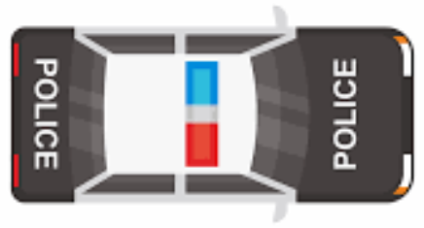


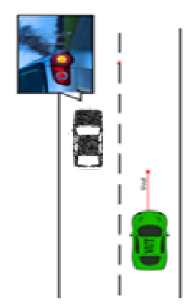
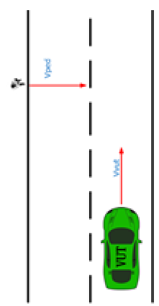

Example 1:
Ego vehicle lane keeping while encountering the priority vehicle ^{[1]}
Example 2:
Ego vehicle turning at intersection while encountering other road user ^{[2]}
Ego | w TOR | w/o TOR
Detection | √ | √
Recognition | √ | √
Classification | √ (in task) | √ (in task)
Tracking/ Prediction |  | √
Response | Ego issues TOR | Ego gives the right of way
Ego | w & w/o TOR
Detection | √
Recognition | √
Classification | √ (normal vehicle)
Tracking/ Prediction | √ (the trajectory of object vehicle)
Response | Ego maintains the safe time margin with the object when passing through the intersection area
Example 3:
Ego vehicle lane keeping while encountering front vehicle turning^{[3]}
Example 4:
Ego vehicle lane keeping while encountering a VRU crossing^{[3]}
Ego | w TOR | w/o TOR
Detection | √ | √
Recognition | √ | √
Classification | √ (normal vehicle) | √ (normal vehicle)
Tracking/ Prediction | √ | √
Response | Ego issues TOR | Ego slow down until the completion of ORU turning
Ego | w TOR | w/o TOR
Detection | √ | √
Recognition | √ | √
Classification | √ (VRU) | √ (VRU)
Tracking/ Prediction | √ | √
Response | Ego issues TOR | Ego slow down until the completion of VRU crossing
Ego vehicle
Other vehicles part of the scenario
pedestrians
[1] GRVA-12-23, 2.14 [2] GRVA-12-23, 2.13 [3] FRAV-17-09

Slide 3
The detailed provisions under the OEDR Framework would be:
No. | Safety Recommendations | Detailed Provisions (under discussion)
The ADS should drive safely (based on the informal document GRVA-12-23)
3 | The ADS shall detect and respond to objects and events relevant to its performance of the DDT. | Objects and events might include, but are not limited, to: Vehicles, motorcycles, bicycles, pedestrians, obstacles Road accidents Road safety agents / enforcement agents Emergency vehicles The ADS shall detect objects in and around its path of travel that exceed a minimum size. The ADS shall recognize objects as static or mobile. The ADS shall recognize markings and signals used to indicate priority vehicles within the ODD of its feature(s). The ADS shall classify priority vehicles within the ODD of its feature(s) in accordance with the relevant traffic law(s). The ADS shall yield the right of way to priority vehicles in service in accordance with the relevant traffic law(s). -> The ADS shall respond the priority vehicles appropriately in accordance with the relevant traffic laws, the response may include: Issuing a transition demand if the ADS permits a transition of control, or Giving the right of way to the priority vehicle
5 | The ADS shall interact safely with other road users. | The ADS shall avoid collisions with safety-relevant objects where possible. -> The ADS shall maintain the safe time margin with the object when passing through the intersection area The ADS shall signal intended changes of direction. The ADS shall signal its operational status (active/inactive) as needed.

Slide 4
Next step & plan:
Build out OEDR framework based on FRAV discussion and experts’ suggestions;
  ORU properties;
  OEDR hierarchy requirements;
  External signaling issues;
  …
Elaborate pending issues related to ORU:
  Clarification of ORU
  Consideration on animals
  …

