Slide 1
Transitions of Control:
ADS Data Elements Illustration
Submitted by the ADS data collection workstream leader
Document FRAV-24-08
24th FRAV informal group session
8 February 2022
FRAV/VMAD/EDR/DSSAD Complementarity

Slide 2
Transitions of Control: FRAV draft provisions (subject to change)
An ADS which permits a transition of control shall be designed to ensure safe transitions of control. (4.2.5.)
“Transition of control (TOC)” means a procedure by which the ADS engages the fallback user in dynamic control of the vehicle such that the fallback user assumes the role of driver upon completion. (2.18)
“Fallback user” means a user designated to assume the role of driver upon completion of a transition of control. (2.9.)
“Driver” means a qualified human being engaged in dynamic control of the vehicle. (2.5.)

Slide 3
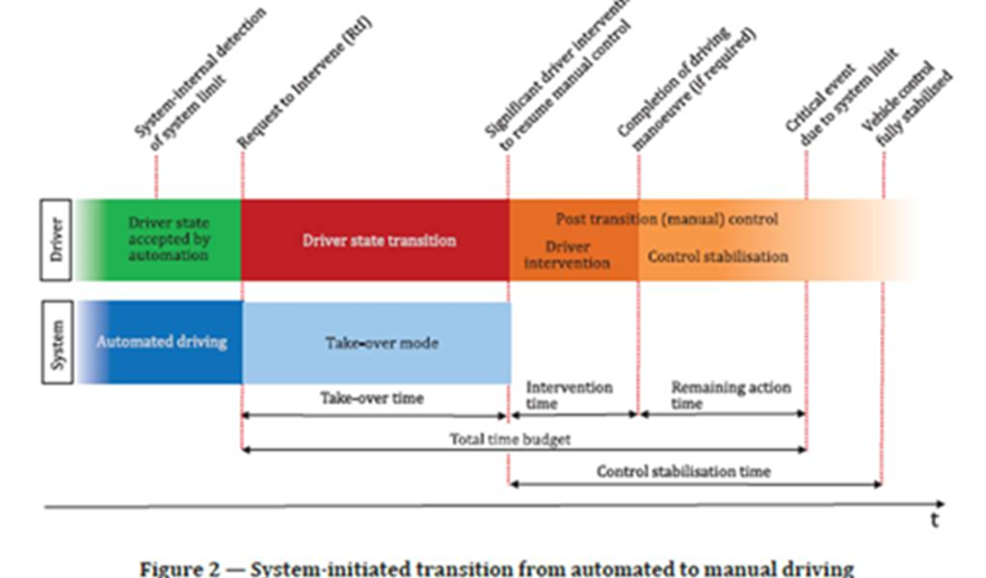
Commonality of transition steps
The interaction shall follow a common sequence of actions and states in the transition of control (change of user roles)

Slide 4
Logically Derived TOC aspects
TOC trigger (something initiates transition sequence)
  User intervention
  ODD exit
  System fault
Transition demand issued if ADS initiated TOC
Evaluation of user inputs (verification of stable control)
TOC completed
}
Only these triggers initiate a transition demand from the ADS.

Slide 5
Sequence Elements Raised in FRAV Discussions
User intervention
ODD exit condition
DDT-critical fault
Advance transition notifications
  Delayed user response
Transition demand
User input verification
  Inadequate or no user response
Delayed response to user intervention due to safety condition
TOC complete
Fallback to minimal risk condition

Slide 6
Data Elements Considerations
TOC only applicable to ADS designed for use with a fallback users.
TOC involve identifiable steps or elements, but TOC sequences differ depending upon conditions and user responses.
  User or ADS initiated
  Advance notifications
  Adequate or inadequate user inputs
  TOC may be unsuccessful requiring fallback to MRC
Objectives and use of data differ between EDR and ISMR
  EDR for crash analysis by safety authority (e.g., specific elements of TOC sequence relevant to causation chain).
  ISMR involves manufacturer reporting of performance metrics (e.g., frequency of unsuccessful TOC).
Nonetheless, data elements may be identical for EDR and ISMR

Slide 7
Complementarity Across Informal Groups
EDR/DSSAD can propose data elements.
FRAV can propose safety specifications.
VMAD can propose performance metrics.
Each group can benefit from the views of the others.
The critical need is to ensure consistency and alignment.
  Terms and definitions
  Data elements and requirements for ADS behaviors and actions
  Data elements should enable reporting on performance metrics

