Slide 1

Specific driving data in heavy duty vehicles
for accident reconstruction
- What is needed to analyse the cause of accidents -
Dr. Dipl.-Ing. Michael Weyde
Publicly appointed and sworn in Expert
for Accident Reconstruction and Evaluation of Accident Data Storage Systems
Member of the Board of the European Association for Accident Research and Analysis, EVU

Slide 2
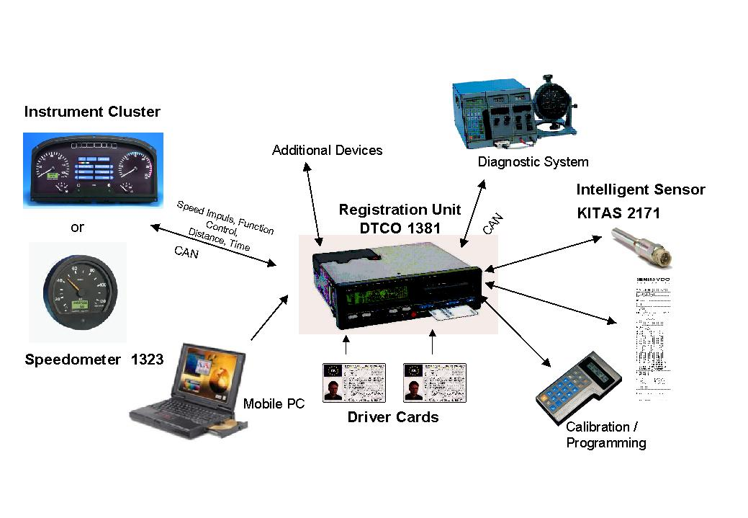
Status Quo
Since the 1970s, there have been regulations in the EU for the installation of control devices in vehicles for the transport of goods from 3.5 tons permissible total weight and in vehicles for the transport of people with more than 9 people, if the vehicle is used commercially and driving time is not monitored by different means
Digital tachograph since 2002, but only for passenger vehicles with more than eight seats in addition to the driver's seat and a maximum mass of more than 10 t and for vehicles for the carriage of goods with a maximum mass of more than 12 t. (EWG) Nr. 3821/85
• Identification data of the digital tachograph and the distance and speed sensor
• all drivers who drove the vehicle and identified themselves with the chip card within the last 365 days
• the driver's activities (driving, work, availability and rest times) incl. start and end of the daily work period
• Speed data for the last 24 hours in second resolution
• Exceeding the speed when the speed limiter is set
• calibration/programming data, controls and downloads carried out
• Errors in the system
• since 2019 (EU Regulation 165/2014):
Occasional geolocation data to check the speed data
Source: Continental AG
Notes:
2

Slide 3
What other driving data is there in trucks?
Assignable event data memories can be found in:
Airbag-CU (rarely installed)
Engine-CU (little accident-relevant information)
Brake-CU (especially in trailers, but only if equipped with ABS / ESC)
Emergency-Braking Systems / turning assistant systems
Radar / camera module (distance sensors)
Navigation devices / logistic tools
Dash-Cams
… how ever, some of them can only be read out completely by vehicle or system manufacturers

Slide 4
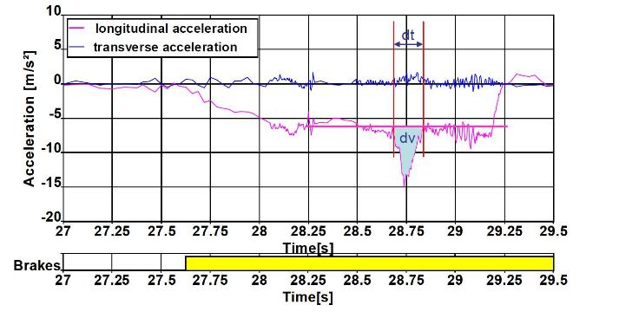
How to detect an Impact?
U.S. regulation CFR 49 Part 563 defines
an EVENT (i.e. crash) by delta-V
Delta-V is not measured, but calculated
by the product of time and acceleration
In passenger cars, it is possible to detect even small impacts by evaluating acceleration („JERK-DETECTION“)
Neither deceleration nor the jerk or the delta-V on it‘s own is suitable to differentiate a small impact from normal driving of a HDV
Source: EUROPEAN COMMISSION
DIRECTORATE-GENERAL FOR ENERGY AND TRANSPORT

Slide 5
Preliminary remarks:
In HGV, an impact will not only be recognizable from acceleration or change in acceleration
It takes other triggers to recognize an impact
But, if there is no acceleration-data (longitudinal & lateral), neither trajectory curve nor collision speed is not to be reconstructed suffenciently
a sample rate of 2 Hz is too low for pre-crash data,
especially for vehicle speed, but also for status data like steering wheel angle, acceleration and brake pedal

Slide 6
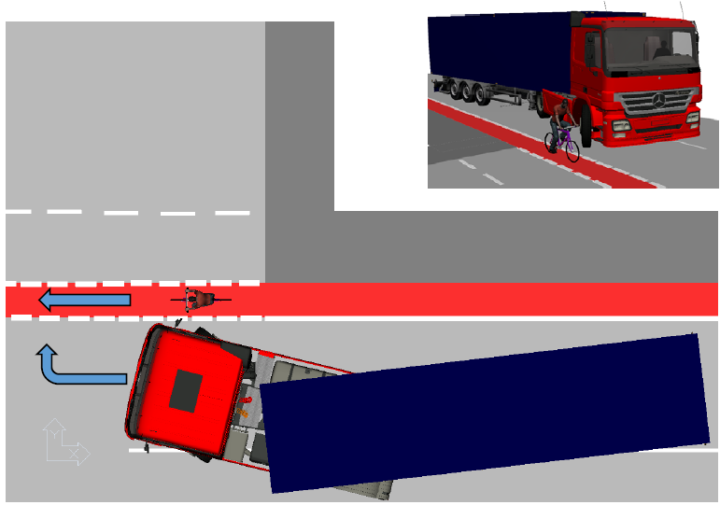
Typical conflict situation between HGV and VRU, e.g. cyclists

Slide 7
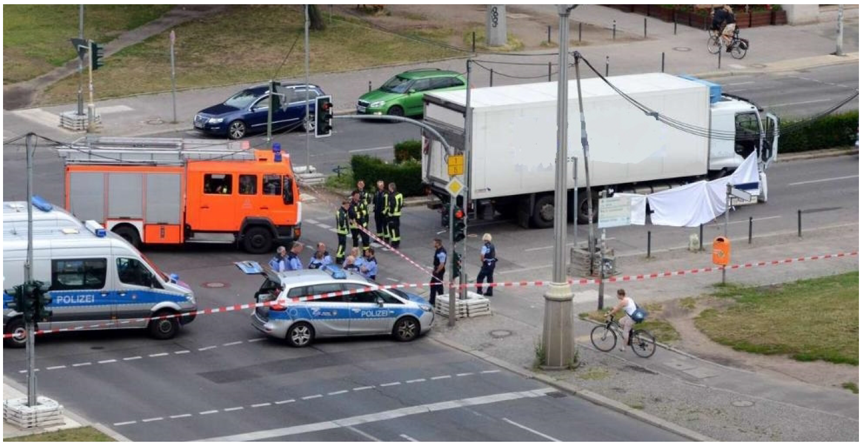
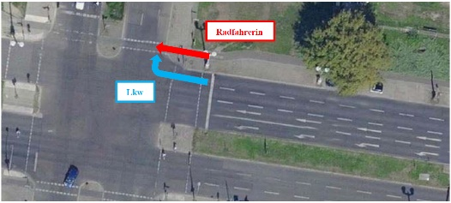
Case Study
Overview of the Accident site
Cyclist
HGV
Bild: AERO VIEW

Slide 8
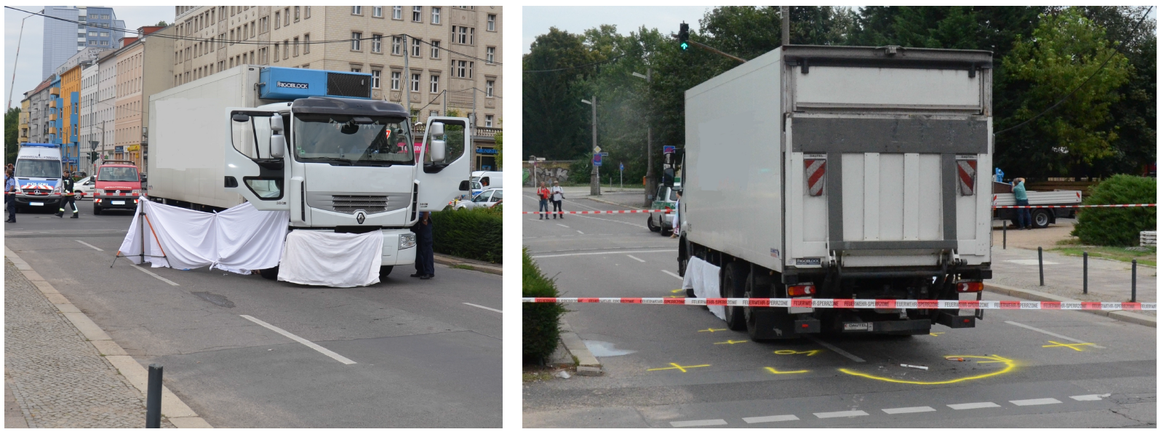
Case Study
Final position of the Truck with cyclist under the truck
Bild: Ing.-Büro Dr. Weyde, Berlin
Bild: Ing.-Büro Dr. Weyde, Berlin
Bild: AERO VIEW

Slide 9
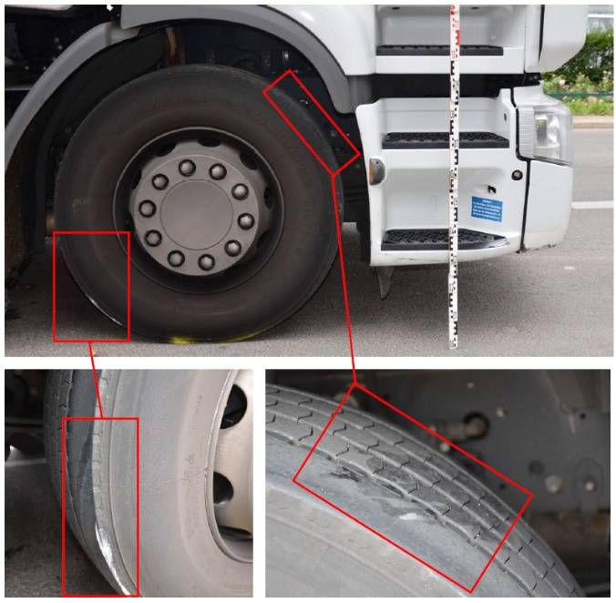
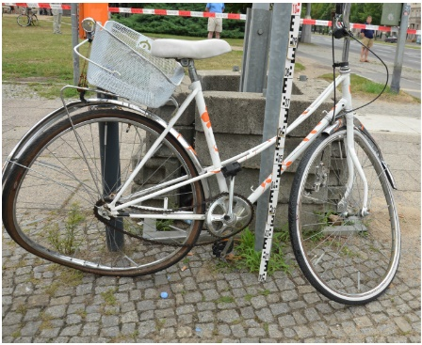
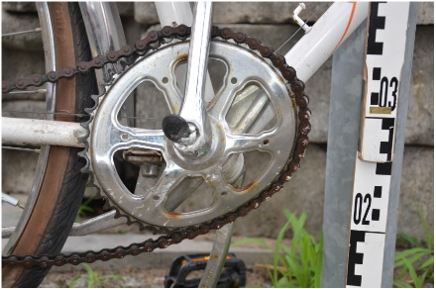
Case Study
Contact marks on the right front wheel and the right side of the truck
Damage to the bicycle
Bild: Ing.-Büro Dr. Weyde, Berlin
Bild: AERO VIEW
Bild: Ing.-Büro Dr. Weyde, Berlin
Bild: Ing.-Büro Dr. Weyde, Berlin

Slide 10
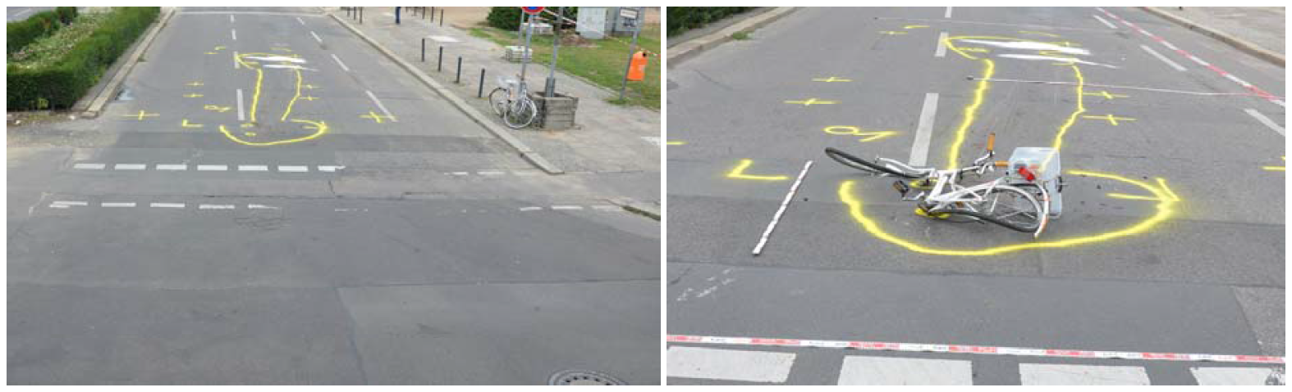
Case Study
Location of traces at the accident site (left) and assignment of the notch and scratch marks
Bild: Ing.-Büro Dr. Weyde, Berlin
Bild: Ing.-Büro Dr. Weyde, Berlin
Bild: AERO VIEW

Slide 11
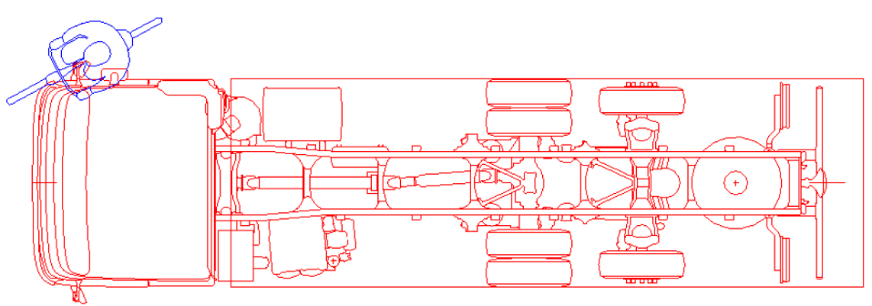
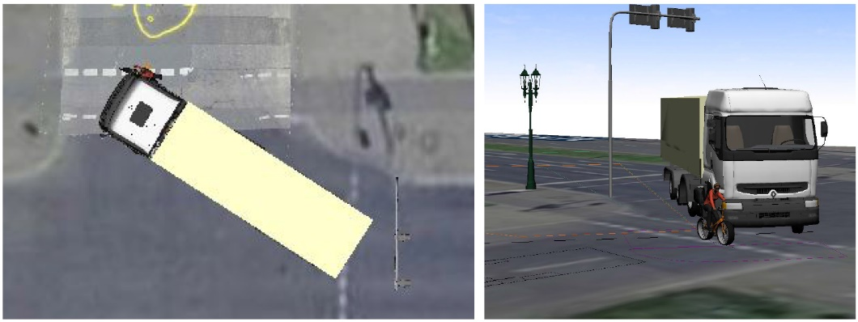
Case Study
Relative Collision Position
Possible absolute Collision Position (not proofed, because no information on steering)
Bild: AERO VIEW

Slide 12
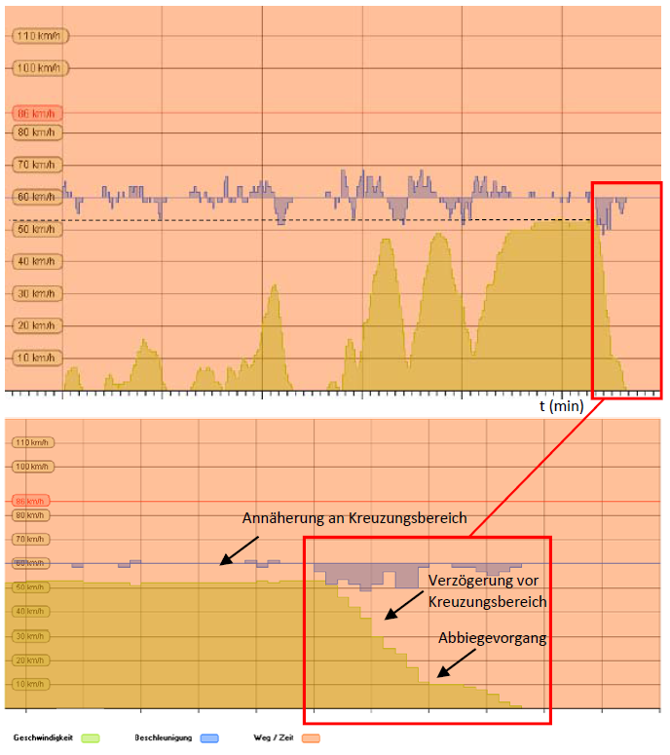
Case Study
Evaluation of the digital tachograph
Wheel-Speed
Approaching the intersection
Calculated Wheel acceleration
Decelerating before turning, less than 4 m/s²
time
Bild: AERO VIEW
Bild: Ing.-Büro Dr. Weyde, Berlin
Turning, at a speed of ca. 10 km/h

Slide 13
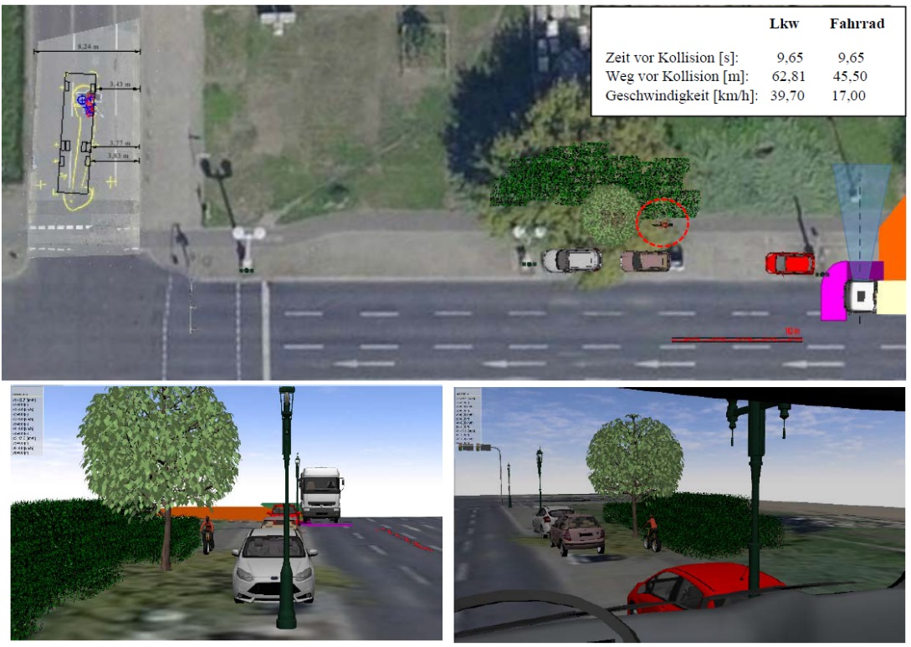
Case Study
Possible Approach to the intersection (t = -9,6s), but we do not really know, where the cyclist was, without having ambient data of sensors or cameras
Bild: Ing.-Büro Dr. Weyde, Berlin
Bild: AERO VIEW

Slide 14
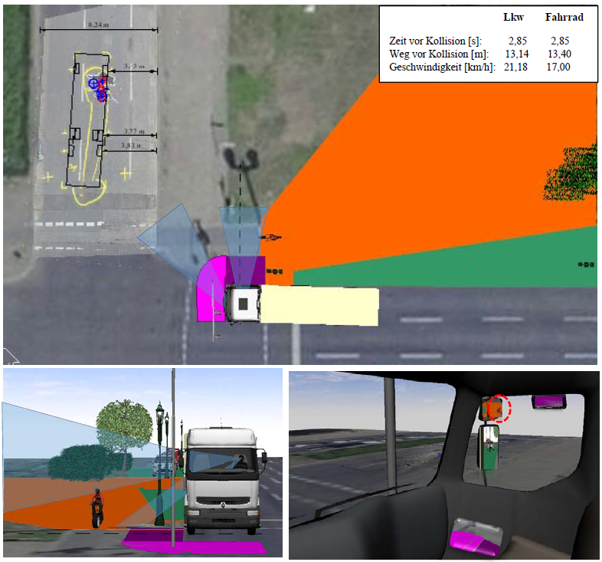
Case Study
Possible Approach to the intersection (t = -2,8s), but we do not really know, where the cyclist was, without having ambient data of sensors or cameras
Bild: Ing.-Büro Dr. Weyde, Berlin
Bild: AERO VIEW

Slide 15
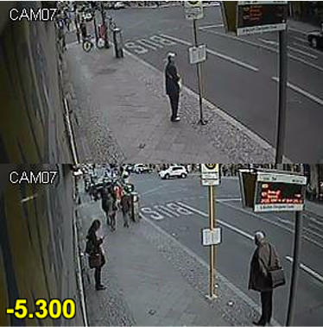
Further Case Studys
Bild: Ing.-Büro Dr. Weyde, Berlin
Bild: AERO VIEW

Slide 16
Interim Conclusions:
Structure-borne noise sensors on different protruding external components could detect an impact on the HGV and would help not only to detect slight impacts, but also to prevent trucks from rolling over VRUs
Even a sample rate of 2 Hz (0,5 s per sample) might lead to miss-interpretation and wrong jurisprudence, because for instance braking shortly before an impact will not be recognized
In addition to the speed, the steering wheel angle, the accelerator- and brake pedal must be recorded in an EDR of trucks
Correspondent to typical times for driving actions the sample rate of speed and status data should be 10 Hz (0,1 s per sample)
Acceleration (longitudinal and lateral) should also be recorded pre-crash with 100 Hz, in order to prove the vehicle‘s speed redundantly from its wheel speed

Slide 17
What do you need for accident reconstruction?
Measurements that show how the vehicle moved (kinematics)
- Acceleration (longitudinal, lateral and vertical)
- Rate of rotation (pitch, roll and roll angles)
- Wheel speed
- Differentiable status information about the operation of:
- Steering (e.g. steering angle on steering wheel or wheels)
- Brake (e.g. brake pedal position and/or pressure)
- Aaccelerator pedal and throttle position
- Geo-Position-Data
- Reliable information about possible measurement or status errors
- Ambient data (e.g. photos, videos and/or measured values from distance sensors) to determine the correctness of a controlling intervention [both on the driver and on the vehicle side]

Slide 18
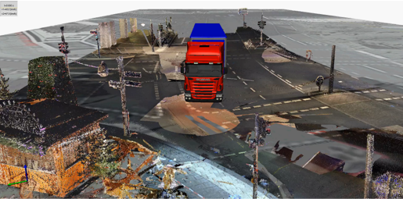
Nowadays, it needs a cooperation of different disciplines to allow an accident investigation, which bids the doubts to remain silent
Numerical Simulation on the basis of driving data from ESC-Brake-Control Unit, digital tachograph and traces on the scene, documented by Police Laserscan & pictures
Complete clarification of the movements through:
Surveying and documentation of all traces by the police (geodesists at State Police)
Registration and assignment of injuries by forensic pathologists
Reading and evaluating driving data (i in particular from the Brake Control Unit of the trailer [rollover stability system], digital tachograph, geo-positions from logistics software) partly only possible in cooperation with vehicle or system manufacturers

Slide 19
Legal uncertainty due to incomplete and misinterpreted EDR data
Not only for a correct jurisprudence but also for research reasons it is important to understand, what the driver had actually done before the impact, therefore the sample rate of pre-crash data should be higher than usual human action routines in driving

Slide 20
Interim Conclusion:
Even a sample rate of 2 Hz (0,5 s per sample) might lead to miss-interpretation and wrong jurisprudence, because for instance braking shortly before an impact will not be recognized
Correspondent to typical times for driving actions the sample rate of speed and status date should be 10 Hz (0,1 s per sample) prior to impact - Accuracy of synchronisation must be similar!
Acceleration (longitudinal and lateral) should also be recorded pre-crash with 100 Hz, in order to prove the actual vehicle speed redundantly from its wheel speed
Delta-V is not usefull to detect an impact against an HDV, thus we need different triggers for crash detection

Slide 21
Conclusions and Outlook:
- We have to find suitable trigger options for recognizing
even slight impacts against Heavy duty vehicles
- Use of sensors from emergency braking systems to detect impacts and dangerous situations or nearby-collisions could be helpful
- Structure-borne noise sensors could be used in the future
- Storage of driving data before the last 5 standstills can be a temporary solution in the meantime
… thank your for your attention!!!

