Slide 1
Particle emissions from Tyre and brake wear on-going literature review
Sustainable Transport Unit
Institute for Energy and Transport
Joint Research Centre
8 January 2014

Slide 2
ON-GOING LITERATURE REVIEW
Approximately 100 peer-reviewed papers
10 papers presented in international conferences
Several intermediate and final research project reports
Technical publications from brake and tyre companies
Several licentiate and doctoral thesis

Slide 3
MOST IMPORTANT FINDINGS
Importance of wear particles
Physicochemical characteristics of wear particles
Possible health effects of wear particles

Slide 4
IMPORTANCE OF WEAR PARTICLES

Slide 5
NON EXHAUST EMISSIONS - IMPORTANCE
Exhaust and non-exhaust sources are estimated to contribute almost equally to total traffic-related PM₁₀ emissions (2010)
The relative contribution of non-exhaust sources is expected to increase the forthcoming years due to the tendency of decrease of exhaust emissions
Contributions of specific sources to non-exhaust traffic-related PM₁₀ emissions
Source | PM₁₀ (%)
Brake Wear | 16-55*
Tyre Wear | 5-30**
Resuspension | 28-59
* Significantly lower contributions have been reported in freeways (~ 3%)
** Many studies don’t distinguish from road wear

Slide 6
NON EXHAUST EMISSIONS - IMPORTANCE
Tyre wear particles are estimated to be 0.8-7% by mass of ambient PM₁₀, depending on several parameters. This corresponds to ambient concentrations of 0.2-11 μg m⁻³. Higher contributions have been reported with studded tyres
Road dust resuspension contribution to ambient PM₁₀ account for 1–10 µg m⁻³ in European countries (5-6 µg m⁻³) and up to 9–24 µg m⁻³ in Nordic countries, depending on the sampling site and environmental conditions

Slide 7
NON EXHAUST EMISSIONS – GENERAL DIFFICULTIES
Different sampling methodologies applied resulting in non comparable or even contradictory conclusions
Break wear (BW) debris content differs from the bulk material & depends:
Conditions under which
braking event occurs
Driving behavior
Tyre Wear (TW) particles content and generation rates depend upon:
Tyre characteristics
Road surface characteristics
Vehicle characteristics
Vehicle operation
The amount of resuspended road dust particles mainly depends upon:
Traffic density
Street maintenance
Meteorological parameters
Vehicles’
type & operation

Slide 8
PHYSICOCHEMICAL CHARACTERISTICS OF WEAR PARTICLES

Slide 9
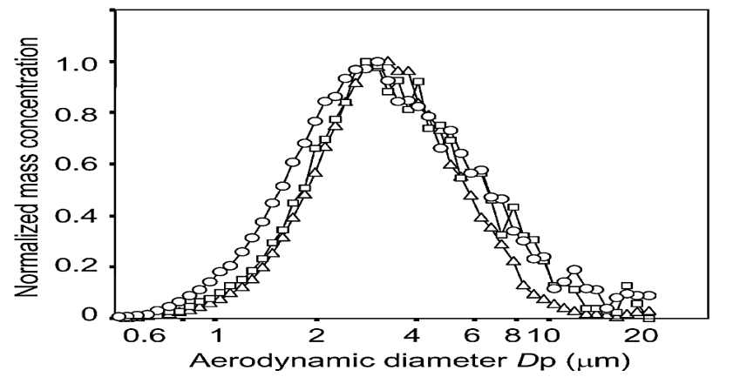
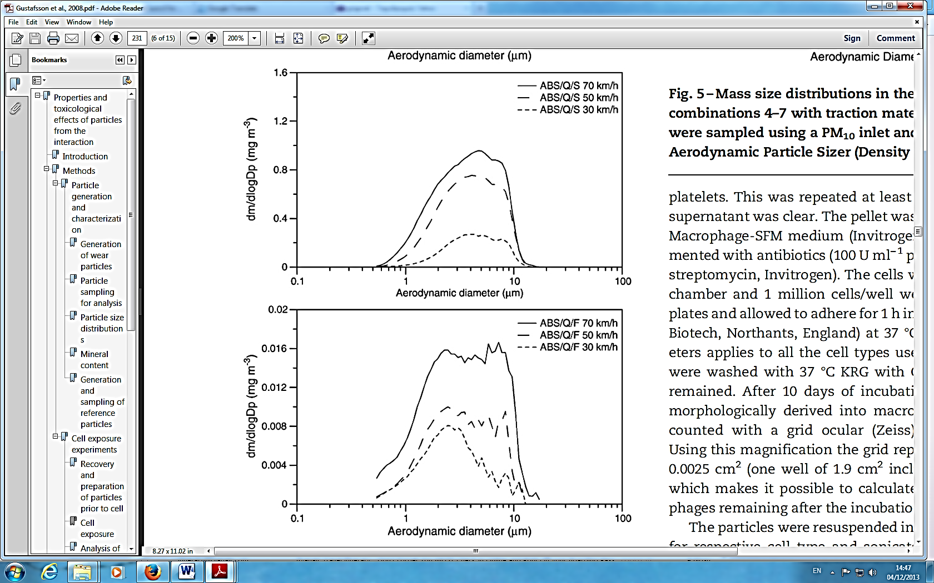
BRAKES
TYRE AND BRAKE WEAR – MASS SIZE DISTRIBUTIONS
TYRES
50% of generated BW particles (mass) become airborne. Among these 80% are PM_{10.} The rest may deposit on the road or nearby
Mass weighed mean diameters of 2-6 μm have been reported
0.1-10% by mass of generated TW particles is emitted as PM₁₀
TW mass distributions appear a clear mode at 50-80 μm, while PM₁₀ mass distribution is bimodal with peaks at 2-3 μm and 5-9 μm
Aerodynamic Particle Sizer
Aerodynamic Particle Sizer
[Example adopted from Iijima et al., 2007]
[Example adopted from Gustafsson et al., 2008]

Slide 10
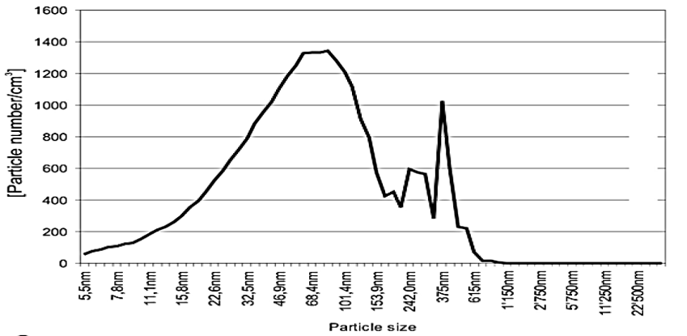
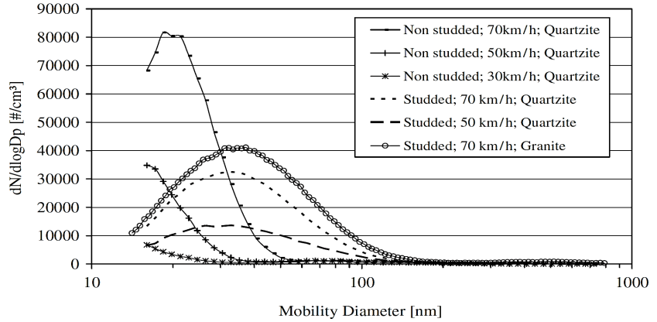
BRAKES
TYRE AND BRAKE WEAR – NUMBER SIZE DISTRIBUTIONS
TYRES
BW PN distributions appear to be bimodal with both peaks lying within the fine mode
Some studies report 1st peak at the UF size, while others find at ~ 350 nm
PN distributions are unimodal. Some studies report a peak at the UF size (~ 15-50 nm), while others mention that under “normal” driving conditions no UF particles are emitted
Transmission Electron Microscope
Scanning Mobility Particle Sizer
[Example adopted from Gasser et al., 2009]
[Example adopted from Dahl et al., 2006]

Slide 11
TYRE AND BRAKE WEAR - CHEMICAL CHARACTERIZATION
Most important chemical constituents of wear particles
 | PM_{2.5} | PM_{2.5-10} | Wear particles
Brake Wear | Transition metals (Cu, Fe), Sb (III, V), Sn, Ba, Zr, Al, S, OC>>EC | FeO, Fe₂O₃, Cu oxides, Sb (III), Sb (V), Sn, Ba, Zr, Al | Cu, Fe, Sb (III, V), Sn, Ba, Zr, Al, S, PAHs, n-alkanes, n-alkanoic acids, benzaldehydes
Tyre Wear | Zn, organic Zn, Cu, S, Si, Organic compounds, EC | Zn, organic Zn, Cu, Si, Mn | Zn, Cu, S, Si, PAHs, benzothiazoles, natural resins, n-alkanes, EC
NEED FOR: Identification of organic constituents in PM₁₀ brake and tyre wear particles and investigation of the chemical composition of modern lining materials

Slide 12
TYRE AND BRAKE WEAR – EMISSION FACTORS
EFs derived from road simulation studies
EFs derived from receptor modeling
 | PM_{2.5} (mg km⁻¹ veh⁻¹) | PM₁₀ (mg km⁻¹ veh⁻¹)
Brakes LDV | 2.1-5.5 | 2.0-8.0
Tyres* LDV | ⁻ | 3.5-9.0
 | PM_{2.5} (mg km⁻¹ veh⁻¹) | PM₁₀ (mg km⁻¹ veh⁻¹)
Brakes LDV | 0.0-5.0 | 1.0-8.8
Tyres* LDV | 0.3-5.0 | 6.0-13
* Friction tyres
* Friction tyres
Brake and tyre wear PM₁₀ EFs of HDVs are estimated to be approximately one order of magnitude higher compared to LDVs
Much higher PM₁₀ EFs have been reported in case of studded tyres
Most commonly used key tracers of BW are Cu and Sb, while for TW Zn, benzothiazoles and SBR

Slide 13
HEALTH RELEVANCE

Slide 14
BRAKE WEAR – HEALTH RELEVANCE
BW contains particles from all fractions involved in the respiratory function
Most particles generated from BW lie in the PM_{2.5} fraction with a significant number being in the UF fraction
[Poepping et al., 2010]
Some chemical constituents of airborne BW particles have been recognized as dangerous or potentially dangerous for humans
Antimony
Sb₂O₃ possible lung carcinogen
Transition metals
Oxidative Stress
Carbonaceous species
Pro-inflammatory responses

Slide 15
TYRE WEAR – HEALTH RELEVANCE
Most studies examine TW related health effects in relation to the pavement wear, so the responses are not directly connected to tyres
Some constituents of airborne TW particles have been recognized as dangerous or potentially dangerous for humans
Transition metals
Oxidative Stress
Zinc
Respiratory problems
Organic compounds
Probable carcinogens (PAHs),
DNA and cell damage
Direct in-vitro and animal studies with TW particles deriving from friction tyres have reached contradictory conclusions
Some studies suggest that natural rubber latex proteins in TW increase latex allergy and asthma symptoms, while others mention that the levels of these proteins in air are very low

Slide 16
CONCLUSIONS
Brake and tyre wear contribute to ambient PM₁₀ and PM_{2.5}. Their relative contribution to traffic related emissions is expected to increase in the forthcoming years
50% of brake wear and 90% of tyre wear is deposited on the road or nearby, with its fate have not yet been well investigated
The physicochemical characteristics of tyre and brake wear PM₁₀ are not completely understood
There are no comprehensive studies linking brake or tyre wear particles with adverse effects on human health

