Slide 1

26th Session
Status Review and Session Orientation
Document FRAV-26-03
Web Conference
15-16 March 2022

Slide 2
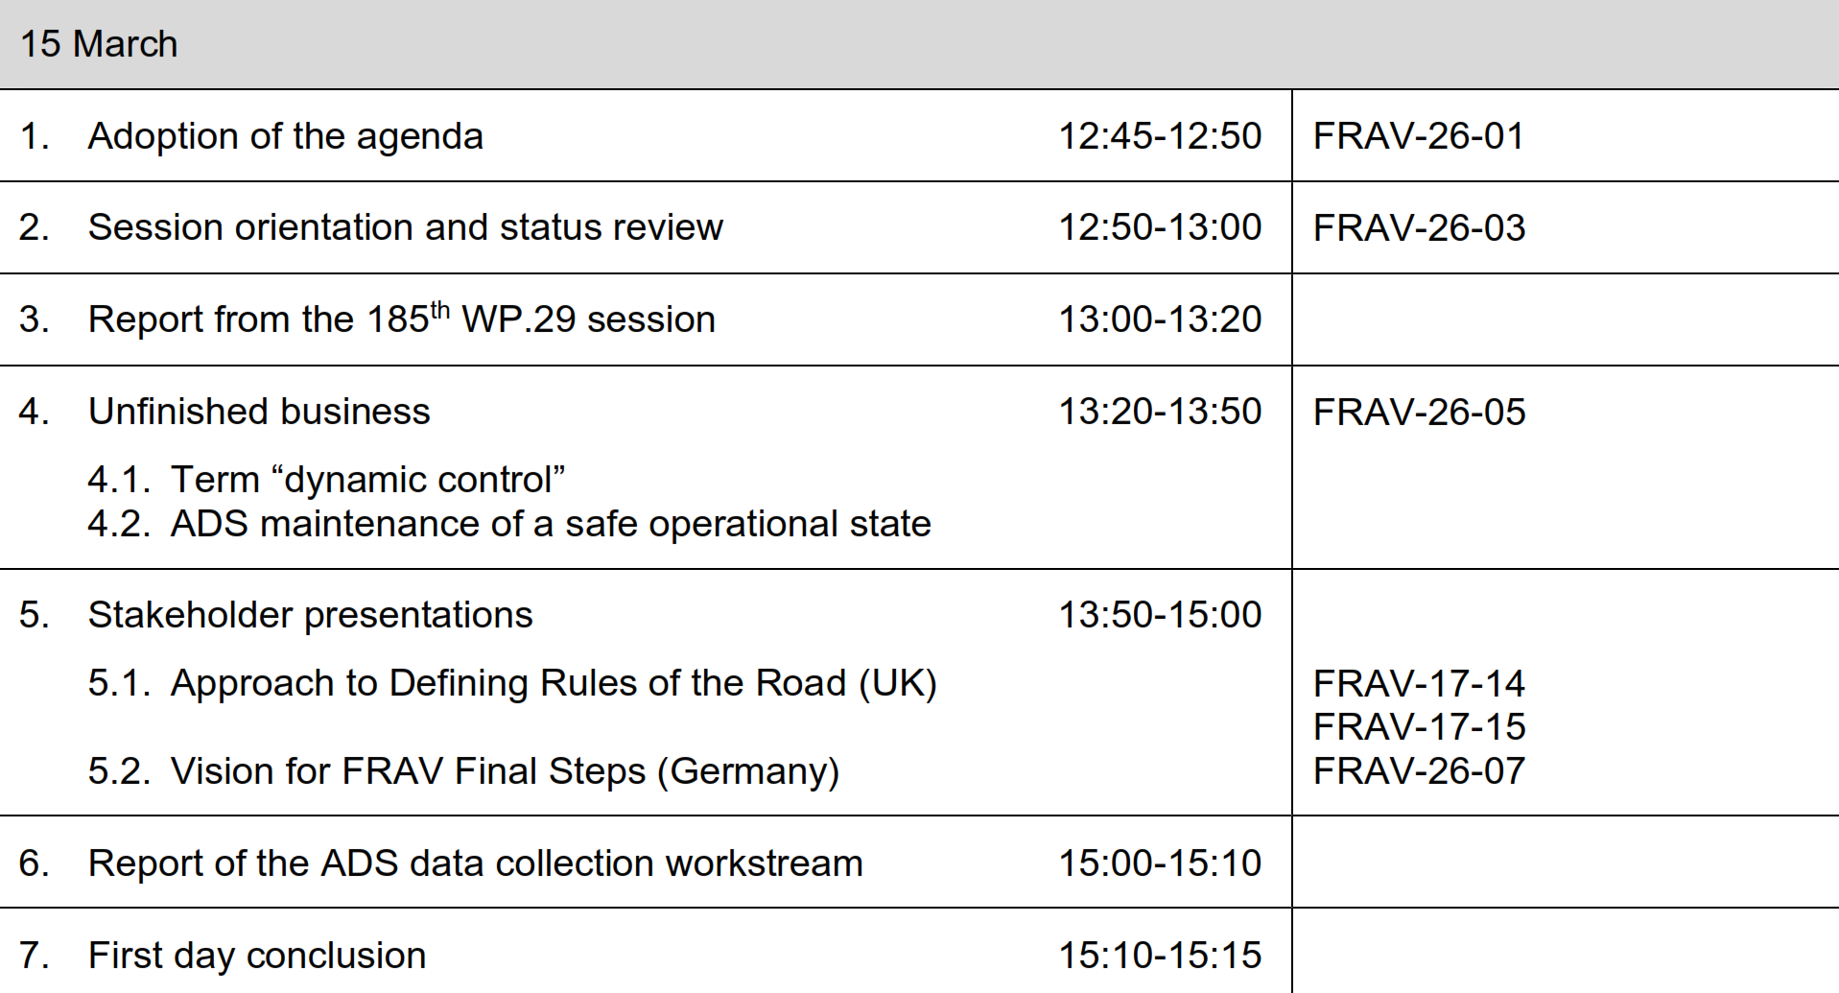
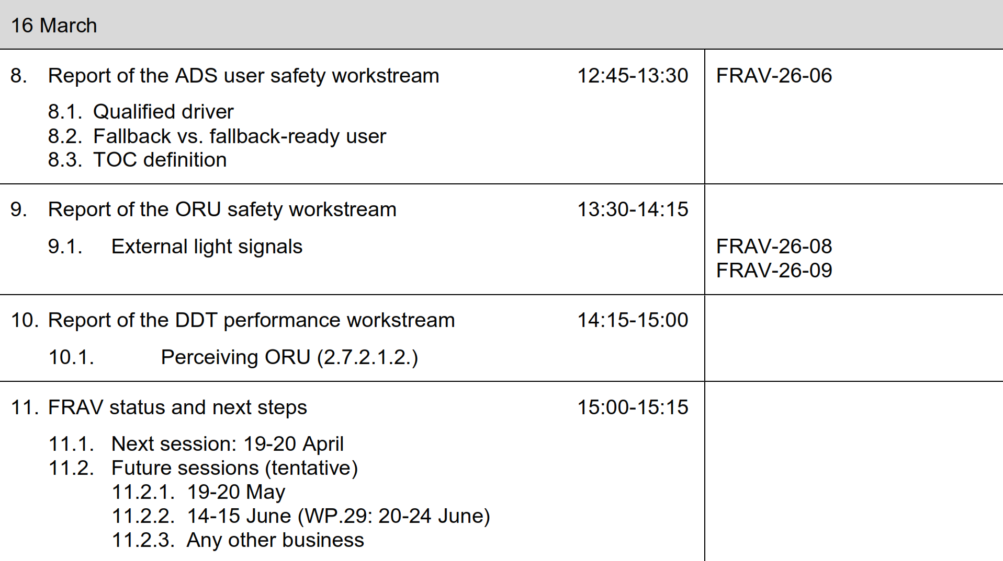
Agenda item 1
Adoption of the agenda
Resolve pending open issues, consider path forward to meet verifiable requirements objectives, review workstream efforts and proposals for Document 5.

Slide 3
Agenda item 2
FRAV status
Reviewed Document 5 (D5)
  Discussed, resolved, and allocated remaining open issues in text
    Introductory text to place “requirements” within context of “recommendations”
  Ongoing work to reach verifiable safety requirements
Agreed on FRAV input to VMAD Scenarios subgroup (SG1)
  FRAV-24-06 (ADS users mapping to “lane-keeping” scenario)
  FRAV-25-08 (SAE input on mapping processes)
  FRAV-25-11 (CLEPA detailed input on mapping requirements and scenarios)
Agreed on FRAV input to EDR/DSSAD on data collection example
  Illustrate FRAV recommendations based on transitions of control
  TOC involve sequences of ADS actions (user notification, verification of responses, TOC completion, etc.)
  Sequences differ (user-initiated/ADS-initiated, relevant notifications, responses, successful/unsuccessful, etc.)

Slide 4
Agenda item 3
Report from WP.29 March session
General comments
AC.2 discussion of GRVA-GRE coordination on light signaling
  GRVA/FRAV Determine conditions, if any, under which an ADS external lighting signal should be activated and recommend to GRE to whom the signal should be displayed and from where it should be visible November 2022
  GRE/AVSR Harmonized performance requirements for an ADS light signal according to the conditions prepared under (a) … in cooperation with GRVA November 2023
  GRVA/FRAV and GRE/AVSR alignment and proposal to WP.29 March 2024
  GRVA to inform WP.1/GE.3 on ADS light signaling work

Slide 5
Agenda item 4
Unfinished business
“Dynamic control”
  D5, para. 2.6. defines “dynamic control” (the real-time execution of operational and tactical functions required to operate a vehicle based on perception, information processing, and decision making)
  D5, para. 2.7. defines DDT (the real-time operational and tactical functions required to operate the vehicle)
  Originated with WP.1 in lieu of DDT—Proposal tabled to remove term.
ADS maintenance of safe operational state
  Originated with AV Framework Document (WP.29/2019/34/Rev.1) Vehicle maintenance and inspection: Vehicle safety of in-use vehicles should be ensured through measures such as related to maintenance and the inspection of automated vehicles etc. Additionally, vehicle manufacturers are encouraged to have documentation available that facilitates the maintenance and repair of ADSs after a crash. Such documentation would likely identify the equipment and the processes necessary to ensure safe operation of the automated/autonomous vehicle after repair.
  Should D5 cover in-use safety and if so, what should be the focus/scope?

Slide 6
Agenda item 5
Stakeholder presentations
Definition of Rules of the Road (UK)
  UK presented an approach to defining ADS performance in terms of “rules of the road” during the 17th session (July 2021: FRAV-17-14 and -15)
  UK would like to further discuss this approach.
Vision for FRAV Final Steps
  FRAV has agreed to develop D5 requirements to reach verifiable specifications
  Germany has prepared input towards achieving this objective (FRAV-26-07)

Slide 7
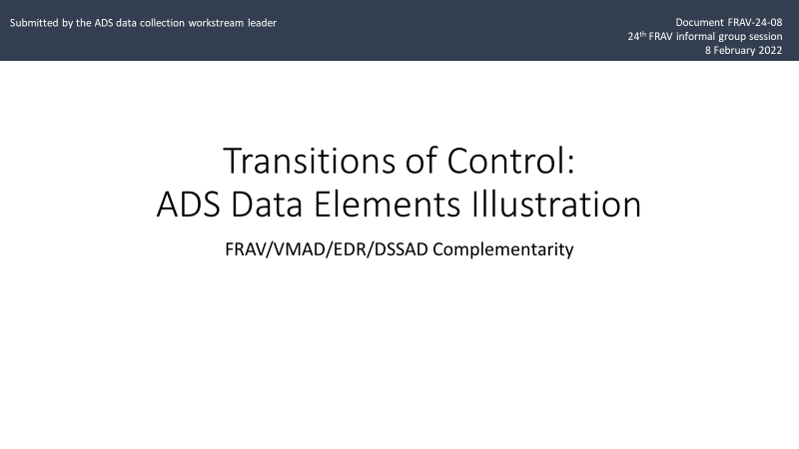
Agenda item 6
EDR/DSSAD feedback
Illustration of FRAV recommendations
  Based on transitions of control (TOC)
  Highlight views on ADS data elements
Main points
  TOC apply to subset of ADS.
  TOC involve action sequences (initiate, verify response, etc.).
  Sequences will differ (user or ADS-initiated, successful or unsuccessful, etc.).
  FRAV and EDR/DSSAD should regularly share draft documents to ensure consistency and compatibility.
EDR subgroup postponed
ADS discussions to 22 March.

Slide 8
Agenda item 8
ADS user safety workstream report
Unfinished business
  FRAV reviewed D5 during previous session and referred the following
    Use of “qualified” in definition of driver—What is its meaning and how to address?
    “Fallback-ready user”—How to address “readiness” of “fallback user”? This includes attention to 3.4.3. on fallback user information and to possible readiness requirements under ADS user safety (4.2.).
    Transition of control—Concept that TOC involves sequence of elements resulting in driver control of the DDT. Further consideration of concept towards understanding safety requirements and refining TOC definition accordingly.
Workstream report on latest deliberations
  Proposals for changes to D5 (FRAV-26-06)
  Follow-up on consideration of VMAD pillars and scenarios application to user safety requirements.

Slide 9
Agenda item 9
ORU safety workstream report
FRAV has discussed interest in external light signaling, especially to inform ORU on ADS operational status.
  Potential safety needs of specific ORU (e.g., police)
  Potential safety risks (e.g., changes in ORU behaviors in encounters with ADS-operated vehicles)
FRAV referred this topic to the ORU workstream
  CATARC has conducted research into views on external signals
  ORU workstream has provided summary of CATARC research and questionnaire
ORU also presented input on mapping safety requirements to VMAD activities and scenarios (FRAV-25-07)

Slide 10
Agenda item 10
DDT performance workstream report
Open D5 issue: Definition of DDT and application to safety requirements
  DDT definition includes “perception”—Further consideration of “perception” and “response”
    Discussion of “2.7.2.1.2. Perceiving other vehicles and road users, the roadway and its fixtures, objects in the vehicle’s path, and relevant environmental conditions”
    Discussion of “perception” and “response” requirements—balance and emphasis
Report on latest deliberations
  Development of FRAV-25-11 towards addressing scenarios, ODD, and verifiable safety requirements

Slide 11
Agenda item 11
Outlook for next steps
FRAV Calendar
Session 26: 19-20 April
[Session 28: 19-20 May]
[Session 29: 14-15 June]
Two-day April session to:
Consider revisions to Document 5 with view towards May GRVA and June WP.29
May session to review updated D5 in detail.

