Slide 1
Update from VMAD-SG1(scenario)
Submitted by SG1 leader
VMAD-25-05
April 12th-13th, 2022
SG1 leader: Hidenori NONAKA (JASIC, Japan)

Slide 2
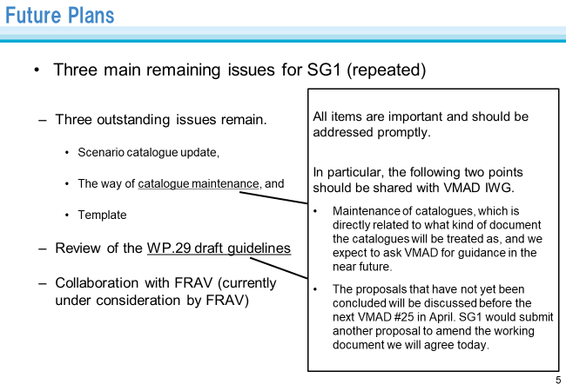
Ongoing SG1 activities
VMAD-24-05
Among above things to do, we had one SG1 session on 23rd March and completed review of the scenario-related part of the draft WP.29 guidelines

Slide 3
Main Discussion Points in Reviewing the Guidelines
Feb | Mar | Apr | May
 |  |  | GRVA#13
VMAD#24 |  | VMAD#25 | VMAD#26
SG1#21 | SG1#22 |  | (SG1#23)
Working document
Informal document
What are reflected
in GRVA working document
First of all, SG1 confirmed that the content of the draft NATM guideline is the same as that of the 2nd iteration of the NATM MD.
SG1 agreed to add one sentence implying abstract scenario in the footnote.
(SG1 did not agree to add Abstract scenario in the same level with the three existing scenario categories: functional, logical and concrete.)
What SG1 submitted to this session of VMAD
(to be reflected in GRVA informal document)
Change in the definition of coverage of scenario catalogue (paragraph 21)
Adding detail explanation on how and when to use random sampling as counter measure of overfitting (paragraph 30)
Others
  Amendment to appropriate expression as Guidelines (paragraph 27)
  Minor revisions of definitions in Annex I

Slide 4
Main Results in Reviewing the Guidelines
 | Original draft Guidelines | Amendments Agreed by SG1
The definition of coverage of scenario catalogue (paragraph 21) | “Coverage” refers to the degree to which a scenarios catalogue sufficiently incorporates real-world driving situations that an ADS may reasonably be expected to encounter during real-world driving in order to validate that the ADS can operate safely. | Coverage” refers to the degree to which scenarios sufficiently incorporate real-world driving situations in order to validate the relevant requirements made by FRAV.
How and when to use random sampling as counter measure of overfitting (paragraph 30) | It is recommended that random sampling among scenarios relevant to a particular ADS and its ODD be considered in order to avoid overfitting. Although more cases of random sampling are preferable from a credibility perspective, it is recognized that this can place a greater burden on manufacturers and the relevant authority (e.g. technical service). This should be considered when determining the volume of tests conducted using random sampling. | It is recommended that sampling techniques be used when selecting parameters to be used in creating logical and concrete scenarios for ADS validation for a particular ADS and its ODD to avoid the ADS being optimised for a set of known test cases. Although, maximising the random sampling are preferable from a credibility perspective, it is recognized that this can place a greater burden on manufacturers and the relevant authority (e.g. technical service). This should be considered when determining the volume of tests conducted using random sampling. It is assumed that for simulation/virtual testing the burden of random sampling is minimum, thus maximising the random sampling approach is feasible.

Slide 5
Future Plans
The next session of SG1 is planned to be held on 16th May.
In the session, the following items are going to be discussed and introduced:
How to maintain the catalogue
Introduction of the Safety Pool Scenario Database (UK)
Collaboration with FRAV
(depending on a discussion in this session of VMAD)
(Other ongoing issues will be discussed in the following sessions.)
Three outstanding issues remain
  Scenario catalogue update,
  The way of catalogue maintenance, and
  Template
Collaboration with FRAV
(currently under consideration by FRAV)
Precisely, because some paragraphs were moved to Annex VII of the draft WP.29 guidelines, it became clear that a larger number of outstanding issues are still under consideration, but they could be integrated into the above three.
See the reference in the last two pages.

Slide 6
Reference: “Outstanding issues” and their progress (1)
 | Outstanding Issues | Status in SG1 | Ref.) NATM MD | WP.29 guidelines for NATM
1 | Which pillars (simulation, track test, real-world test, audit) should be used to assess scenarios? | Done | 5.17 / 36 | No text in the guidelines (This issue should not be described in SG1 section.)
2 | What is "coverage" of scenario? / What is "sufficient" coverage? / How to ensure sufficient coverage? | Done | 5.13 / 32 | 21. It is recommended that the scenarios-based validation methods include adequate coverage of relevant, critical, and complex scenarios to effectively validate an ADS. To note: “Coverage” refers to the degree to which scenarios sufficiently incorporates real-world driving situations in order to validate the relevant requirements made by FRAV. Sufficient coverage is essential to the overall effectiveness and credibility as a validation approach.
3 | Which scenarios are required to validate the functional safety requirements established by FRAV? | Done | - | No text in NATM MD nor the guidelines (This issue should not be described in SG1 section.)
4 | Scenarios not covered by scenario catalogue (Should authority require evaluation of scenarios that are not covered by scenario catalogue?) | Continued consideration with No.14 (maintenance) | 5.10 / 29 | Annex VI Areas for future work - 5.10 If scenarios not covered by scenario catalogue are identified and deemed necessary, they should be included in the scenario catalogue.
 |  |  | 5.23 / 42 | Annex VI Areas for future work - 5.23 The scenario catalogue is not necessarily exhaustive and authorities may need to consider additional scenarios as necessary to support safety validation of an ADS feature. Such a decision could be based on the ODD and behaviour competencies of the ADS. For example, if an AV is developed with an ODD which is not covered in the scenario catalogue, it is essential to add new scenarios to the catalogue to ensure the scenarios used for testing are a function of the ODD.
5 | How to deal with "overfitting" problem? | Done | 5.22 / 41 | 30. It is recommended that sampling techniques be used when selecting parameters to be used in creating logical and concrete scenarios for ADS validation for a particular ADS and its ODD to avoid the ADS being optimised for a set of known test cases. Although, maximising the random sampling are preferable from a credibility perspective, it is recognized that this can place a greater burden on manufacturers and the relevant authority (e.g. technical service). This should be considered when determining the volume of tests conducted using random sampling. It is assumed that for simulation/virtual testing the burden of random sampling is minimum, thus maximising the random sampling approach is feasible.
6 | Should scenario catalogue includes unusual situations (e.g. wrong way driver)? | Done | 5.14 / 33 | 23. … Unsafe behaviors of other road users (e.g. vehicle travelling in the wrong direction, sudden unsignaled lane changes, and exceeding the speed limit) —if reasonably foreseeable—should be included as part of validation testing.

Slide 7
Reference: “Outstanding issues” and their progress (2)
 | Outstanding Issues | Status in SG1 | Ref.) NATM MD | WP.29 guidelines for NATM
7 | What aspect should be dealt with functional/logical scenarios? | Done | 5.15 / 38 | 27 (a) and (b) (logical scenario deals parameters.)
8 | How to deal with various parameters (e.g. perception, vehicle disturbance(e.g. road surface condition, slope, wind)) during certification? | Done | - | No text in NATM MD nor the guidelines (This issue should not be described in SG1 section.)
9 | How to deal with different scenarios for different countries/regions? | Agreed on direction (long-term challenges) | - / 34 | Annex VI Areas for future work 5.15 Country specific scenarios should be respected and need to be covered in the scenario catalogue in the long term.
10 | What is pass/fail criteria for scenario-based testing? | Done | - | No text in NATM MD nor the guidelines (This issue should not be described in SG1 section.)
11 | ODD based scenario generation and/or linking scenario coverage as a function of ODD (How to generate scenario based on ODD? How to consider coverage based on ODD?) | Included in No.12 | - / 30 5.13 / 32 | Annex VI Areas for future work 5.11 It is envisaged that a scenario catalogue will have tags for all scenarios corresponding to their relevant ODD attributes (using a standardised ODD taxonomy) and behaviour competencies.
 |  |  |  | 21. It is recommended that the scenarios-based validation methods include adequate coverage of relevant, critical, and complex scenarios to effectively validate an ADS... (see No.2)
12 | Update of functional scenarios (i.e. Annex2 of NATM MD) | Continued consideration including No.11 | Annex 2 | Some scenarios regarding regular lane change has been added in the MD 2nd iteration. SG1 will continue discussion on this item with reviewing ODD based framework for example.
13 | Should any template for scenario be defined? If so, how will it be? | Continued consideration | - / 37,38 | SG1 agreed to define template and will discuss how it will be in the following SG1 sessions. It was also agreed that the abstract scenario, which was considered to be strongly related to template, would not be included in the Guidelines.
14 | What is the maintenance procedure (e.g. regular update) of scenario catalogue? By whom? | Continued consideration with No.4 |  | Where and who the scenario catalogue is managed is closely related to whether authorities can (or should) use scenarios that are not included in the scenario catalogue (outstanding issue No.4).

