Slide 1
SG3
In Service Monitoring and Reporting
VMAD-25-08
VMAD#25 Meeting
11-12 April 2022
Espedito Rusciano

Slide 2
SG3-In Service Monitoring and Reporting, Objectives and Deliverables
In-Service Monitoring and Reporting (ISMR) addresses the in-service safety of the ADS after its placing on the market (operational experience feedback loop)
It relies on the collection of in-service data(fleet monitoring) to assess whether the ADS continues to be safe when operated on the road and to identify safety risks
This data collection can also be used for the identification of new scenarios to support the development of the Scenario Catalogue.
ISMR allows the whole ADS community to learn from major ADS accidents/incidents through information sharing
SG3 is developing procedures to confirm the in-service ADS safety and to improve the level of safety of ADS based on the evidence collected from the field operation
In Service Monitoring And Reporting
1. Confirmation of safety Assessment
2. Feed Scenario Catalogue
3. Share information and recommendations

Slide 3
Monitoring, Reporting and Investigation
Monitoring
Process | Focus
Monitoring | Overall Data collection and analysis
Reporting | Critical and not critical occurrences
Investigation | Critical occurrences
Reporting
Frequency
Investigation
Severity

Slide 4
In Service Monitoring
Monitoring
Reporting
ISMR
Monitoring (Link with the AUDIT Pillar):
Manufacturers should set up a monitoring program according to the SMS Requirements
Vehicle data collection and analysis by the manufactures for reporting under ISMR, besides EDR/DSSAD
Manufacturers are expected to collect data also from other accessible sources of data (e.g., customer reports)
Processing and Analysis
Data Transfer to Ground Station
On Board Recording
Proactive approach for Safety which shall be integrated in the Safety Management System
Beyond the scope of the occurrences reporting
Increase safety by identifying trends and unusual or unsafe circumstances

Slide 5
In Service Reporting
Monitoring
Reporting
ISMR
Occurrence Reporting:
Occurrence refers to any safety-related event involving a vehicle equipped with an ADS.
For reporting, two different categories of occurrences are defined: critical and not critical occurrences.
The manufacturer should report, as required by the Authority, on both critical and non-critical occurrences
Safety Culture
The main purpose of in-service reporting is the prevention of accidents and incidents and not to attribute blame or liability. (Just culture)
Just Culture

Slide 6
Types of Reporting
Short-term reporting – occurrences that require the manufacturer to take remedial action when data provides evidence of the ADS posing an unacceptable in-service risk. (within 1 month)
  indications of failure to meet safety requirements
  critical occurrence where the ADS was at fault
  other safety-relevant performance issues
Periodic reporting - reporting in the form of aggregated data (per hour of operation or driven km) for ADS-vehicle type and related to ADS operation (at least every year)
  no inconsistencies have been detected compared to the ADS safety performance assessed prior to market introduction;
  the ADS respects the performance requirements set by FRAV and as evaluated in the test methods developed by VMAD;
  any newly discovered significant ADS safety performance issues have been adequately addressed and how this was achieved.

Slide 7
Occurrences list
OCCURRENCE | SHORT-TERM REPORTING [1 Month] | PERIODIC REPORTING [6 Month/1 Year]
1.a. Safety critical occurrences known to the ADS manufacturer or OEM | X | X
1.b. Occurrences related to ADS operation outside its ODD | X | X
1.c. ADS failure to achieve a minimal risk condition when necessary | X | X
1.d. Communication-related occurrences |  | X
1.e. Cybersecurity-related occurrences |  | X
1.f. Interaction with remote operator if applicable |  | X
2.a. Driver unavailability (where applicable) and other user-related occurrences |  | X
2.b. Occurrences related to Transfer of Control failure |  | X
2.c. Prevention of takeover under unsafe conditions |  | X
3.a. Occurrences related ADS failure |  | X
3.b. Maintenance and repair problems |  | X
3.c. Occurrences related to unauthorized modifications |  | X
3.d. Modifications made by the ADS manufacturer or OEM to address an identified and significant ADS safety issue |  | X
4. Occurrences related to the identification of new safety-relevant scenarios | X | X

Slide 8
Investigation
Occurrence Investigations
Focus on critical occurrences, but it can include also other occurrences
It is expected an immediate notification to the authority on occurrences which can pose an immediate risk to public safety.
An Independent body conducts investigations according to its mandate
The investigation report, containing where appropriate safety recommendations, should be made available to all parties involved in the shortest possible time.
The main purpose is the safety investigations of accidents and serious incidents to prevent future occurrences

Slide 9
Outstanding Issues (addressed)
Data elements vs occurrences:
  Need to identify specific data elements to be monitored (and reported) besides the high-level occurrences listed by SG3;
  Non-critical occurrences reporting (e.g., near misses);
ISMR roles and responsibilities:
  Identify roles of national/international authorities, including
    data accessibility/protection and
    development and sharing of safety recommendations
Pending exchange with GRVA/WP29:
  Information sharing among safety authorities & Contracting Parties
  Reporting from other sources than the ADS manufacturers;

Slide 10
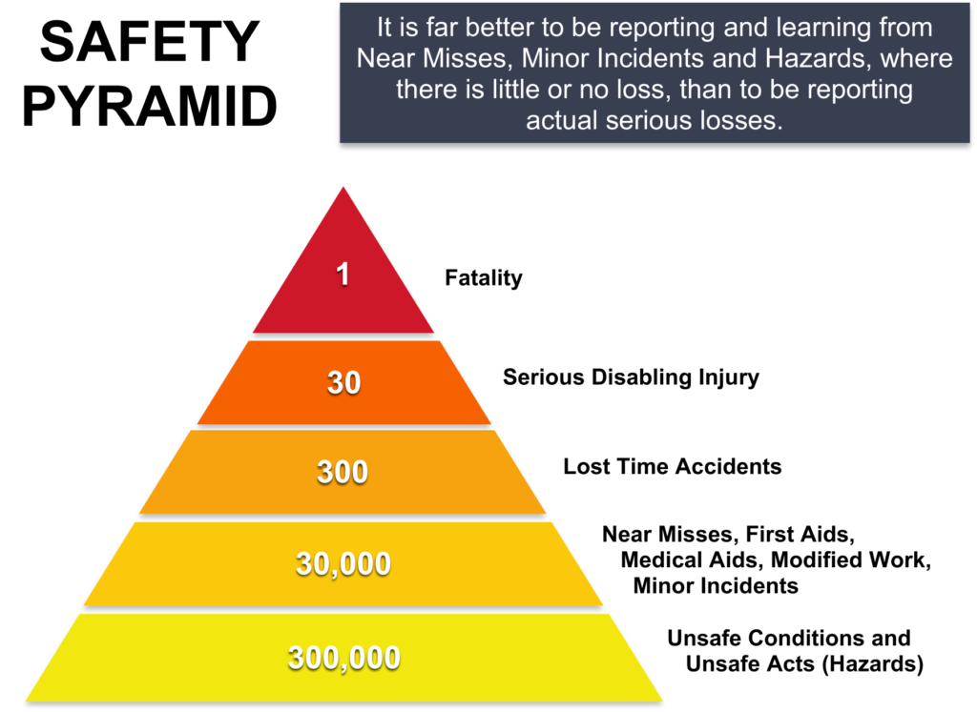
Near misses
“An unplanned event that did not result in injury, illness or damage –
but had the potential to do so”
Near misses are precursors for crashes to come, their analysis is of vital importance to prevent incidents
Near Misses could be included in the monitoring task to fully exploit the possibility to find potentially harmful behaviors in ADS before a collision occurs
Frequency of near miss is highly spread depending on the field and on the way near misses are detected/counted, nonetheless it is typically order of magnitude higher than incident/accident
¹Industrial Accident Prevention, A Scientific Approach, Herbert W. Heinrich 1931.

Slide 11
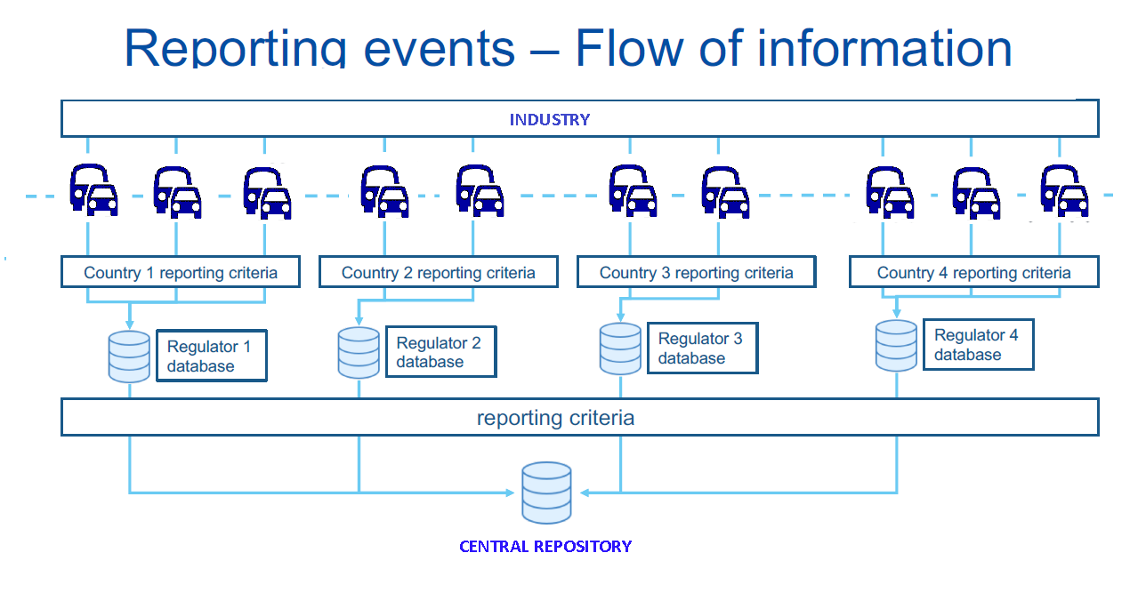
ISMR Roles and responsibilities
Short term and Period reports
SA & IB
SA & IB
SA & IB
SA & IB
Safety recommendations
WP29
SA Annual Reports
Safety recommendations

Slide 12
ISMR Roles and responsibilities
Safety Authority (SA)
  Can be the enforcement Authority or not; if not, it gives recommendations to the enforcement Authority
  Responsible for ISMR data management at national level
  Derives safety recommendations and shares them at higher level
  Publish annual report summarizing the level of ADS safety.
  Investigation Body (IB)
  Independent/impartial body, investigates occurrences
  Issue an investigation report including (where applicable) safety recommendations
  Provides an Annual report with evidence of investigations
MANUFACTURERS
AUTHORITIES
ISMR data
Reports & Safety recommendations

Slide 13
Protection of Information
Data collection should ensure its confidentiality, the protection of its source and the confidence of the reporters
Sensitive safety information should be protected by preventing its use for purposes other than safety.
Safety Authorities have to set up a confidential reporting scheme and to ensure that no personal details are ever recorded in the databases both at national/international level.

Slide 14
Information sharing among safety authorities & Contracting Parties
The final aim of ISM is to improve ADS safety through dissemination of lessons learned
A broader exchange of information and the dissemination of safety recommendations should be ensured among the Contracting Parties, at international level
It is recommended that WP29 promotes and facilitates a broader exchange of information
Organisations databases
National databases
WP29 Repository
Guiding principles
  Access to the database for the authorities
  Safety Recommendations publicly accessible
  Promote cooperation among Contracting parties/authorities with regular exchange of information

Slide 15
Reporting from other sources
Limiting the reporting requirements to manufacturers will also limit the amount and type of information covered by ISM, with a strong impact on the achievable safety improvement.
E.g. identification of traffic rules infringement is not possible through data collected on-board the vehicle, and reporting by local authorities and ADS vehicle users is needed.
Other transport sectors extend the operational reporting mechanism also to drivers, operators, users, traffic managers, and any other person connected to the vehicle operation.

Slide 16
Interaction with other groups
FRAV
Safety Performance
Performance metrics/thresholds
EDR DSSAD
Data vs Occurrences (including near misses)
Data collection and storage
FGAI4AD
AI real time monitoring
AI behavioral drifting
FRAV-ISMR could interact for the identification of the performance to be monitored and relevant metrics/thresholds
In Service Monitoring And Reporting
EDR/DSSAD-ISMR could interact to identify the data to be collected for the characterization of the occurrences
FG4AIAD-ISMR
could interact to identify the AI performance and behaviors that can be potentially monitored during the operations

Slide 17
Thank you !

Slide 18
Interaction with other groups (Example)
FRAV
ISMR
EDR/ DSSAD
Safety recommendations:
The ADS shall recognize the conditions and boundaries of the ODD of its feature(s) pursuant to the manufacturer’s declaration
  Provision:
  The ODD conditions and boundaries (measurable limits) should be established by the manufacturer.
Occurrence:
ADS operation outside its ODD
Data To be Collected
Environmental Condition data
Road data
Vehicle data
Etc..
1
2
ODD Conditions to be monitored:
  Precipitation (rain, snow)
  Time of day (light intensity, including the case of the use of lighting devices)
  Visibility
  Road and lane markings
2
3
4
Metric/Threshold:
Number of ODD excursion

