Slide 1
OICA Response to CP Proposals on eCall
14 February 2022

Slide 2
Introduction
This paper is in response to NL proposal to add a dedicated radiated immunity test mode in Annex 6 which includes initiating eCalls or being in an active eCall
Contents
Exploring the origins of the request
Double certification of radio equipment?
Practical difficulties in performing eCall in EMC laboratory environment
Lack of test standard to ensure uniform implementation
Low probability making an eCall while being exposed to high field strengths
Balance between risk, benefit and effort required to perform such a test
Additional point on spurious emissions
OICA recommendation

Slide 3
Origins of the request
Origins of the requests for including eCall in ECE R10 comes from 3 specific references in ECE R144
References to ECE R10 are in § 7.2, §17.2 and § 35.2:
“ If the applicant for approval so requests the Electro Magnetic Compatibility may be part of the approval of a type of AECC [AECD or AECS]. In this case, the following provisions shall apply.
The effectiveness of AECC [AECD or AECS] shall not be adversely affected by magnetic or electrical fields. This shall be demonstrated by compliance with the technical requirements and transitional provisions of UN Regulation No. 10, 04 series of amendments or any later series of amendments.”
AECC: Accident Emergency Call Component
AECD: Accident Emergency Call Devices
AECS: Accident Emergency Call System
An RF immunity test is implied but not during an eCall

Slide 4
Double certification of radio systems
  Radio systems are already certified to relevant radio standards
    For example in EU, eCall devices are certified in accordance with Radio Equipment Directive 2014/53/EU (RED)
    EU has issued a guidance on the applicability of this document specifically dealing with vehicles. In §1.6.3.10 Radio equipment installed in vehicles: Where radio equipment is installed in vehicles such as cars, caravans, trains, etc (normally falling under a type approval legislation), the radio equipment has to comply with the RED.
    RED Compliance Association has issued a Technical Guidance TGN 01. In §3.3 a note is added:
    “According to the RED Guide at the time of issuing this REDCA TGN: In cases where the radio module or radio equipment is installed into a vehicle or fixed installation; the host vehicle or host fixed installation does not become a final radio product and therefore is not subject to assessment to the RED. In such cases, the radio module remains the CE Marked radio device, even if permanently installed within the vehicle or fixed installation at the time of placing the vehicle or fixed installation on the market.”
It is not required by EU or REDCA to certify whole vehicle to Radio Equipment Directive

Slide 5
Conflicting requirements
LV Directive 2014/35/EU (LVD)
Radio Equipment Directive 2014/53/EU (RED)
EMC Directive 2014/30/EU (EMCD)
Essential requirements that radio equipment shall meet acc. to Article 3:
Article 3.1a
„health and safety of persons and of domestic animals, the protection of property”
Article 3.2
„efficient use of radio sepctrum“
Article 3.1b
„adequate level of electromagnetic compatibility“
as „set out in Directive 2014/35/EU, but with no voltage limit applying“
„as set out in Directive 2014/30/EU“
List of Harmonized Standards for Presumption of Conformity published in the Official Journal of the EU
Standardization Organizations with according expertise and standardization mandate: CEN, CENELEC
List of Harmonized Standards for Presumption of Conformity published in the Official Journal of the EU
Standardization Organizations with according expertise and standardization mandate: CENELEC, ETSI
List of Harmonized Standards for Presumption of Conformity published in the Official Journal of the EU
Standardization Organizations with according expertise and standardization mandate: CEN, CENELEC, ETSI
Immunity requirements for -among others- cellular communications defined in ETSI EN 300 489-1 (Chapter 9.2.2) by ETSI
Expertise and responsibility w.r.t EMC requirements for radio equipment lies with ETSI.
Proposal: Immunity requirements for E-Call shall not be defined within UN ECE R10.

Slide 6
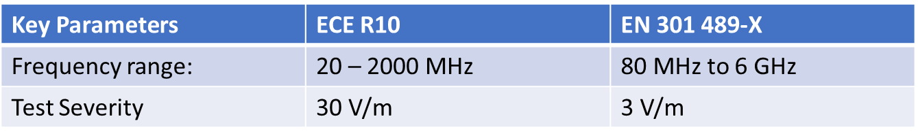
Conflicting requirements
Radio Equipment are typically certified to various standards such as:
  EN 301 489-1 V2.2.0 (2017-03),
  EN 301 489-17 V3.2.0 (2017-03),
  EN 301 489-19 V2.1.1 (2019-04),
  EN 301 489-52 v1.1.0 (2016-11)
There are some frequencies (20-80MHz) which are not tested as radio equipment
Test severity of R10 is 10 times more severe
The performance of radio equipment used for eCall, which is certified to relevant radio standards, during an active eCall is uncertain if exposed to ECE R10 requirements.
State of the art eCall radio equipment has not been certified to ECE R10

Slide 7
Practical issues
There are practical challenges with establishing successful communication links in the presence of unintended radio frequency emissions from radiated immunity test.
  High power amplifiers used for radiated immunity tests (typically 10 kW) generate broadband noise
  Harmonics of test signals: When a certain frequency is generated, especially with Pulse Modulation, it generates harmonics at higher frequencies which could block cellular communications.
ISO11452 on signal quality:
  Output harmonic shall be limited to -12 dB below 1 GHz and -6 dB above 1 GHz
  When testing at 30 V/m, this allows up to 7.5V/m up to 1 GHz and 15 V/m above 1 GHz [ignores antenna gain]
  Typical Cellular signal strength is measured in microvolts/m and unwanted signals from EMC equipment will disrupt communication channel
  Top of the range equipment may perform better but is not affordable in all settings
Economically viable technical solutions are required for uniform implementation in all Technical Services

Slide 8
Lack of test guidance
When establishing a communication link, one must define at least the channel frequency and power level.
Even when using maximum RF signal permitted in cellular standards, signal received by the vehicle radio equipment will be many orders of magnitude lower (V/m vs µV/m) compared to noise from test equipment.
How do we ensure uniform implementation of RF communications in all test labs?
What would be the acceptance criteria?
    If testing in a single test call for all frequencies, MDS is sent once so it can not be checked at each frequency
    If we check for audio quality, how do we define intelligibility? Is a short disturbance lasting a second OK? How about some crackle or hiss in the background?
Many EMC labs have no experience of testing communication devices.
Uniform implementation can not be assured unless there is technical guidance which provides clear, unambiguous guidance on RF parameters (frequency, signal level, satellite navigation parameters) and vehicle test setup to enable eCall in EMC laboratories.
Recommendation: Request ISO WG 3 to add eCall testing to their Technical Report on C2X

Slide 9
Perspective on field strength
An extensive study¹ which analysed the results of spot and long-term measurement found that majority of electric field strengths are <1V/m. Less than 1% are greater than 6 V/m and less than 0.1% are above 20 V/m.
A different 10 month study in France² including 2,493,211 measurements, did not find fields over 0.26 V/m
Exposure to field strengths above 20V/m is very rare and only observed in very specific cases such as:
  Close to military or airport radars and high powered broadcast transmitter sites
    Such sites have restricted access to the public are not relevant in the context of eCall
  When high power radio equipment is installed on the vehicle itself
    Such equipment are ‘push to talk’ and can be ignored while an eCall is needed
  When a cellular phone (esp. 2G) operated within touching distance of a measurement probe.
    Using a cellular phone right next to vehicle antenna while making an eCall is not a realistic risk
1) Electromagnetic field exposure assessment in Europe radiofrequency fields (10 MHz-6 GHz) Gajšek P.. Journal of Exposure Science and Environmental Epidemiology, Volume 25, Issue 1, Pages 37 - 4411 January 2015
2) Radio frequency exposure in the French general population: Band, time, location and activity variability, Environment International, Jean-François Viel, Volume 35, Issue 8, 2009, Pages 1150-1154,
There is very low probability of exposure to more than 20 V/m in public roads while using eCall
Notes:
Jean-François Viel, Elisabeth Cardis, Monika Moissonnier, René de Seze, Martine Hours,
Radiofrequency exposure in the French general population: Band, time, location and activity variability,
Environment International,
Volume 35, Issue 8,
2009,
Pages 1150-1154,
ISSN 0160-4120,
https://doi.org/10.1016/j.envint.2009.07.007.
(https://www.sciencedirect.com/science/article/pii/S0160412009001573)
Abstract: Information on the exposure of individual persons to radiofrequency (RF) fields is scarce, although such data are crucial in order to develop a suitable exposure assessment method, and frame the hypothesis and design of future epidemiological studies. The main goal of this survey is to assess individual RF exposure on a population basis, while clarifying the relative contribution of different sources to the total exposure. A total of 377 randomly selected people were analyzed. Each participant was supplied with a personal exposure meter for 24-hour measurements (weekday), and kept a time–location–activity diary. Electric field strengths were recorded in 12 different RF bands every 13s. Summary statistics were calculated with the robust regression on order statistics method. Most of the time, recorded field strengths were not detectable with the exposure meter. Total field, cordless phones, WiFi-microwave, and FM transmitters stood apart with a proportion above the detection threshold of 46.6%, 17.2%, 14.1%, and 11.0%, respectively. The total field mean value was 0.201V/m, higher in urban areas, during daytime, among adults, and when moving. When focusing on specific channels, the highest mean exposure resulted from FM sources (0.044V/m), followed by WiFi-microwaves (0.038V/m), cordless phones (0.037V/m), and mobile phones (UMTS: 0.036V/m, UMTS: 0.037V/m). Various factors, however, contributed to a high variability in RF exposure assessment. These population-based estimates should therefore be confirmed by further surveys to better characterize the exposure situation in different microenvironments.
Keywords: Base station; Cellular phone; Cordless phone; Exposure assessment; FM; Radiofrequency; TV; WiFi

Slide 10
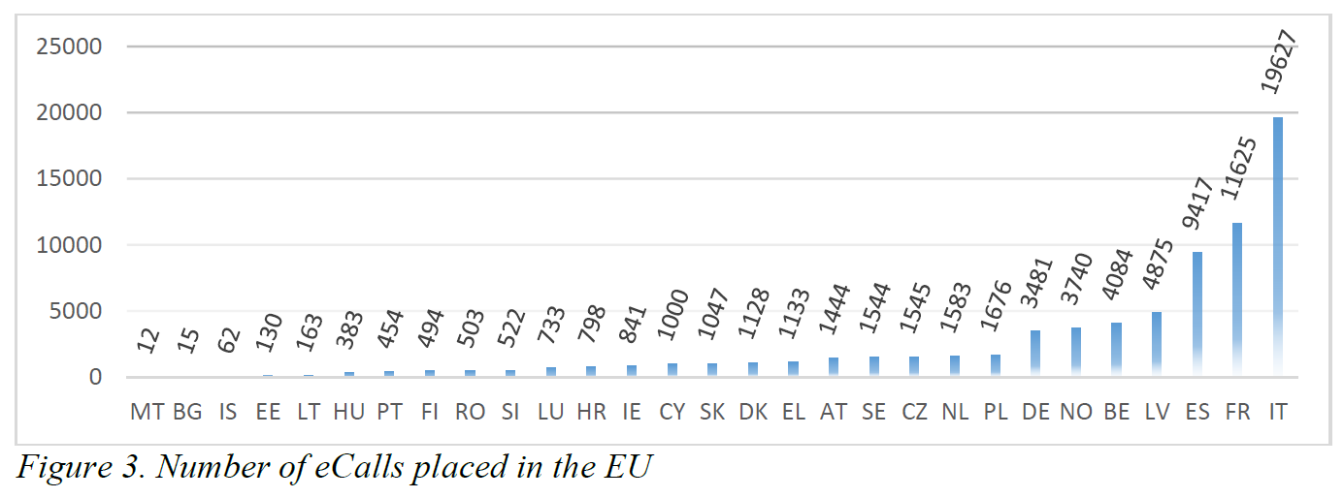
Usage of eCall
Total of all above calls = 74,059

Slide 11
Probability of occurrence
Initiate an eCall while exposed to 30 V/m
It is estimated that ONE eCall was placed per 450,000 km travelled in 2019
  In 2019, 74,059¹ eCalls were placed in EU 27
  Approximately 3 million² vehicles with eCall travelled 33.9 billion kms based on an average of 11,300³ km per vehicle in EU in 2019
Mobile phone coverage is not 100%.
  for example 2% of UK roads or 5,540 miles has no mobile phone voice coverage from any network provider.
Probability of being exposed to field strengths greater than 20 V/m is less tan 0.1% very rare and only happen is very special cases (near military radars, TV or Radio transmitters which have restricted access to the public)
Probability of initiating an eCall at the same time as experiencing high EM field is near zero
REPORT FROM THE COMMISSION TO THE EUROPEAN PARLIAMENT AND THE COUNCIL on the effectiveness of the implementation of the single European emergency number '112' Brussels, 15.12.2020, COM(2020) 808 final, figure 3,. Numbers reported by all memmber states were added to obtain this number.
As of 31 march 2020, reported by www.euspa.europa.eu/newsroom/news/ecall-2-years-saving-lives
Average distance travelled by car in 2019, https://www.odyssee-mure.eu/publications/efficiency-by-sector/transport/distance-travelled-by-car.html
Notes:
http://apps.cept.org/eccnews/aug-2020/ecall_an_update.html
Two thirds of these eCalls were manually triggered and one third automatically triggered. It was also noted that these figures included test calls and no breakdown was provided between test calls, false calls and real life emergencies. Eleven Member States did provide more detailed information on the number of false calls which was estimated at 92% of all calls received.
Information available from France provides further insights. The PSAPs in France received around 12,000 eCalls in 2019. Some 83% were manually triggered and 17% were automatically triggered. Following a filtering process, only 3% were transferred to the 112 PSAP as real-life emergency calls. It was also noted that the Calling Line Identification (CLI) associated with 66% of these eCalls was an ITU global 15-digit number (+882/+883).

Slide 12
Balance between social benefit and effort required
eCall offers a social benefit and is intended to save lives
Risk of eCall being activated at the same time as experiencing such high field strengths is near zero. There is higher chance of not having cellular coverage.
There is a high risk of of non-compliance if eCall is made part of ECE R10 radiated immunity requirements because state of the art telecommunication equipment are designed for 3 V/m.
Adding this extra burden
  May necessitate development of new radio equipment
  Increase costs
  Delay implementation in developing markets ( it is already mandatory in EU) hence preventing saving of loss of life
  EMC test duration will increase
The effort required to perform the test is not proportionate to the risk

Slide 13
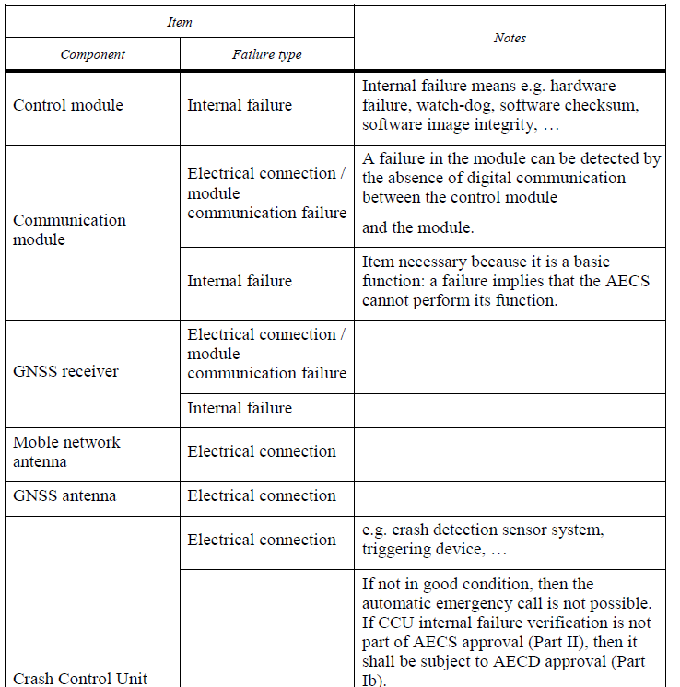
Internal diagnostics
In accordance with R144 §7.5.2, §17.5.2 and §26.5.3
“A warning signal shall be provided in case of AECC/AECD/AECS internal malfunction. Visual indication of the AECC/AECD/AECS malfunction shall be displayed during failure.”
eCall equipment must have internal checks and all faults which would prevent it from making a call must lead to a warning indication
Tables 1, 2 and 3 details all relevant failure types
Internal diagnostics, mandated by R144, shall detect any internal faults

Slide 14
Additional point on Radiated Emissions Tests
§ 6.10.7 asks for RF transmitters to be tested in the transmit mode and spurious emission to be measured
This section is implemented in contrasting ways by different Contracting Parties (CPs) and is causing unnecessary burden given the rapid increase Connected Vehicle features.
At least one CP requires that intentional transmitters (i.e. eCall modem) are in transmit mode during off board radiated emission tests. This is not necessary because communications equipment are already certified as radio equipment to relevant standards which includes measurement of in band Wanted emissions, out of band emissions and spurious emissions.
Note: R144 does not request RF features to be tested either. According to § 1.2. R144 does not apply to “Communication module functionality and communication antenna functionality, unless otherwise prescribed in this Regulation;”
§ 6.10.7 should be revised to eliminate re-measurement of spurious emissions at vehicle level

Slide 15
Summary
ECE R144 implies an RF immunity test but does not mandate a test in during an eCall
State of the art eCall radio equipment has not been designed to meet ECE R10
Economically viable technical solution are not readily available to enable uniform implementation
There is very low probability of exposure to more than 20 V/m in public roads
Probability of initiating an eCall at the same time as experiencing high EM field is near zero
The effort required to perform such a test is not proportionate to the risk
Required test mode is not necessary as internal diagnostics, mandated by R144, shall detect any internal faults
Request to perform a dedicated radiated immunity test mode for eCall is not mandated by regulations, addresses a very low occurring use case, and will put a large burden on the industry. It is therefore unnecessary, unjustified and disproportionate to the social benefit it would bring.
Requested test mode is not mandated, unnecessary and burden on industry in disproportionate to the risk

Slide 16
Alternative OICA Proposals for R10-07
We recommend that:
  Initial OICA proposal is adopted for radiated immunity testing of eCall
    Functionality of eCall is verified before and after entire test sequence
    During tests as defined in Annex 6, 50 km/h or Brake mode, it is verified that
      No warning messages are induced
  Previous OICA proposal revise 6.10.7 (eliminate the request to measure RF emissions from intentional transmitters) to be re-considered

Slide 17
Thank you for your attention

