Slide 1
Proposal to test long vehicles to Annex 6 in frequency range of 2-6 GHz
OICA Proposal
14 Feb 2022

Slide 2
Introduction
In the 26th meeting of GRE Informal Working Group for EMC, we discussed radiated Immunity testing in the 2-6 GHz range for long vehicles
NL experts introduced proposal to test long vehicles with a small antenna
OICA experts judged this not suitable for vehicle testing
This paper proposes an alternative by utilising ISO11451-2; long vehicles are to tested by introducing additional reference points near electronic modules with immunity related functions and their harnesses

Slide 3
Proposal: amend Reg.10-06 Annex 6, §1.3
Current Text:
1.3. Alternative test methods
The test may be alternatively performed in an outdoor test site for all vehicles. The test facility shall comply with (national) legal requirements regarding the emission of electromagnetic fields.
If a vehicle is longer than 12 m and/or wider than 2.60 m and/or higher than 4.00 m, BCI (bulk current injection) method according to ISO 11451-4 shall be used in the frequency range 20 to 2,000 MHz with levels defined in paragraph 6.8.2.1. of this Regulation.

Slide 4
Alternative Proposal: amend Reg.10-06 Annex 6,
1.3. Alternative test methods
The test may be alternatively performed in an outdoor test site for all vehicles. The test facility shall comply with (national) legal requirements regarding the emission of electromagnetic fields.
If a vehicle is longer than 12 m and/or wider than 2.60 m and/or higher than 4.00 m, BCI (bulk current injection) method according to ISO 11451-4 shall be used in the frequency range 20 to 2,000 MHz with levels defined in paragraph 6.8.2.1. of this Regulation. For the frequency range of 20 to 6,000 MHz, ISO11451-2 shall be used with additional Reference point(s) which shall be chosen by the manufacturer in conjunction with the Type Approval Authority after considering the distribution of electronic systems with immunity related functions and the layout of any wiring harness.

Slide 5
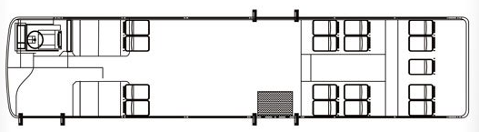
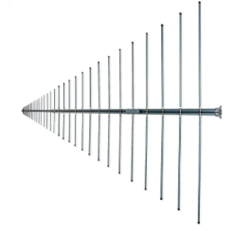
Long Vehicles
Proposal
Select test points based on location of immunity related ECUs
Vehicle reference points
Vehicle reference line
Targeted antenna positions test all modules with immunity related functions

Slide 6
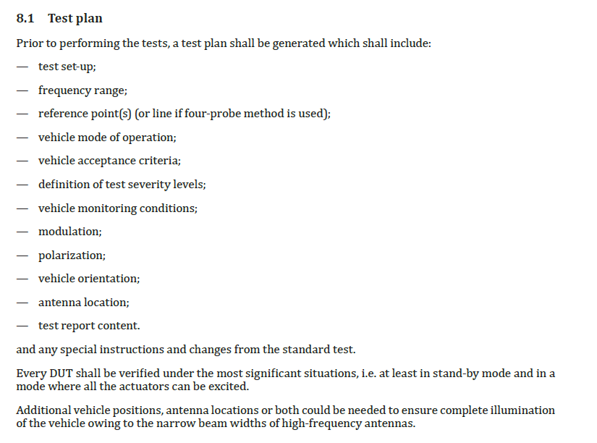
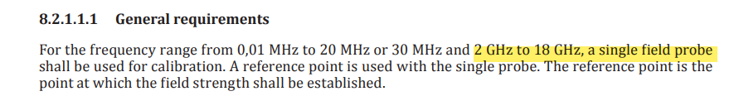
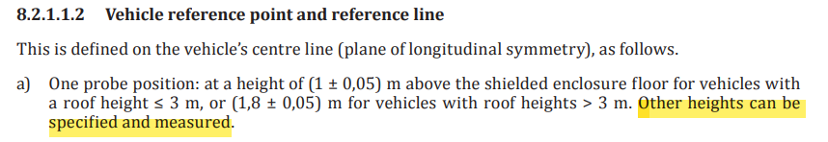
Calibration
Field calibration is to be performed in accordance with ISO11451-2
ISO11451-2 does not explicitly define a side reference points for calibration but additional points
are permitted (and used) to side facilitate testing.
It would be better if this topic is addressed to the ISO working group to revise ISO 11451-2.

Slide 7
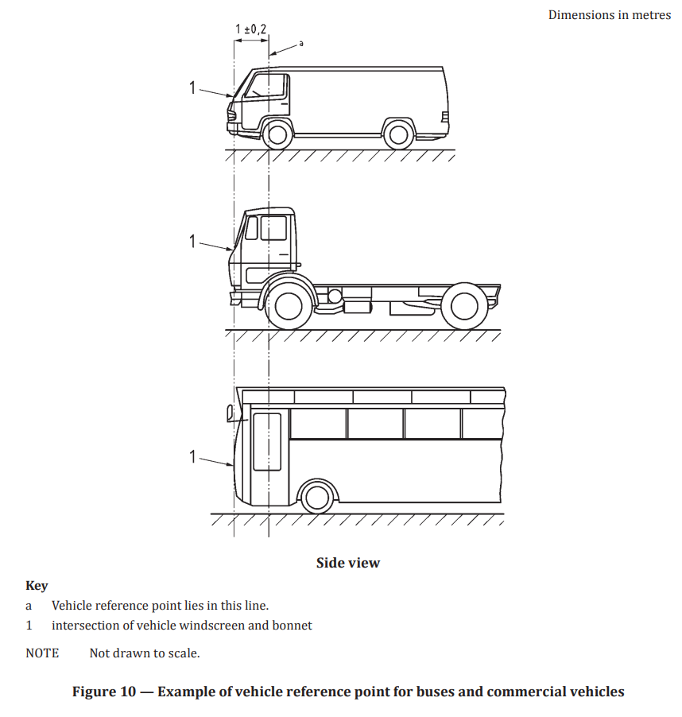
Calibration – examples for long vehicles

Slide 8
Additional idea for consideration…
What would the CPs think about the possibility of mixing vehicle and component type approval.
E.g. in the frequency range up to 2 GHz all tests to be done at the vehicle. Above 2 GHz it should be possible to switch to the component method (ISO 11452-2) for ESA with immunity related functions.
Today it is necessary to decide first to do vehicle type approval or component type approval.

Slide 9
Summary and recommendations
After further considerations, it is agreed that ISO11451-2 may be used for long vehicles
It is proposed to revise Annex 6, §1.3 to specify use of antenna radiation method to test long vehicles
Request ISO working group to revise ISO 11451-2 to include side reference points
Consider allowing ESA type approval for radiated immunity for frequencies above 2 GHz

