Slide 1

27th Session
Status Review and Session Orientation
Document FRAV-27-03
Web Conference
19-20 April 2022

Slide 2
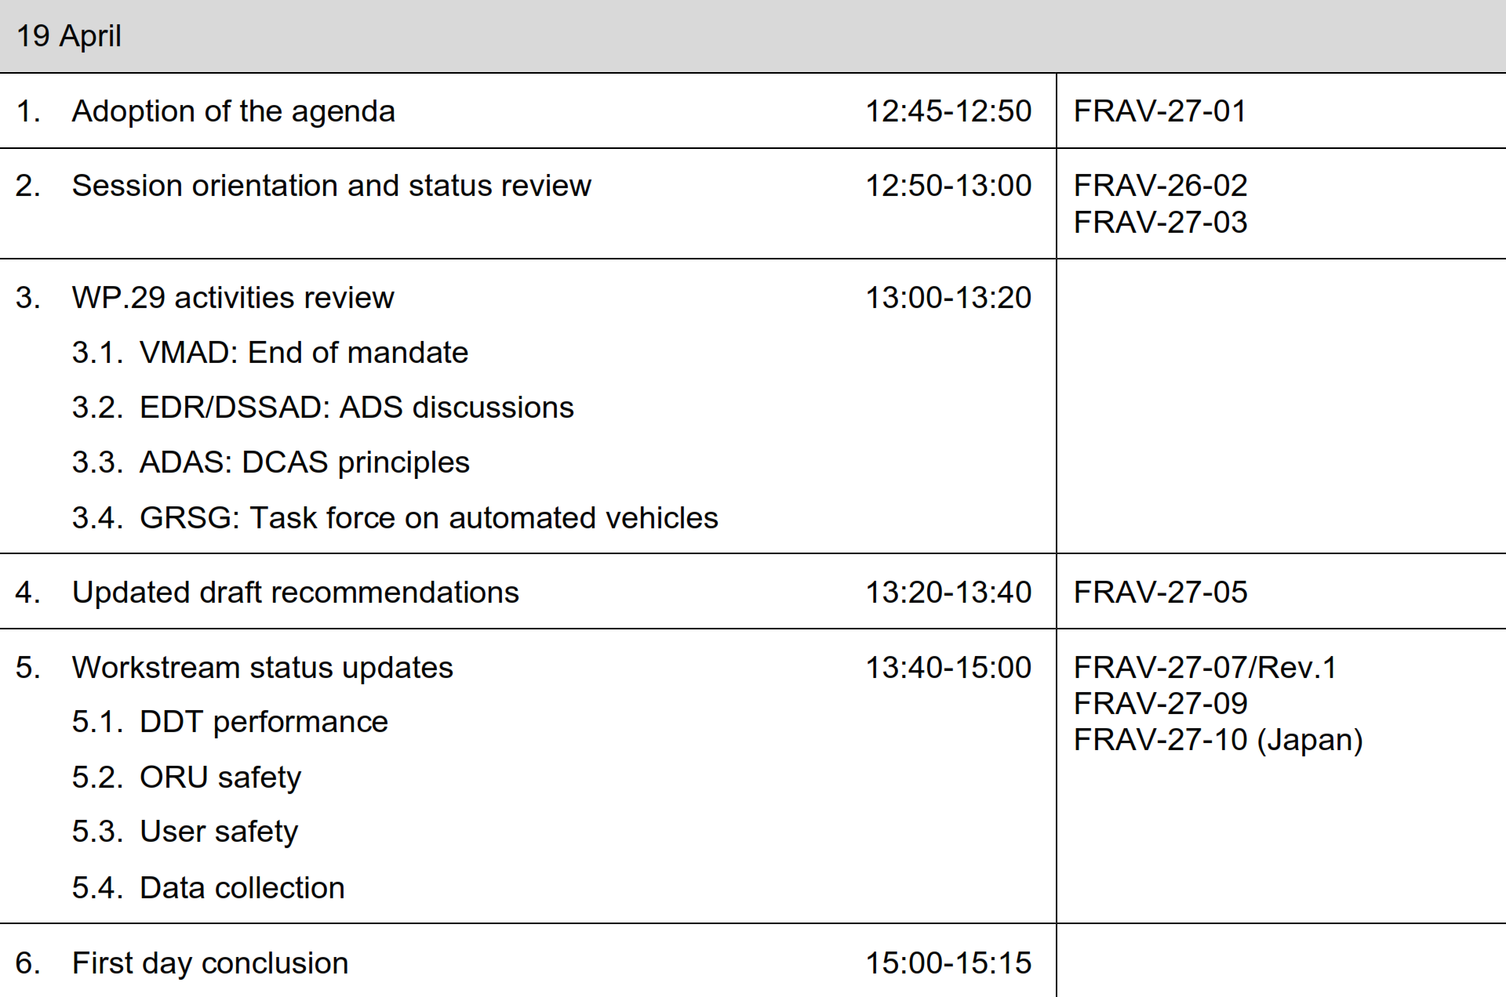
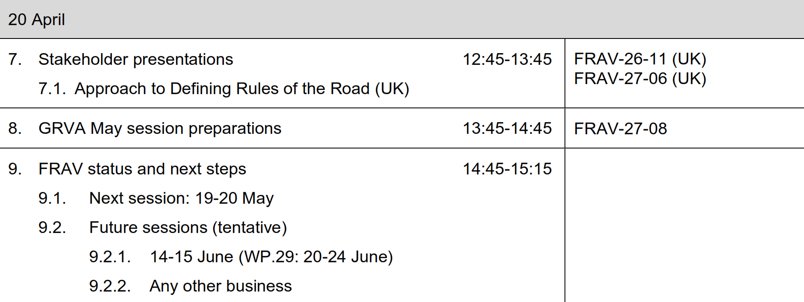
Agenda item 1
Adoption of the agenda
Review updates and status of Document 5, consider workstream status and directions, considers “rules of the road” approach to criteria, and discuss expectations for short-term outcomes (end 2022) to convey to GRVA in May.

Slide 3
Agenda 2
FRAV status
Document 5
  FRAV-27-05 updated per discussions during the 26th session.
    §2.5. driver definition
    §2.6.2.1.2. sensing and perception description
    §2.17. transition of control definition
  Open issues
    Harmonization of driver definition with WP.1 and across WP.29
    §2.18. User definition still refers to “dynamic control” (deprecated during last session)
May GRVA session
  Updated safety recommendations document (revised Document 5)
  Status report (especially directions of work and short-term expectations for outcomes)

Slide 4
Agenda item 3
WP.29 activities
VMAD
  Submitting Master Document with symbol to GRVA (formal document for information).
  Views original mandate as fulfilled.
  Looking to GRVA/WP.29 for any further guidance.
EDR/DSSAD
  ADS interests assigned to DSSAD subgroup.
  Interest in EDR and general performance information.
  Welcomed FRAV illustration of recommendations (TOC example).
  Agreed on importance of sharing information to ensure coherence.
  No request for further FRAV support.

Slide 5
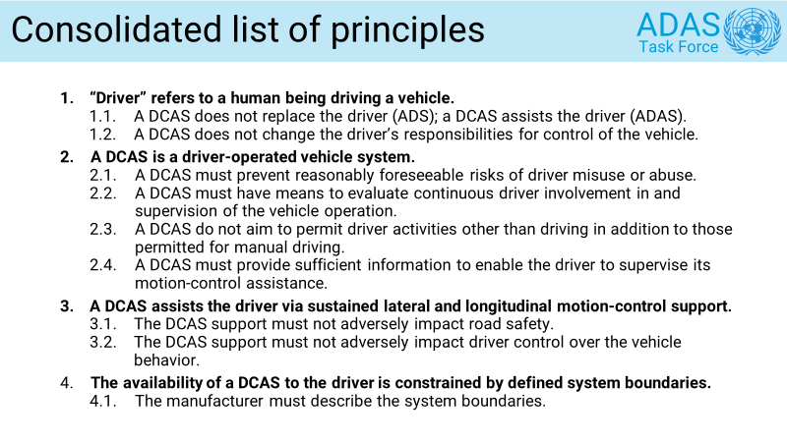
Agenda item 3
WP.29 activities
Driver-control assistance systems (DCAS) require a driver. Uniform definition of “driver” could be important.

Slide 6
Agenda item 3
WP.29 activities
GRSG discussions on “automated vehicles”.
  Informal document proposing to amend new regulation on driver direct vision (M₂, M₃, N₂, N₃) regarding “automated vehicles” and “fully automated vehicles”.
  Definitions described collision-avoidance systems, not ADS.
  Amendment not accepted but expect further discussions.
GRSG proposed to establish a task force on automated vehicles.
  Netherlands circulated email for meeting to set up task force.
  Proposed to “future proof” GRSG regulations regarding use of “driver”.
FRAV outcomes important to other activities. Uniform WP.29 understanding of “driver” and other terms such as “fallback user” and of ADS diversity such as purely driverless vehicles, dual mode, L3 mode of operation, etc.

Slide 7
Agenda item 4
Document 5: Open items
Discussion of “driver” definition.
  General view to align with existing definitions
  Supported ISO/SAE definition (“A user who performs in real time part or all of the DDT and/or DDT fallback for a particular vehicle.”)
  Request to check on WP.1—1949 Geneva Convention: “any person who drives a vehicle, including cycles, or guides draught, pack or saddle animals or herds or flocks on a road, or who is in actual physical control of the same”.
    WP.29 scope: Any person who drives a vehicle or who is in actual physical control of a vehicle on a road.
    FRAV: Person = human being; actual = real-time
    WP.1 opted not to use DDT in NDRA resolution (FRAV has conversely opted not to use “dynamic control”).
  FRAV not addressing “driver” per se, so aim to find definition useable by WP.29 that does not conflict with WP.1.
    [Any human being who is in real-time physical control of a vehicle on a road.]
User definition contains “dynamic control”—Request for views

Slide 8
Agenda item 5
Workstream reports
ADS performance of the DDT
Safety of Other Road Users (ORU)
  Includes work on FRAV input for GRE on light-signaling
User safety and safe use
ADS data collection (EDR/DSSAD cooperation)

Slide 9
Agenda item 7
Stakeholder presentations
Definition of Rules of the Road (UK)
  First presented in July 2021 (FRAV-17-14 and FRAV-17-15)
  Update provided in March 2022 (FRAV-26-11)
  Detailed presentation during this session.

Slide 10
Agenda item 8
FRAV report to GRVA
Diversity of ADS and ODD
142 safety proposals
Five “Starting Points”
List of “Safety Topics”
Safety topics review
Tasks/Objectives
Common Understanding
Safety Needs
General Requirements
Specifications
ADS descriptions
Package Delivery
Updated draft safety recommendations
Three paths to verifiable criteria
  DDT performance within model expectations
  OEDR framework to determine property detection for ORU recognition
  Roles approach for ADS interactions with users

Slide 11
Agenda item 8
FRAV report to GRVA
SCOPE
WORKSTREAMS
APPROACHES
Nominal DDT
DDT Performance
DDT Models
CLEPA
Safety-Critical
ORU Safety
ORU Properties
User Safety
China
User Safety
User Roles
Failure Management
Netherlands
Safety Maintenance
Performance Data
EDR/DSSAD
SAE

Slide 12
Agenda item 8
FRAV report to GRVA
Why the workstream is pursuing the approach(es).
  Challenges being addressed.
  Responsiveness to starting points and safety recommendations.
Expectations for results/outcomes.
  How would the approach impact Document 5?
  What are expectations for the “global requirements”?
Current status/focus of the efforts.
  How advanced is the work?
  How much needs to be done?
Provide a basis for May discussions on mandate, road map, and deliverables.

Slide 13
Agenda item 8
FRAV report to GRVA
VMAD concluding mandate
  Integration of VMAD outcomes and collaboration into FRAV deliberations
Automation-related activities across WP.29 Working Parties
  GRE and GRSG work on “driver” and current regulations
  GRE request for input on light-signaling for ADS vehicles
  Common terms and understanding of automation and ADS
FRAV mandate and expectations for milestone deliverables
FRAV-27-08 provides a basis for preparing no more than three slides (preferably 1-2) per workstream to inform GRVA of FRAV directions and expectations for outcomes.

Slide 14
Agenda item 9
Outlook for next steps
FRAV Calendar
Session 28: 19-20 May
[Session 29: 14-15 June]
Two-day May session to:
Finalize submissions to May GRVA session (FRAV status report and updated safety recommendations document)

