Slide 1
Thermal Propogation Task Force(TP-TF) Report for 24th IWG Meeting
2022.6

Slide 2
Background and main activities
TP test was discussed in the 23rd IWG meeting
  Several issues still need to be discussed(parking, scope, safety requirements, pass/fail criteria,etc)
  Discussion in logical order was suggested to avoid repeating unnecessary discussions
Several meeting was held to facilitate the discussion for TP test
  Apr 6th -TP-TF documentation sub-group meeting（details in documentation sub-group report）
  Apr 26th TP-TF meeting

Slide 3
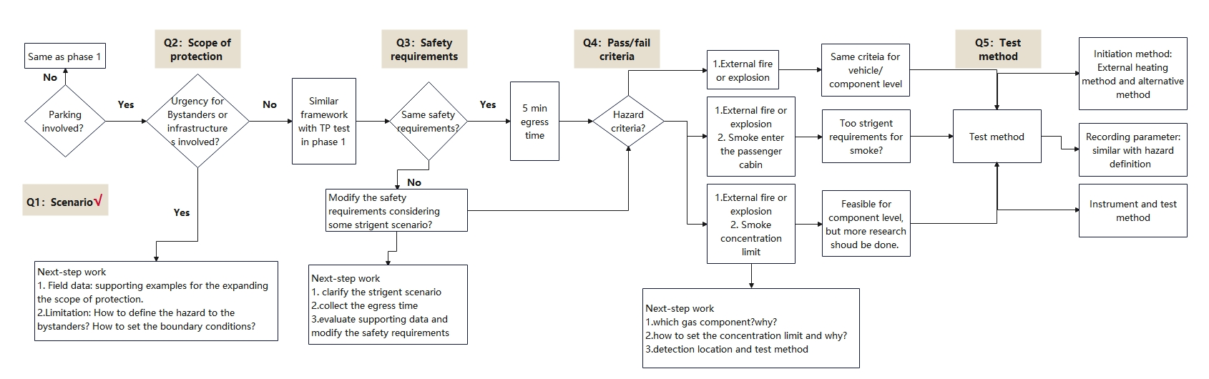
Overview of TP-TF meeting in Apr 26th
In order to avoid repeating discussions, focus on the main issues and improve efficiency, China suggest discussing the following 5 questions in order.

Slide 4
Question 1: Does Parking mode need to be involved？
Background
All co-sponsors agreed that parking mode needed to be addressed (Japan abstain due to no TR/TP events) in previous TP-TF meeting . Japan agreed on this issue before the TP-TF meeting in Apr 26th.
In the meeting
Consensus was achieved for this question in the meeting. All CPs agreed that parking mode need to be involved.

Slide 5
Question 2: Do We need to expand the scope of protection？
Background
If the scope of protection limited to occupants, the framework of test method is basically consistent with the firtst stage, except for the operation mode(considering parking mode).
If bystander and infrastructure outside the vehicle should be considered, discussion on field data and limitation needs to be conducted:
In the meeting
China, Japan and OICA: suggested limit the protection scope to occupants in phase 2
US, Canada and Korea suggested to continue discussion in expanding the scope of protection to fully address the risks
EU suggested that bystander should be considered but infrastructure shouldn’t be involved in the scope of protection

Slide 6
Question 3: How to define the hazardous situation?
Background
If hazardous situation is defined as external fire or explosion by visual inspection, the pass/fail criteria is same between vehicle level and component level.
If hazardous situation is defined as external fire or explosion and no smoke enters the passenger cabin by visual inspection. Is “no smoke enters the passenger cabin” criteria too stringent?
If hazardous situation is defined as external fire or explosion and smoke concentration limit, some followed-up work related to smoke need to be conducted
In the meeting
China and OICA: considering there isn’t mature method and requirements on smoke, they suggested to continue discussing smoke-related issues in the phase 3.
US and Canada suggested no smoke in the passenger cabin is acceptable, China and Japan noted that this criteria is too strigent. EU suggested that visual inspection is a acceptable way.
China, Japan and OICA agreed that discussion on gas component, concentration limit and detection method should be done in phase 3, the US and Canada also suggested to be cautious on this topics.

Slide 7
Question 4: Do we need to modify the safety requirements?
Background
If the safety requirements need to be modified, following work should be carried out:
  clarify the strigent scenario
  collect the egress time
  evaluate supporting data and modify the safety requirements
In the meeting
Current requirement is applicable and sufficient for the original scope and mode.
If the scope or mode will be modified, the safety requirements need to be modified or add additional ones
Several CPs such as US, Canada and EU, suggested to discuss external warning requirements.

Slide 8
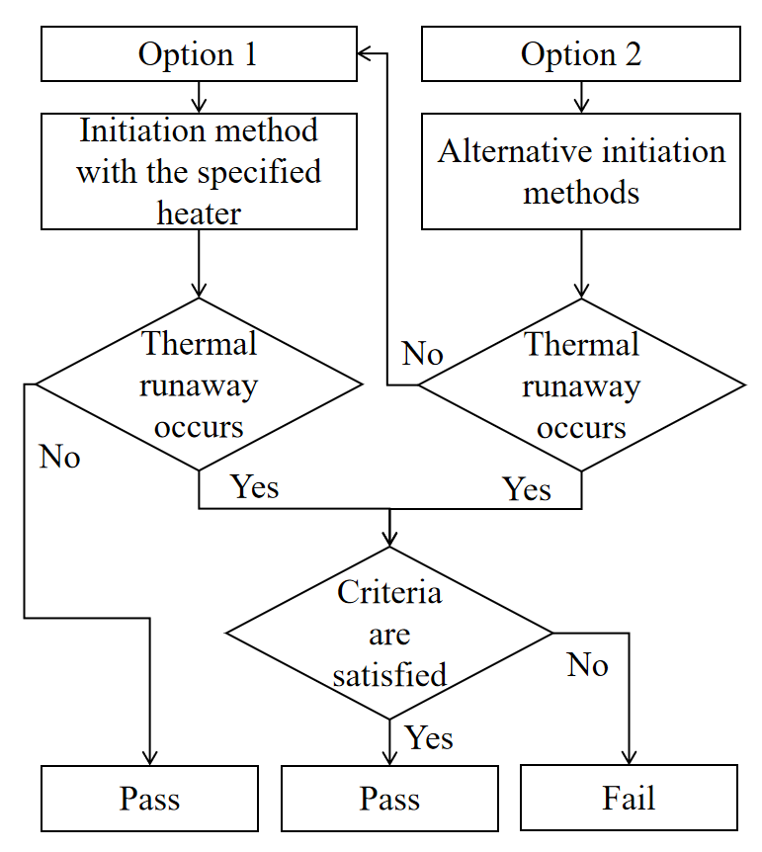
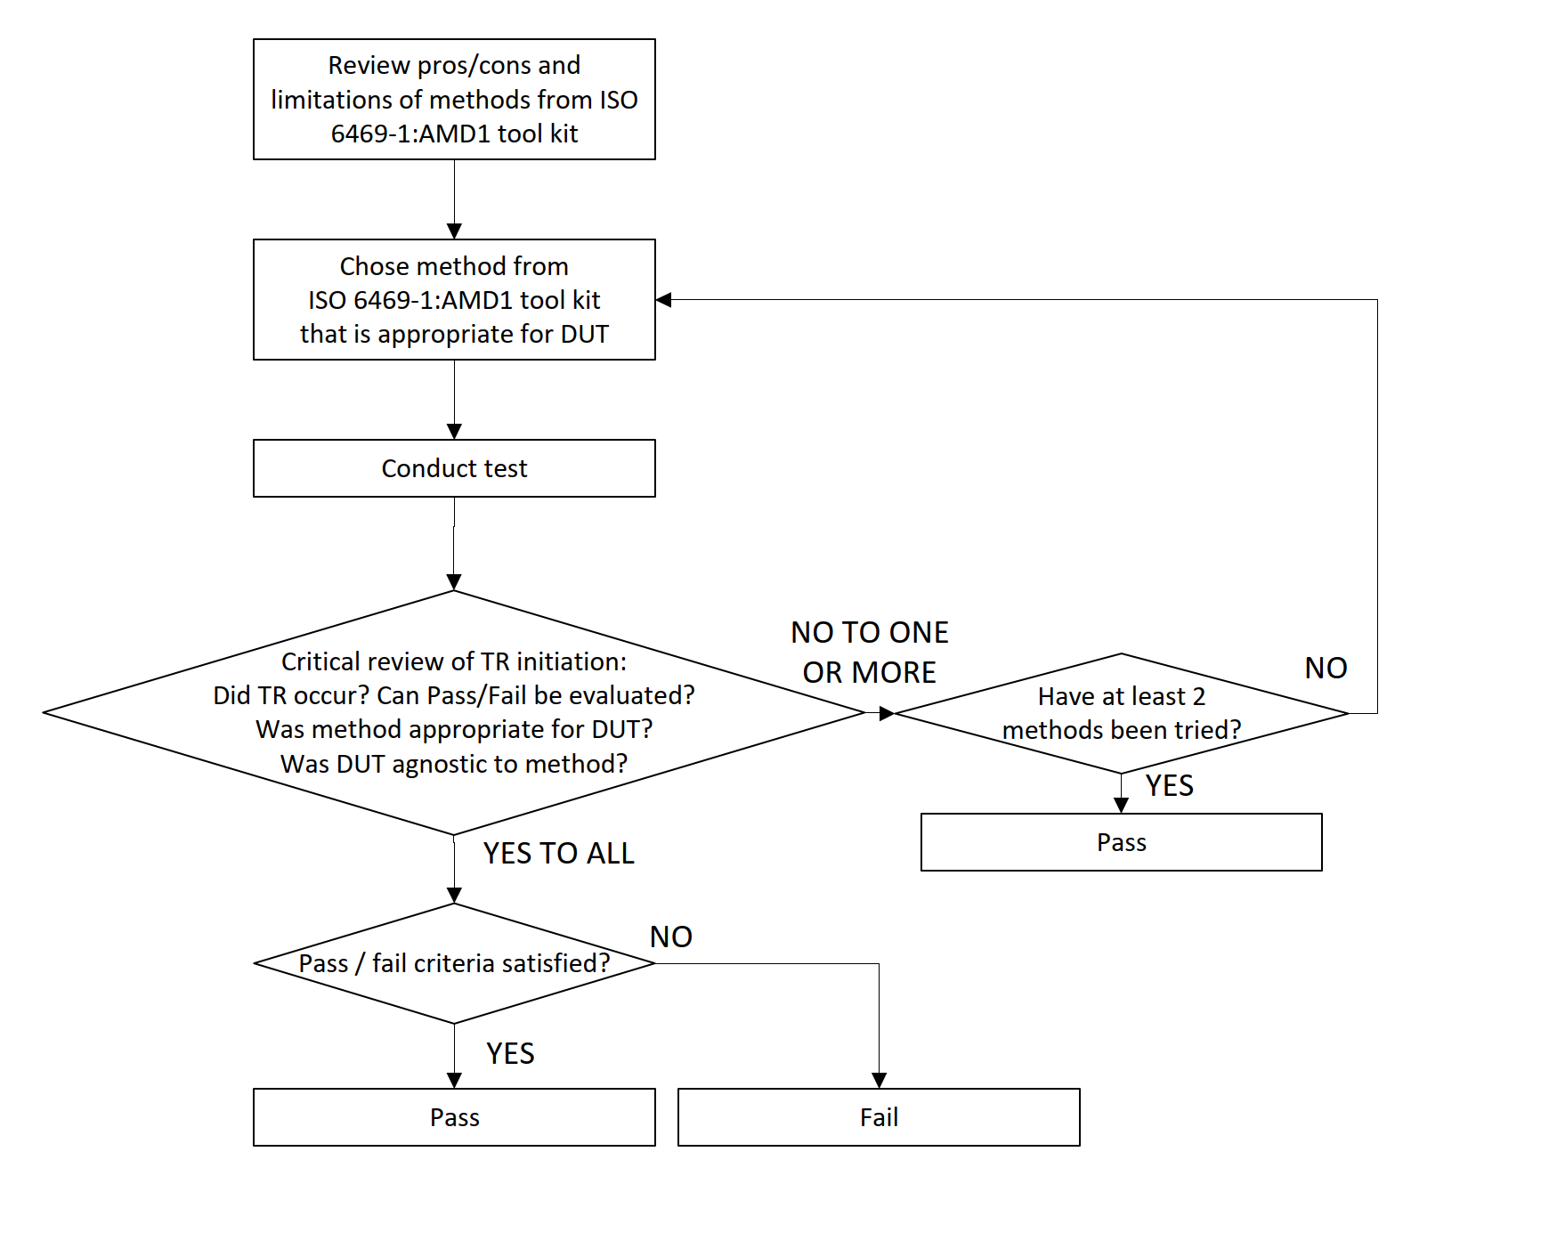
Question 5: Is there any comments on initiation method?
JP-CN proposal
CA proposal
In the meeting
Initiaion method should be discussed after other important issues.
China suggest to set a limit to the alternative initiation method such as ISO 6469-1 AMD, but the US don’t think it is necessary at this time.

Slide 9
Summary and next-step work
Parking mode-Consensus was achieved for this question in the meeting. All CPs agreed that parking mode need to be involved.
Scope-Different opinion on whether expanding the scope, which need further discussion and information input.
Hazard definition-Considering timetable, more simple but beneficial ways should be considered.
Safety requirements-If the scope or test mode will be modified, the safety requirements need to be modified.
Initiation method-Need more discussion(after other issues)
Next meeting: Scheduled after 24th IWG meeting

