Slide 1
Opinion on main issues of TP test
China
2022.6

Slide 2
Outline
In order to focus more on the test methods and ensure the completion of relevant work before the deadline, we put forward suggestions for focusing on the main problems and sovle them one by one.
  Question 1: Does Parking mode need to be involved?
  Question 2: Do we need to expand the scope of protection?
  Question 3: Do we need to modify the safety requirements?
  Question 4: How to define the hazardous situation?
  Question 5: Initiation method?

Slide 3
Question : Does Parking mode need to be involved？
Question : Do we need to expand the scope of protection?
difficult
out of cabin
Parking
scenarios
easy
in cabin
Driving
Option1：keep all parking and driving mode and scenarios in phase 2
Option2：leave out of cabin to phase 3 but keep parking mode in phase 2
Option3：leave parking mode to phase 3

Slide 4
Question: How to define the hazardous situation?
Hazardous situation is defined as external fire or explosion by visual inspection, the pass/fail criteria is same between vehicle level and component level.
Smoke and gas concentration are important issues. We think the problems （such as Which gas component? why? How to set the concentration limit and why? Detection location and test method）can be studied as a independent topic in a new group, and can be directly cited in TP when the research is mature.

Slide 5
Question: Do we need to modify the safety requirements?
It is not recommended to extend safety requirements to the outside of the cabin.
We believe that it is feasible to adopt safe time as the requirement.
We are open to Whether the 5min safe escape time needs to be adjusted.

Slide 6
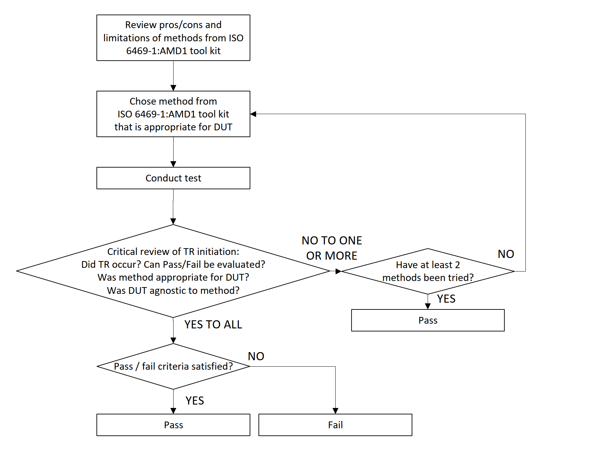
Question: initiation method?
It is recommended to directly refer to the methods in ISO 6469-1AMD.
We suggest that if one method cannot trigger thermal runaway, other methods in ISO 6469-1AMD should be tried until TR successfully triggered.
Did TR occur？
Did TR occur？
Have all methods been tried？
Have all methods been tried？

Slide 7
Make decisions on major issues to avoid repeating inefficient discussions
Since the answers to these three questions affect the content of follow-up work, it is hoped that consensus can be reached on the three core issues before next meeting.
Is safety outside the vehicle considered?
Can the trigger method refer to ISO 6469-1AMD?
Whether the flue gas should be reflected in the standard?
Can everyone make a statement today？Or after the meeting by email？

Slide 8
Thanks

