Slide 1



WLTP correction algorithms progress report from TUG (chassis) and TNO (road load) preliminary results
Working Paper No. WLTP-05-13
TU Graz: Stefan Hausberger
David Leitner
TNO: Norbert Ligterink
Rob Cuelenaere
Pim van Mensch

Slide 2
Correction algorithms for variations in the WLTP testing
Chassis dynamometer test (TUG)
    vehicle state (temperature, battery, fuel, etc.)
    test execution (velocity deviation, gear shifts, etc.)
    measurement equipment (accuracy, coast-down values, etc.)
Road load (coast-down) test (TNO)
    ambient conditions (wind, temperature, etc.)
    vehicle state (mass, wheels, tyres, alignment, etc.)
    test execution (tyre pressure, etc.)
    circuit (gradient, road surface, altitude, etc.)

Slide 3
WP 110 Correction parameters and algorithms for chassis dynamometer procedures
No | Parameter | Method | Comments
C1 | Deviation against target speed | Resulting deviation in positive cycle work at the chassis dyno can be corrected with marginal change based on Willans line: ΔkWh_{fuel}/ΔkWh_{work}. Deviations in braking could be corrected via the cycle distance. | At the moment approach and formulas are tested at TUG with measurements on 2 cars.
No | Parameter | Method | Comments
C2 | Quality of reference fuel (Heating value, density, H/C ratio) | Based on specific heating value [kWh/kg] and C-fraction of the test fuel the CO2 emissions could be corrected to be in line with a defined target fuel property (ratio of CO₂/kWh) | Tolerances for mass%-C and heating values as well as for their test methods to be checked.

Slide 4
WP 110 Correction parameters and algorithms for chassis dynamometer procedures
No | Parameter | Method | Comments
C3 | Inlet air temperature and humidity | Correct for combustion efficiency variations with ambient air conditions | First simulation of combustion process shows minor effects. Test on chassis dyno foreseen for 01/2014
No | Parameter | Method | Comments
C4 | Temperatures from preconditioning and soak | Correct for oil and water temperatures at the start of the test by generic function for work to overcome friction losses (ΔW/ΔT) | Generic friction loss elaborated from engine tests. Application on first measured vehicle showed good correction effect, Further validation on-going
No | Parameter | Method | Comments
C5 | Battery state of charge | The charging, or discharging, of the battery is to be added to the total work. | Already implemented in GTR draft. Validation with measurement on 2 cars on-going

Slide 5
WP 110 Correction parameters and algorithms for chassis dynamometer procedures
No | Parameter | Method | Comments
C6 | Inaccuracy of road load simulation of the chassis dynamometer | Calculate deviation against target braking force. Measured CO2 value could be corrected with Willans function similar to method for No. C1 | Status: check possible order of magnitude and actual GTR framework for road load determination on the chassis dyno to elaborate method for calculating deviation (e.g. difference against “target coast down” with defined pre-conditioning on chassis dyno)
No | Parameter | Method | Comments
C7 | CVS-Dilution Factor DF | Measured or generic Lambda value could be used instead of “Lambda=1” to derive DF | Error from Lambda-assumption is rather small.
No | Parameter | Method | Comments
C8 | Measurement equipment | Check if the state of art accuracy is better than the allowed tolerance.

Slide 6
WP 110 Correction parameters and algorithms for chassis dynamometer procedures
No | Parameter | Method | Comments
C9 | Electrified vehicles | Main part to consider are how the battery charging/discharging losses should be considered in the energy balance
No | Parameter | Method | Comments
C10 | Gear shifts | Deviations from the set shift locations influence engine efficiency. Corrections could be possible due to engine speed dependent efficiency ratios | Simulation work with model PHEM with max. off-set in gear shift time. Results may be used to elaborate generic correction function.

Slide 7
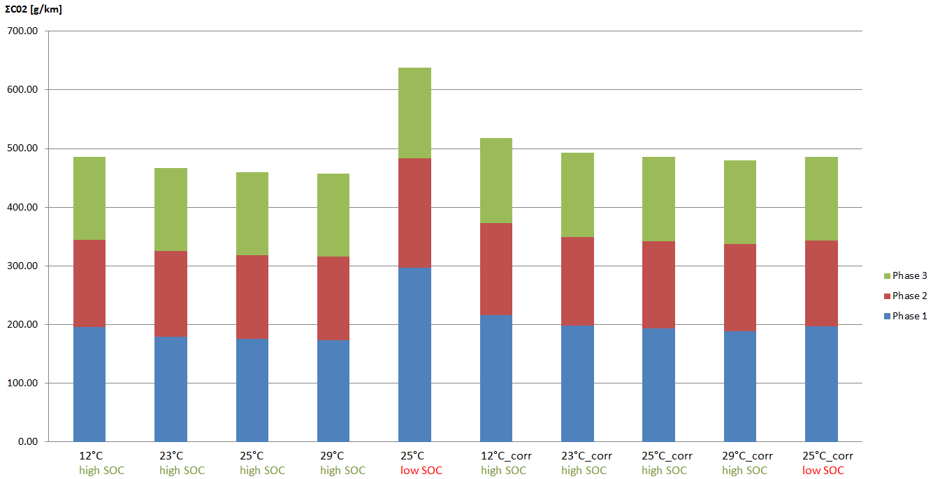
Example for result vehicle 1: Comparison of fuel consumption before and after SOC-correction
(T-correction not applied here)

Slide 8
WP 210 Correction parameters and algorithms for road load determination
No | Parameter | Method | Comments
R1 | rotational inertia correction | Weigh the wheels and tyres and use [60%-70%] of the weight as rotational inertia. | The rest of the driveline (after transmission) has a limited contribution, effect may vary somewhat with rim sizes and wheel type (secondary effect).
No | Parameter | Method | Comments
R2 | tyre pressure correction | The rolling resistance is corrected for difference between pressures by: f0_{final} = f0_{test} * (P_{test}/P_{set})^{alpha} | Conservative estimates: alpha ~ [1.0 - 1.5] (P_{test} > P_{set}) alpha ~ [0.7 - 1.2] (P_{test} < P_{set}) apply per tyre, average the result.
No | Parameter | Method | Comments
R3 | correct tyre pressure during the test (multiple values possible) | Measure or monitor tyre pressure during test (e.g. [every hour] and [shortly] before and after the test). | Tyre pressure varies +/- 12% during the test: in the high velocity tests tyres may heat up substantially. (Impossible to predict in all detail, therefore measurement is recommended.)

Slide 9
WP 210 Correction parameters and algorithms for road load determination
No | Parameter | Method | Comments
R4 | tyre label correction | f0_{final} = f0_{test}*(CRR_{class}/CRR_{test}) | Correct the actual tyre labels (CRR) back to the setpoint value, if CRR_{test} < CRR_{class}.
No | Parameter | Method | Comments
R5 | variation in results due to wind gustiness | Restrict time between tests, use sequential tests only. Ensure for the correct averaging of wind velocities. | Wind can vary substantially from minute to minute. Difficult to avoid, limit the effect. Apart from low vehicle velocities, wind always has a negative effect (higher road loads).
No | Parameter | Method | Comments
R6 | worst-case grill-vanes settings | Use open grill-vanes as worst case | Grill-vanes settings can result in a substantial change in air-drag. Effect is product of pressure drop and volumetric flow: large grill air flow preferable.

Slide 10
WP 210 Correction parameters and algorithms for road load determination
No | Parameter | Method | Comments
R7 | ambient temperature corrections | Tyre rubber viscoelasticity (as included) seems of limited relevance in combination with internal tyre temperature. | Tyre pressure during test strongly related to ambient conditions and test execution. If tyre pressure is corrected separately, additional temperature corrections may not be relevant.
No | Parameter | Method | Comments
R8 | wheel alignment (toe-in) | add to f0: [N] [0.25] * g * M_{TM} * angle/180 | Correct of absence of toe-in during the test. Difficult to validate. (Still under investigation.)
No | Parameter | Method | Comments
R9 | wheel caps | additional drag due to air flow through the wheels: maximal flow → open/no wheel caps. | Recommendation

Slide 11
WP 210 Correction parameters and algorithms for road load determination
No | Parameter | Method | Comments
R10 | Road surface correction | Use MDP (Mean Profile Depth) to correct f0 with: [CRR_{test} = CRR_{tyre} + 0.00172*MPD] | Literature study, still under review. [MPD_{standard} ~ 1.5?]
No | Parameter | Method | Comments
R11 | air density correction | Use air pressure and water vapour pressure. (Water vapour pressure depends on relative humidity and temperature.) | Already included. Air viscosity (onset of turbulence) still under investigation

Slide 12
TNO road-load validation programme:
one vehicle (from top-five EU sales 2012-2013)
3 test circuits (The Netherlands, Belgium, and Spain)
25 tests (variation of settings and conditions, 600+ runs, 58 hours of data)
  wheel size
  tyre label
  tyre pressure
  grill-vanes settings
  test mass
  wheel alignment
  ambient conditions (based on minute-by-minute data)
    temperature
    wind (minute mean and max, and direction)
    pressure
    relative humidity
  typical variations during a test: 2.8% (run-by-run, uncorrected)
  typical variations between tests: (on basis of test averages)
      20 km/h: 13%
      120 km/h: 3.5 %

Slide 13
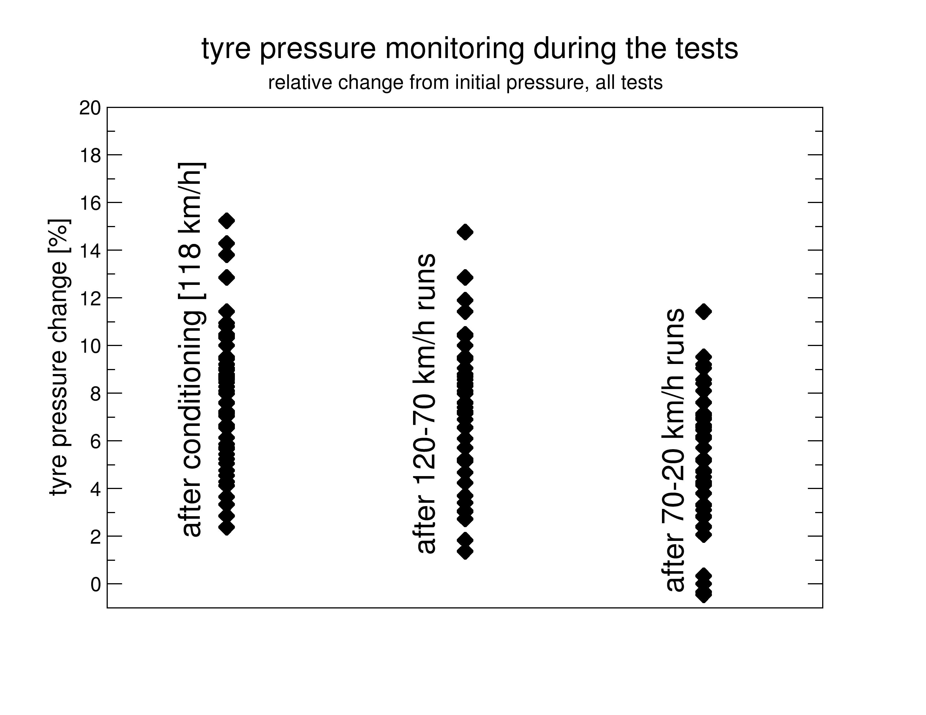
example: tyre pressure variations during testing
0%-15% higher pressure, similar effect on rolling resistance
12% span in the measurements
→ ~15% in rolling resistance

Slide 14
timeline & deliverables
Deliverables:
    description of the methods
    validation of the methods
    draft regulatory texts
Milestones:
    draft report on methods end January 2014
    complete draft report in March
    final report in June

