Slide 1
HELPNET System Specifications
AECS-03-05
26 February 2014
JAPAN

Slide 2


1. HELPNET System Composition and Functions
Services of HELPNET
Position info depositing & accident reporting (data/voice communication): Reporting device
Member/vehicle information acquisition: Members Center
Voice communication with reporters & telephoning to public agencies: HELPNET Center
Data transmission between HELPNET Center and public agencies: HELPNET Center, Public agencies
Reported data:
・Position info (report site)
・Position info (travel trail)
・Road type
・Sensor info (∆V, etc.)
・Originator ID
Reported data:
▪Position info (report site)
▪Position info (travel trail)
▪Road type
▪Sensor info (∆V, etc.)
▪Member info (phone no., name…)
▪Vehicle info (no., model, color…)
Public agencies
【通報データ】
・位置情報（通報場所）
・位置情報（走行軌跡）
・道路種別
・センサ情報（⊿Ｖなど）
・会員情報（電話番号、名前など）
・車両情報（ナンバー、車種、色など）
Info
acquisition
警察
警察
・・・
警察
・・・
Police
Police
Police car
・・・
Reporting device
Members Center
HELPNET Center
Operator
Originator ID
-
Member/
vehicle info
消防
・
・
消防
Member
reporter
消防
消防
・・・
・・・
Fire service
Data
communication
Data
communication
Data
communication
Fire service
Ambulance
・・・
Voice
communication
Voice
communication
Report to public agencies (police/fire stations in jurisdiction)

Slide 3
2. Sequence of Telecommunication
Emergency reporting
Two reporting modes: (a) Automatic reporting at airbag deployment, (b) Manual reporting by original reporter
Communication starts up by data transmission from the reporting device; an operator at HELPNET Center finds the situation through voice communication and reports to a public agency.
In case of automatic reporting (if impossible to converse with the original reporter), the operator calls for an ambulance.
Reporting device
Members Center & HELPNET Center
Public agencies
(fire/police stations)
Reported data (originator ID, position)
HTTP/1.1
Packet net
Phone no. for voice communication
Calling phone no. to talk
Voice communication
Voice communication
Circuit switched net
Reported data (position, member/vehicle info)
Dedicated IP net
(Online or FAX)
HTTP/1.1
Voice communication
(notification of the original reporter’s condition, data transmission)
Direct conversation

Slide 4
3. Functions of the Reporting Device
Functions installed in the reporting device
Retention of data for connection with the HELPNET Center
Data on originator ID (to identify the reporting device/member)
HELPNET Center’s URL for data transmission
Recording of position and time data
Data to specify positions using GPS, gyro, vehicle velocity signals, map-matching, etc. (even where GPS cannot work)
Data on travel trail (64 points) leading up to the accident point
*In case voice communication with the original reporter is difficult, the above data are used to speculate whether an expressway or a surface road, the direction of vehicle progress.
*The travel trail is about 5 km long (64 points at 80 m intervals) so as to suit Japan’s road environment where many expressways and surface roads run parallel.
Acquisition of sensor data to estimate the injury severity (future function)
Data on airbag condition, multiple crash, speed change (See “4. List of Data Reported to the HELPNET Center”.)
Voice communication
Hands-free conversation by the original reporter (sufficiently large sound volume dispensing with a handset)
Automatic response (talk readiness) to voice from emergency agency or HELPNET Center after data transmission

Slide 5
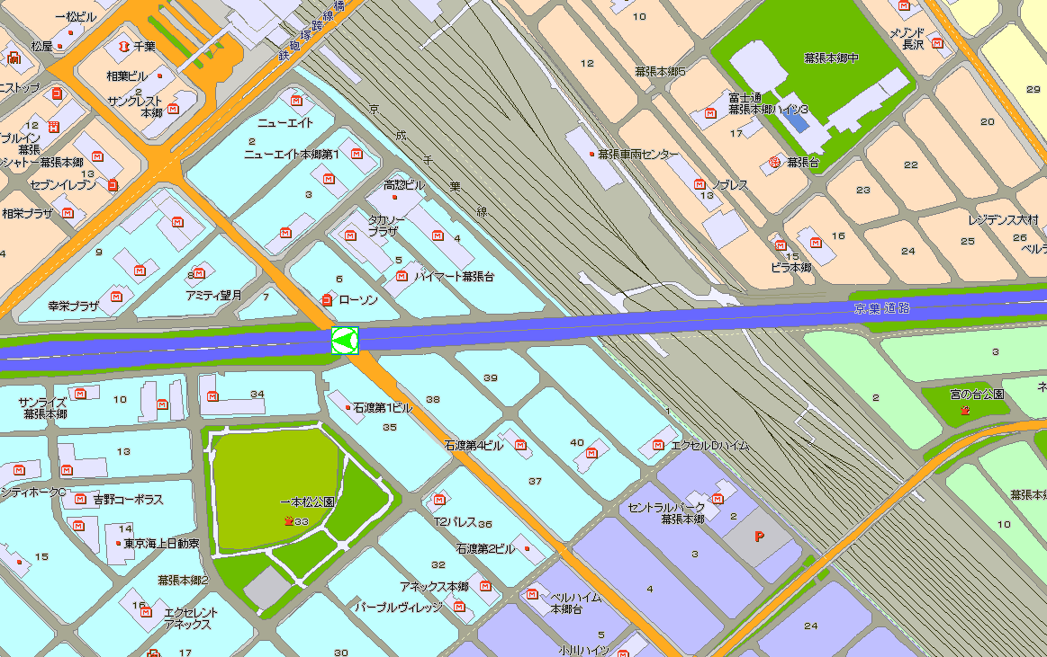
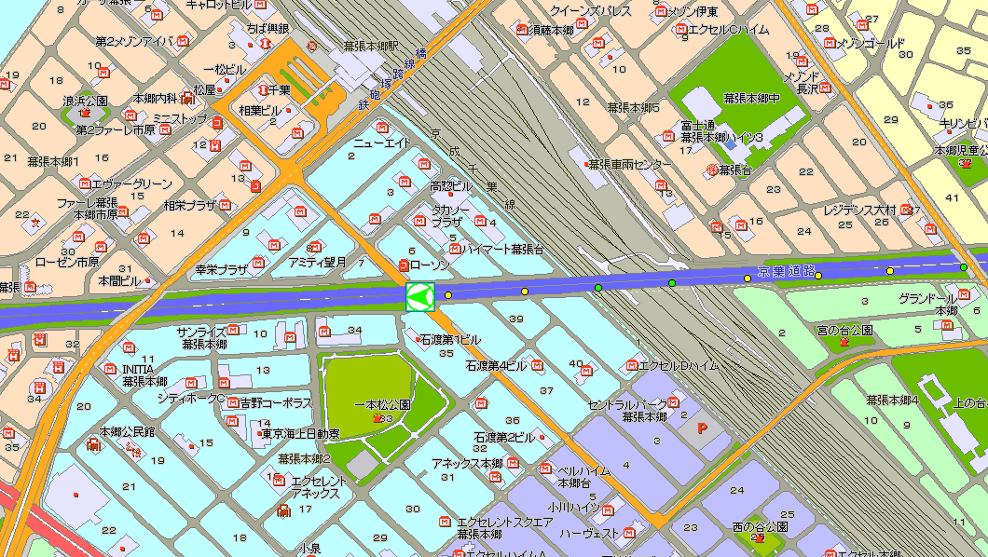
Example of data usage with or without travel trail (1): Chiba, Chiba Prefecture
Without travel trail
Keiyo Expressway runs above a surface road, crossing another surface road.
The data on the accident point alone cannot identify the road type (surface road or expressway).
Indication of the travel trail consisting of several points finds that the vehicle was running above a railroad track (Keiyo Line), which then helps speculate that the reporting was made from the expressway.
(19 October 2013)
With travel trail (about 10 points)

Slide 6
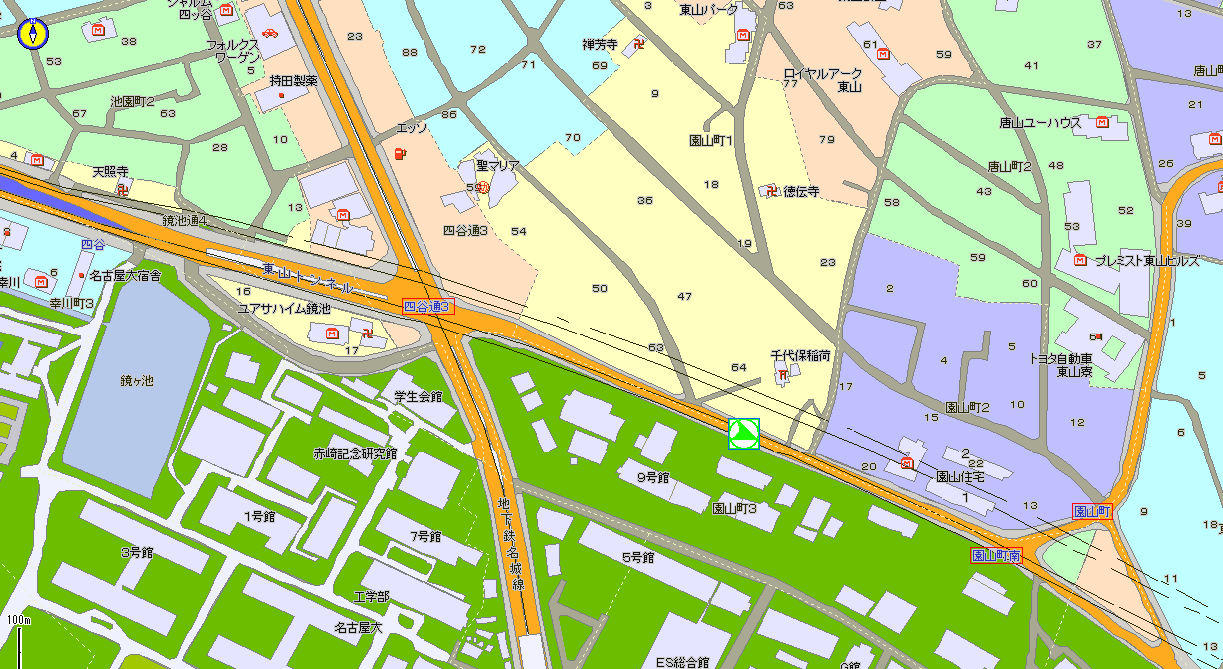
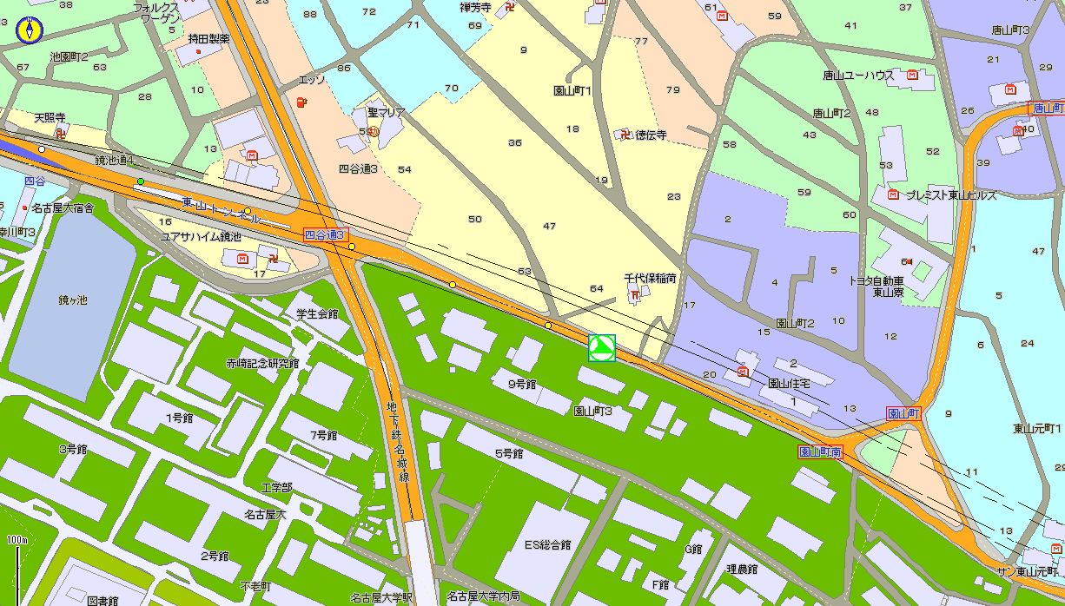
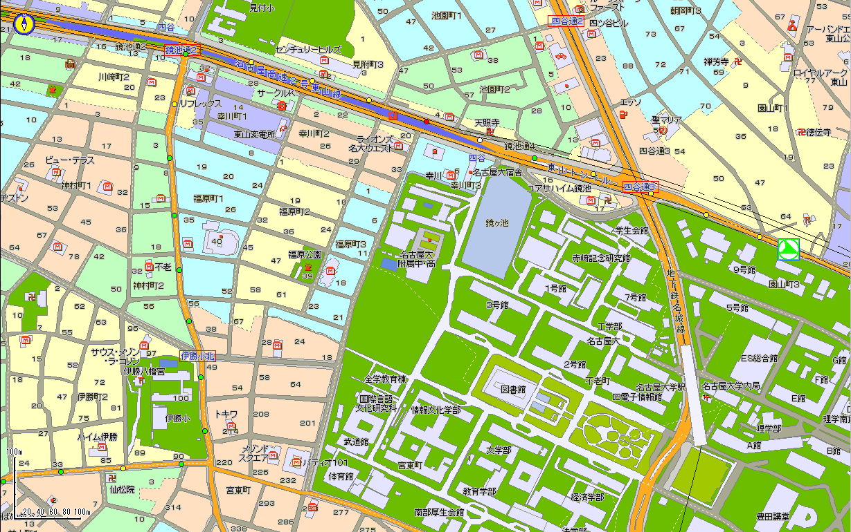
Example of data usage with or without travel trail (2): Nagoya, Aichi Prefecture
Without travel trail
A surface road runs above Nagoya Expressway Route 2 (Higashiyama Route).
The data on the accident point and several other points alone cannot identify the road type (surface road or expressway).
Indication of the complete travel trail finds that the reporting was made from the surface road.
(30 May 2013)
Trail traveled
With travel trail (about 10 points)
With travel trail (complete)

Slide 7
4. List of Data Reported to the HELPNET Center - 1
Data from the reporting device
Tag |  | Value and Description
Sequence No. | SQ_NO | Request sequence No. 00-99
Origination time | E_TIM | UTC “YYYY-MM-DDThh:mm:ssTSD”
Originator phone No. | TEL | Mobile phone no. of originator
Originator ID | U_ID | No. assigned to reporting device for member/vehicle ID
Service ID | S_ID | No. to identify service category
Report type | C_TYPE | 0：Manual 1：Automatic
Sensor info 1 | S_KIND | [Sensor info 1] (1) Front airbag (2) Side airbag (3) Rear-impact sensor (4) Overturn sensor (5) Belt sensor (driver) (6) Belt sensor (passenger) [Sensor info 2] (1) Passenger detect (2) Multiple crash (speed change 2 generated) [Value] 0: Sensor info lacking 1: Sensor info OFF 2: Sensor info ON 3: Sensor info abnormal
Sensor info 2 | S_KIND2
Speed change 1 (Fore-aft) | S_DVL1 | Speed change –128 ~ +127; Unit km/h (Fore-aft) + impact from rear; - impact from front (Lateral) + impact from left side; - impact from right side
Speed change 1 (lateral) | S_DVW1
Speed change 2 (Fore-aft) | S_DVL2
Speed change 2 (lateral) | S_DVW2

Slide 8
4. List of Data Reported to the HELPNET Center - 2
Tag |  |  | Value and Description
Unit of latitude/longitude |  | UNIT | 0: Degree, minute, second 1: Degree
Geodetic data (latitude, longitude, height) |  | DTUM | 0: WGS-84 geodetic reference system
No. of transmission sites |  | P_NO | Standard 64 sites
Position info 1 | Position acquisition time | P_TIM1 | UTC “YYYY-MM-DDThh:mm:ssTSD”
 | Latitude information | P_LAT1 | Latitude information
 | Longitude information | P_LON1 | Longitude information
 | Direction | P_DIR1 | 0~359 degrees
 | Speed | P_SPD1 | Km/h
 | Position accuracy | P_DEF1 | Meters
・ ・ ・ | ・ ・ ・ | ・ ・ ・ | ・ ・ ・
Position info 64 | Position acquisition time | P_TIM64 | UTC “YYYY-MM-DDThh:mm:ssTSD”
 | Latitude information | P_LAT64 | Latitude information
 | Longitude information | P_LON64 | Longitude information
 | Direction | P_DIR64 | 0~359 degrees
 | Speed | P_SPD64 | Km/h
 | Position accuracy | P_DEF64 | Meters
5. Originator Data Transmitted by Center to Public Agencies
Tag |  | Value and Description
Member’s name in Kanji | P_NAM | Member’s name in Kanji
Member’s name in Kana | K_NAM | Member’s name in Kana
Registered number | C_NUIM | Registered number
Automaker’s name | C_NAM | Vehicle name (automaker’s name)
Vehicle model name | V_NAM | Vehicle name (model name)
Vehicle type | T_NAM | Vehicle type, etc.
Body color | C_COL | Vehicle body color

Slide 9
6. Summary of HELPNET
HELPNET system has developed transmission data and reporting sequence that are different from e-Call MSD, because of requests from the fire and policy agencies.
Transmission data
Following optional data must be included to answer Japanese needs:
UN-regulation should permit to add optional data.
Member information (ID)
Position/travel trail information
AACN accident info from vehicle sensors
Reporting sequence
The reporting sequence of HELPNET, fitted to the Japanese infrastructure, differs from e-Call as follows:
Packet data communications
Referencing of member info and reporting of phone number info by the center
Information relay from the center to public agencies
For countries to suit their different national conditions, no detailed requirements for reporting sequence should be established in any UN Regulations.

Slide 10
7. Japan’s Position
Transmission data
Japan requests the regulation to be such that, in addition to the MSD (minimal set of data) to be sent from the vehicle, supplemental data transmission may be allowed depending on each Contracting Party’s communication infrastructure and other conditions. As regards the VIN to be included in the MSD, each Contracting Party’s national regulation should be complied with.
* Data communication method
The regulation should include a provision that simply states that each Contracting Party may use any data communication method suitable for use in that country.
The data communication conditions greatly vary from country to country. Moreover, since the data communication method development takes place rapidly, future technological progress would be compromised if the regulation contained detailed requirements based on the current data communication technologies.

