Slide 1
Technical regulation in the scope of
ERA-GLONASS emergency response system deployment
Victor Gladkikh,
Deputy head of complex on technical regulation, Phd
Artem Klimovskiy,
Technical analyst
Seminar on ERA GLONASS
Accident Emergency Call System (AECS)
Moscow
February 25th 2014

Slide 2
Technical regulation and Standardization action plan in the scope of ERA-GLONASS project
Field of activity | Target | Planned actions
Technical regulation | To amend the Technical Regulation on wheeled vehicles safety with requirements on IVS obligatory installation and main IVS requirements (ERA-GLONASS terminal) | 1. Technical Regulation of Customs Union (ТR CU 018/2011) - DONE 2. Draft Technical Regulation of Russian Federation (approved by Government Resolution № 720 on September 10th 2009)
Standardization | 1. To ensure ERA-GLONASS system usage 2. To ensure execution of Technical Regulation on wheeled vehicles safety (Russian TR, ТR CU) 3. To guarantee functional compatibility of Russian ERA-GLONASS and EU eCall systems | National standards development in the scope of ERA-GLONASS system deployment - DONE

Slide 3
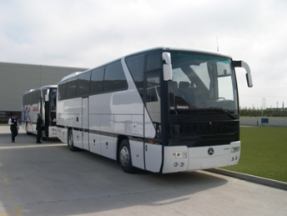
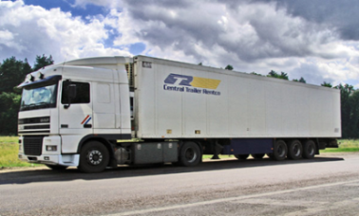

Technical regulation of Customs Union on wheeled vehicles safety (ТR CU 018/2011)
Objects of technical regulation
(ERA GLONASS onboard terminals):
M2, M3,
N2, N3
in-vehicle emergency call device (IVeCD) –
intended to determine the coordinates, speed and direction of the vehicle by means of signals of at least two global navigation satellite systems, to transfer the data on the vehicle when in road and other accidents in manual mode*⁾ and to provide two-way voice communication with emergency services using mobile telephone networks (vehicles of categories M1 & N1 not relevant to R94&R95, M2, M3, N2 & N3).
in-vehicle emergency call system (IVeCS) –
a system which has a IVeCD functionality, intended to transfer the data on the vehicle when in road and other accidents in automatic mode (vehicles of categories M1 & N1 relevant to R94&R95).
M1, N1
MVNO
90%
*) In automatic mode for IVeCD - from Jan 1st 2017 when rollover.

Slide 4
Agreed IVS introduction schedule
in-vehicle emergency call device (IVeCD) | in-vehicle emergency call system (IVeCS)
01 Jan 2015 –assessment of compliance in the form of vehicle type approval at first time (vehicles of categories M1 & N1 not relevant to R94&R95; M2, M3, N2 & N3) | 01 Jan 2015 –assessment of compliance in the form of vehicle type approval at first time (vehicles of categories M1 & N1 relevant to R94&R95)
01 Jan 2016 – categories of vehicles that will be put in circulation in the territory of the of Customs Union: - vehicles of categories M2 & M3 (intended for commercial passenger transportation or transportation of children); - vehicles of categories N2 & N3 (intended for dangerous cargo transportation)
01 Jan 2017 – all vehicles that will be put in circulation in the territory of the of Customs Union (vehicles of categories M1 & N1 not relevant to R94&R95; M2, M3, N2 & N3) | 01 Jan 2017 – all vehicles that will be put in circulation in the territory of the of Customs Union (vehicles of categories M1 & N1 relevant to R94&R95)
MVNO
90%

Slide 5
Ensuring execution of Technical Regulation of
Customs Union (1/2)
ТR CU 018/2011
Requirements
(clause 13.1; sections 16 & 17 of
Annex 3 , clause 118 of Annex 10)
Compliance assessment (Chapter V)
(UN Regulation for AECS not available)
List of standards defining requirements
List of standards for Compliance assessment
International Regulation (UN Regulation)
Regional (Interstate GOST)
National (GOST R)
MVNO
90%

Slide 6
Ensuring execution of Technical Regulation of
Customs Union
National standards «Road accident emergency response system» (2/2)
Purposes of development | 1. To ensure ERA-GLONASS system usage 2. To ensure execution of Technical Regulation on wheeled vehicles safety (Russian TR, ТR CU) 3. To guarantee functional compatibility of ERA-GLONASS and eCall systems
Set of standards | All-system (3) | Standards of technical requirements (2) | Standards for compliance testing (6)
Objects of standardization | Terms and definitions (Draft GOST R) General provisions (Draft GOST R) GOST R 54721-2011 “General base service description” & Amendment №1 GOST R 54721 | GOST R 54620-2011 “In-Vehicle Emergency Call System. General technical requirements” & Amendment № 1 GOST R 54620 GOST R 54619-2011 “Protocol of data transmission from in-vehicle emergency call system to emergency response system infrastructure” & Amendment № 1 GOST R 54619 | Road accident emergency response system. Test methods: GOST R 54618-2011 “Compliance test methods of in-vehicle emergency call system for electromagnetic compatibility, environmental and mechanical resistance requirements” (& Amd.1); GOST R 55530-2013 “Functional test methods of In-Vehicle emergency call system and data transfer protocols”; - GOST R 55531-2013 “Test methods of in-vehicle emergency call system conformity to the requirements for quality speakerphone in a vehicle cabin”; GOST R 55532-2013 “Test methods of in-vehicle emergency call system crash detection feature; GOST R 55533-2013 “Test methods for wireless communication module of in-vehicle emergency call system; GOST R 55534-2013 “Test methods for navigation module of in-vehicle emergency call system”
Standards in GREEN are approved,
Standards in RED are finalized and forwarded for approval to ROSSTANDADRT

Slide 7
National standard on IVS requirements approved in Dec 2011
Development and approval (1/2)
Harmonization with international standards
  ISO/IEC standards:
  ISO 2575:2010/ Amd.1:2011 Road vehicles -- Symbols for controls, indicators and tell-tales. Amendment 1
  ISO 24978:2009 Intelligent transport systems -- ITS Safety and emergency messages using any available wireless media -- Data registry procedures
  Etc.
  CEN standards:
  EN 15722 Road transport and traffic telematics — eSafety — eCall minimumset of data (MSD)
  EN 16072 Intelligent transport systems — eSafety – Pan European eCall – Operating requirements
  Etc.
  ETSI/3GPP/ITU standards:
  ETSI TS 124 008 (3GPP TS 24.008) Technical Specification Group Core Network and Terminals-- Mobile radio interface Layer 3 specification-- Core network protocols; Stage 3,Release 8.
  ETSI TS 126 267 (3GPP TS 26.267) Technical Specification Group Services and System Aspects-- eCall Data Transfer-- In-band modem solution-- General description, Release 8
  ITU-TP.1100/1110 Narrow/Wideband-band hands-free communication in motor vehicles
  Etc.

Slide 8
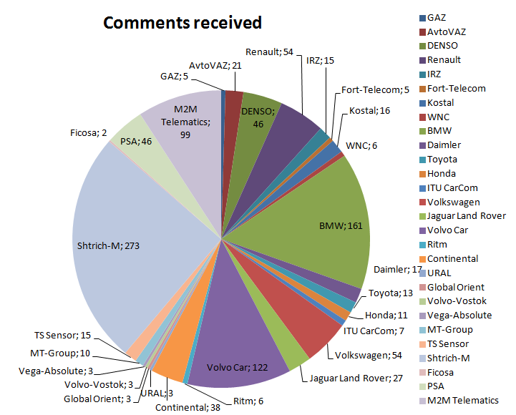
National standard on IVS requirements approved in Dec 2011
Development and approval (2/2)
TS (NIS standard): IVS requirements
Requirements review started | July 2010
Requirements review duration | 13 months
Number of companies received requirements | 370
Number of companies submitted comments | 33
Total number of comments received | 1081
National standards drafts: IVS requirements
Standards drafts review started | Aug 2011
Standards drafts review duration | 3 months
Number of companies notified about standards drafts review | 345
Number of companies submitted comments | 12
Total number of comments received | 285
National standards drafts: IVS review data
Standards drafts review started | Aug 2011
Standards drafts review duration | 3 months
Number of companies notified about standards drafts review | 345
Number of companies submitted comments | 12
Total number of comments received | 285
Confirmed IVS requirements review was organized effectively
OEM associations – 22 members in total
more than 5 Tier 1 suppliers
35 OEM’s confirmed they do understand IVS requirements
More than 5 Tier 1 suppliers and more than 5 Russian companies confirmed aftermarket / retrofit IVS mass production can start in Q1 2013
Standard is approved, published and available at Federal information fund of technical regulations and standards (FGUP STANDARTINFORM)

Slide 9
National standards on test methods approved in Aug 2013
Development and approval (1/2)
National standards drafts: review data
Standards drafts review started | June 2012
Standards drafts review duration | September 2012
Standards drafts review duration | 3 months
Public review notification on Rosstandart website | http://www.gost.ru/wps/portal/pages.Notif.StandartAbout
National standards drafts on TC 363 «Radionavigation» website | http://www.internavigation.ru/page.phtml?p=8
Total number of companies notified about standards drafts review | 560
Including:
Member companies TC 363 | 35
Car manufacturers | 170
Navigation & communication related companies (Russian & foreign) | 255
Aftermarket vehicle components manufacturers | 100

Slide 10
National standards on test methods approved in Aug 2013
Development and approval (2/2)
National standard* | Number of comments received**
GOST R 55530-2013 GNSS. Road accident emergency response system. Functional test methods of In-Vehicle emergency call system and data transfer protocols; | 32
GOST R 55531-2013 GNSS. Road accident emergency response system. Test methods of in-vehicle emergency call system conformity to the requirements for quality speakerphone in a vehicle cabin; | 15
GOST R 55532-2013 GNSS. Road accident emergency response system. Test methods of in-vehicle emergency call system crash detection feature; | 25
GOST R 55533-2013 GNSS. Road accident emergency response system. Test methods for wireless communication module of in-vehicle emergency call system; | 36
GOST R 55534-2013 GNSS. Road accident emergency response system. Test methods for navigation module of in-vehicle emergency call system. | 7
Results of public review: Accepted – 75% of all comments received Rejected with justification – 20% of all comments received Comments provided – 5 % of all comments received
*) Standards are approved, published and available at Federal information fund of technical regulations and standards (FGUP STANDARTINFORM)
**) A consolidated comment table was received from ACEA

Slide 11
IVS national standards amended in 2013
Development and approval (1/2)
National standards drafts (Amd.1 GOST R 54XXX-2011) : review data
 | GLONASSUNION
Standards drafts review started | July 2013
Standards drafts review duration | August 2013
Standards drafts review duration | 1 month
Public review notification on Rosstandart website | http://www.gost.ru/wps/portal/pages.Notif.StandartAbout
National standards drafts on TC 363 «Radionavigation» website | http://www.internavigation.ru/page.phtml?p=8
Total number of companies notified about standards drafts review | over 150
Including:
Member companies TC 363 | 35
Car manufacturers | 45
Navigation & communication related companies (Russian & foreign) | 70
Aftermarket vehicle components manufacturers | 10

Slide 12
IVS national standards amended in 2013
Development and approval (2/2)
National standard | Number of comments received
Amd.1 GOST R 54618-2011 GNSS. Road accident emergency response system. Compliance test methods of in-vehicle emergency call system for electromagnetic compatibility, environmental and mechanical resistance requirements; | over 356
Amd.1 GOST R 54619-2011 GNSS. Accident emergency response system. Road 0accident emergency response system. Protocols of data transmission from in-vehicle emergency call system to emergency response system infrastructure; | over 80
Amd.1 GOST R 54620-2011 GNSS. Road accident emergency response system. In-vehicle emergency call system. General technical requirements. | 10
Results of public review: Accepted – 60% of all comments received Rejected with justification – 30% of all comments received Comments provided – 10% of all comments received
Standards are forwarded to national standardization organization (ROSSTANDART) for approval and publication

Slide 13
UN Regulation development on
Accident Emergency Call System
World Forum for Harmonization of Vehicle Regulations on its 159th session (WP 29), March 2013 – Russian Federation (Ministry of industry and trade of Russian Federation) announced its intention to propose a new UN Regulation on emergency call systems;
World Forum for Harmonization of Vehicle Regulations on its 160th session (WP 29), June 2013 – an informal working group (IWG) was created under The Working Party on General Safety (GRSG) for developing the new UN Regulation on emergency call systems. IWG on emergency call system starts working on this subject under the chairmanship of the Russian Federation.
(ECE/TRANS/WP.29/1104, Paragraphs 74-76);
1st meeting of the GRSG IWG on Accident Emergency Call System (AECS) (in the scope of 105 GRSG session WP 29, 08 -10 October 2013, Geneva) - UN Regulation draft discussion developed by Russian Federation (AECS-01-05e);
2nd meeting of the GRSG IWG on AECS (05 - 06 December 2013, Paris) – UN Regulation draft discussion developed by OICA (AECS-02-02e);
3rd meeting of the GRSG IWG on AECS (25 - 28 February 2014, Moscow):
- Seminar on ERA-GLONASS emergency call systems;
- UN Regulation draft discussion developed by OICA with propositions of Russian Federations;
4th meeting of the GRSG IWG on AECS - 28 - 30 April 2014, Paris (OICA).
MVNO
90%

Slide 14
Thank you!

