Slide 1
ERA-GLONASS Project Status
Seminar on ERA GLONASS
Accident Emergency Call System (AECS)
Moscow
February 25th 2014

Slide 2



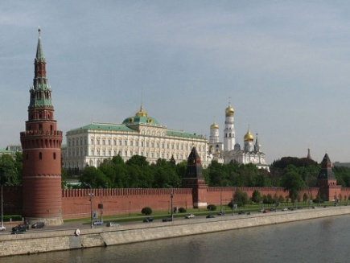









GLONASS Union is a Non-profit Partnership
ERA-GLONASS
National navigation services provider
Government contractor for building the ERA-GLONASS System
Partnership of Navigation-based Services market leaders

Slide 3
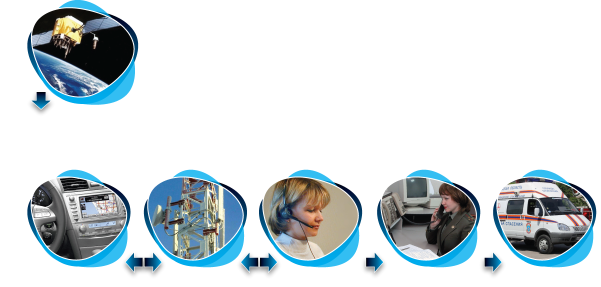
National Initiative to Increase Safety on Russian Roads
  Saving up 4 000 lives annually
  Decrease of disabilities and fatalities
  Mitigation of road accident consequences severity and liquidation costs
  Economical effect is expected to reach 22 billion Rubles by 2020
GLONASS/GPS
* Estimations done assuming 100% vehicles are equipped with ERA-GLONASS IVSs
Harmonization with European eCall
ERA-GLONASS
In-Vehicle System
ERA-GLONASS Operator
Regional PSAP (System-112)
Emergency Response Services
Mobile
networks
Emergency Response to a road traffic accident

Slide 4
4 years from the idea to realization!
Project Key Points
October
2009
Project approved by the Commission for Modernization and Technological Development of Russia's Economy
Ministry of Transport takes over a role of Sate Customer form Roscosmos
GLONASS Union appointed as sole Contractor
Amendments to Technical Regulation of Vehicle Safety are adopted
The Federation Council approved the Federal Law on ERA-GLONASS System
ERA-GLONASS System is put into pre-production operation
First State Contract for ERA-GLONASS design and deployment is signed
Service is available for the vehicles with ERA-GLONASS OBU
May
2010
2012
30 January 2013
December 2013
2014
2015

Slide 5
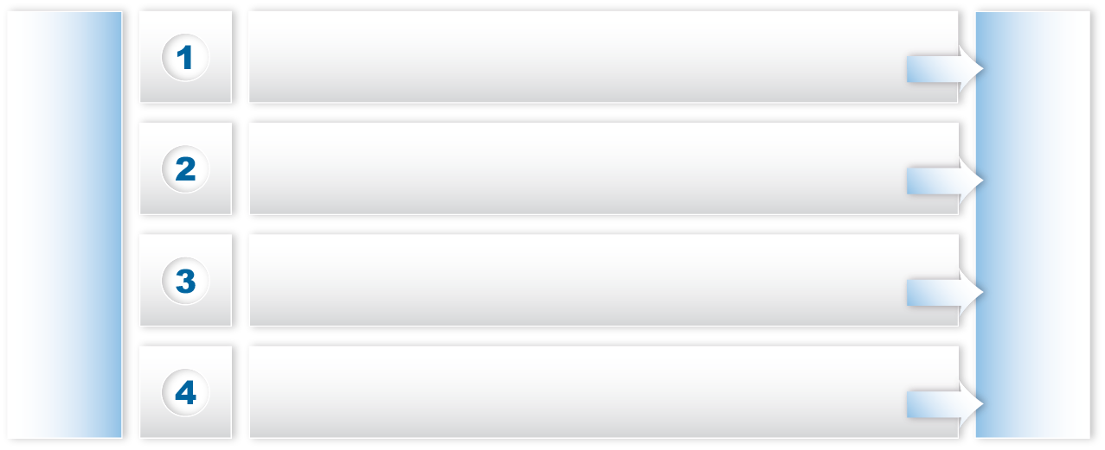
ERA-GLONASS development
2010
2011
2012
2013
2014
Feasibility, Requirements definition
PoC,
Pilot project, Planning
System and Network Design
Procurement, Deployment,
Ready for Service
Integration
to major MNOs and System-112
May 2010
Start of ERA-GLONASS project (Government Contract signed)
Operations start in 2014
Service to start in 2015
System design -> Planning -> Deployment
Legislation and Regulatory Framework development
In-Vehicle System requirements definition
Emergency Response Services interplay definition

Slide 6
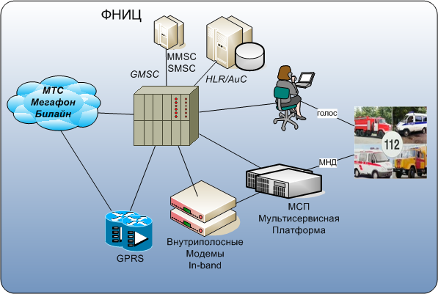
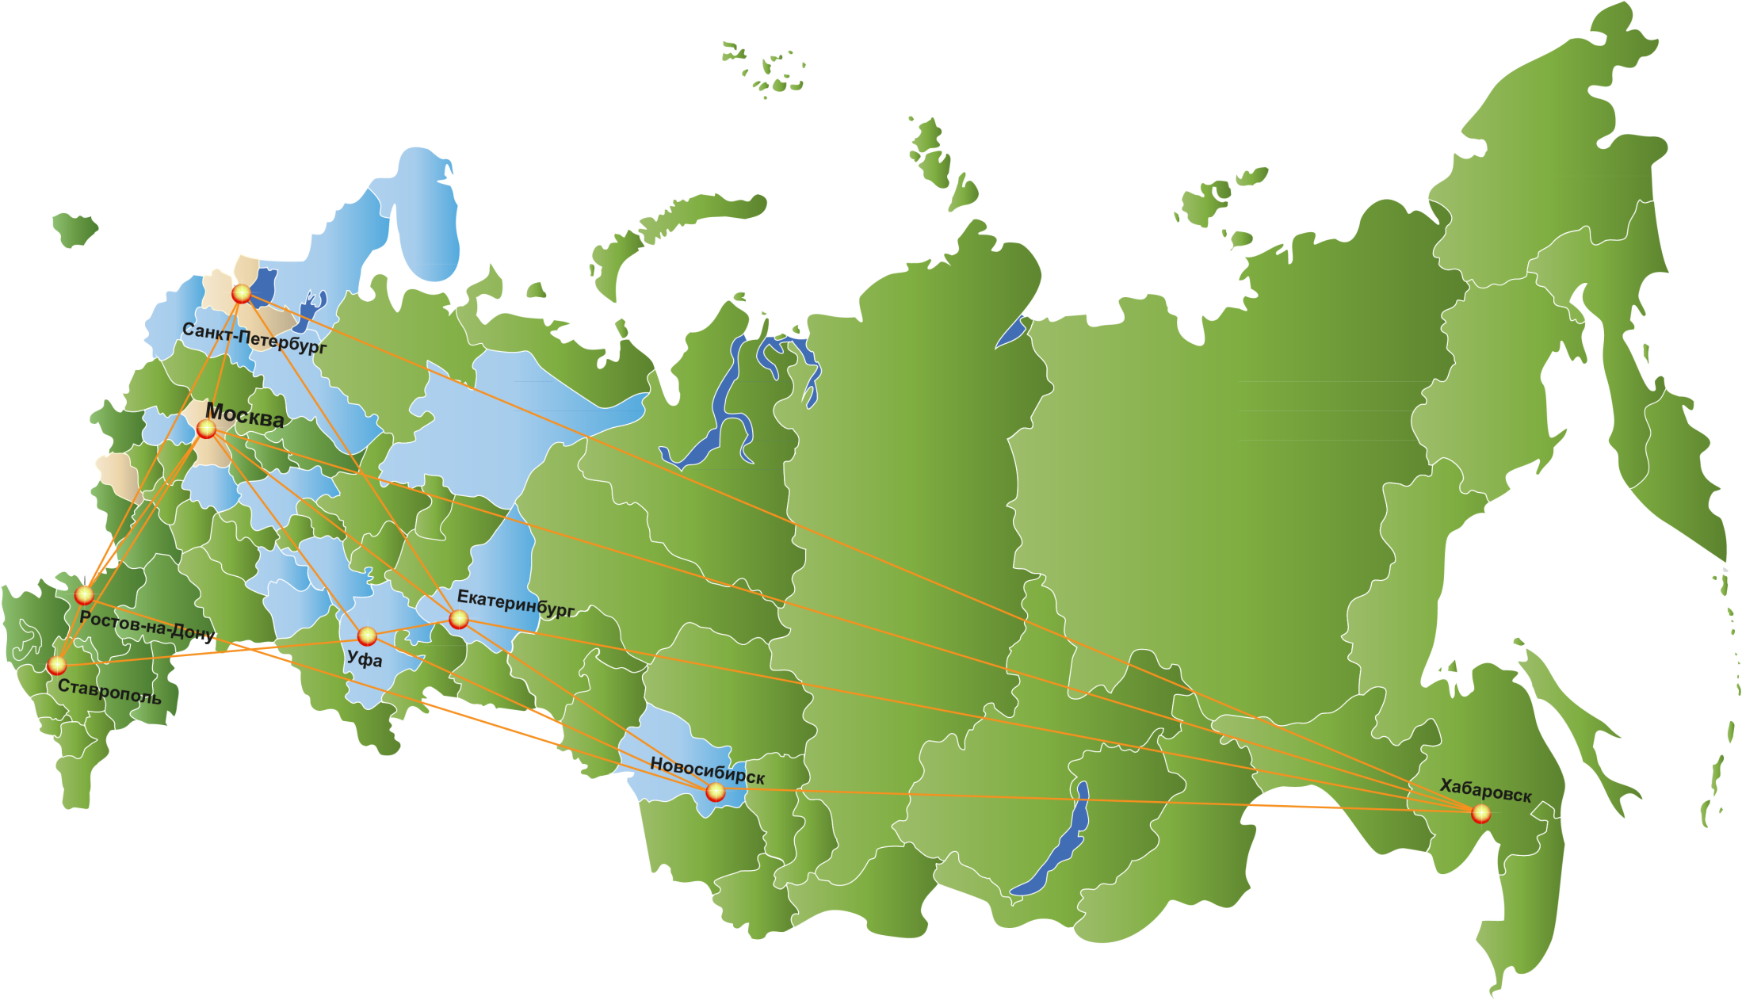

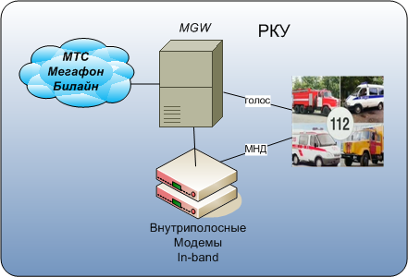

ERA-GLONASS footprint
Service available in each region of Russia ✔
Federal roads coverage*
МТС 91%
Megafon 94%
Beeline 85%
ERA-GLONASS
99%
* Official data, as of Dec 2013
MVNO Infrastructure - 80 Nodes
2011
2 Central nodes + 1 Regional node (MSK, SPB, Kursk)
15 Regional nodes (3 NIC + 12 RKU)
62 Regional nodes (3 NIC + 59 RKU)
2012
2013

Slide 7
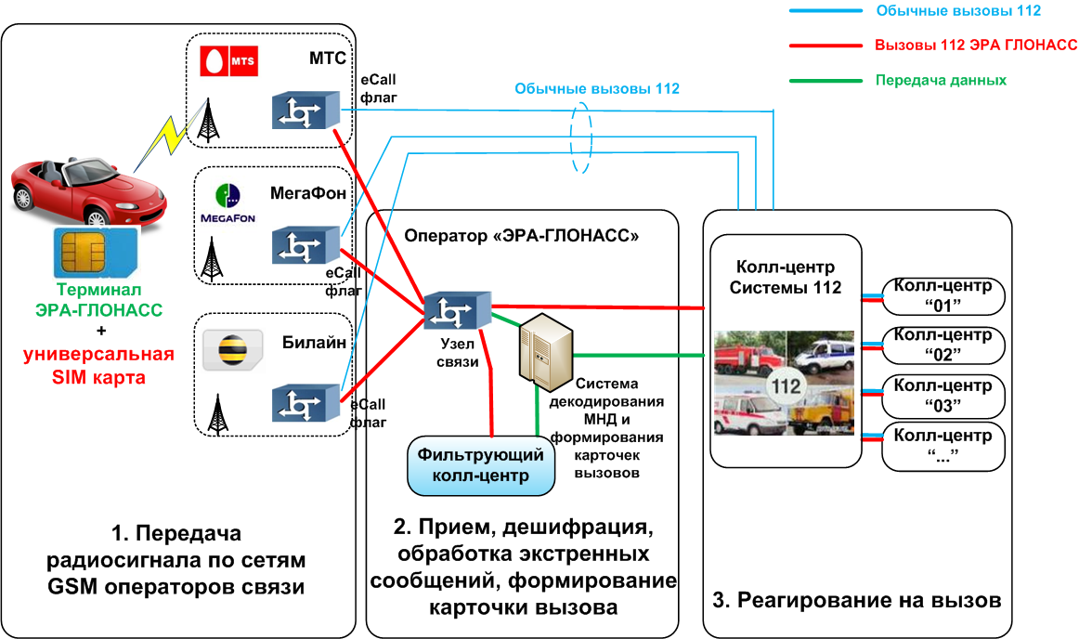
ERA-GLONASS mode of operations
Regular 112 calls
ERA-GLONASS calls
Data transmission
MTS
eCall Flag
Regular 112 calls
MegaFon
ERA-GLONASS Operator
112 System (PSAP)
ERA-GLONASS Terminal
eCall Flag
Call Center «01»
Beeline
Call Center «02»
Communication node
MSD and Incident Cards
Call Center «03»
eCall Flag
Call Center «…»
Filtering Call Center
1. Transmission of the emergency call through GSM networks
2. Emergency calls decoding, processing, and recording
3. Emergency response

Slide 8
Major differences of ERA-GLONASS and eCall
  Mandatory requirements
  GLONASS GNSS support - a MUST
  Combined GNSS receivers (e.g. GLONASS/GPS/Galileo) - welcome
  MSD transmission
  In-band (primary method – standardized by 3GPP)
  SMS (backup mechanism)
  Extended Echo Cancellation and Noise Reduction requirements for IVS
  Test requirements:
  Test call to be initiated from a vehicle, results to be transmitted to back-end
  UMTS 900/2100 support
  Standardized I/O port and standardized protocol for external sensors
  Multi-profile eUICC with ERA-GLNOASS MVNO profile
  Optional requirements
  Remote IVS management (mandated for Retrofit IVS only)
  Remote IVS software upgrade (mandated for Retrofit IVS only)
  Crash Acceleration Profile recording for crash severity estimation in the back-end system
  “Black box” function (raw data storage)

Slide 9
Major differences of ERA-GLONASS and eCall
  Single point of responsibility for operations and maintenance of emergency infrastructure
  Cumulative cellular coverage though all Federal roads of Russia. IVS registers in available PLMN
  Dedicated SMSC as MSD backup bearer
  Carrier grade PLMN breakouts with major Russian mobile networks
  Redundancy of hierarchal architecture (three levels network: Federal, Macro-regional, Regional)
  Filtering Call Center of few agents to qualify emergency calls countrywide (83 regions)
  IVS testing subsystem used for vehicle periodic technical inspection
  Base for public Services (road accident prevention, insurance telematics, digital tachygraphy,
  road tolling, …) and variety of consumer Value Added Services

Slide 10
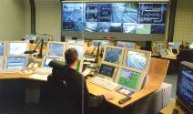
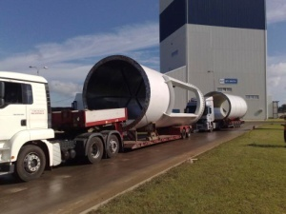
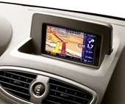

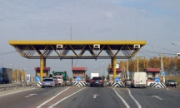
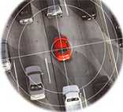
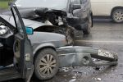
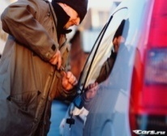



Potential for Value Added Services
Government (G2C)
Corporate (B2B)
Consumer (B2B2C)
Telematics Server
SDP
Portal
CRM, Billing
Contact-center
MVNO, own dedicated Backbone
Fleet Management
Road tolling, Tachographs
ITS
Crash reconstruction
SVT,
b-call,
i-call, etc.
Insurance
Telematics
Concierge
Service
Infotainment

Slide 11
Thank you

