Slide 1
German point of view
Results of the national meeting of German experts
Automatic Emergency Call Systems

Slide 2
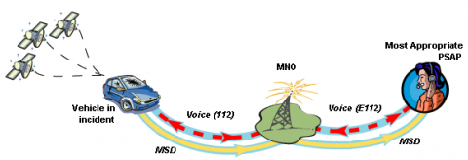
Automatic Emergency Call Systems
Scope of the UN-Regulation
Type Approval can only regulate the the minimum vehicle performance
all other process participants are not subject to the influence of a type test of a vehicle

Slide 3
Automatic Emergency Call Systems
The availability of a sufficient mobile phone and satellite network as well as qualified emergency centers is under the responsibility of the member states

Slide 4
Automatic Emergency Call Systems
Homologation of the vehicle should ensure,
that after a standard accident (UN-R 94, UN-R95) the vehicle is able under minimum conditions (to be defined) to determine its position and to establish a mobile phone connection in a sufficient quality (to be defined)

Slide 5
Automatic Emergency Call Systems
The vehicle should be able to determine the position on base of a sufficient available (to be defined) signal as a
GPS-Signal,
GLONASS-Signal or
Galileo-Signal

Slide 6
Automatic Emergency Call Systems
The vehicle should be able to communicate (to be defined) with an emergency centre via a common telephone number (112) and use a “world module” able to support cellular frequencies (to be defined) available all over the world with a sufficient quality (to be defined)

Slide 7
Automatic Emergency Call Systems
Systems, installed in vehicles within the scope of UN-R 94 and UN-R 95, shall be triggered automatically.
All other vehicles shall be fitted with a system which may be triggered manually

Slide 8
Automatic Emergency Call Systems
All systems should be crash resistant
This should be demonstrated after the crash test which is mandatory for the approval of the vehicle
For systems installed in vehicles not within the scope of UN-R 94 or UN-R 95
the crash resistance should be demonstrated after a sled test according to UN-R 17 Annex 7

