Slide 1
Subgroup Crossmatrix
Quo vadis?

Slide 2




Quo vadis?
01
02
Initial situation / context
Objectives and Output
different models/ different simulation approaches
different composition of fleet
different scenarios / different market situation
by standard scenarios:
  Make studies/simulations comparable
  Show the impact of proposed measures
  Improve simulation inputs/models
03
04
Contents and methods (How?)
Next steps
Crossmatrix, what ever it means
Use standard scenarios for comparability and impact assessment
Define standard scenarios with improved input data
Calculate these standards as a base for an impact assessment (calculated)

Slide 3
Several Steps needed
01
02
03
04
05
06
Fleet
Road
Traffic
Noise
People
Costs
Phase
Data Aquisition/Data Definition
Simulation / Calculation
Evaluation
Main input
  Noise level
  (vehicle & tyres)
  % LDV/HDV/MC
  % BEVs/Tamp.
  % AVAS/TRW/ RWS
  …
  Lanes/Surfaces
  Speed Limits
  Traffic volume
  Level of service
  Observer position
  Observer number
  #Single events
  …
  Fleet data
  Road data
  traffic flow
  Fleet data
  (noise levels)
  Road data (observer position)
  Noise level of traffic flow
  Road data (# People in what distance)
  Noise Classes
  Number of people affected
  Health/Society costs
  Industry/Consumer costs
  …
Result
Fleet composition
Road Scenarios
Traffic Flow
Noise level of traffic flow
Affected People
Cost-Benefit-Analysis

Slide 4
Data Work is the Base!
Based on this stepwise approach, our data input needs a hierarchic structure
Every scenario (5-10) has to be fully defined regarding the structure and level of detail ->
1 Excel sheet for every scenario
Additional data shall not be needed

Slide 5


Conclusion
Standard Scenarios
Calculation Tools
Standard scenarios are fully defined per hierarchically structured data (generic description).
The impact of proposed measures can be described by a change of input data in the category (fleet, road or traffic flow), that is influenced.
Objectives achieved
Calculation with individual simulation tool is possible without tampering of additional data.
Degree of detail can be adjusted to possibilities of simulation model (chance for improvement)
Easy estimation of impact of measures
Calculation differences are shown
Input for Improvement of simulations can be derived

Slide 6
Focus on Step 01 and 02
01
02
03
04
05
06
Fleet
Road
Traffic
Noise
People
Costs
Phase
Data Aquisition/Data Definition
Simulation / Calculation
Evaluation
Main input
  Noise level
  (vehicle & tyres)
  % LDV/HDV/MC
  % BEVs/Tamp.
  % AVAS/TRW/ RWS
  …
  Lanes/Surfaces
  Speed Limits
  Traffic volume
  Level of service
  Observer position
  Observer number
  #Single events
  …
  Fleet data
  Road data
  traffic flow
  Fleet data
  (noise levels)
  Road data (observer position)
  Noise level of traffic flow
  Road data (# People in what distance)
  Noise Classes
  Number of people affected
  Health/Society costs
  Industry/Consumer costs
  …
Result
Fleet composition
Road Scenarios
Traffic Flow
Noise level of traffic flow
Affected People
Cost-Benefit-Analysis

Slide 7
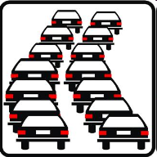




Proposal of Next Steps
Experts of Implementation Team FLEET
Generic Description
Check/Refinement
Composition of Scenarios
FLEET
Road
Scenarios fixed by
Team FLEET &
Team ROAD
01
02
Experts of Implementation Team FLEET
Experts of Implementation Team ROAD
Impl.-Teams
Generic Description
Check/Refinement
ROAD
FLEET
01+02
02
01
Experts of Implementation Team ROAD
Subgroup Crossmatrix
Presentation / Hand over for Calculation/Simulation
5-10 Scenarios which represent the focus of the future regulatory work
03+04+05

Slide 8

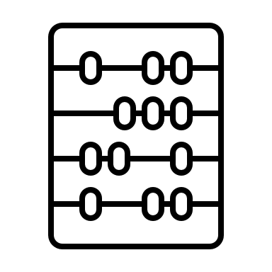

Working-Subgroup „Crossmatrix“
ROAD
Implementation Team
FLEET
Implementation Team
CALCULATION
Simulation Team
Stakeholders of Roads
Stakeholders of Vehicles
Simulation Model Owners
  Member 1
  Member 2
  (Member 3)
  Member 1
  Member 2
  (Member 3)
  Member 1 (Model 1)
  Member 2 (Model 2)
  Member 3 (Model 3)
  …

