Slide 1
SG2 on Simulation/Virtual Testing
Progress report
VMAD-26-08
VMAD
18 May 2022
B. Ciuffo, B. Simkin

Slide 2
SG comments
No new SG2 meeting since last VMAD
SG2 had previously noted there interest on how virtual testing tools are used and validation w.r.t. to UNECE R157 approvals.
SG2 requested for information to be shared from approval authorities on this topic.
This could represent and interesting input for the continuation of the work in VMAD.

Slide 3
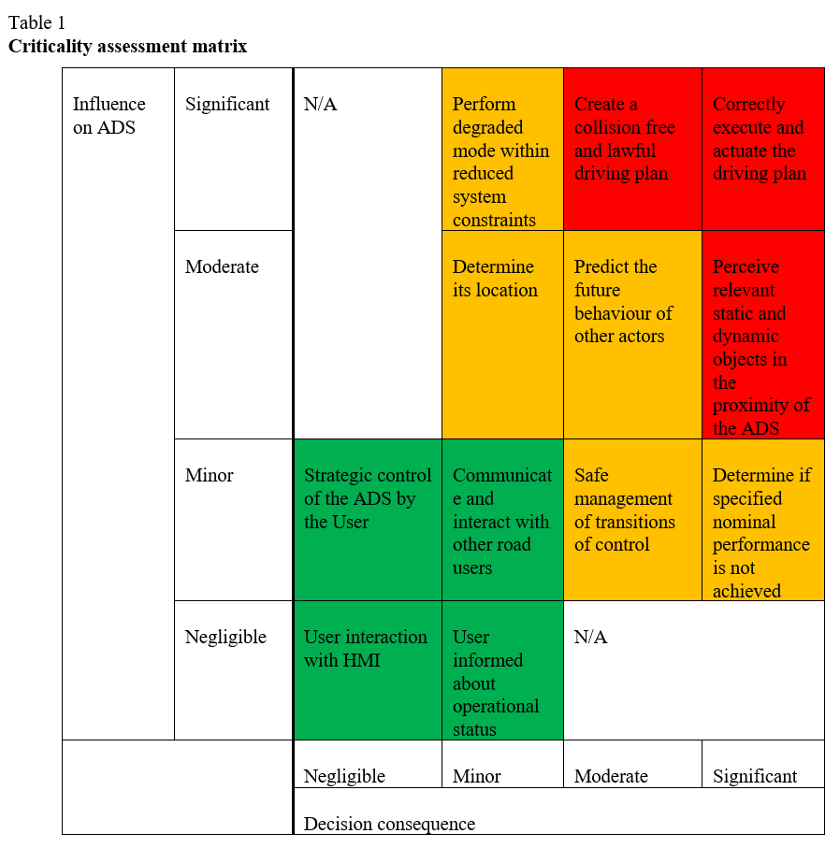
Amendments to the Master Document
Comment on Master document:
  page 62: SG2 previously agreed to remove the wording inside the criticality assessment matrix.

Slide 4
Additional topics to be discussed within SG2
For the time being the SG2 did not see the need to discuss additional topics.
For this reason, for the time being, we consider the work of SG2 as concluded

Slide 5
Thank you
Biagio.CIUFFO@ec.europa.eu
bsimkin@nvidia.com
Notes:
Update/add/delete parts of the copy right notice where appropriate.
More information: https://myintracomm.ec.europa.eu/corp/intellectual-property/Documents/2019_Reuse-guidelines%28CC-BY%29.pdf

