Slide 1
OICA comments on Switzerland proposal (GRBP-74-02)
Submitted by the expert of OICA Informal document GRBP-74-28 74th GRBP, 15-17 September 2021 agenda item 6.

Slide 2
Switzerland proposal (GRBP-74-02)
Switzerland proposes to mandate a cut-off for AVAS above 20 km/h for environmental benefits especially in residentials area.
For Switzerland AVAS sound above 20km/h is a superfluous noise pollution and undermines noise abatement.
OICA position:
Abrupt cut-off / on will induce for both car cabin passengers and pedestrians a harmful effects:
  Noise annoyance due to impulse noise effect
  Additional danger due understanding behaviour.
The proposal from Switzerland would conflict with the original intent of UN R138 to ensure compatibility with FMVSS 141.
We further refer to the presentation of the World Blind Union (WBU) GRB-62-16 where concerns were raised that “the proposed AVAS standard does not appear to add sufficient sound to existing electric and hybrid vehicles”.
We are ready for a revision of UN R138 addressing all these concerns raised by France and Switzerland to outline a clear application range of AVAS. This revision shall as well address the need for a technical revision as suggested by ISO.

Slide 3
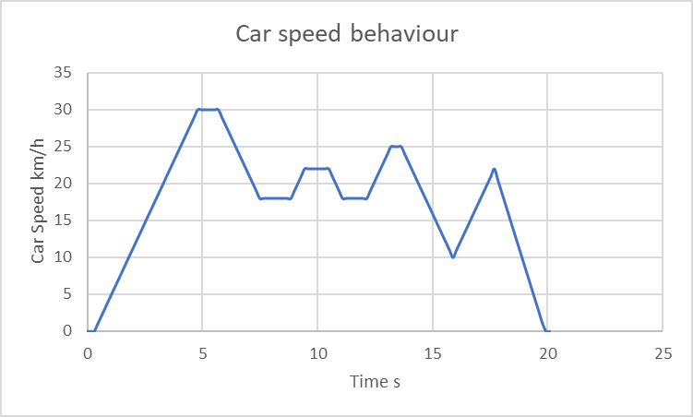
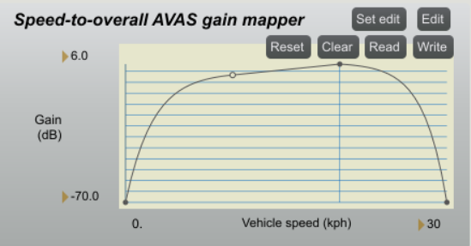
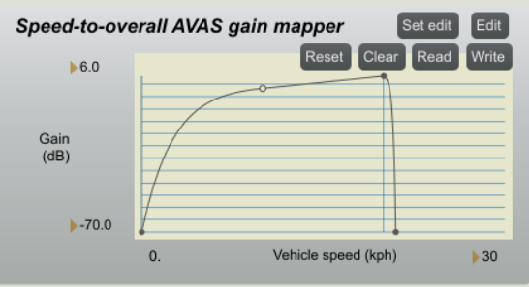

Sound comparison of AVAS with/without fade
Audio example (simulation) in residential area with 30 km/h speed limitation:
Vehicle speed simulation
based on real driving
With Fade
Without Fade

