Slide 1
Temperature Correction of Tyres
Special Case in UN-Regulation No. 51.03
Paragraph 3.3.4 in Annex 3, Appendix 2

Slide 2
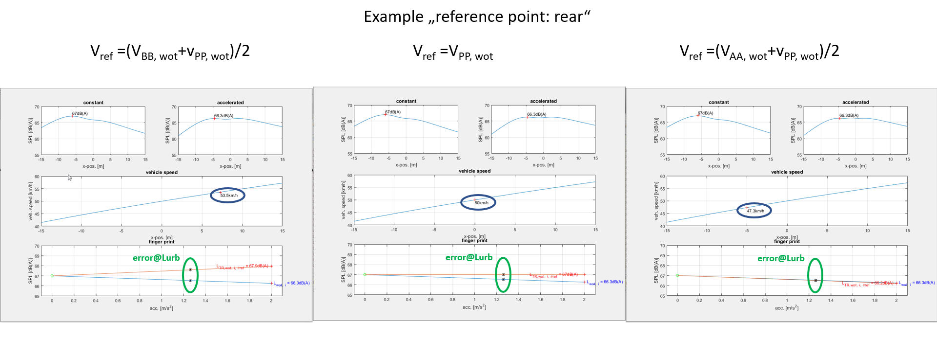
Temperature Correction of Tyres
Special Case
Source: simulation of Ulrich Messer

Slide 3
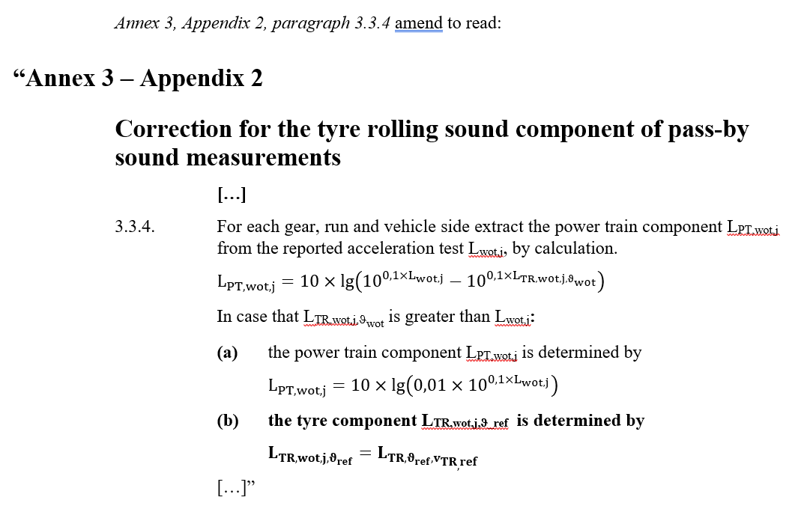
Temperature Correction of Tyres
Special Case
The problem occurs mainly with BEVs due to the minimal powertrain sound component
A: Accelerated Tyre rolling sound set to v_{ref} and ϑ_{ref} (no speed correction) based on cruising condition
Problem:
  Tyre rolling sound @ cruising is higher than the overall sound level @ acceleration
  Powertrain sound component can’t get negative and is set to 1% of overall level
  Recompositing of L_{urban} based on Tyre Rolling sound @ cruising leads to higher values due to the overestimation of tyre component
Reason:
  simplification of the temperature model uses tyre rolling sound @cruising adjusted to averaged speed between PP’ and BB’ for recompositing L_{wot, ϑref}
  if the maximum sound level is before PP’ the situation gets worst
Measures in this special case
  New definition of tyre rolling sound @ acceleration (two approaches)

Slide 4
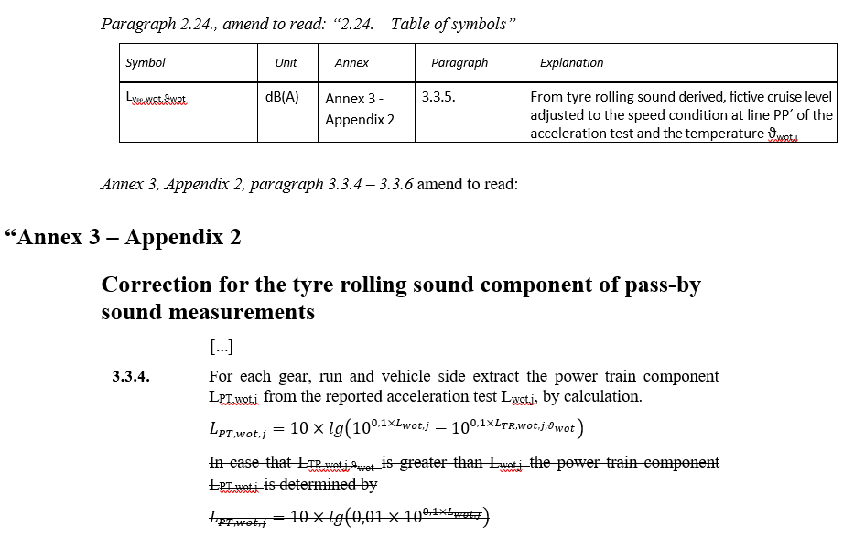
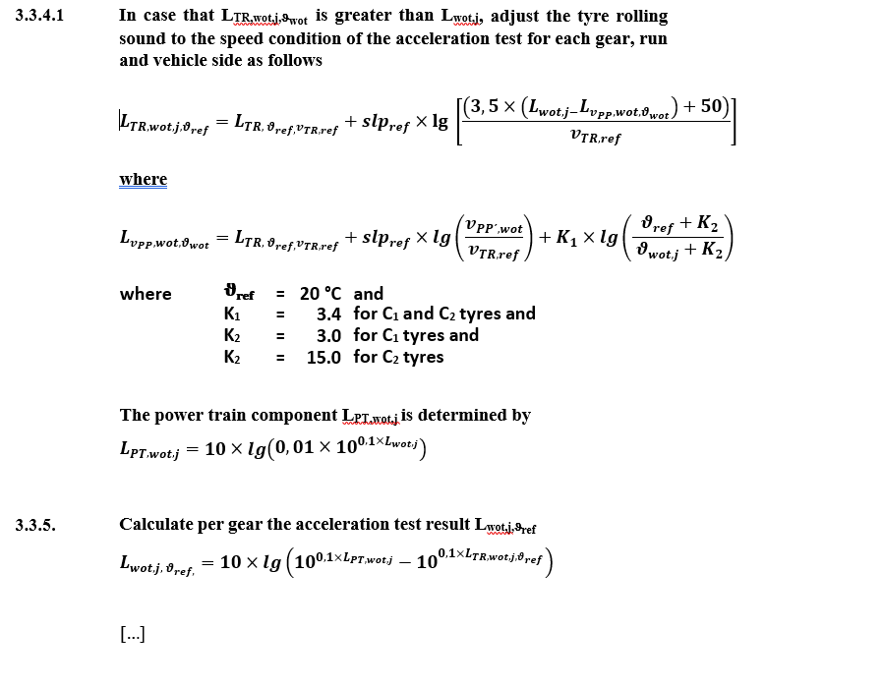
Temperature Correction of Tyres
Special Case
B: Accelerated tyre rolling sound adjusted to a virtual speed lower than v_{TR,ref}

Slide 5
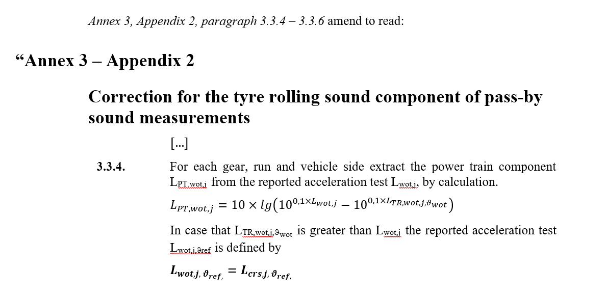
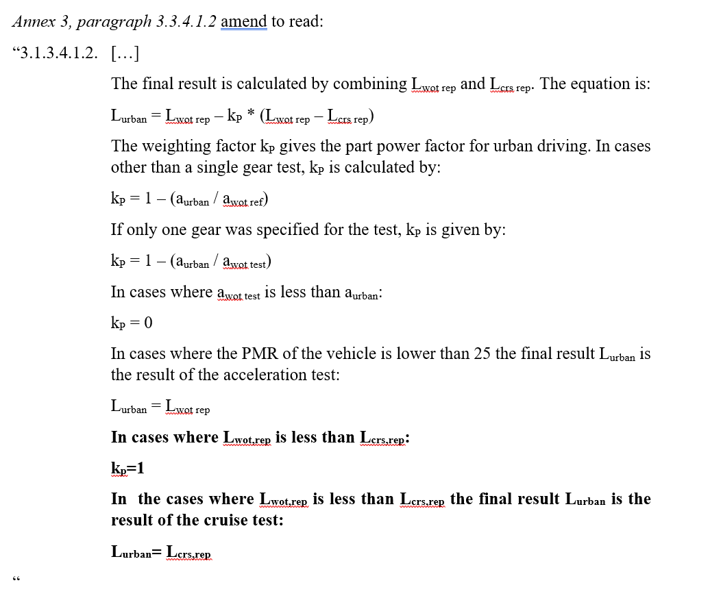
Temperature Correction of Tyres
Special Case
C1: Reported L_{urban} is set to L_{crs}
C2: Reported L_{urban} is set to L_{crs}
Justification:
  that means L_{crs}>L_{wot}.
  In this case only L_{crs} should be used final sound level as L_{urban} for Annex 3. Otherwise L_{urban} is less than L_{crs}.
  lower sound level than L_{crs} as final value in Annex 3 does not makes sense for regulation

