Slide 1
Method of testing for immunity of long vehicles to electromagnetic radiation
Alternative possibility for higher frequencies
May 2022 (V1)

Slide 2
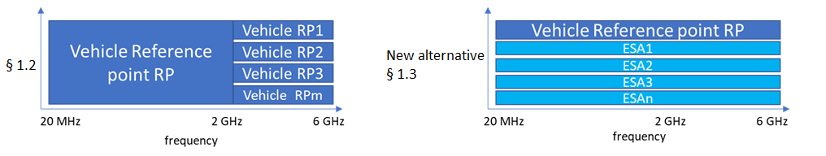
Immunity testing of long vehicles:
Alternative possibility for higher frequencies
Definition of a long vehicle: longer than 12 m and/or wider than 2.60 m and/or higher than 4.00 m
Use the possibility for testing immunity to fields for higher frequencies for long vehicles to take ESA / subsystem homologation for vehicle homologation (UNECE R10.06: 4.1.1.2):
Add to Annex 6 new paragraph:
§ 1.3 Procedure for alternative test method for higher frequencies long vehicles
Instead of multiple reference points the following method can be used:
Testing vehicle immunity to fields with the usual reference point for high frequencies (see § 1.2)
For ESAs / subsystems outside the beamwidth of the antenna, use the ESA / subsystem results according Annex 9 of ECE R10 for vehicle homologation without full ESA type approval.

Slide 3
Immunity testing of long vehicles:
Problem description
Depending on the vehicle design, it is possible, that components with immunity related functions are distributed throughout the whole vehicle
Especially for long vehicles it is possible that such components are far away from the reference points according Annex 6/ISO 11451-2
Generally it would be possible to define additional reference points. But in practice it is extremely difficult to decide how to do. For example:
  The relevant vehicle length from which additional reference points are required depends on the frequency range -> the higher the frequency the more smaller vehicles are affected.
  Especially for large vehicles additional reference points depend on the size of the test laboratory. Consequently, these must also be selected depending on the circumstances of the test laboratories. There is a risk, that the test result will depend on the laboratory chosen

Slide 4
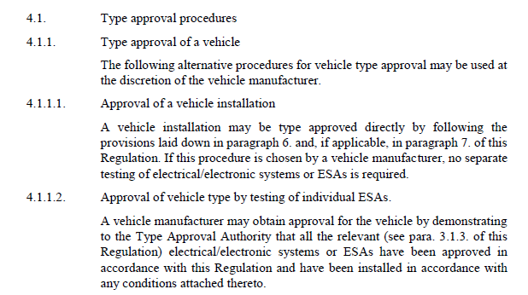
Immunity testing of long vehicles:
Proposal justification
It is already possible to register vehicles without an EMC vehicle type test, provided that all relevant ESAs have an own type approval (see UNECE R10 (Rev.6) § 4.1).
This possibility will be used for this proposal only for immunity to fields for higher frequencies only for long vehicles to overcome test methods insufficiencies and limit the measurement workload to a reasonable level

Slide 5
Immunity testing of long vehicles:
Proposal for wording
Black text – original in R10.06
Grey highlighted text – latest OICA proposal to be agreed in the IWG
Blue highlighted text: new proposal in this email
1.2. Test method
This test is intended to demonstrate the immunity of the vehicle electronic systems. The vehicle shall be subject to electromagnetic fields as described in this annex. The vehicle shall be monitored during the tests.
If not otherwise stated in this annex the test shall be performed according to ISO 11451-2.
1.3. Alternative test methods
The test may be alternatively performed in an outdoor test site for all vehicles. The test facility shall comply with (national) legal requirements regarding the emission of electromagnetic fields.
If a vehicle is longer than 12 m and/or wider than 2.60 m and/or higher than 4.00 m, one of the following methods shall be used :
BCI (bulk current injection) method according to ISO 11451-4 shall be used in the frequency range 20 to 2,000 MHz with levels defined in paragraph 6.8.2.1. of this Regulation.
      in the frequency range 20 to 2,000 MHz either BCI (bulk current injection) method according to ISO 11451-4 or immunity to external sources according to ISO 11451-2 with additional antenna position(s) which shall be chosen by the manufacturer in conjunction with the Type Approval Authority after considering the distribution of electronic systems with immunity related functions and the layout of any wiring harness can be used with levels defined in paragraph 6.8.2.1. of this Regulation. In the frequency range 2,000 to 6,000 MHz immunity to external sources according to ISO 11451-2 with additional antenna position(s) which shall be chosen by the manufacturer in conjunction with the Type Approval Authority after considering the distribution of electronic systems with immunity related functions and the layout of any wiring harness shall be used with levels defined in paragraph 6.8.2.1. of this Regulation.
      or
In the frequency range 20 to 6,000 MHz vehicle shall be tested as described in 1.2 and ESAs with immunity related functions which are outside of the beamwidth of the test antenna shall be supplemented by additional test report(s) in accordance with Annex 9 and from a test laboratory accredited to applicable parts of ISO17025 and recognised by the Type Approval Authority.

Slide 6
Further Considerations
It may be considered to apply the alternative method for all types of vehicles.
Address need for development of a radiated immunity test procedure to ISO TC22/SC32/WG3:
  ISO 11451-2 is under revision, especially reference point is already under discussion
  ISO 11451-5 (Reverberation chamber test method for vehicle): DIS ballot will be launched soon. Publication of the standard can be expected in 2023.
  TEM Horn method is based on EN 61000-4-39 and not applicable for vehicle. Request ISO working group to discuss the use of this method.

