Slide 1

Battery, fuel cells and hybrid vehicles update
Subgroup “USERS”
Update June 2022

Slide 2
Summary
Ways of working
Bow ties developed
Information gathering
Way forward

Slide 3
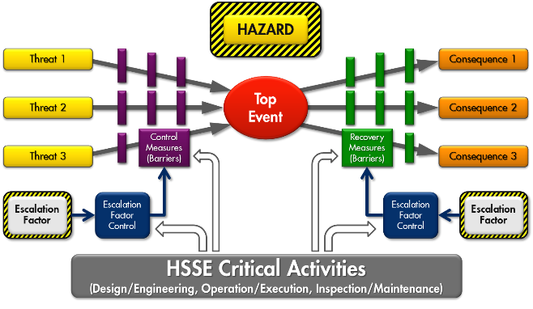
Ways of working
  Technical standards
  Need of extra barriers?
  Know how vehicle manufacturers
  Know how vehicle users
  Know country delegates
Discussion
Threat-to-consequence lines
Existing barriers
Remaining risk (qualitative)
9 Biweekly 3 hours telecon
1 F2F meeting

Slide 4
Bow ties developed
Locations
Loading sites
Unloading sites
Public roads
Retail petrol stations
Main components
Battery pack
Electrical motor
Inverter
Cabin heat exchanger
Recharging equipment
High voltage wirings
Endurance braking device
H2 propulsion system (tank, pipes etc)
ADR tank
Hazards/top events
High voltage electricity/Release of electricity
Battery chemical energy/Thermal runaway
Temperature/High temperature
High pressure H2/LOPC
Chemical product/Spill
Liquid H2/LOPC

Slide 5
Bow ties developed
Most important items
Control of ignition sources in an ATEX environment
  Recharging in a chemical plant/refinery
  De-energizing of the high voltage system
  Charging during (un)loading
Risks related to battery runaway
  Battery lateral crash protections
  Leak of load onto battery
  Fire suppression systems
  External fire scenario
  Emergency response

Slide 6
Information gathering
Presentation from experts on:
Hydrogen safety and trucks (Volvo)
Battery and Battery Management System (Daimler)
Emergency response (CTIF)
Review of R100 (RiSe)

Slide 7
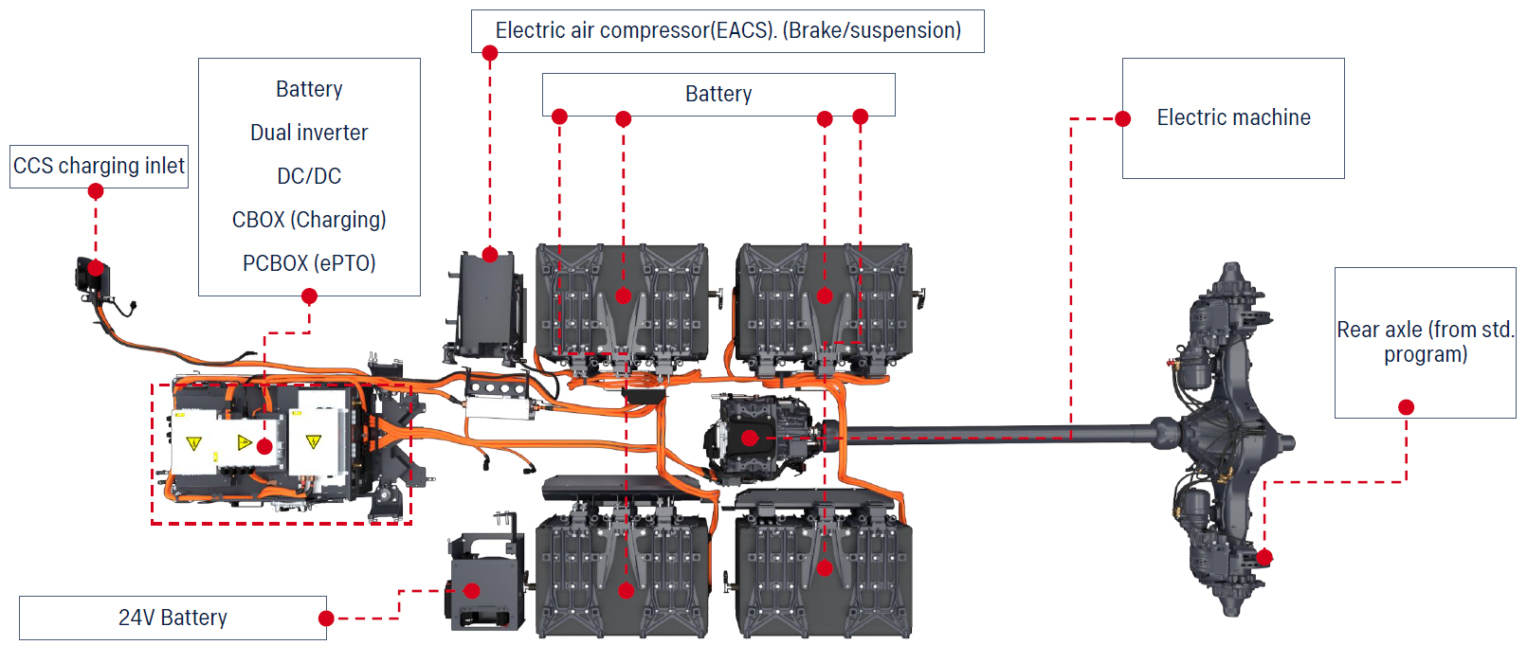
Information gathering (visit to Scania demo centre)

Slide 8
Information gathering (visit to Scania demo centre)
Video available on demand, too big to be added to the UN WikiSpace.

Slide 9
Way forward
  Refine bow ties
  Identify safety gaps
  Identify new needed barriers and how to translate them in ADR
  Submit a working document to WP15 of November or later with proposed amendments for ADR 2025
  Working documents which are approved for ADR 2025 might be in scope for multilateral agreements to anticipate the use of BEV/HFCV

Slide 10
Contact:
Dario Pinna
Cefic Programme dario.pinna@shell.com
Thank you.
About Cefic
Cefic, the European Chemical Industry Council, founded in 1972, is the voice of large, medium and small chemical companies across Europe, which provide 1.1 million jobs and account for 15% of world chemicals production. Cefic members form one of the most active networks of the business community, complemented by partnerships with industry associations representing various sectors in the value chain. A full list of our members is available on the Cefic website.
Cefic is an active member of the International Council of Chemical Associations (ICCA), which represents
chemical manufacturers and producers all over the world and seeks to strengthen existing cooperation with global organisations such as UNEP and the OECD to improve chemicals management worldwide

