Slide 1
Calculation of Upstream CO₂ for Electrified Vehicles
EVE-9 Meeting UNECE GRPE
18-Feb 14

Slide 2
Lifecycle GHG Emissions Performance
(Real world, based on EPA eGRID2012)

Slide 3
U.S. Perspective on
EV Emissions Accounting
Emissions inventory and regulatory benefits
  Must reflect state-of-the-art life-cycle GHG accounting
    For example, always count “upstream” GHG emissions associated with feedstocks, power plants, and grid transmission losses
Regulatory treatment
  Regulatory issue
    Regulate upstream GHG via utilities, automakers, or both?
  Policy issue
    Do we want to incentivize potential game-changing technologies?

Slide 4
EV Treatment in U.S.
National Program GHG Standards

Slide 5
U.S. National Program GHG/CAFE Standards
(www.epa.gov/otaq/climate/regulations.htm)
 | MY 2010 Baseline | MY 2016 Standards | MY 2025 Standards
GHG emissions | 351 g/mi (218 g/km) | 250 g/mi (155 g/km) | 163 g/mi (101 g/km) [54.5 mpg if…]
Fuel economy | 25.3 mpg (9.3 L/100 km) | 34.1 mpg (6.9 L/100 km) | 48.7-49.7 mpg (4.7-4.8 L/100 km)

Slide 6
U.S. National Program
GHG Compliance Incentives for EV/PHEVs
Timeframe | GHG Emissions Compliance Treatment for Grid Electricity | Compliance Multiplier
2012-2016 | Below sales limit: 0 grams/mile Above sales limit: Net upstream | None
2017-2021 | 0 grams/mile | EV: 2.0 … 1.5 PHEV: 1.6 … 1.3
2022-2025 | Below sales limit: 0 grams/mile Above sales limit: Net upstream | None

Slide 7
U.S. National Program
Net Upstream GHG Approach for EVs
Measure vehicle electricity consumption over EPA city and highway test cycles in watt-hours/mile
Divide value by 0.935 to reflect transmission losses to reflect electricity needed at the electric powerplant
Multiply value by 0.534 grams/watt-hour to reflect EPA projection of overall electricity upstream GHG emissions (both powerplant and feedstock) associated with extra electricity demand for EVs/PHEVs in 2030
Subtract the upstream GHG emissions of a gasoline vehicle with the same footprint meeting its CO₂ target

Slide 8
U.S. National Program
Genesis of 0.534 g/w-hr Emissions Factor
Used EPA’s Integrated Planning Model (IPM) to project how US grid would accommodate “extra” EV/PHEV electricity demand in 2030 timeframe
Some EV/PHEV-specific assumptions
  Distributed projected EV/PHEV sales similar to hybrids
    E.g., more EVs per capita in California than in Wyoming
  Assumed 25% on-peak charging and 75% off-peak charging
IPM projected powerplant “mix” to meet “extra” demand
  80% natural gas, 14% coal, 6% wind and other feedstocks
Emissions factors for this powerplant mix
  0.445 g/w-hr at powerplant
  0.534 g/w-hr for powerplant plus feedstock-related GHG

Slide 9
U.S. National Program
Example MY 2025 Calculation
(for vehicle similar to 2014 Nissan Leaf)
EPA city/highway electricity consumption of 210 w-hr/mi
Divide by 0.935, to reflect transmission losses, to get 225 w-hr/mi
Multiply by the 2030 “extra” EV/PHEV electricity GHG emissions factor of 0.534 g/w-hr, to get 120 g/mi
Subtract the upstream GHG emissions of a comparable-footprint gasoline vehicle of 41 g/mi, to get 79 g/mi

Slide 10
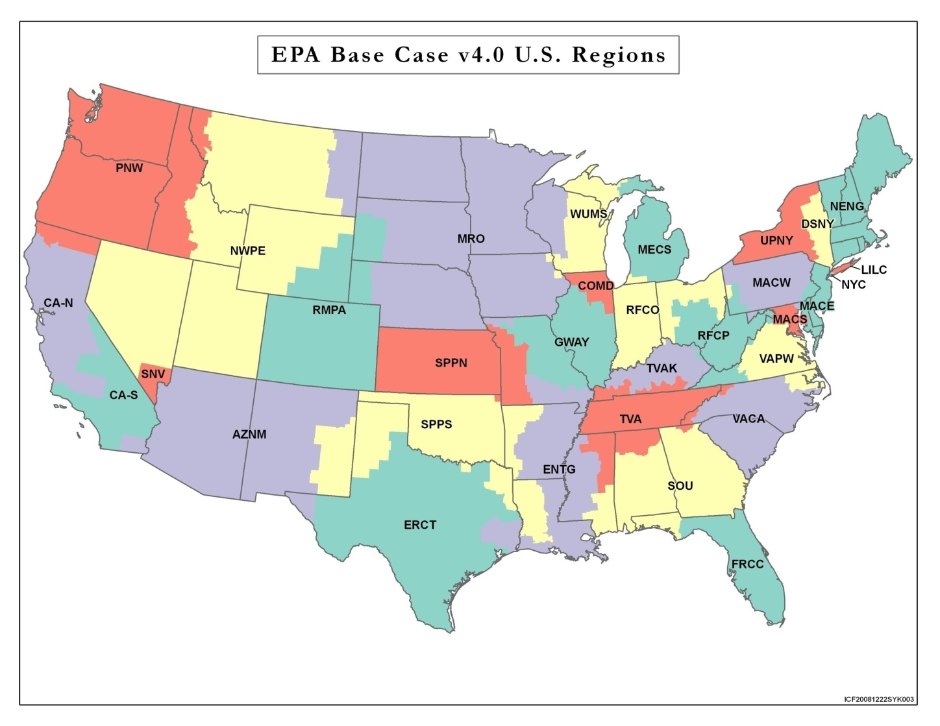
Modeling Power Plant Emissions
EPA uses IPM to estimate power plant emissions
Long-term electricity model for U.S. grid
Provides least-cost solutions subject to
  Environmental
  Transmission
  Reliability
  Demand
Model Regions of IPM

Slide 11
What is IPM?
Detailed economic dispatch model
  Simulates least-cost operation of electric power system
IPM asks: Is there enough power to meet demand?
  Can I buy it from elsewhere?
    At what cost?
  Can I retrofit existing plants?
    At what cost?
  Can I build it?
    At what cost?
IPM repeats these questions for thousands of power plants in the U.S. for every hour of the year to 2050

Slide 12
Basis of Least-Cost Selection
Dispatch Stack - Hierarchy which calls generators by increasing operating costs
  Renewables
  Nuclear Base Load
  Base Load
  Intermediate Load
  Peaking Plants
Generation mix sensitive to time of day
  Emissions impacts vary greatly between on-peak & off-peak
Load Profile
Peak
Load
Electricity Demand
Intermediate
Load
Increasing Costs
Base Load
Nuclear
Renewables
6 AM Noon Midnight Noon 6 AM

Slide 13
To Evaluate Impacts of Electrified Vehicles
Start with USDOE fleet size projections
Estimate nationwide EV fleet/energy requirements w/OMEGA
  2012-2025: Interpolate from no fleet to 2025 levels
  2025-2050: Technology penetration stabilizes; fleet grows though attrition
Distribute EV fleet into 32 IPM regions
  Front-load ZEV & §177states
  Top 40 US Bureau of Census Metropolitan Statistical Area (MSA)
  Historical precedent, manufacturer production plans, etc

Slide 14
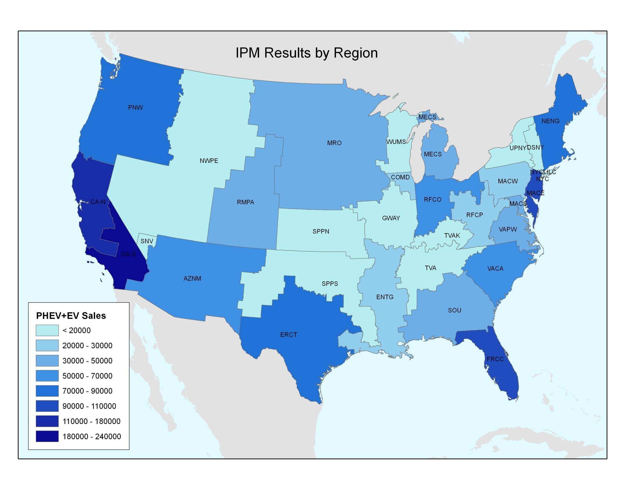
How Many Electrified Vehicles by 2020?
6
5
2
9
3
1
10
8
7
4

Slide 15
IPM Electrification Scenarios
Estimate VMT using MOVES
Combine vehicle energy requirements w/VMT
Allocate energy charging requirements by time of day
  a. 25% On-peak, 75% Off-peak
IPM estimates incremental emissions/price impact

Slide 16
Insignificant Power Consumption
U.S. Total (2025)
  4.6 million GW-hr
PHEV/EV Total (2025)
  28.5 thousand GW-hr

Slide 17
Projected Fuel Mix in 2030
PHEV/EV Charging
All Electric Power Sector

Slide 18
Projected Fuel Mix by Model Run Year
GW-hr
Model Run Year

Slide 19
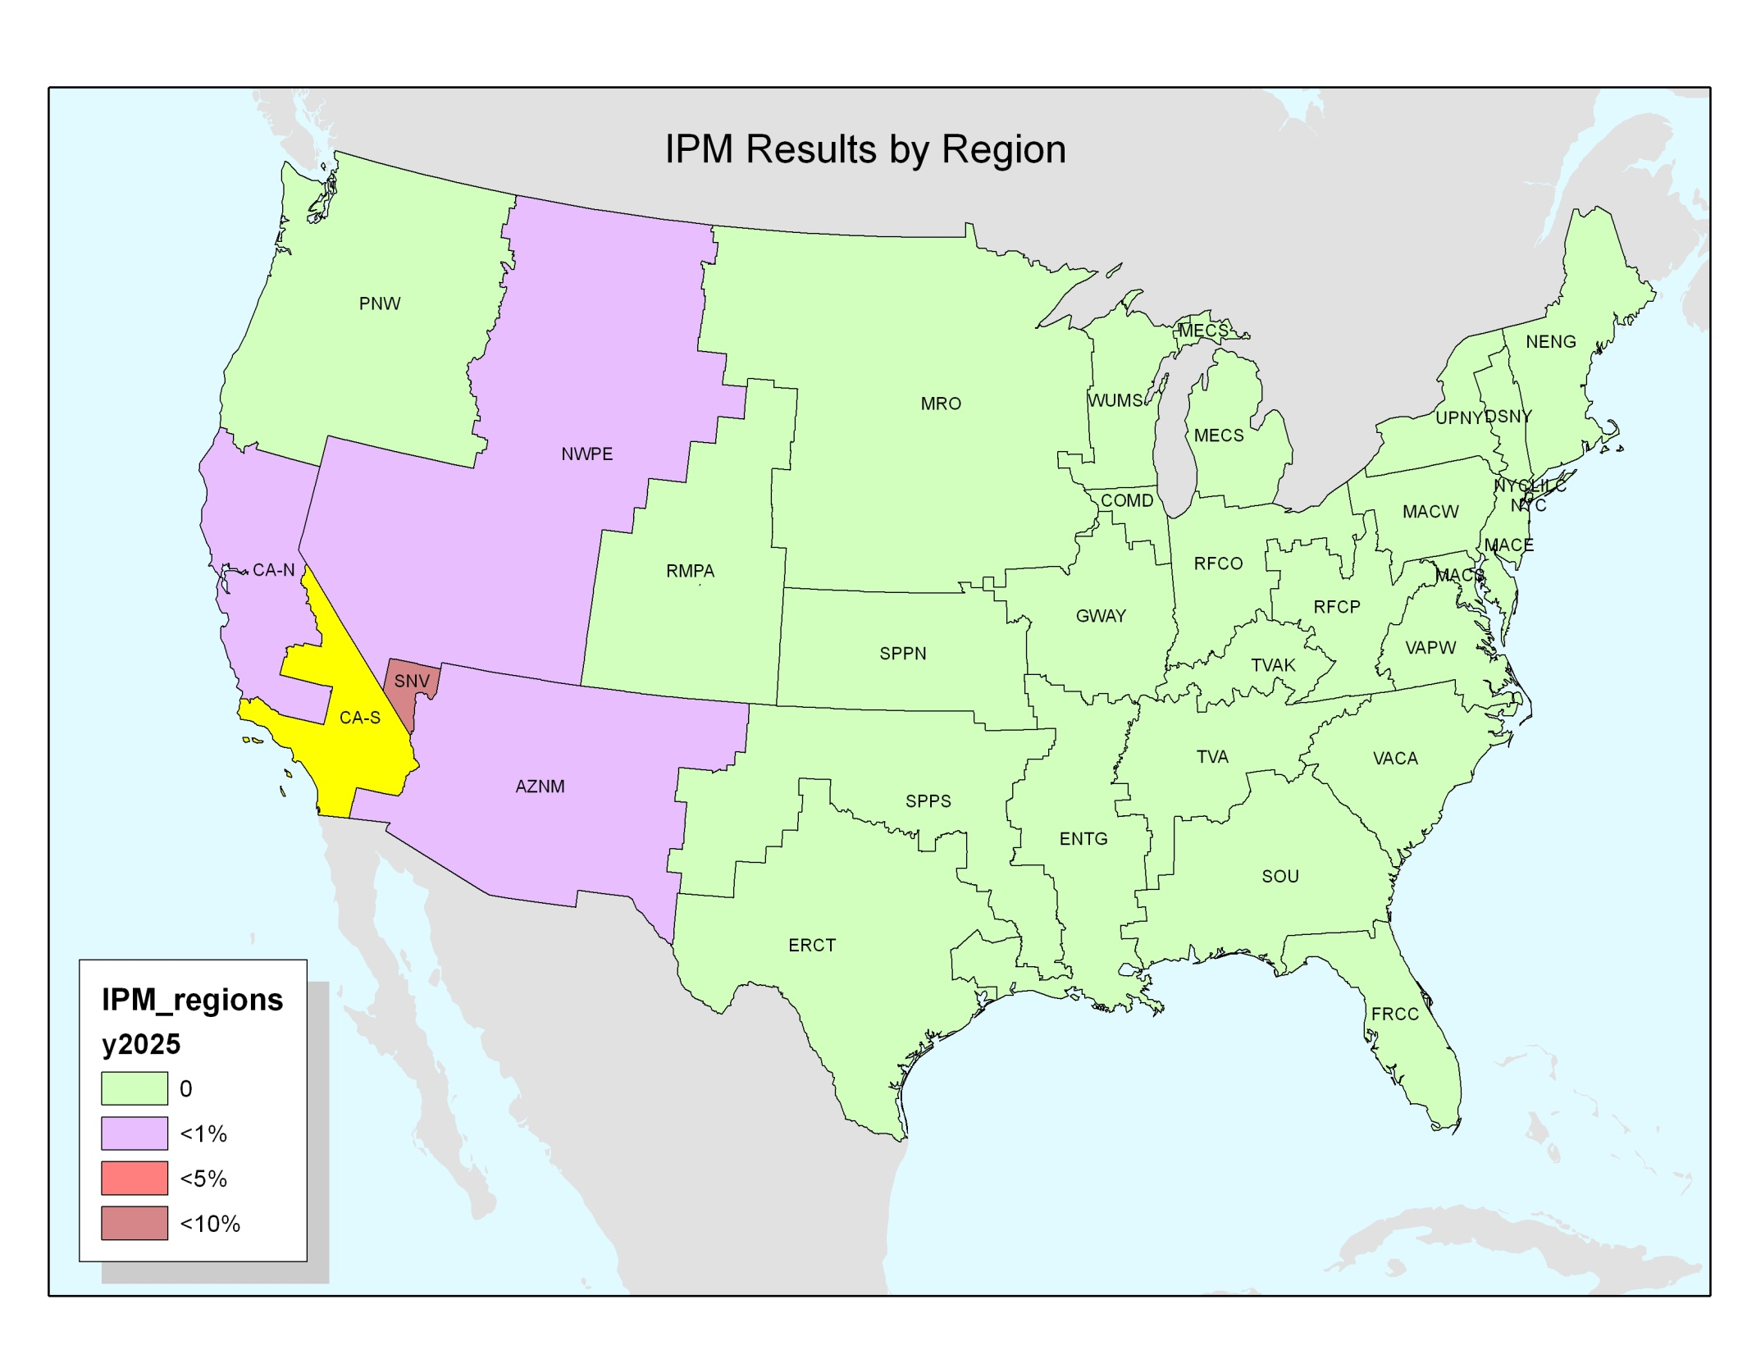
Where Will Electricity to Charge Vehicles in Southern California Power Come From in 2025?
Regional
Interties
Regional
Interties
Power Imports
>

