Slide 1
Application of NATM approach in the EU ADS Regulation
VMAD-27-05
VMAD #27
EC-JRC
5 October 2022

Slide 2
The new EU ADS Regulation (2022)
Commission Implementing Regulation laying down rules for the application of Regulation (EU) 2019/2144 of the European Parliament and of the Council as regards uniform procedures and technical specifications for the type-approval of motor vehicles with regard to their automated driving system (ADS)
ANNEXES to the Commission Implementing Regulation
Information Document
Performance Requirements
Compliance Assessment
PART 1 Traffic Scenarios
PART 2 Audit of SMS and safety assessment
PART 3 Tests
PART 4 Guidelines for the credibility assessment
PART 5 In-service reporting
EU Type approval certificate
Commission Implementing Regulation (EU) 2022/1426 of 5 August 2022

Slide 3
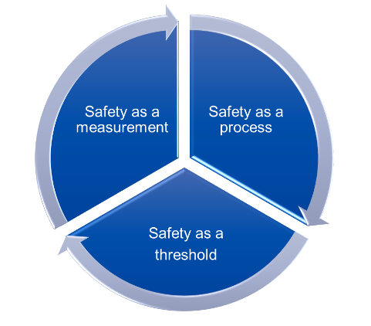
New Assessment Method
Safety Requirements
VISION ZERO
based on SoA performance

Slide 4
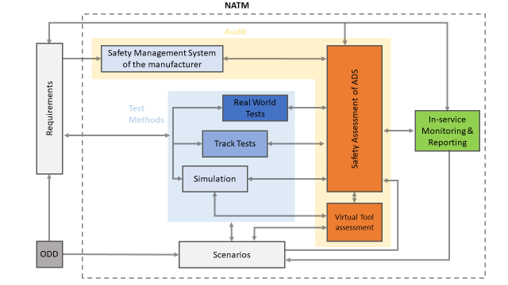
VMAD NATM

Slide 5
Annex 1 – Information Document
To be submitted in 3 copies
Provides general and detailed information on the ADS, the design concept, validation process, data storage, cybersecurity, information to users
Does not contain sensitive information related to the safety analysis
Is part of the documentation package that will be shared with all TAAs

Slide 6
Annex 2 – Performance Requirements
ADS performance is defined based on desired behaviour
  "Nominal Scenarios“ (normal operation)
  "Critical Scenarios" (emergency operation)
  "ODD Boundaries"
  "Failure Scenarios"
  MRM
  Human-Machine Interaction
Functional and operational safety must be ensured
The residual risk is evaluated according to the declared acceptability criteria

Slide 7
Annex 3 – Compliance Assessment
Part 1: The consideration of the most relevant scenarios for the ODD
Part 2: The assessment of the ADS design concept and the audit of the manufacturer safety management system.
Part 3: The tests of the most relevant traffic scenarios.
Part 4: The credibility assessment for using virtual toolchain to validate ADS
Part 5: The in-service reporting to demonstrate the safety performance in the field.

Slide 8
PART 1: Scenarios
Minimum set of scenarios
Lane change
Crossing, turning
Emergency manoeuvre
Pedestrian/cyclist crossing (urban&rural, motorway)
Hub-to-hub (motorway entry, exit, toll station, …)
Appendix 1: Methods to generate scenarios relevant to the ADS ODD and not covered in PART 1

Slide 9
ODD-based scenarios approach

Slide 10
PART 2 – AUDIT SMS & SAFTY ASSESSMENT
SAFET ASSESSMENT
The manufacturer shall provide a documentation package which gives access to the design and validation of the ADS.
AUDIT of the SMS
The Manufacturer shall demonstrate that effective processes, methodologies, training and tools are in place, up to date and being followed within the organization to manage the safety and continued compliance throughout the ADS lifecycle.
  Manufacturer’s Declaration of Compliance for SMS
  Certificate of Compliance for SMS (by TAA/Technical Service)

Slide 11
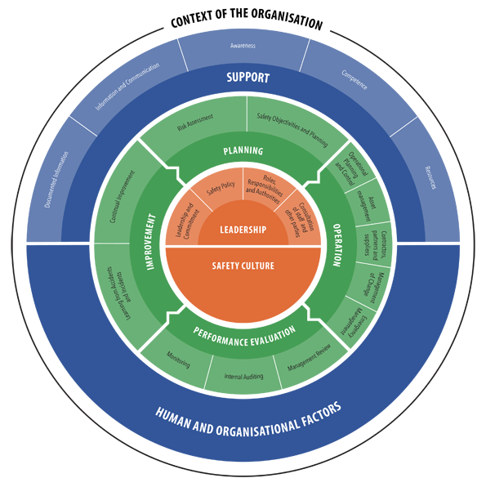

Process Audit
SAFETY CULTURE
to verify the maturity of the manufacturer's processes related to safety management and their correct implementation
European Railway Agency – European Union
Safety Management System

Slide 12
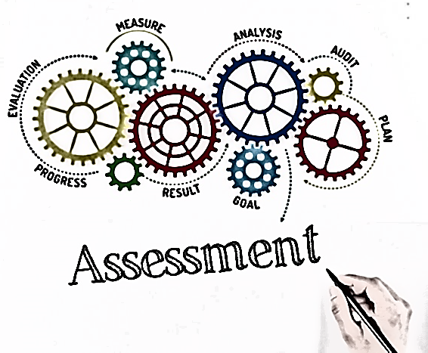
ADS Safety Assessment
The safety concept complies with the legislative requirements
It has been correctly implemented into the design
It has been validated (through virtual, track and real world testing)
Is correctly documented
Assessment report by Authority
PART 1
Information Document
Part 2
Formal documentation package
Part 3
Confidential material

Slide 13
PART 3 - TESTS
These tests shall confirm the minimum performance requirements
Test results shall be documented and reported in accordance with point 6 of part 2
Tests scenarios to assess the performance of the ADS on a test track (e.g. lane keeping and changing, response to road infrastructure, collision avoidance, cut-in, etc…)
The ADS shall also be tested on-road in accordance with the applicable law of the Member State granting the type-approval and provided that tests can be carried out safely and without any risk to other road users.

Slide 14

Physical testing
TRACK TESTING
Basic capabilities
Critical/emergency situations
Repeatability
PUBLIC ROAD TESTING
Final verification
Normal operation in real world
Representativeness

Slide 15
PART 4 - CREDIBILITY ASSESSMENT
Principles for the credibility assessment for using virtual toolchain in ADS validation
The credibility assessment framework provides a general description of the main aspects considered for assessing the credibility of an M&S solution together with guidelines of the role played by third parties assessors in the validation process with respect to credibility.
Team's Experience and Expertise is also assessed
“Simulation Handbook” providing evidence of the credibility assessment

Slide 16
Simulation and Virtual testing
Simulation tools needed to tackle the complexity of ADS
Lower testing cost/time, safer, repeatable…
Tools/tool-chains validation and results reliability

Slide 17
PART 5 – IN-SERVICE REPORTING
The manufacturer shall report relevant occurrences during ADS operation:
  The manufacturer shall report within one month any short-term occurrences, as described in Appendix 1, which needs to be remedied by the manufacturer to the type-approval authorities, market surveillance authorities and the Commission
  The manufacturer shall report every year to the type-approval authority that granted the approval on the occurrences listed in Appendix I. The report shall provide evidence of the ADS performance on safety relevant occurrences in the field.

Slide 18
List of occurrences to be reported

Slide 19


In-Service Monitoring and Reporting
Learning from in-service data is a central component to the safety potential of ADS
Guiding principle that safety is of global concern and its improvement should not be limited by geographical or organizational borders (ECCAIRS)
Objectives: Safety confirmation, scenarios generation, safety recommendations
EDR
EDR
DSSAD

Slide 20




Not addressed in VMAD/FRAV yet
L4 use-cases for public transport: 2 phases for market introduction
Remote control centre / remote operation
Infrastructure & communication
Overarching framework to
  ensure the highest common level of safety
  improve accessibility and use of safety information

Slide 21

Thank you!
© European Union 2022
Unless otherwise noted the reuse of this presentation is authorised under the CC BY 4.0 license. For any use or reproduction of elements that are not owned by the EU, permission may need to be sought directly from the respective right holders.
Slide 11: image left-hand side, source: heiko119; Slide 11: image right-hand side, source: ERA; Slide 12: image, source: garagestock
Notes:
Update/add/delete parts of the copy right notice where appropriate.
More information: https://myintracomm.ec.europa.eu/corp/intellectual-property/Documents/2019_Reuse-guidelines%28CC-BY%29.pdf

