Slide 1
Report of the SDG on 14th TF ADAS

Slide 2
Progress with drafting the DCAS UN Regulation
The Small Drafting Group (SDG) was set up at the 11th ADAS TF session
  The SDG participants: RUS, EC/JRC, NL, UK, AVERE, OICA, CLEPA, AAPC
The SDG:
  Developed and agreed DCAS key principles, which were further agreed by the ADAS TF at the 12th session
  Developed the method of reviewing the Master Document (The latest version ADAS-13-02 was prepared by the TF Secretary and circulated within the SDG)
  Started the consideration and revision and restructuring of the master document (starting point ADAS-13-02)

Slide 3
DCAS Master Document Review Process
Stages & Timing
GRVA-16/17
May/Sep. ‘23
Draft 3
(final)
We are here
GRVA-14
Sep. ‘22
Draft 1
GRVA-15/16
Jan./May ‘23
Draft 2
Stage 1
Stage 2
Stage 3
Stage 1
overview and restructuring
identify issues (redundancies, contradiction with principles, interpretation…) to be solved on the Stage 2
Stage 2
detailed review
Agree on content of the requirements
Stage 3
fine tuning
finalize wording and definitions

Slide 4
Procedure of SDG for the review (Stage 1)
Guiding questions:
  Does each requirement comply with key principles?
  Is each requirement applicable to all types of DCAS?
  Does it need to be moved in another place?
  Is side comment/discussion point relevant for this headline/sub-headline?
  Should additional paragraph(s) be introduced to address such side comment/discussion point?
Derived tasks
  Check if the existing requirements are in line with the principles and in the right place
  Add missing requirements, where necessary
  Clustering of the several DCAS features (what is specific, what in common?)
  Establishment of a new structure to address the clustering approach

Slide 5
Restructuring of the DCAS regulation
There could be
  A variation of different functions/features covered by DCAS systems and
  A variation of level of support within different functions features
Therefore a clustering of the functions/features would allow to clearly link the requirements to the specific feature/function.
Nevertheless, there requirements which all specific functions/features have in common and hence placed in a general section.
General Requirements
lane keeping + speed/distance control [+ optional: DILC on motorway]
DCAS specific features
Advanced driver initiated manoeuvres
Advanced driver initiated lane change
Other advanced driver initiated manoeuvres
System initiated maneuvers
LC
provisions for string stability, HMI and a function bringing the vehicle to a safe stop
transitions between LK phases
Driving hands-free
… [e.g., advanced Parking]

Slide 6
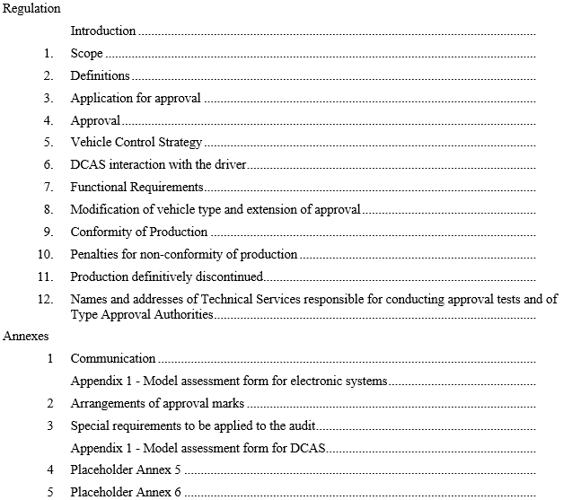
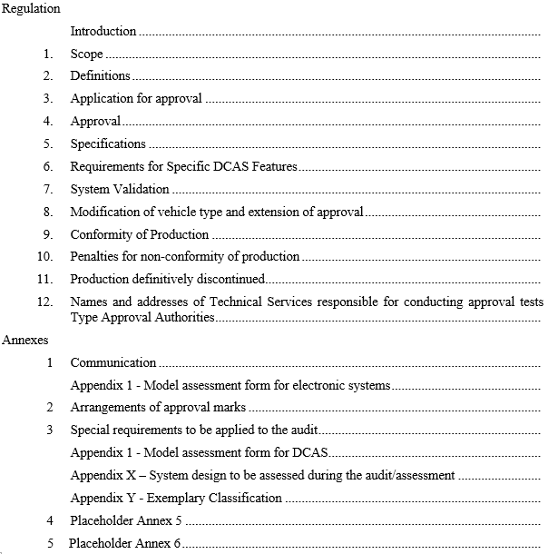
Restructuring
MD ADAS-13-02
MD ADAS-14-02

Slide 7
Restructuring
MD ADAS-14-02
5. Specifications
5.1. General Requirements
5.1.1. General operational principles
5.1.2. DCAS interaction with other vehicle assistance systems
5.1.3 Functional requirements
  5.1.3.1. General OEDR requirements
  5.1.3.2. System boundaries
  5.1.3.3. Vehicle dynamic behaviour / system dynamic control assistance
    5.1.3.3.1. Lane Keeping
    5.1.3.3.2. Lane Change
    5.1.3.3.2.1. General Requirements
    5.1.3.3.2.2. Specific Requirements for driver initiated lane change assistance [Placeholder]
  5.1.3.3.4. Deceleration
5.1.4. System safety response to detected failures
5.1.5. DCAS and driver interactions (two directions)
  5.1.5.1. Driver operation of the system (what the driver does with the system)
  5.1.5.1.1. DCAS modes of operation (off / stand-by / active)
  5.1.5.1.2. System activation and deactivation
  5.1.5.1.2.x. Preconditions for DCAS activation
    5.1.5.1.3. System status information
    5.1.5.1.4. System deactivation
    5.1.5.1.5. Driver override
  5.1.5.2. System assurance of driver engagement (what the system does with the driver)
    5.1.5.2.1. Driver monitoring strategy/mechanism
    5.1.5.2.1.1. Monitoring Requirements
    5.1.5.2.1.2. Criteria for proper driver engagement
    5.1.5.2.2. Driver disengagement
    5.1.5.2.3. Warning Cascade
  5.1.5.3. Driver Information Material [education]/[instruction] with regard to DCAS

Slide 8
Restructuring
MD ADAS-14-02
6. Requirements for specific DCAS features
6.1. Specific requirements for advanced driver initiated maneuvers
  6.1.1. Advanced driver initiated lane change
  6.1.2. Advanced assistance for other driver initiated maneuvers [Placeholder]
  6.1.3. [Low speed manoeuvring] [Placeholder]
6.2. System initiated manoeuvers
  6.2.1. General requirements for system initated manoeuvres
    6.2.1.1. Functional requirements
    6.2.1.2. HMI
  6.2.2. Specific requirements for system initiated lane change
    6.2.2.1. Functional requirements
  6.2.3. Specific requirements for maneuvers to transition from one phase of lane keeping to another
    6.2.3.1. Functional requirements
    6.2.3.2. Special provisions for dedicated maneuvers
    6.2.3.2.1 Special provisions when forming an access corridor for emergency and enforcement vehicles
6.3. Specific requirements for hands-free driving [Placeholder]

Slide 9
Scope of DCAS regulation
DCAS was established to address features beyond the limitations of UN-R79, this in a more general way than UN R79.
Therefore, the focus is to establish provisions for these advanced features instead of re-regulating systems already addressed by R79.
Para 2.1: “Driver Control Assistance Systems (DCAS)” – hardware and software collectively capable of assisting a driver in controlling the longitudinal and lateral motion of the vehicle on a sustained basis containing at least one specific feature, which is described under section 6 of this regulation, and which requires the human driver to be permanently engaged and to monitor the environment, and vehicle/system performance.

Slide 10
Next steps
Start of stage 2 with detailed review of the requirements
  Section Modes of Operation
  Section Driver Engagement Monitoring
  Review of the existing requirements
  Assessment of DCAS → elaborating on the annexes
Introduction and definitions could be checked after finalizing the requirements in stage 3

