Slide 1
Thermal Propagation discussion
The questions for China presentation material
“Venting of Gases Test for Electric Vehicles”
EVS25-E2TG-0300 [CN]Venting of Gases Test for Electric Vehicles
25th EVS-GTR IWG
Nov. 2022

Slide 2
Japan’s questions for China presentation material
Thank you so much for sharing the useful test result.
It’s very helpful and interesting for us because we JPN do not have any experience of vehicle/pack tests with LFP batteries.
Regarding test conditions and results, there are some questions.
It would be appreciated if you could give us comments for these JPN’s questions.

Slide 3
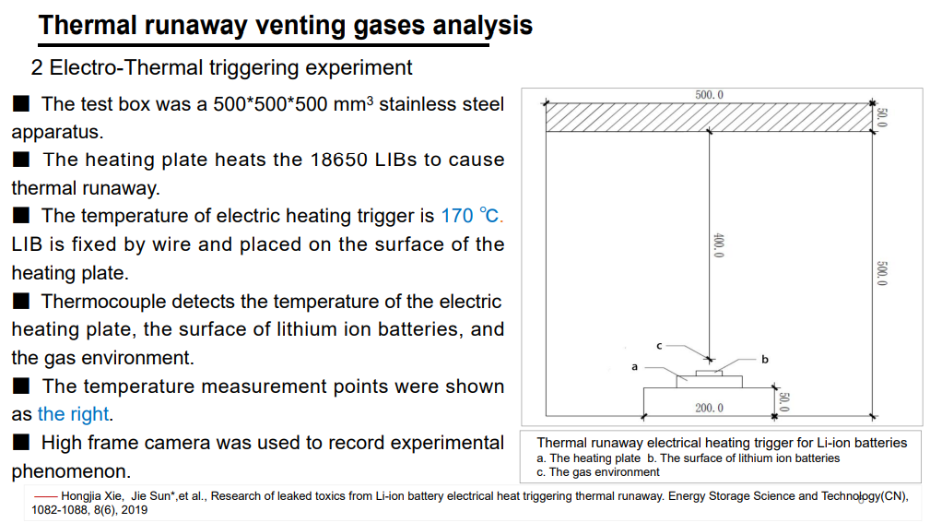
Japan’s questions for China presentation material
What does “temperature of electric heating trigger” mean?

Slide 4
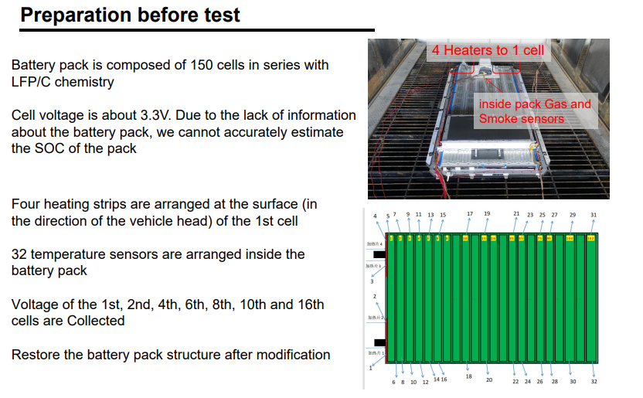
Japan’s questions for China presentation material
Could you share the information about heater specifications?
Heater size
Heater output power
Heater attaching position
(ex. Center of cell surface etc. )
Heater fixing method to cells’ surface
Back pressure on heaters
Could you share the exact locations on cells’ surface where the temperature sensors are attached?

Slide 5
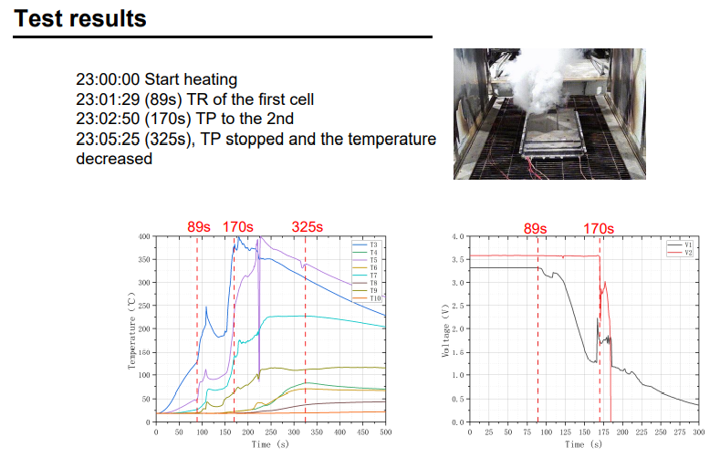
Japan’s questions for China presentation material
What parameters are used to judge the cell thermal runaway occurs? DT/dt or cell voltage or others?
When is the heater stopped?
What trigger is the heater stopped?
Is the upper limit temperature of the heater set for the test?
If so, how much is the temperature of the heater?

Slide 6
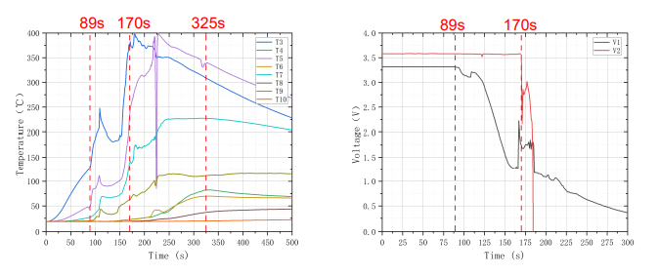
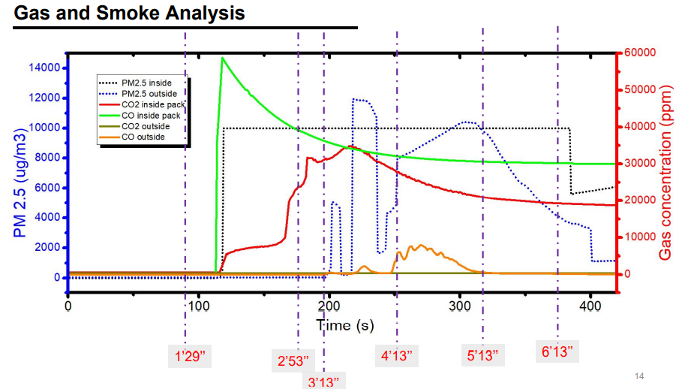
Japan’s questions for China presentation material
Does the air ventilator of the test room turn on during the test?
Is the start timing (zero point of X-axis) of these graphs identical?
The peak of CO concentration due to second cell thermal runaway cannot be observed in this graph.
Do you have any idea about this?

Slide 7
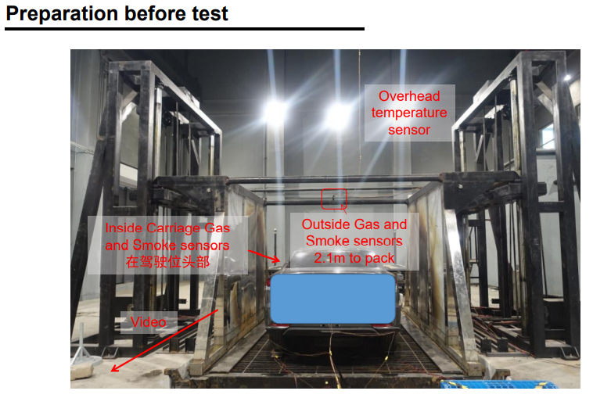
Japan’s questions for China presentation material
Could you share the exact location of the gas sensor in the vehicle cabin?

Slide 8
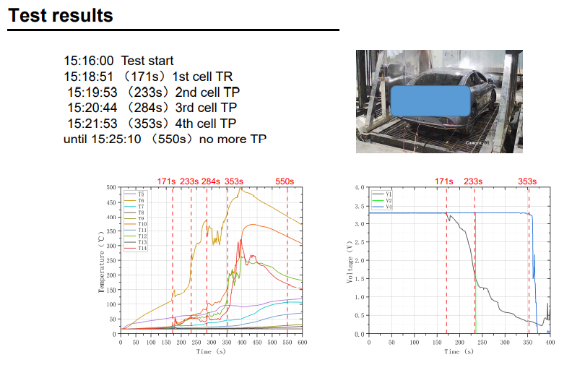
Japan’s questions for China presentation material
What parameters are used to judge the cell thermal runaway occurs? DT/dt or cell voltage or others?
When is the heater stopped?
What trigger is used to stop the heater?
Is the upper limit temperature of the heater set for the test?
If so, how much is the temperature of the heater?
Is there any specific reason to open the vehicle windows during the test?
Is this vehicle test conducted with IG-ON?
If so, is there any warning provided for this thermal event?

Slide 9
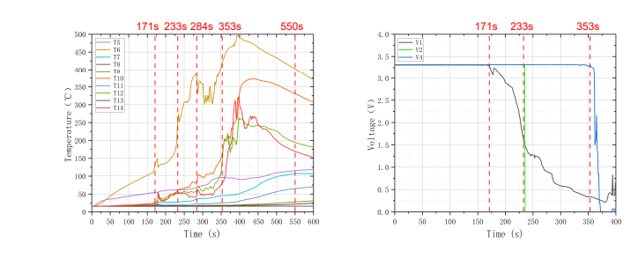
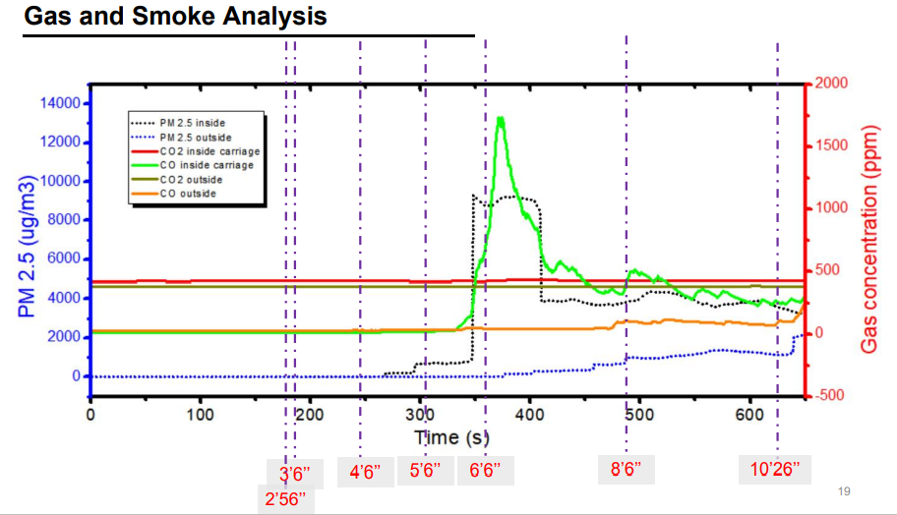
Japan’s questions for China presentation material
Does the air ventilator of the test room turn on during the test?
Is the start timing (zero point of X-axis) of these graphs identical?

Slide 10
Japan’s questions for China presentation material
Thermal propagation behaviors are different between two test results.
Tested batteries and test conditions are basically identical, aren’t they?
Do you have any idea about the reason why these differences are observed?
Heating time for generating thermal runaway of trigger cell is different.
Pack test result
(Thermal runaway: 2 cells)
Max. temp. of trigger cell is different.
Number of cells with reaching thermal runaway is different.
Vehicle test result
(Thermal runaway: 4 cells)

