Slide 1
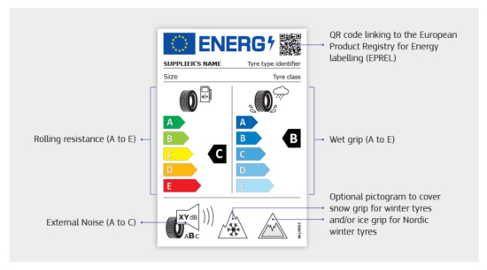
Luc Goubert, Belgian Road Research Centre
21st meeting of the IWG Measurement Uncertainty hybrid meeting
The STEER uncertainty analysison the EU Tyre (Noise) Label

Slide 2
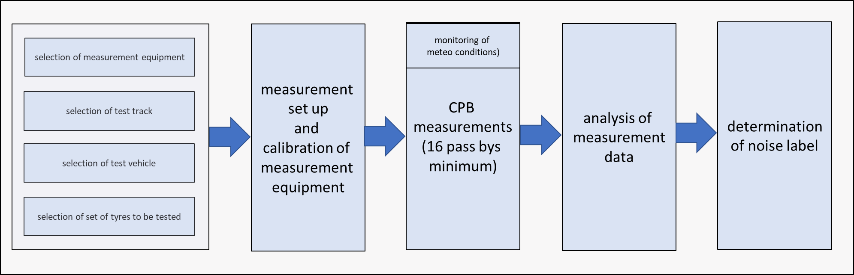
Regulation No 117 of the Economic Commission for Europe of the United Nations (UNECE)

Slide 3
Regulation No 117 of the Economic Commission for Europe of the United Nations (UNECE)
Regulation No 117 (UNECE):
Controlled Coast By-method
(smooth) ISO 10844 test track
Test vehicle equipped with 4 tyres to be tested
Two sided measurements
At least 16 runs

Slide 4
Uncertainty analysis
41 “sources of uncertainty” identified in whole procedure, classified in 8 categories
Analysis complying with GUM*
Category name | Category #
Equipment | 1
Experimental set up | 2
Measurement conditions | 3
Measurement | 4
Test vehicle | 5
Test track | 6
Test tyres | 7
Calculation | 8
*ISO/IEC Guide 98-3:2008 (E) Uncertainty of measurementPart 3: Guide to the expression of uncertainty in measurement (GUM: 1995)

Slide 5
Uncertainty contribution from the test track
ETRTO¹: 0,92 dB
M+P: “old” RRT of 2005²: max-min difference about 4 dB
Recent Swiss study³: 1,3 dB
Expert vision within consortium: about 1 dB
¹ETRTO, 2019. Tyre noise uncertainties in UN Regulation No. 117,
Presentation at 2nd Meeting of GRBP Task Force, Brussels, 28-29 November 2019.
²Van Blokland, G., Peeters, B., 2006. Comparison of surface properties of ISO 10844 test tracks.
³Bühlmann, E., Schlatter, F., Sandberg, U., 2021.
Temperature influence on tire/road noise measurements:
Recently collected data and discussion of various issues related to standard testing procedures.
Proc. INTER-NOISE 2021 - 2021 Int. Congr. Expo. Noise Control Eng. https://doi.org/10.3397/IN-2021-1830

Slide 6
Uncertainty contribution from the test tyres
Sample to sample variations: 0,26 dB¹ up to 0,42 dB²
“Tyre family” effect: 0,59 dB up to 1,1 dB³
¹ETRTO, 2019. Tyre noise uncertainties in UN Regulation No. 117,
Presentation at 2nd Meeting of GRBP Task Force, Brussels, 28-29 November 2019.
²STEER analysis from the data base from a tyre manufacturer
³Swedish-Polish study carried out in the margin of STEER project (see § 4,2,5 of STEER Final Report)

Slide 7
Uncertainty contribution from the test vehicle
ETRTO¹: 0,51 dB
STEER analysis²: 0,60 dB
¹ETRTO, 2019. Tyre noise uncertainties in UN Regulation No. 117,
Presentation at 2nd Meeting of GRBP Task Force, Brussels, 28-29 November 2019.
²extracted from the data base from a tyre manufacturer

Slide 8
Uncertainty contribution from the measurement conditions
Main uncertainty contribution is from the temperature correction: 0,59 dB¹
¹ § 3.3.7 of STEER Final Report

Slide 9
Uncertainty analysis: results

Slide 10
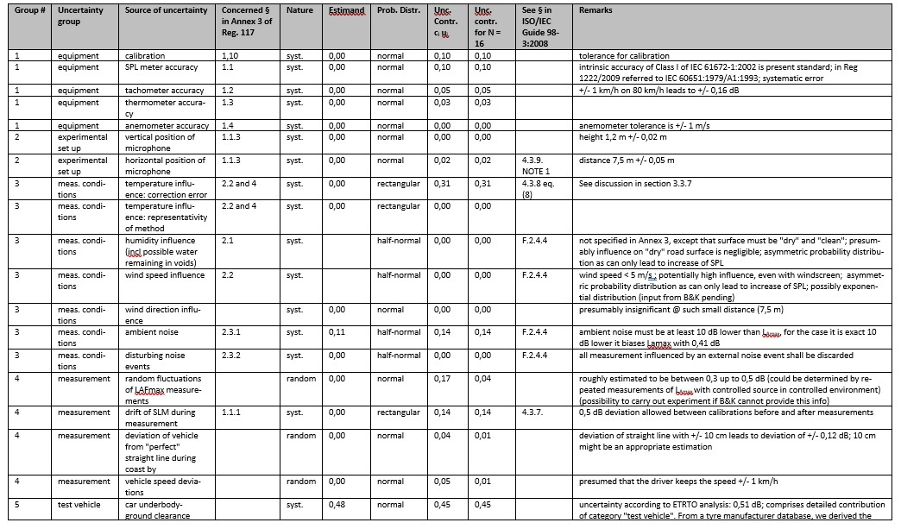
Detailed STEER MU analysis: see Annex 1 of STEER Final Report

Slide 11
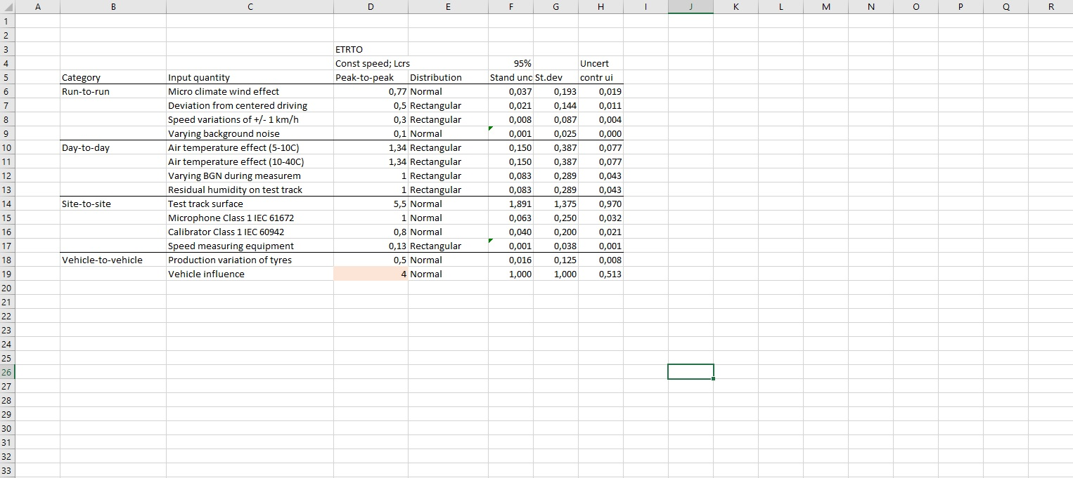
ETRTO uncertainty analysis (received from Truls on 15-09-2022)

Slide 12
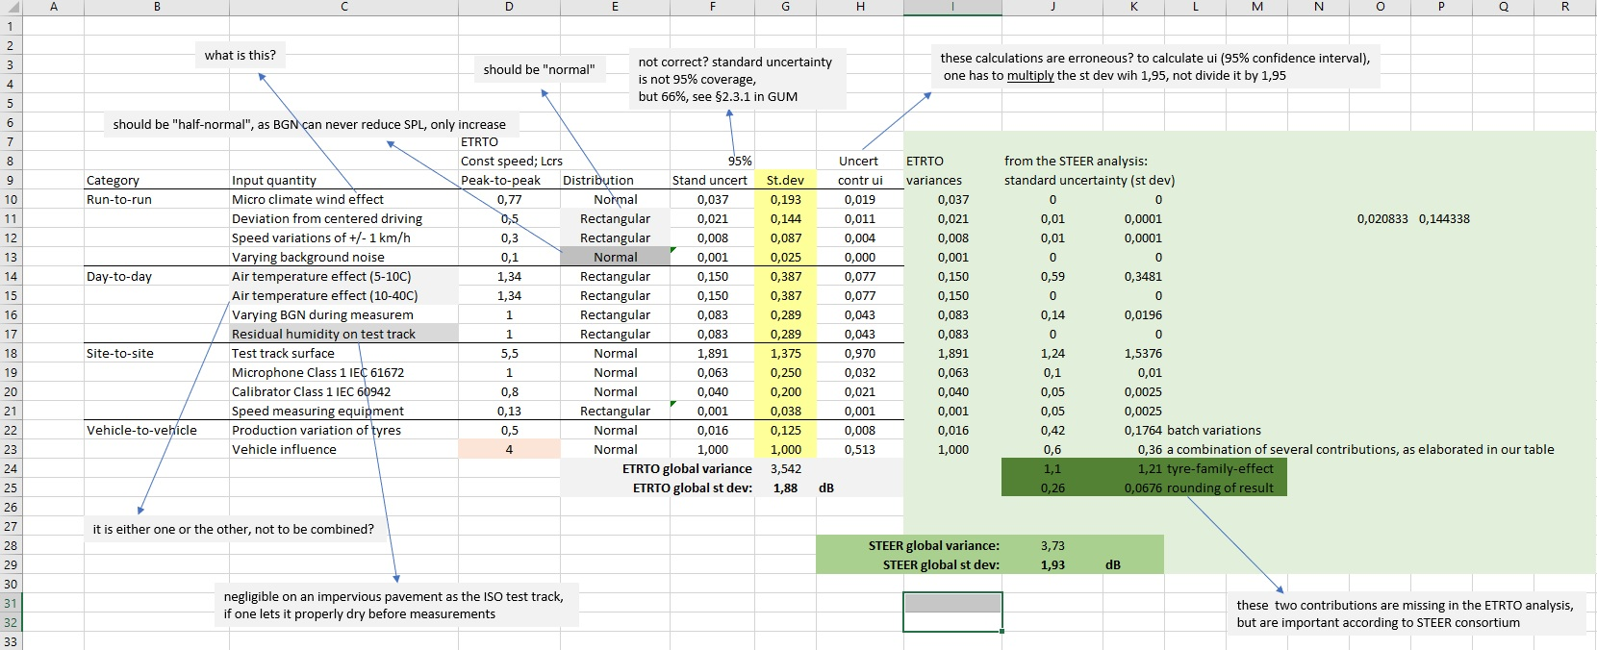
ETRTO uncertainty analysis (with my comments/questions)

Slide 13
Senior research scientist
Belgian Road Research Centre
Luc Goubert
0474/508356
l.goubert@brrc.be
www.brrc.be

