Slide 1
Disturbing pixel faults
Justification for not incorporation single pixels failure test procedure as part of type approval test within UN Reg.46 document.
Pixel fault is part of component requirement.
The examiner of the testing authorities shall verify documentation submitted by the applicant and check whether the documentation cites that the production of component are properly controlled so that the outgoing component test criteria complies the type approval limit determined under UN Reg. 46 or the relevant ISO 16505 standards.
Within the component test, there are two different categories for the verification/test which shall be performed accordingly.
Product characterization of the CMS such like distortion, resolution, magnification are generally determined according to the product design of the component. Within this category, the typical variation is controlled to keep an average production quality level per all samples. Therefore, the use of a typical sample is appropriate to verify the conformance of the product to the requirement. On the other hand, in the second category, some product characteristics such like pixel faults are types of failure that does not necessary occurs to all production samples, and may inevitably occur as a probabilistic fact. Bringing a typical sample does not reflect an average characteristic of the product in series production and type approval are verified based on the
submitted the documentation.

Slide 2
Test procedure determining the acceptance criteria level of the worst case sample for component level pixel fault test.
Pixel fault in itself does not precisely lead to misunderstanding of the scene perception and the scene interpretation. What is important is how relevant a pixel fault is relative to the driver’s ocular acutance.
And additionally, our neural system interprets and recognizes objects as an image information from a complex group of pixel signals composing an object, and such scene recognition capability still remains under situation of partial image occlusion. As an example of possible case, consider a scene where driver sees a pedestrian and we have a bird or butterfly flying in between. We expect not loose the understanding of a presence of a pedestrian in such situation even if a small visible bird flying in between the driver and the target vulnerable pedestrian unless the bird is a Condor causing some major occlusion.
In general, a presence of single dot visible by driver is not critical in interpreting what is occurring with the scene and those dots may even be out of perception by the driver himself if the driver does not gaze directly onto the very exact physical point because human eye cornea is composed by a best resolution central cone cell area and low resolution rod cell where the resolution is much lower compared to the driver eye acuity measure for receiving the driver license.
What needs to be cared are those large scale “disturbing size pixel fault”, which extend in size by several units beyond the minimum required resolution.
It is further expected that the single pixel size of the devices used in the system will carry at least about 1.5 times more pixel counts compared to the required minimum resolution, to compensate for the Nyquist sampling frequency effect. What we observe through the CMS is an integration of signal generated by several pixels.

Slide 3
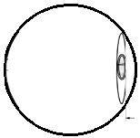
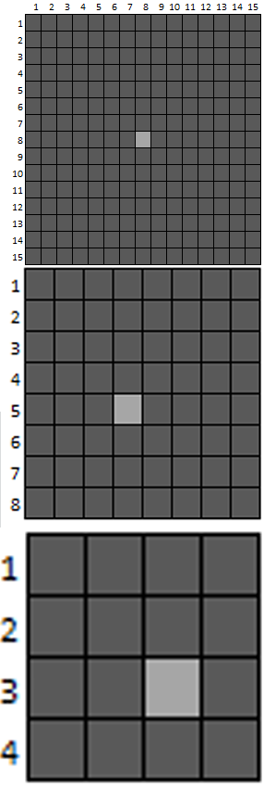

This correspond resolution achievable by the driver’s eye acuity
which forms a circle of least confusion.
Luminance (in grey
scale value)=166
$$\text{a}\text{monitor}\text{[}\text{m}\text{]}$$
$$\text{a}\text{monitor}\text{[}\text{m}\text{]∗}\left(\frac{1}{V_{eye}}\right)\text{∗}\left(\frac{1}{60}\right)\text{[}\text{degree}\text{/}\text{arcmin}\text{]∗}\left(\frac{π}{180}\right)[rad/degree]$$
Luminance (in grey
scale value) = 89
Total luminance perceived
by the observer is the
integrated luminance
within this circle:
94 pixels with signal level 89
1 pixel with signal level 166
1/V_{eye}
1/V_{eye}
25 pixels with signal level 89
1 pixel with signal level 166
1/V_{eye}
4.5 pixels with signal level 89
1 pixel with signal level 166

Slide 4
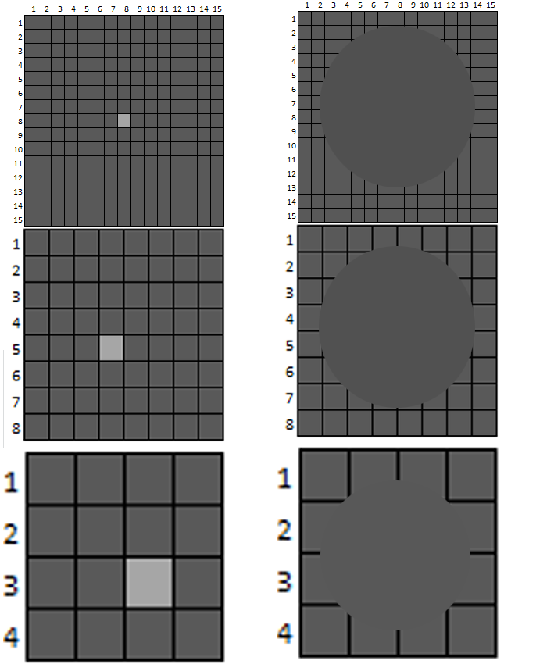
The perceived luminance is the averaged luminance within the this circle including the dark
bordering screen door effect around each
pixel if any.
Signal level as averagely measured: 80
Signal level as averagely measured: 81
Signal level as averagely measured: 88
Illustrative figures showing brightness following single fault pixel in panel with different resolution

Slide 5
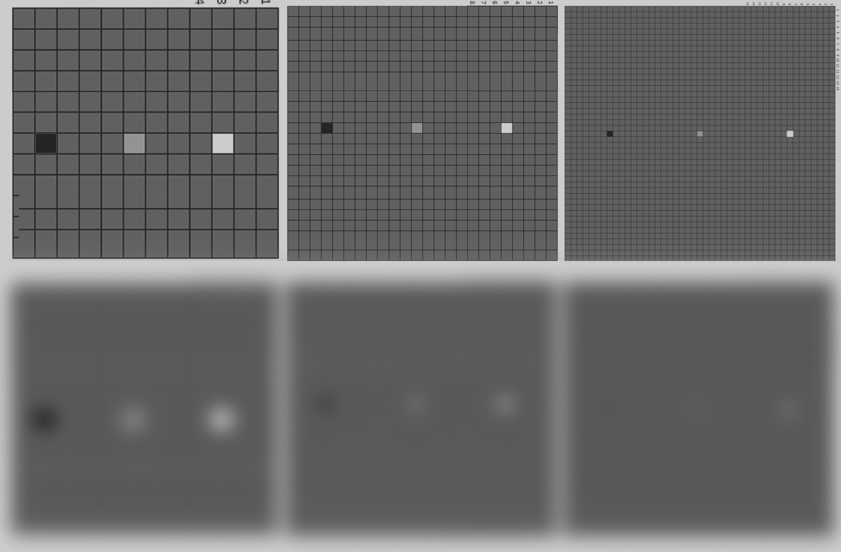
The resolution (or size per pixel) of monitor panel expected to be used in CMS will be such that the screen meshes around pixel are no longer observable when viewed with bare eye.
Below is an illustrative image artificially generated to explain how pixel of same output value is observed.
In the below example, panel in the right with pixel size approximately 1/8 has to have 8 faulty pixel of the same output level as seen in the left most example. So, acceptance criteria shall be created as average value within the driver perceivable circle of minimum confusion, represented by viewing opening angle 1/V_{eye}.

Slide 6
Presence of a “white blemish”(, or also referred as “hot pixel”, “ever bright pixel” or “bright pixel”) becomes significant and annoying when the integrated signal level within the circle of minimum resolution(or circle of minimum confusion) exceeds a certain limit level.
It is not the independent signal level of a single pixel that makes such pixel fault annoying and disturbing but the local perceptible signal difference (integrated signal) causing the luminance.
Therefore, acceptance limit criteria shall be created so that the effective human perceptivity factor is considered.
A possible measurement method to be adopted for CMS acceptance limit test, is first to find single bright signal points candidates within the image and then integrate the signal level around this specific pixel which may exhibit a high output level and averaging over within the surrounding pixel, at a range determined by the circle of minimum resolution (in other words, the circle of confusion).
Proposed criteria:
1. Averaged signal within the circle of minimum resolution around occasional local brightest pixel or cluster shall be no more than 30% of the local average signal level of the surrounding pixel but excluding the local brightest pixel signal level or the respective cluster.
2. The signal level of occasional pixel fault brightest pixel shall not exceed 80% of the signal level of the surrounding pixel but excluding the local brightest pixel signal level or the respective cluster.
The test if applicable is to be performed at room temperature 22 +/- 2 degrees Celsius by capturing a dark and black scene with camera scene illumination under 1lux.
$$\text{The} \text{diameter} \text{of} \text{this} \text{circle} \text{of} \text{minimum} \text{confusion} \text{is} \text{calculated} \text{as} \text{amoni}\text{tor}\text{[}\text{m}\text{]∗}\left(\frac{1}{V_{eye}}\right)\text{∗}\left(\frac{1}{60}\right)\text{[}\text{degree}\text{/}\text{arcmin}\text{]∗}\left(\frac{π}{180}\right)[rad/degree]$$

Slide 7
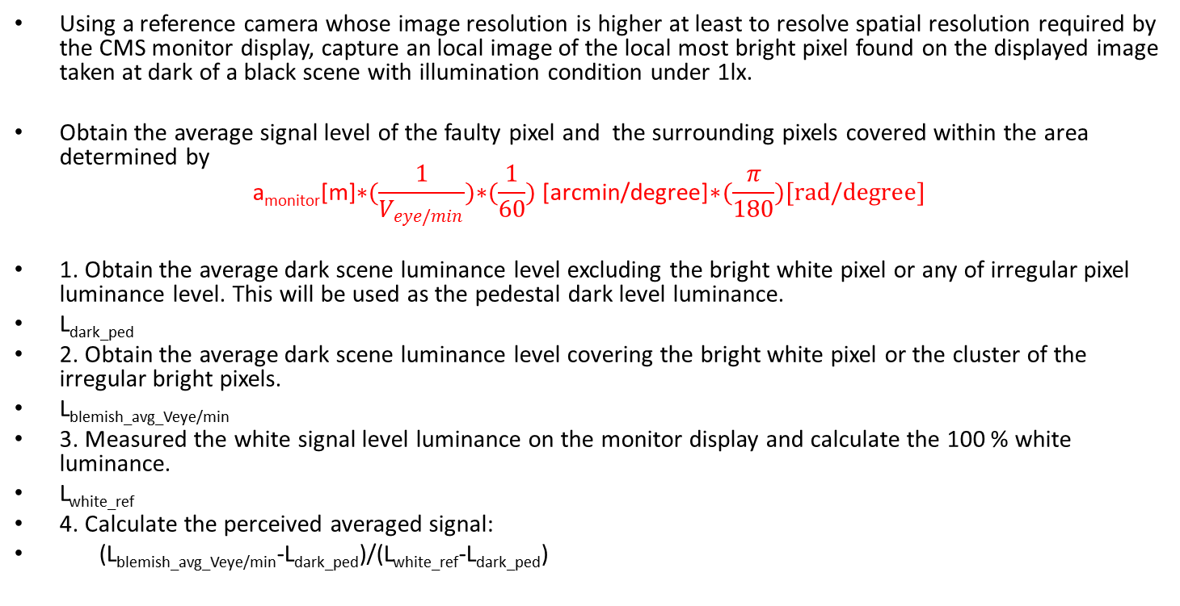
Using a reference camera whose image resolution is higher at least to resolve spatial resolution required by the CMS monitor display, capture an local image of the local most bright pixel found on the displayed image taken at dark of a black scene with illumination condition under 1lx.
Obtain the average signal level of the faulty pixel and the surrounding pixels covered within the area determined by
$$\text{a}\text{monitor}\text{[}\text{m}\text{]∗}(\frac{1}{V_{eye/min}})\text{∗}(\frac{1}{60})\text{ [}\text{arcmin}\text{/}\text{degree}\text{]∗}(\frac{π}{180})[rad/degree]$$
1. Obtain the average dark scene luminance level excluding the bright white pixel or any of irregular pixel luminance level. This will be used as the pedestal dark level luminance.
L_{dark_ped}
2. Obtain the average dark scene luminance level covering the bright white pixel or the cluster of the irregular bright pixels.
L_{blemish_avg_Veye/min}
3. Measured the white signal level luminance on the monitor display and calculate the 100 % white luminance.
L_{white_ref}
4. Calculate the perceived averaged signal:
(L_{blemish_avg_Veye/min}-L_{dark_ped})/(L_{white_ref}-L_{dark_ped})
L_{white_ref}
L_{blemish_avg_Veye/min}
L_{dark_ped}
Absolute Zero

Slide 8
Basic test procedure for white blemish verification using a CMS sample exhibiting maximum
level of faulty pixel.
The CMS under evaluation shall display an image captured by the CMS camera capturing a black body at dark environment. The dark environment shall be an illumination condition with less than 1 lux or equivalent.
In a dark room environment, using a reference evaluation camera, capture an image of the local faulty pixel image displayed on the monitor screen, including at least an additional area enough to obtain an average luminance level surrounding the faulty pixel to be evaluated.
Manually adjust the exposure condition of the evaluation camera so that the dark minimum output level and maximum output level of the CMS comes in within the reproducible tone range of the reference camera. Do not over-exposure or under-exposure.
Plot the signal level of the capture image of the reference camera and obtain the differential for the faulty pixel level, expected maximum white level displayable by the CMS relative to the
pedestal dark level of the CMS. The pedestal level might not necessary be 0 level of the reference camera, but over the floor dark noise signal level of the reference camera.
Calculate the average signal level around the faulty pixel relative to the maximum white reference level.
This average pixel level around the faulty pixel shall not exceeds the maximum acceptance level of 30%.

Slide 9
Basic test procedure for dark blemish verification using a CMS sample exhibiting low responsive l faulty pixel.
The CMS under evaluation shall display an image captured by the CMS camera capturing a uniform white panel illuminated under a diffused uniform light environment.
In a dark room environment, capture an image of the local faulty pixel image displayed on the monitor using a reference evaluation camera, including at least an additional area enough to obtain an average luminance level surrounding the faulty pixel to be evaluated.
Manually adjust the exposure condition of the evaluation camera so that the dark minimum output level and maximum output level of the CMS comes in within the reproducible tone range of the reference camera. Do not over-exposure or under-exposure.
Plot the signal level of the capture image of the reference camera and obtain the differential for the faulty pixel level, expected maximum white level displayable by the CMS relative to the
pedestal dark level of the CMS. The pedestal level might not necessary be 0 level of the reference camera, but over the floor dark noise signal level of the reference camera.
Calculate the average signal level around the faulty pixel relative to the maximum white reference level.
This average pixel level around the faulty pixel shall not exceeds the minimum acceptance level of 30%.

Slide 10

Example of white blemish

Slide 11
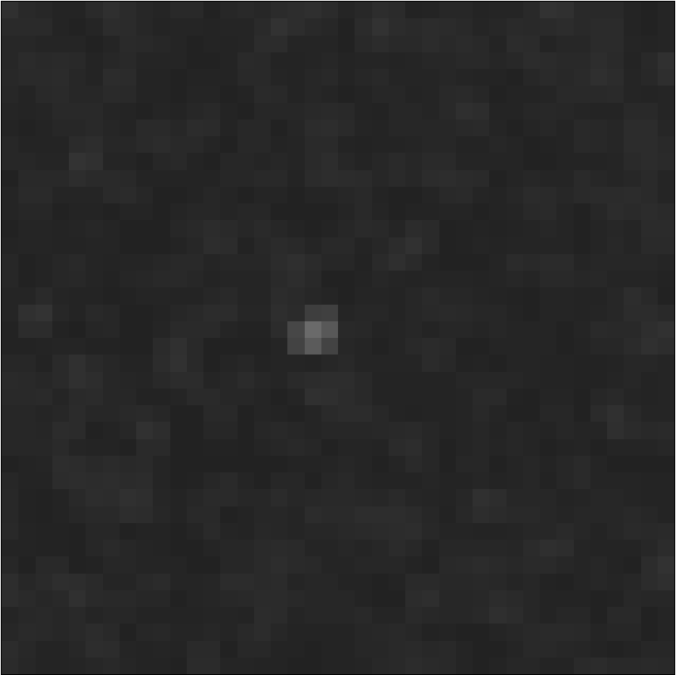

Close up as camera output
Close up as smoothed over 5 pixel range

Slide 12
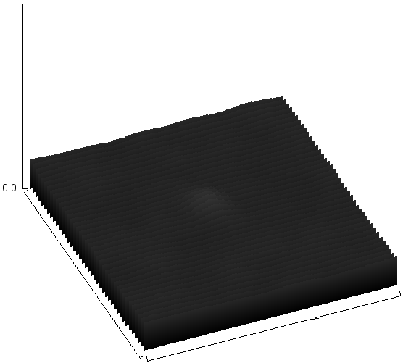
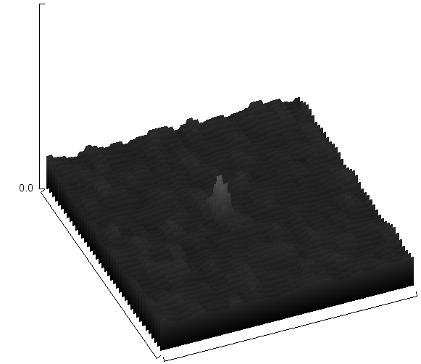
3D plot profile
Close up as camera output
Close up as smoothed over 5 pixel range

Slide 13
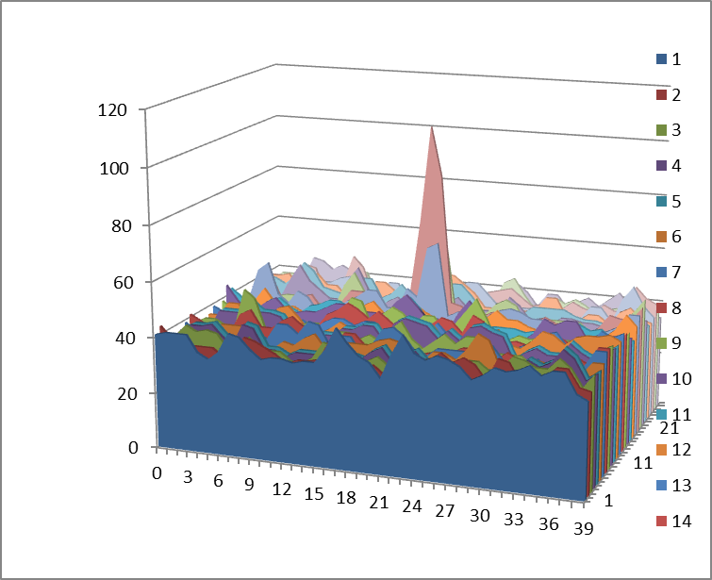
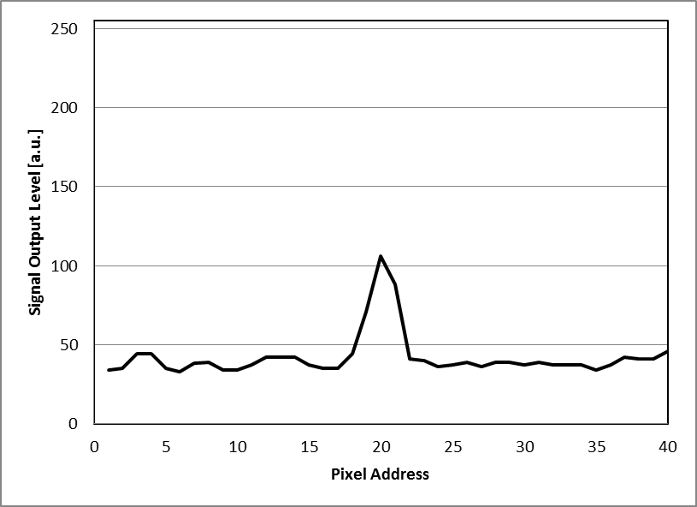
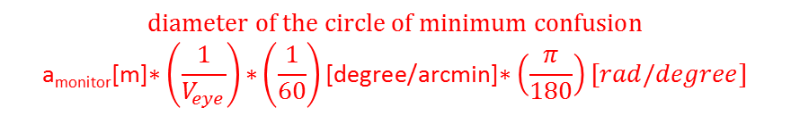
$$\text{d}\text{iameter} \text{of} \text{the} \text{circle} \text{of} \text{minimum} \text{confusion}$$
$$\text{a}\text{monitor}\text{[}\text{m}\text{]∗}\left(\frac{1}{V_{eye}}\right)\text{∗}\left(\frac{1}{60}\right)\text{[}\text{degree}\text{/}\text{arcmin}\text{]∗}\left(\frac{π}{180}\right)[rad/degree]$$
White reference level
L_{white_ref}
L_{blemish_avg_Veye/min}
L_{dark_ped}
Black reference floor level

Slide 14
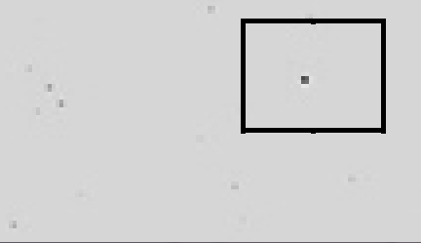
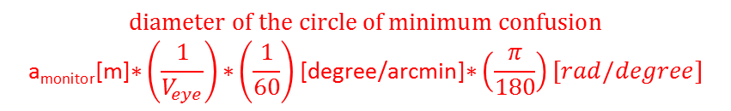
L_{blemish_avg_Veye/min}
L_{white_ref}
$$\text{d}\text{iameter} \text{of} \text{the} \text{circle} \text{of} \text{minimum} \text{confusion}$$
$$\text{a}\text{monitor}\text{[}\text{m}\text{]∗}\left(\frac{1}{V_{eye}}\right)\text{∗}\left(\frac{1}{60}\right)\text{[}\text{degree}\text{/}\text{arcmin}\text{]∗}\left(\frac{π}{180}\right)[rad/degree]$$
If tonal range on the CMS monitor is reproduced on the reference camera such that the
dark floor level of the camera under test is off-set from the reference camera 0 level,
correct it accordingly.

