Slide 1
Annex 12 #2.6.4
Camera Monitor arrangement
IGCMS-II-03-12

Slide 2
First proposal for location of the different display areas
  “The arrangement of the monitor(s) inside the vehicle shall be in such a way as expected by a driver.
  This means, that the image of the right side field of view shall be presented to the right of the longitudinal vertical plane passing through the ocular reference point, defined in paragraph 12.1. The image of the left side field of view shall be presented to the left of the longitudinal vertical plane passing through the ocular reference point.
  If the CMS shows more than one FOV on one display, non-continuous images shall be clearly separated from each other.”

Slide 3



Monitor Arrangement
Right
Left
Left FOV
Situation with mirrors
Central FOV
Right FOV

Slide 4
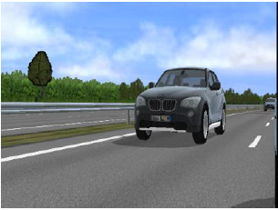
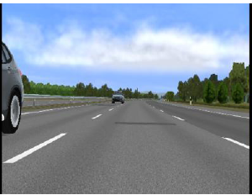
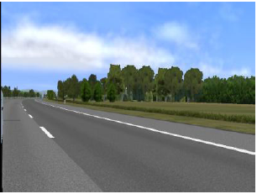
Monitor Arrangement
Right
Left
Left FOV
ALLOWED with CMS
Central FOV
Right FOV

Slide 5
Monitor Arrangement
Right
Left
Left FOV
ALLOWED
Central FOV
Not recommanded
« What is in front of the driver should be dedicated to forward driving informations »
Right FOV

Slide 6
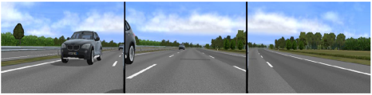
Monitor Arrangement
Right
Left
Left FOV
ALLOWED
Central FOV
Not recommanded
« What is in front of the driver should be dedicated to forward driving informations »
Right FOV

Slide 7
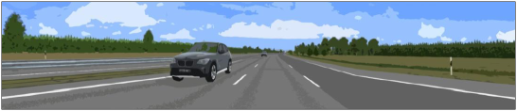
Monitor Arrangement
Right
Left
Left FOV
ALLOWED
Central FOV
Not recommanded
« What is in front of the driver should be dedicated to forward driving informations »
Right FOV

Slide 8
Monitor Arrangement
Right
Left
Left FOV
FORBIDDEN
Central FOV
This is an issue for OICA
Right FOV

Slide 9
Monitor Arrangement
Right
Left
Left FOV
FORBIDDEN
Central FOV
This is an issue for OICA
Right FOV

Slide 10
OICA new proposal
  “The arrangement of the monitor(s) inside the vehicle shall be in such a way as expected by a driver.
  This means, for a left hand drive vehicle, that the image of the right side field of view shall be presented to the right of the longitudinal vertical plane passing through the ocular reference point, defined in paragraph 12.1. The image of the left side field of view shall be presented to the left of the longitudinal vertical plane passing through the ocular reference point.
  [Notwithstanding the above requirements, in case where the Class I and Class III fields of view are shown merged on one display and the car manufacturer demontrates that the field of vision is increased by xx%, the central axis of the display may be located between the longitudinal vertical plane passing through the ocular reference point and the median longitudinal plane of the vehicle.]
  If the CMS shows more than one FOV on one display, non-continuous images shall be clearly separated from each other.”

Slide 11
Monitor Arrangement
Right
Left
Left FOV
ALLOWED
With OICA proposal
Central FOV
Right FOV

Slide 12
Monitor Arrangement
Right
Left
Left FOV
ALLOWED
With OICA proposal
Central FOV
Right FOV

Slide 13
Monitor Arrangement
Right
Left
Left FOV
ALLOWED
With OICA proposal
Central FOV
Right FOV

Slide 14
Monitor Arrangement
Right
Left
Left FOV
FORBIDDEN
Agreed
Central FOV
Right FOV

