Slide 1
DPPS-Subgroup HBM Qualification
Issues still open
No. | Issue | Name | Date
1 | Who monitors and maintains the GV models? Austrian ministry? | Corina | Aug 22
2 | Review ACz and HCz | Corina, Alexander | Nov 22
3 | Review weight of 6-year-old child | Corina, Alexander | Nov 22
4 | Weight for adult HBMs to be defined | Corina, Alexander | Aug 22
5 | Documentation of Validation of AM50 (Appendix B of Annex 2) | Corina, Andre, Oliver, Alexander | Febr 23
6 | Simulations with validated HBMs must be done on updated GV models | Corina | Nov 22
7 | Thresholds must be filled in tables 3-5 | Corina, Alexander | Nov 22
8 | “Static test required” should be described in main document | Alexander | Sept 22
9 | How to proof largest HBM? | All | Sept 22
10 | How to deal with HBMs that have only chin contact with bonnet? | All | Sept 22
11 | What if only 6-year-old hits DPPS | All | Sept 22
12 | What if undeployed simulation not required as all HIT>TRT? | All | Sept 22
13 | How to proceed for WAD’s < WAD 6YO? | All | Sept 22

Slide 2
DPPS-Subgroup HBM Qualification
Annex 2
Annex 3

Slide 3
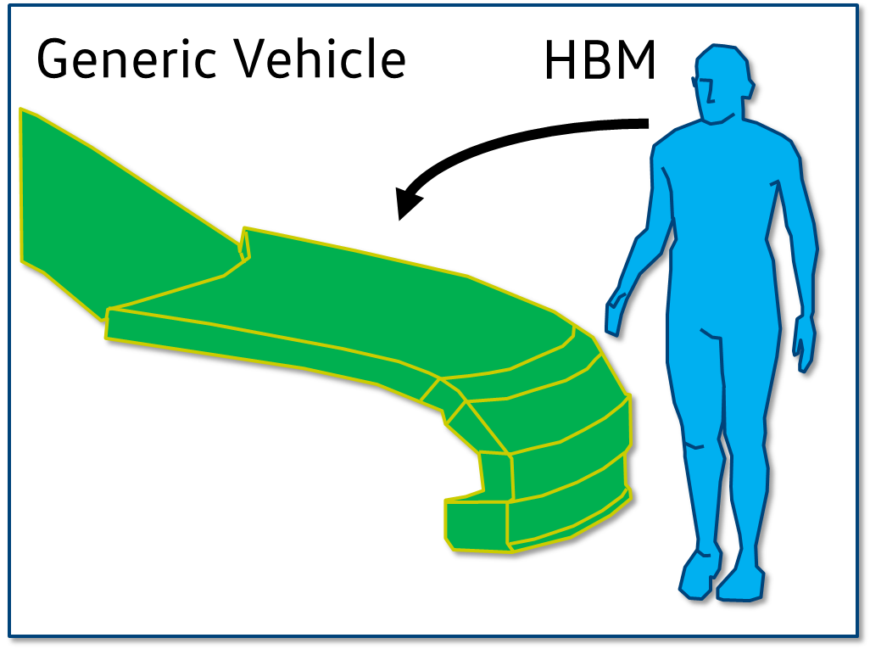
DPPS-Subgroup HBM Qualification
Annex 2
Annex 3

Slide 4
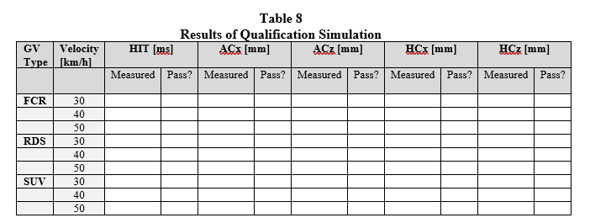
DPPS-Subgroup HBM Qualification
Annex 2
Annex 3
HBMs have to fullfil thresholds to be qualified

Slide 5
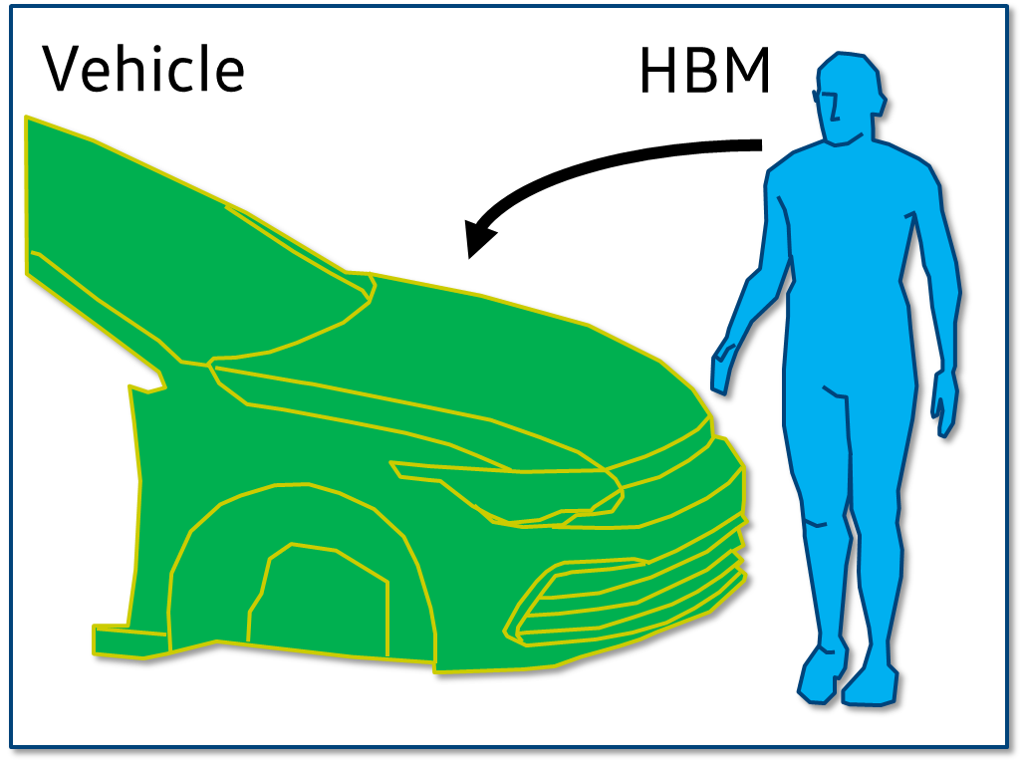
DPPS-Subgroup HBM Qualification
Annex 2
Annex 3
HBMs are qualified
HBMs have to fullfil thresholds to be qualified

Slide 6
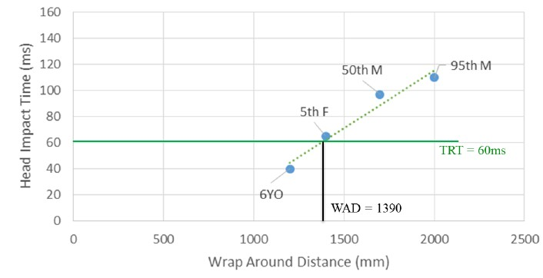
DPPS-Subgroup HBM Qualification
Annex 2
Annex 3
HBMs are qualified
HBMs have to fullfil thresholds to be qualified
HIT over WAD

Slide 7
DPPS-Subgroup HBM Qualification
Annex 2
Annex 3
HBMs are qualified
How to create these thresholds?
HBMs have to fullfil thresholds to be qualified
HIT over WAD

Slide 8
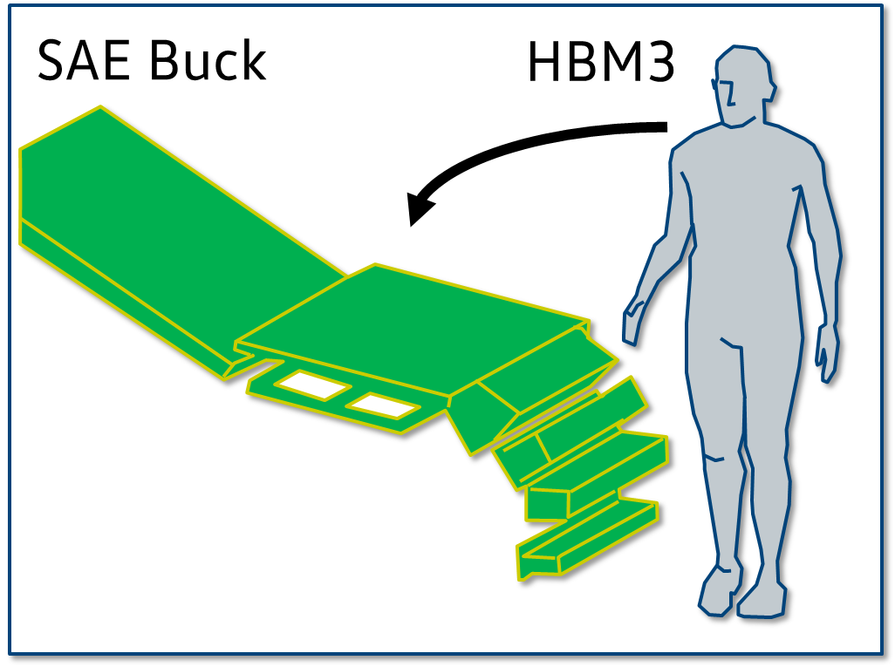
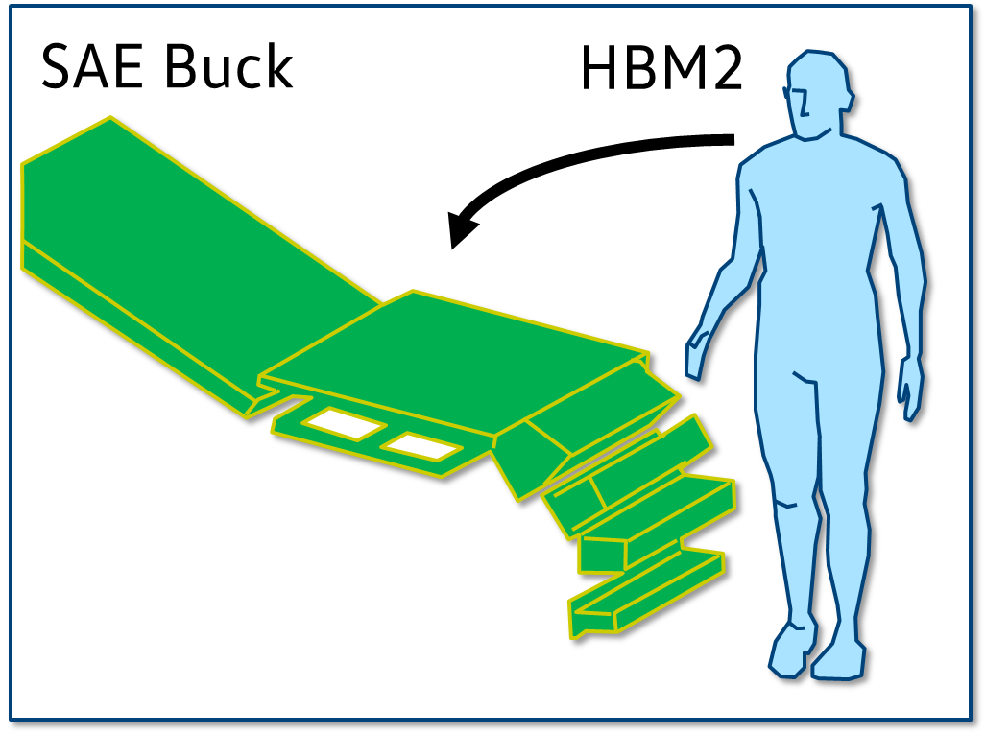
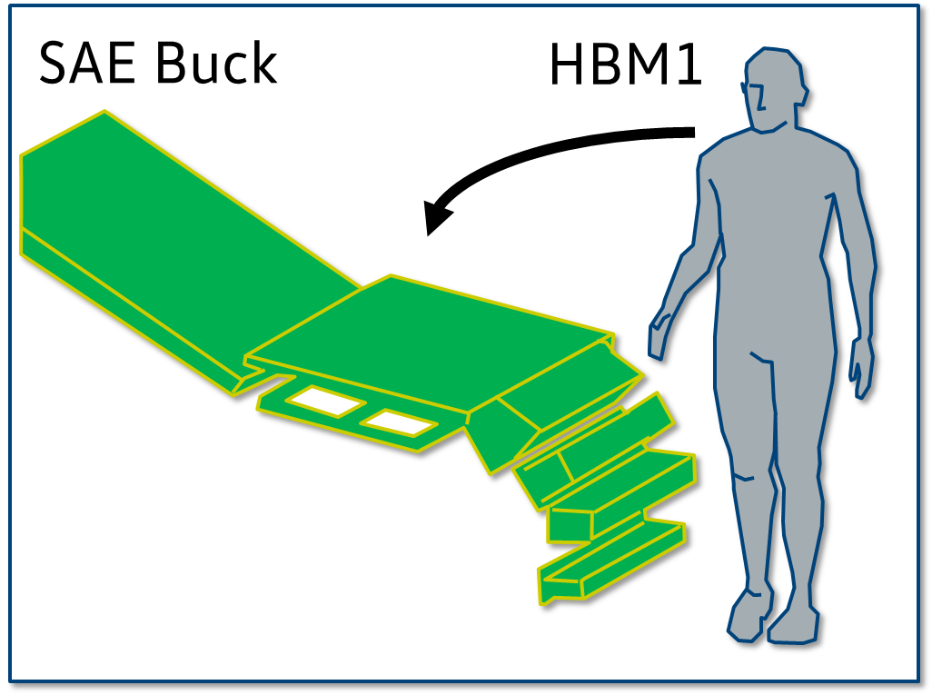
DPPS-Subgroup HBM Qualification
Appendix B of Annex 2
Validation
PMHS test on SAE Buck

Slide 9
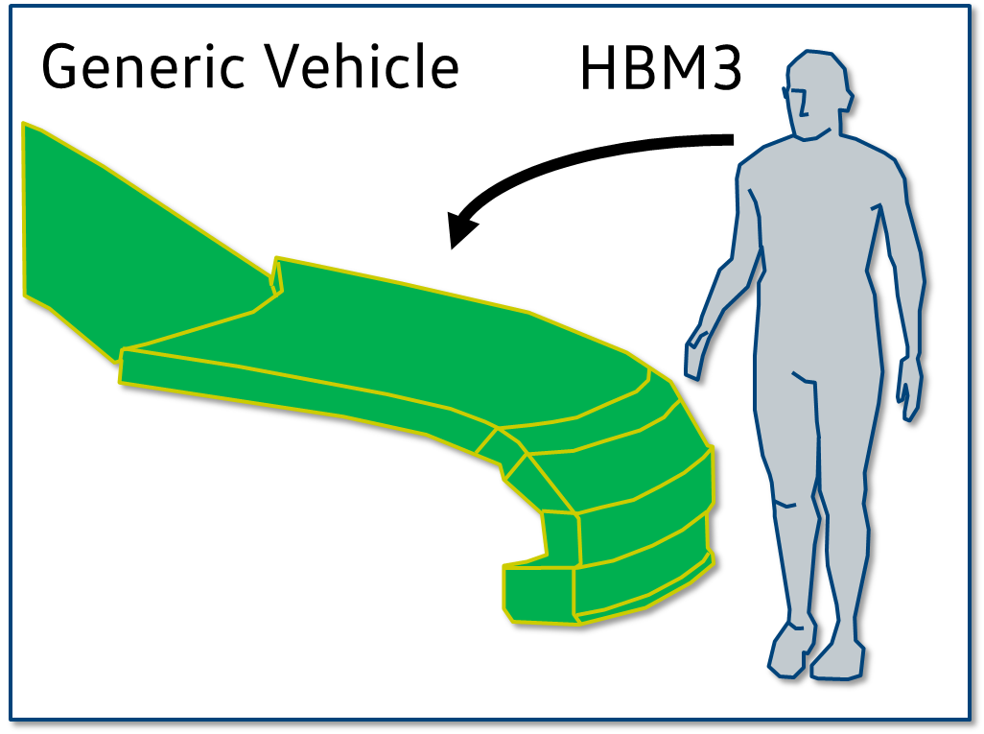

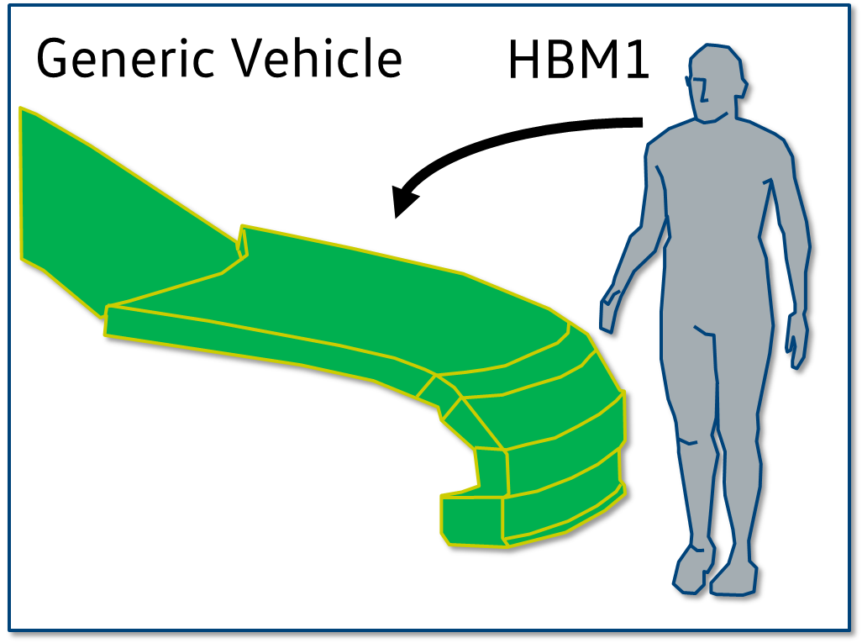
DPPS-Subgroup HBM Qualification
Appendix B of Annex 2
Validation
PMHS test on SAE Buck
Create Thresholds

