Slide 1
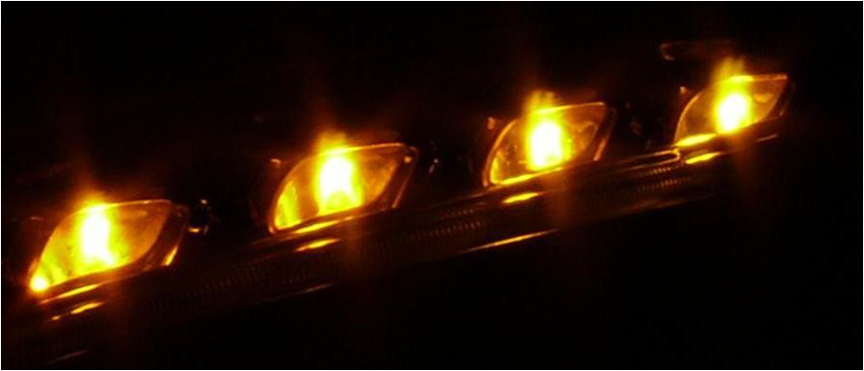
Appearance of signal lamps
SLR-58-05
Front turn signal – photo with a camera
-

Slide 2
Appearance of signal lamps
Determination of the effective projected luminous lens area using a CCD-camera
Questions:
What it the right contrast ratio for a picture of the signal lamp to
get a good correlation between picture and „real“ impression ?
What could be a good threshold for measuring the effective projected luminous lens area in accordance to maximum of the luminance?
Testing setup:
A headlamp with 4 separate LED-optics building up a turn signal was shown to 13 persons.
They had to choose from 6 CCD-camera pictures of this signal lamp which one gives the right appearance impression.

Slide 3



Appearance of Signal lamps
Testing setup
Labratory light
switched off
10 m
Ca. 1,10 m
Ca. ,80 m

Slide 4

Appearance of Signal lamps
Testing setup
Labratory light
switched on
10 m
Ca. 1,10 m
Ca. ,80 m

Slide 5

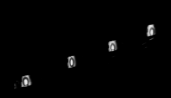
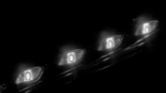

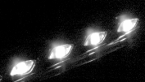
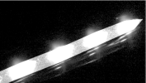
Appearance of Signal lamps
BLL –Front Table of pictures with different appearance*
*A picture taken with a CCD-camera carries the information of the luminance of the turn signal.
From this data set different images were generated by varying the threshold to black and white.
In relation to the maximum of the luminance this leads to different contrast ratios.

Slide 6
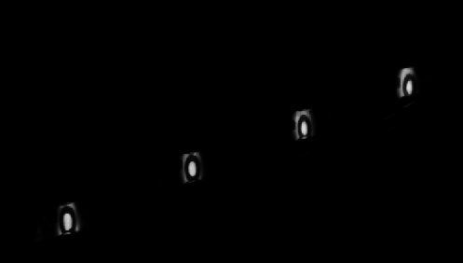
Appearance of Signal lamps
1. Luminance picture
1

Slide 7

Appearance of Signal lamps
2. Luminance picture
2

Slide 8

Appearance of Signal lamps
3. Luminance picture
3

Slide 9

Appearance of Signal lamps
4. Luminance picture
4

Slide 10

Appearance of Signal lamps
5. Luminance picture
5

Slide 11
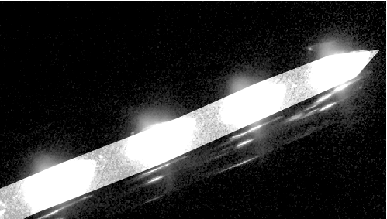
Appearance of Signal lamps
6. Luminance picture
6

Slide 12
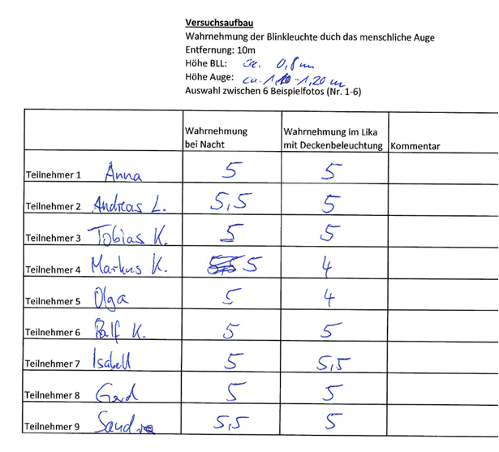
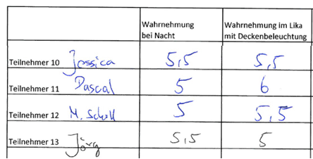
Test results

Slide 13
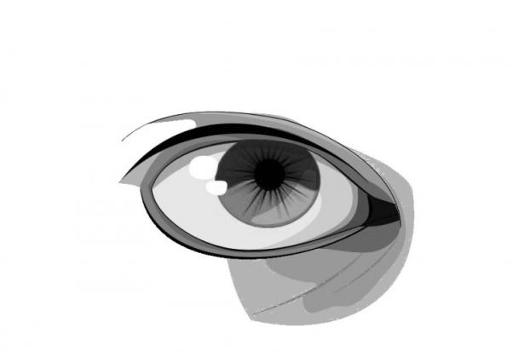
The human eye
Whiche luminance difference can the human eye see?
Human eye
The human eye can perceive scenes with a very high dynamic contrast ratio, around 1.000.000:1.
Adaption is achieved in part through adjustments of the iris and slow chemical changes, which take
some time (e.g. the delay in being able to see when switching from bright lighting to pitch darkness).
[source: Wikipedia „ High dynamic range rendering“]

Slide 14
Appearance of signal lamps
Conclusion
The test persons identified the picture 5 as the best fitting picture to give the right impression of the appearance seen by the human eye.
The trend goes even to higher contrast ratio (A lot of the test person noted 5,5)
Comment 06.10,2022:
This is to show the test set up used in 2011 to evaluate the correlation of contrast ratio to human eye perception
This is meant to give an idea of a possible experimental set up to pick up the idea of contrast ratios or minimum luminances for current Apparent Surface discussions within SLR

