Slide 1
Task Force Direct Vision: Progress & Status Phase 2
Iain Knight & Johannes Peter Bauer on behalf of the Task force
VRU-Proxi-25-02

Slide 2
Objectives
From Terms of Reference
  Amending the alternative testing method for innovative vehicle designs (e.g. aerodynamic narrow A-pillar designs) by replacing paragraph 5.3. (April 2023 or earlier if possible)
  For vehicles with competing objectives (e.g. improved direct vision versus high capacity transport, high efficiency, new powertrain technology, impact on freight industry) with direct vision challenges an alternative approach could be considered. It shall be limited to Level 3 for N3 category of vehicles and shall be based on quantified data. (October 2023 or earlier if possible)

Slide 3
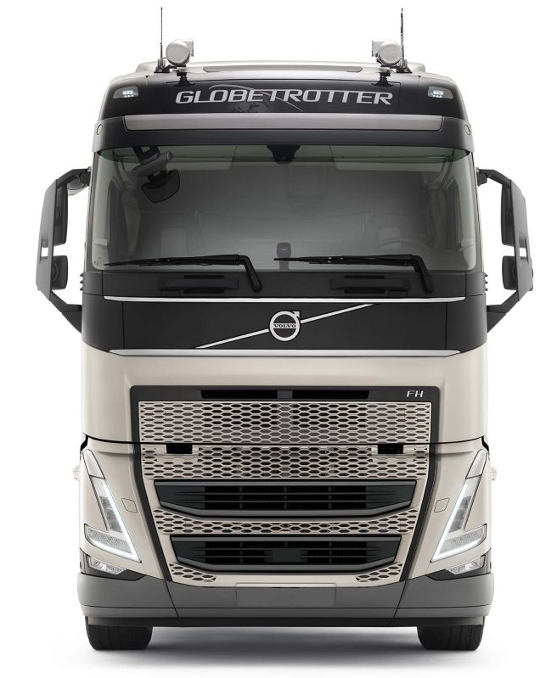
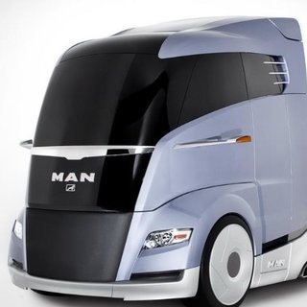
Design Neutrality – What is the problem?
Method development to date based on past/current cab design
Future truck design may vary: narrower distance between A pillars a particular feature of aerodynamic concepts
Current method defines front, nearside and drivers side view based on A-pillar and sets a limit value to each side
Making the A pillars closer together laterally will make the view out of the front window smaller and the view out of the side windows bigger. A vehicle that passes the regulation with a standard cab configuration, could fail on frontal limit if A pillars are moved closer together and nothing else changes

Slide 4
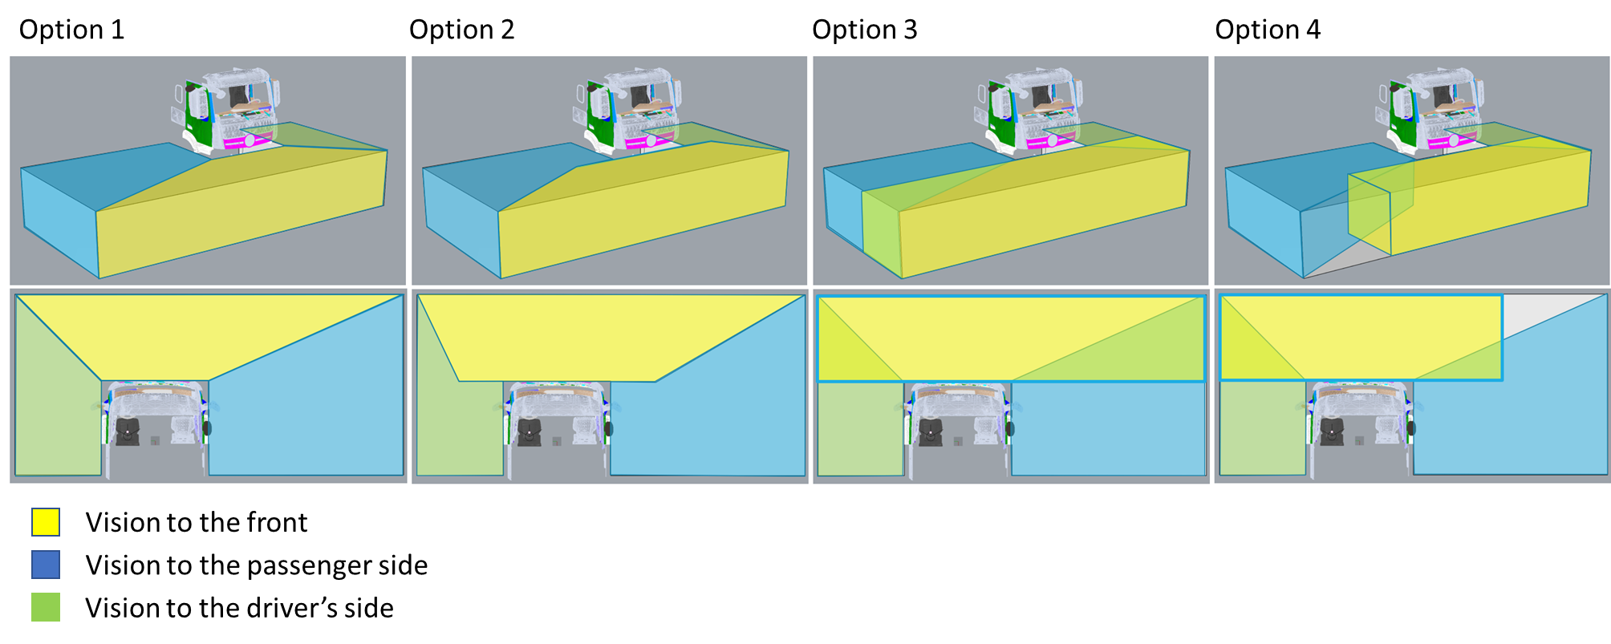
Design Neutrality – What Solutions are Proposed?
All options involve defining at least the front view as a section of assessment volume. Deemed visible whichever area of the cab (windscreen, side window, lower door window etc) they are seen through
  Options 1 & 2 have 3 discrete views all defined independently of vehicle configuration
  Options 3 & 4 have independently defined front zone but side zones remain tied to A-pillar position

Slide 5
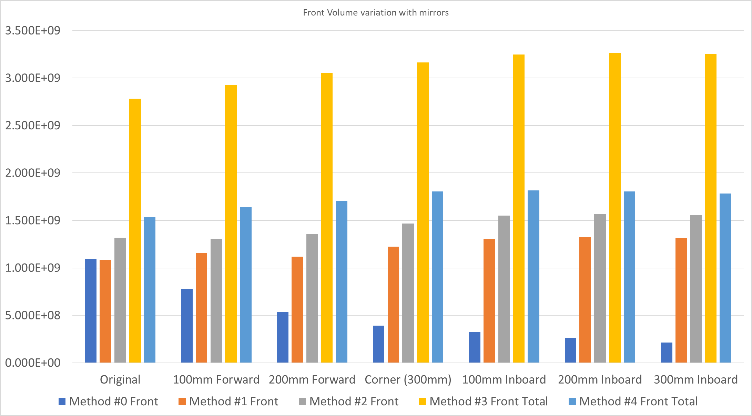
Results of the analysis: Tech neutrality
Regulated method is #0 (Dark blue)
  As A-pillar moves from original position, volume reduces substantially – Not tech neutral
All new methods #1 to #4 are substantially less variable – large improvement in tech neutrality
Least variation is method #4 (light blue), because with current designs the amount of volume visible is low in front of the vehicle but larger to the side. A pillars do move from outside to inside of frontal zone though
Variability is larger with method#3 but A-pillars are always in the frontal zone in realistic ranges.

Slide 6
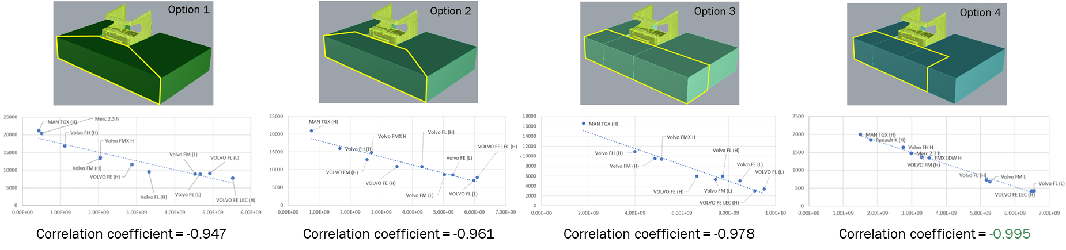
Results of the analysis: Equivalent safety
Whatever new frontal zone is chosen, a new limit value is required and this needs to be demonstrably equivalent to the existing value in terms of safety.
Original method derived the limit from correlation analysis of VRU distance and volume
Concerns are that this approach will be less valid the wider the front zone is, a particular issue for method #3. However, correlation remains strong based on a sample of 10 existing vehicles
The best correlation is achieved with method #4

Slide 7
Current Status: Tech Neutrality
We have 4 candidate methods – all are substantially better than the regulated version in this respect
Task force is agreed that we shouldn’t use method #1 or #2
Work is continuing to either:
  Reach consensus on a single approach
  Bring a clearly explained choice between method #3 and #4 to VRU Proxi CPs
Remaining work
  For the selected method, doing additional analysis to support the selection of the limit value
  Drafting the regulatory text
Question: Should the new approach be a REPLACEMENT of the existing method, or an ALTERNATIVE (similar to the R151 approach)?

Slide 8
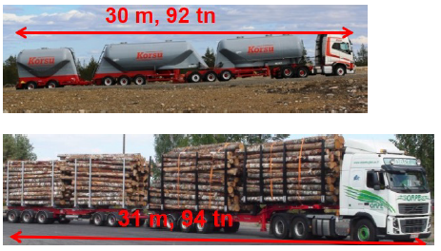
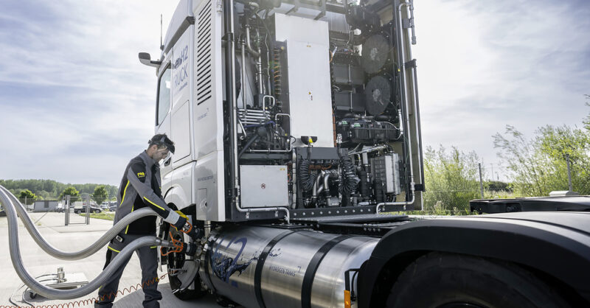
Alternative Approach for Competing Objectives
High Capacity Transport (HCT) Concept
  Sweden has presented a case for why they consider it essential that vehicles capable of use in HCT must remain available through full type approval & proposed some simple amendment text
  Await a proposal from industry explaining why that can’t be met with existing DVS limits and what the alternative approach should be
Zero Emission Vehicles
  Limited progress to-date

Slide 9
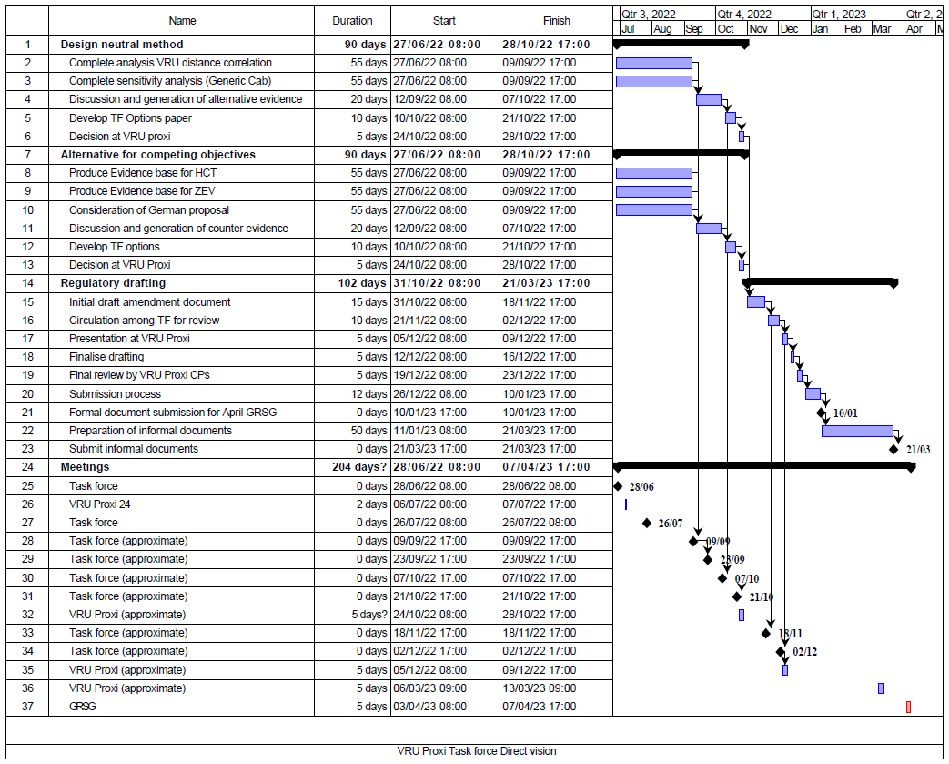
Work plan and timing
Design Neutral Method
  With work to establish limit value still to be completed, we are around one month behind schedule
  Propose beginning to draft text in parallel with the limit value work
  Recovery of time remains possible but challenging
  Decisions needed quickly
    Replacement method or alternative
    Method 3 or 4. Task force aims to agree. Whether this proves possible will be known very soon. If not possible a CP decision would be needed urgently if April GRSG deadline is to be met
Zero Emission Vehicles
  Ambition was to exceed TOR deadline (October 23 GRSG) by submitting for April
  More significantly behind the schedule required to achieve that.

Slide 10
Summary
Task force has made good progress on design neutrality and has candidate methods that are much improved
Timescales are challenging and some key analyses and decisions are still required
Very fast progress will be needed on ZEV if the more ambitious April GRSG target is to be met, but October remains possible as a fall back.

