Slide 1
GRVA Taskforce on Fitness for ADS
1st Meeting — 7 October 2022

Slide 2
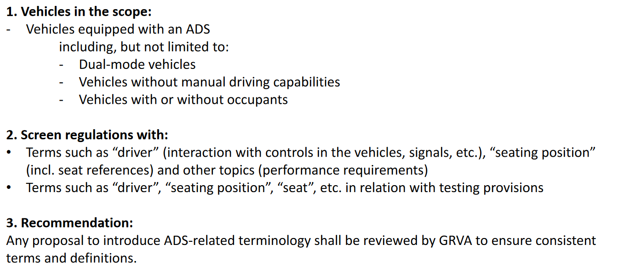
Recap of guidance from WP29 & GRVA
Report to WP29 in March 2023
Intermediary report to GRVA in January 2023
Guidance from GRVA:

Slide 3
Inventory of GRVA Regulations and GTRs
Regulation | Title
R13 | Heavy vehicle braking
R13H | Brakes of M1 and N1 vehicles
R78 | Braking (category L vehicles)
R79 | Steering equipment
R89 | Speed limitation devices
R90 | Replacement braking parts
R102 | Close coupling devices (CCDs)
R130 | Lane Departure Warning System (LDWS)
R131 | Advanced Emergency Braking Systems (AEBS)
R139 | Brake Assist Systems (BAS)
R140 | Electronic Stability Control (ESC)
R147 | Mechanical coupling components of combinations of agricultural vehicles
R152 | Advanced Emergency Braking Systems (AEBS) for M1 and N1 vehicles
R155 | Cyber security and cyber security management system
R156 | Software update and software update management system
R157 | Automated Lane Keeping System (ALKS)
GTR | Title
GTR 3 | Motorcycle brake systems
GTR 8 | Electronic stability control systems
= within scope
= to be decided
= may need to consult GRSG

Slide 4
Inventory of relevant explicit terms
Provisional template for listing terms related to human driving

Slide 5
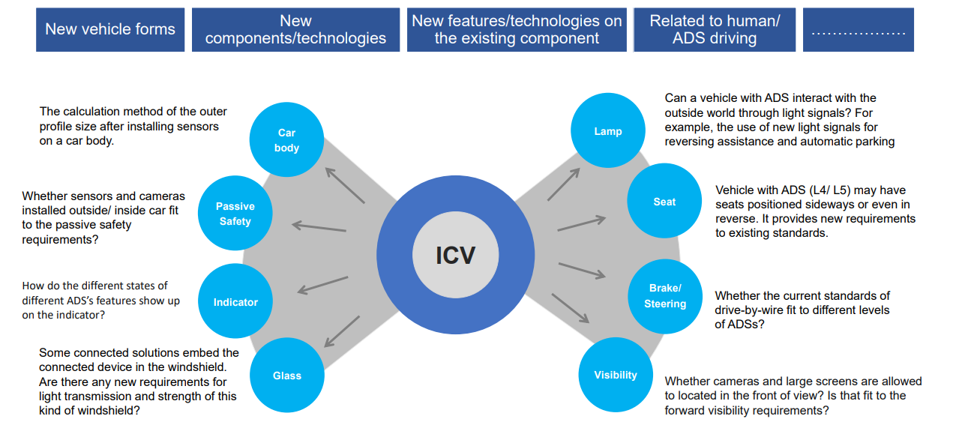
Inventory of relevant implicit terms

Slide 6
Deliverables
Table of all relevant prescriptions
  Reason for ADS impact
  Level of impact / priority
  Options for making the prescription fit for ADS
TBD: Whitebook for drafting future Regulations / GTRs
  For non ADS Regulations, terms to avoid and precautions to take
  For ADS Regulations, prescriptions identified in non ADS Regs that must be implemented in ADS Regs
Step 1
Step 2

Slide 7
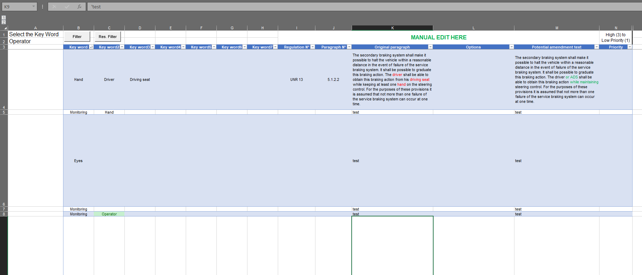
Template spreadsheet for screening UNR/GTR

Slide 8
Provisional timeline
Screen all prescriptions
Create list of relevant terms
Filter relevant UNR/GTR
Explore options
Draft deliverables
10/2022
11/2022
12/2022
01/2023
15th
GRVA

Slide 9
Scheduling future meetings
2nd meeting targeted for 21 October
Target pace: 5~6 meetings before 15th GRVA
In-person meetings: welcoming volunteers for hosting
  Potential dates:
    Mid-December
    Week before 15th GRVA (e.g. 19-20 January 2023)
    Between 15th GRVA and 189th WP29 (February 2023)

Slide 10
Next steps
Link to all relevant files: https://wiki.unece.org/pages/viewpage.action?pageId=179700571
Next meeting:
  Presentation of existing work
  Validation of relevant UNR / GTR
  Validation of relevant terms
  Dispatching UNR/GTR screening

Slide 11
Backup
EU ADS Regulation 2022/1426
NHTSA Occupant Protection for Automated Driving Systems

