Slide 1
Status report of JASIC/JATMA – ETRTO meeting on 2023 test campaign
46th IWG WGWT
13th October 2022

Slide 2
Test campaign to improve test precision in 2023
At 45th IWG WGWT, JASIC and ETRTO each proposed test campaign plan in 2023 to improve test precision
JASIC's proposal focuses on reviewing the WWGI formula
ETRTO's proposal focuses on the accuracy of water depth measurements
Meetings were held between JASIC/JATMA ETRTO on 16 and 29 September to finalise the content of the 2023 test campaign

Slide 3
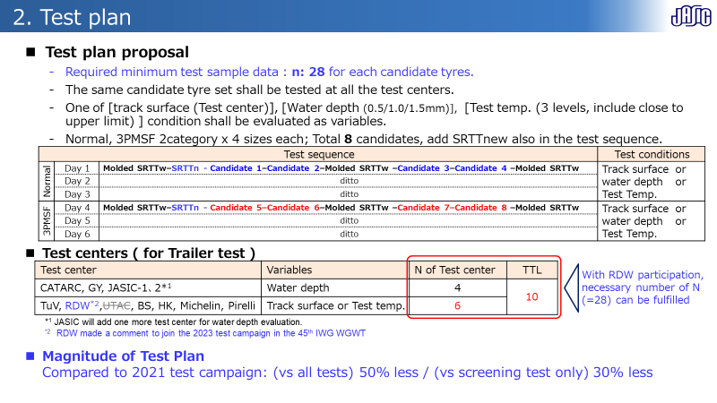
JASIC Proposal for 2023 test campaign
Test plan for reviewing the WWGI formula.
JASIC is of the opinion that the existing WWGI formula needs to be assessed in terms the following aspects
Coefficients
Multiple regression analysis was not processed well because of the testing number of each candidate tyre in 2021 test campaign is insufficient small.
Correction term
Test water depth factor which has high influence on the wet performance was not take into account to the formula.
Lack of testing over a wide temperature range
Test temperature range at 2021 test campaign were rather narrow.
(most of the test were done at 15 – 25℃)
Wet μ temperature compensation shows certain variation.
WT-46-xx
JASIC proposed the test plan, consisting of half the magnitude of 2021, to verify these aspects

Slide 4
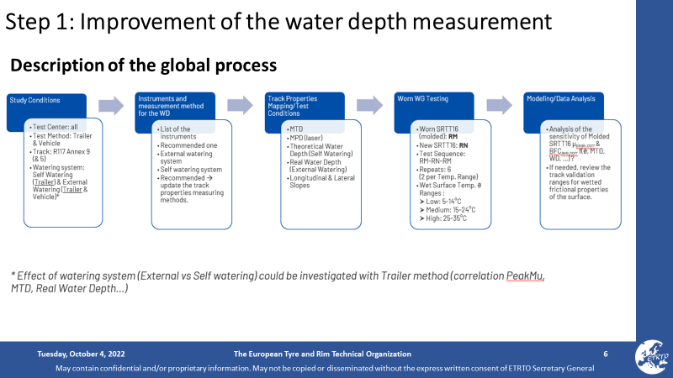
ETRTO Proposal for 2023 test campaign
Test plan for standardise measurement of water depths
ETRTO is of the opinion that it is needed to identify and quantify the sources of variability, and detected the following parameters
Variations in SRTT
It was solved with molded SRTT.
Improvement of the water depth measurement
By standardise measurement of water depths with a high accuracy, it is possible to control the exact water depth between different watering methods and different track characteristics (MTD) thus improving the test precision.
Furthermore, ETRTO proposed a test campaign in 2024, after the standardisation of water depth measurement methods, potentially focusing on
it is possible to reduce the mu peak range for the molded SRTT and/or
the introduction of the water depth in the formula is effective to reduce the variation of the test.
WT-46-zz
ETRTO proposed the 2 step test plan with standardization of water depth as step 1

Slide 5
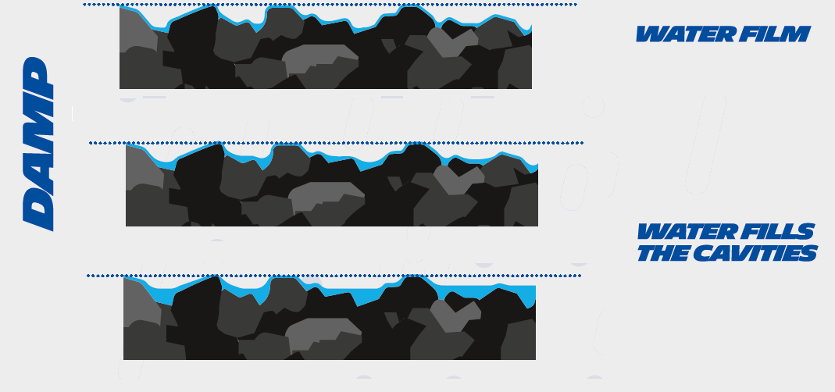

ETRTO Proposal for 2023 test campaign
Test plan for standardise measurement of water depths
WT-46-zz
Action items in each stage are studied and defined

Slide 6
Conclusions
JASIC/JATMA and ETRTO respect each other‘s proposals.
However, it is not able to reach a common workplan agreement, mainly due to differences in timelines.
  JASIC opinion:
  Testing for review of WWGI formulae and standardisation of water depth measurement methods will be carried out in parallel in 2023.
    Because the IWG WGWT ToR states that test precision improvement activities are to be carried out in 2023.
ETRTO opinion:
  In 2023, standardisation of the water depth measurement method will be carried out.
  In 2024, if deemed necessary, additional testing to improve the test precision will be conducted. The test plan will be considered in the results of the improvement of the water depth measurement method.
Decision to be taken in IWG WGWT on 13 October

Slide 7
Timeline
JASIC/JATMA and ETRTO respect each other‘s proposals.
However, it is not able to reach a common workplan agreement, mainly due to differences in timelines.
Decision to be taken in IWG WGWT on 13 October
 | 2022 | 2023 | 2024 | 2025
ETRTO Opinion
JASIC Opinion
Standardization of water depth measurement
Test precision improvement*
GRBP
GRBP
Working document
Working document
Standardization of water depth measurement
Test precision improvement
GRBP
Working document
* Test to be performed if deemed necessary

