Slide 1
Proposal on VMAD Approach to address Level 4
VMAD #28
EC-JRC
14 December 2022

Slide 2
Roadmap for Automated Driving Deployment

Slide 3
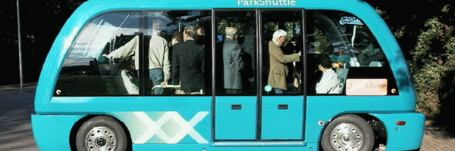
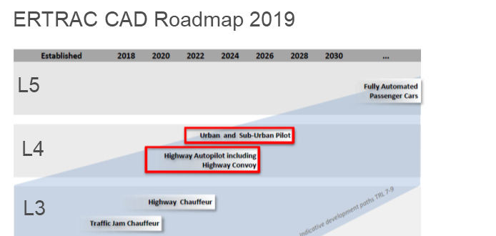


ERTRAC Roadmap & MVWG-ACV discussion
(2020)
Today
2025
2030 2050
Major uptake of Robot taxi/ shuttles in cities, level 4
2021-2024: Robot taxis/ shuttles (level 4) first commercial services.
Zero fatalities
Vehicles levels 1-2 (driver assist) available on the EU market
2024-2026
All new vehicles on EU market equipped with level 1 (EU law) or 2.
Major uptake of level 4 passenger cars on motorways
2030
Major uptake of level 4 trucks on motorways
2021: First “highway chauffeur” (level 3) to go on the EU market
First level 3/4 trucks on motorways

Slide 4
McKinsey Center for Future Mobility
(2021)
Most survey respondents expect L4 use cases to emerge by 2024 or 2025*
* Kersten Heineke, Ruth Heuss, Ani Kelkar, and Martin Kellner, What’s next for autonomous vehicles?, McKinsey Center for Future Mobility, December 2021.

Slide 5
ACEA/CLEPA roadmap (MVWG-ACV, 2021) automotive - Library (europa.eu)

Slide 6
L4 usecases
Shuttles
Robotaxis
AVP
Hub-to-hub

Slide 7
Proposed approach to L4 use-cases

Slide 8
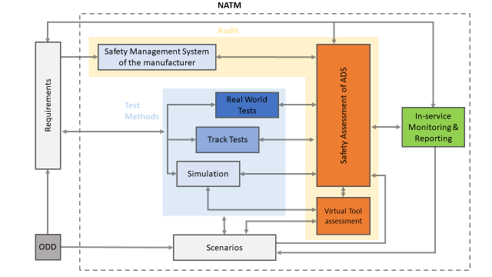
VMAD NATM: application to L4 use-cases

Slide 9
SG1: SCENARIOS
Define minimum set of scenarios for L4 use-cases, e.g.
  Lane change
  Crossing, turning
  Emergency manoeuvre
  Pedestrian/cyclist crossing (urban&rural, motorway)
  Hub-to-hub (motorway entry, exit, toll station, …)
Apply the principles for scenarios generation to L4 use-cases (e.g. ODD-based framework)
Benchmark: EU ADS Regulation

Slide 10
SG2: CREDIBILITY ASSESSMENT
Apply the principles for the credibility assessment for using virtual toolchain in L4 use-cases validation
Benchmark: EU ADS Regulation

Slide 11
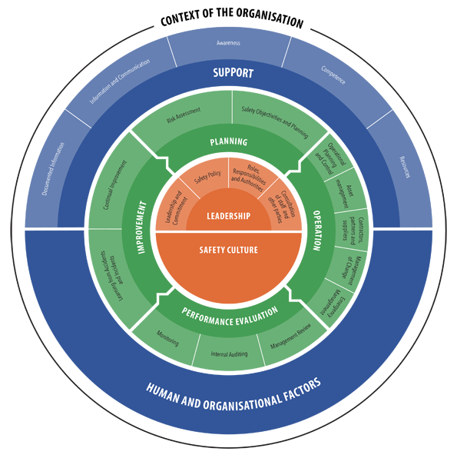
SG3 – AUDIT SMS & SAFTY ASSESSMENT
AUDIT of the SMS
Apply the principles for the AUDIT of the SMS to L4 use-cases
Benchmark: EU ADS Regulation
SAFETY ASSESSMENT
Apply the principles for the ADS Safety Assessment of the SMS to L4 use-cases
Benchmark: EU ADS Regulation
PART 1
Information Document
Part 2
Formal documentation package
Part 3
Confidential material

Slide 12


SG3: IN-SERVICE REPORTING
Apply the principles for the ISMR to L4 use-cases
Benchmark: EU ADS Regulation
EDR
EDR
DSSAD

Slide 13

SG4: TESTS
Apply the principles for the TRACK TESTING to L4 use-cases
Benchmark: EU ADS Regulation
Apply the principles for the PUBLIC ROAD TESTING to L4 use-cases
Benchmark: EU ADS Regulation

Slide 14
Additional open issues
VMAD
FRAV
NATM for remote operation
NATM for Infrastructure & communication
Requirements for L4 use-cases
Remote control center/operation
Infrastructure & communication
VMAD & FRAV
Compile matrix requirements vs pillars considering L4 use-cases

Slide 15

Thank you!
© European Union 2022
Unless otherwise noted the reuse of this presentation is authorised under the CC BY 4.0 license. For any use or reproduction of elements that are not owned by the EU, permission may need to be sought directly from the respective right holders.

