Slide 1

Considerations of test protocols
VMAD-28-09
Leadership SG4 Test track and real world validation
28th VMAD Meeting
14 – 15 December 2022
Tokyo

Slide 2
A general thought
Driving
license
Vehicle
Would you give a driving license to a person who drove only in a driving simulator?
No ADS
Driving
license
Vehicle
ADS
Driving
license
Vehicle
‘Full’ ADS

Slide 3
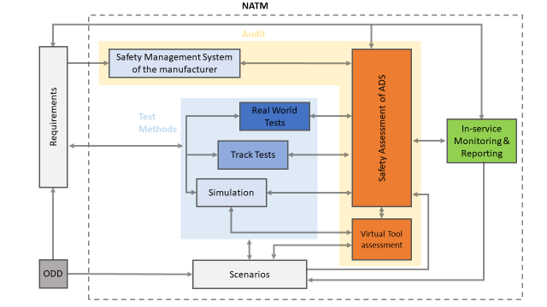
Test track & Real world
Validity
In-service monitoring
Real-world Tests
Test track
Driving simulator
Simulations
Controllability

Slide 4
starting points
FRAV:
  The requirements of FRAV are at a general level (cover all types of ADS)
  Verifiable criteria depends on type of ADS
    General requirements on test methods & protocols
Different types of ADSs require different test protocols
    General requirements on test protocols
An ADS should be tested in an environment that is relevant for its ODD.
If applicable: the HMI of a vehicle with ADS should be tested integrally

Slide 5
Test track - thoughts
Focus on assessment of safety critical scenarios / failures
  UNR 157 Amendment 1
Test Track fit for purpose
  relevant environment
Include variation within a scenario (no fixed scenario’s)
# repetitions of scenario
Test edge case of a safety critical scenario (e.g., the most difficult versions of that scenario)

Slide 6
Test track – available info
From UNR 157 Amendment 1
  3.1. Track testing
    The system shall be verified on a closed-access area with various scenario elements to test the capabilities and functioning of an ALKS.
  3.2.3. In order to test the requirements for failure of functions, …, and implementation of a minimal risk manoeuvre, errors may be artificially induced and the vehicle may be artificially brought into situations where it reaches the limits of the defined operating...
  3.3.1. …Parameters of the traffic critical scenarios shall be chosen in order to ensure a certain difficulty level. The type-approval authority shall include tests of traffic critical scenarios, if any:
    (a) in the “difficult” parameter range and;
    (b) in the “unavoidable collision” parameter range for the given scenario.
Thanks to JRC

Slide 7
Real world – anticipatory Driving behaviour (thoughts)
Determine relevant routes within ODD
  include conditions relevant for ADS
  possibility of expanding ODD in steps (by different route lengths, different road conditions)
  Length of route (#km)
Determine measurements
  environment (e.g., road, weather)
  driving behaviour

Slide 8
Real world – anticipatory Driving behaviour (thoughts)
Drive on different time slots if relevant (e.g., to include different traffic volumes)
Each drive will be unique in terms of situations (‘scenarios’) encountered
  # expected scenarios
  # unexpected scenarios
  Log scenario’s (driving conditions)
Determine # assessors
Develop assessment protocol

Slide 9
Real world – interaction vehicle & user (thoughts)
Determine relevant routes within ODD
  include conditions relevant for interaction
  possibility of expanding ODD in steps
  Length of route (#km)
  Register environment (e.g., road, weather)
Determine measurements
  Driving behaviour
  Interaction related measurements
Drive different time slots if relevant

Slide 10
Real world – interaction vehicle & user (thoughts)
Each drive will be unique in terms of situations (‘scenarios’) encountered
  # expected scenarios
  # unexpected scenarios
  Log the entire drive including 360° video
Determine pool of naive drivers
  number
  demographic aspects (male/female, age, drving experience, etc)
Include ToC, Take over and activation
  ODD exit

Slide 11
Real world – available info
From UNR 157 Amendment 1
  Public road testing
  3.1. The public road test shall primarily verify the ALKS normal operation within (but including coming close to) the system ODD boundaries…
  3.2. For the public road test the type-approval authority shall assess the system in a fault-free condition of the vehicle and its ALKS system…
Thanks to JRC

Slide 12
Real world – available info
From UNR 157 Amendment 1
  4.2. If applicable to the system’s ODD, the composition of the public road test shall allow the verification of the system in free-flow, lightly congested and heavily congested traffic conditions.
  Instructions on the determination of the test route:
  4.3. The location and selection of the test routes, time-of-day and environmental conditions shall be determined by the type-approval authority. Such tests shall cover different time-of-day and light intensity. They shall include scenarios in which the ALKS is expected to experience challenging scenarios…
Thanks to JRC

Slide 13
Real world – available info
Category | Type of scenario
Prevention of activation when the system is outside of its ODD | On a section of highway that is not suitable
 | In an urban environment
 | On a normally suitable road when other conditions (e.g. weather/time of day) are not met
System override by the driver | Intervention made by the steering wheel
 | Intervention made by the acceleration pedal
 | Intervention made by the brake pedal
No violation of traffic rules | Adheres to speed limits
 | Repeated changes in speed limit above 60 km/h
 | Exposure to different road signs which require system reaction (at least [3] different times)
 | Sufficient distance to vehicle in front
 | Does not cross solid lane markings where lane change is prohibited
Response to road events | Tunnel
 | End of motorway
 | Work zone
 | Toll station
 | Reacts to closed lane
 | Emergency vehicle approaching
 | Change in environmental conditions
Thanks to JRC

Slide 14
Test Track & real world (Public road?)
There is some information available we can use and try to generalize
There is information that we can extract from requirements and generalize

Slide 15
Example of a Test Matrix for Real World Testing: Motorway Application
 |  | Traffic Situations
Safety Requirements |  | Driving on the motorway | Merging | Lane Change | Overtaking | Exiting Motorway
1.1. | Safe lateral positioning in a lane of travel | The ADS demonstrates it does not leave its lane and maintains a stable position inside its ego lane across the speed range within its system boundaries. | The ADS demonstrates it achieves a stable position inside the target lane upon completion of the lane change procedure. | The ADS demonstrates it achieves a stable position inside the target lane upon completion of the lane change procedure. | The ADS demonstrates it achieves a stable position inside the target lane upon completion of the lane change procedure. | The ADS demonstrates it maintains a stable position in the off-ramp lane.
2.1. | Respond safely to the cut-in of another vehicle | The ADS adapts the vehicle positioning in response to the (nominal) cut in. The ADS responds appropriately to a dangerous cut in, if applicable.
2.2. | Safe longitudinal positioning relative to a lead vehicle | The ADS demonstrates it maintains a safe longitudinal position relative to a lead vehicle. | The ADS demonstrates it maintains a safe longitudinal position relative to a lead vehicle during and upon the completion of the lane change procedure. | The ADS demonstrates it maintains a safe longitudinal position relative to a lead vehicle prior and during the lane change procedure. The ADS demonstrates it maintains a safe longitudinal position relative to a lead vehicle upon the completion of the lane change procedure, if applicable. | The ADS demonstrates it maintains a safe longitudinal position relative to a lead vehicle prior and during the lane change procedure. | The ADS demonstrates it maintains a safe longitudinal position relative to a lead vehicle, if applicable.

Slide 16
Safe lateral positioning in a lane of travel
The ADS demonstrates it does not leave its lane and maintains a stable position inside its ego lane across the speed range within its system boundaries.
This can simply be tested
System boundaries (ODD) needs to be included.
Variation within ODD needs to be applied (what is encountered on the road)
Test set up can be rather straight forward but needs description of what to include

Slide 17
Safe longitudinal positioning relative to a lead vehicle
The ADS demonstrates it maintains a safe longitudinal position relative to a lead vehicle. (same considerations apply to safe lateral distance)
Difficult to test
Safe is a subjective concept
Safe depends on the context (the road environment, weather, traffic volume, position of other vehicles)
Maintains means action → what does the vehicle do for maintaining
Test requires an assessment of safe driving.
Determine different conditions that need to be included.

Slide 18
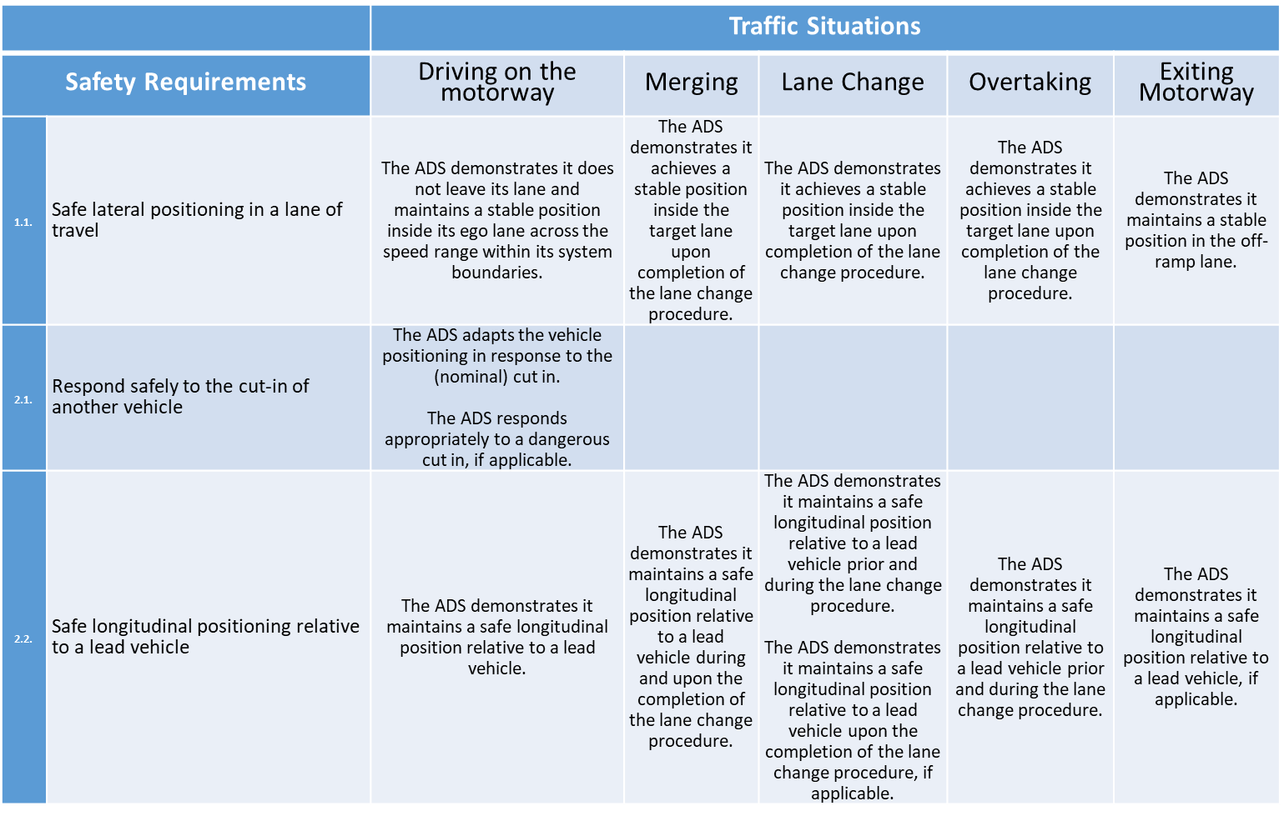
Approach to continue
Dissect the safety requirement and provisions in what needs to be measured
Within ODD determine what needs to be covered and which variation is needed
General requirements of the test
Some of the measurements are available others may still need to be developed
Variation within scenario’s is needed for robustness.
km’s or hours driven, analyses, # assessors, etc.

Slide 19
Some general thoughts
There is currently nothing about a driver monitoring system. No requirements nor how to evaluate the system. It seems an essential system for ADS.
We need to get from the general level of the testing framework to a detailed level depending upon the ADS use case
We need to learn from each other
  in testing
  in interpretation of results
  ...

