Slide 1
DPPS opening time is calculated by deducting the sensing time (ST) from the HIT at that particular test point
DPPS Fire Delay = Launching Duration Head Impactor – HIT + Sensing Time
Launching duration head impactor is rig-specific and is the time period between launching of the head impactor and the time of head impact to the undeployed bonnet.
Head Impact Time (HIT)
Leg Impact
Initiation of Deployment Module
Head Impact
Pedestrian to Vehicle Event:
Sensing Time (ST)
DPPS Opening time (OT)
Head Impactor launch
Lab Test:
DPPS Fire Delay
DPPS Opening time (OT)
Launching Duration Head Impactor

Slide 2
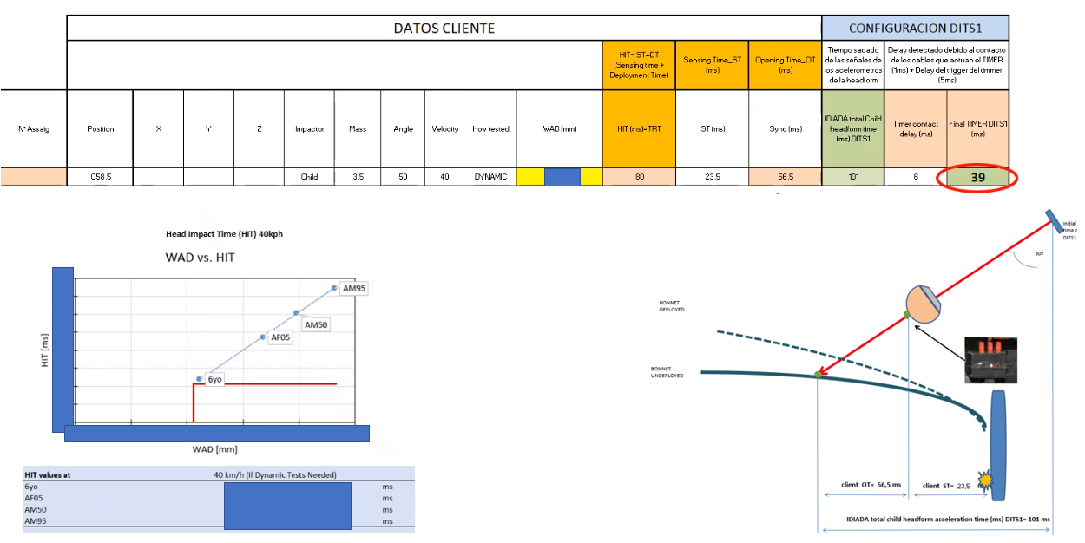
DPPS opening time is calculated by deducting the sensing time (ST) from the HIT at that particular test point
DPPS Fire Delay = Launching Duration Head Impactor – HIT + Sensing Time
Launching duration head impactor is rig-specific and is the time period between launching of the head impactor and the time of head impact to the undeployed bonnet.
Head Impact Time (HIT)
Leg Impact
Initiation of Deployment Module
Head Impact
Pedestrian to Vehicle Event:
Sensing Time (ST)
DPPS Opening time (OT)
Head Impactor launch
Lab Test:
DPPS Fire Delay
DPPS Opening time (OT)
Launching Duration Head Impactor

